Slide 1
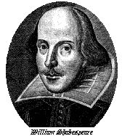
Introduction to Bill Shakespeare
Mr. Mooney
English 2

Slide 2
Shakespeare: the man
Born in Stratford-on-Avon, England in 1564
Went to London as a young man, worked as an actor
Wrote poems and plays that citizens of London flocked to see
Write his birthplace down and year!

Slide 3
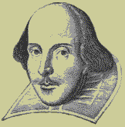
Shakespeare: the man
After a successful career, he retired in Stratford, where he died in 1616
Over 400 years after his birth the plays of Shakespeare are performed even more often than during his lifetime

Slide 4
About Shakespeare
Owned an acting company
Built the Globe theater in 1599
Where to find further info on Shakespeare?
www.mrmooney.com

Slide 5
Question for you…
What are the two types of works (or genres) Shakespeare is most famous for?

Slide 6
Poetry
Sonnets
“Shall I compare thee to a summer’s day…”
“Let me not to the marriage of true minds admit impediments…”

Slide 7
The Modern Globe Theatre
The modern Globe is located than 200 feet
from the original location of the one from the 17th century (1599-1613).
Several plays are performed on the stage of The Globe each summer.

Slide 8
CXVI.
Let me not to the marriage of true minds
Admit impediments.
Love is not love
Which alters when it alteration finds,
Or bends with the remover to remove:
O no! it is an ever-fixed mark
That looks on tempests and is never shaken;
It is the star to every wandering bark,
Whose worth's unknown, although his height be taken.

Slide 9
CXVI.
Love's not Time's fool, though rosy lips and cheeks
Within his bending sickle's compass come:
Love alters not with his brief hours and weeks, But bears it out even to the edge of doom. If this be error and upon me proved, I never writ, nor no man ever loved.

Slide 10
Tragedies
Titus Andronicus
Romeo and Juliet
Julius Caesar
Hamlet
Othello
King Lear
Macbeth
Antony and Cleopatra
Coriolanus

Slide 11
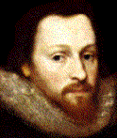
Key terms
Acting Company
Blank Verse
Imagery
Metaphor
Simile
Verse and Prose
Are you still with me?

Slide 12
Questions?

