Slide 1

Last-minute Tips
Mr. Mooney
Updated 2019

Slide 2
Last-minute Tips
Remember: discussing purpose & effect is more important than listing terms
Read the prompt carefully and make sure you know exactly what is being asked before you dive right in
For the analysis, LINK the stylistic choice to the prompt’s question
  ex. balanced to state of mind
Do NOT Skip questions on the multiple choice

Slide 3
Speculate!
Every non-fiction piece will have various levels of complexity
  It’s your job to look for that curve, that shift
  Remember, holy shift!
If you do, you will take your essay to the next level of critical analysis

Slide 4

Speculate!
If you don’t speculate, you will reach a ceiling on your essay prompt score
If you follow a formula for you essay, you will be limited in your score

Slide 5
Synthesis Essay
Make sure you cite by saying:
  …in Campbell’s essay (use last name)
  …in the article “Has Television Reshaped Politics?”
  Do NOT say “in source A” & do not use footnotes
You must cite 3 or more documents
Yes, you can bring in outside information
The synthesis essay is not worth more
Synthesis the sources within themselves also!!!!

Slide 6


The 3 Prompts will Be:
Argument Essay
Rhetorical Analysis Essay
Synthesis Essay
(You shouldn’t be surprised.)

Slide 7
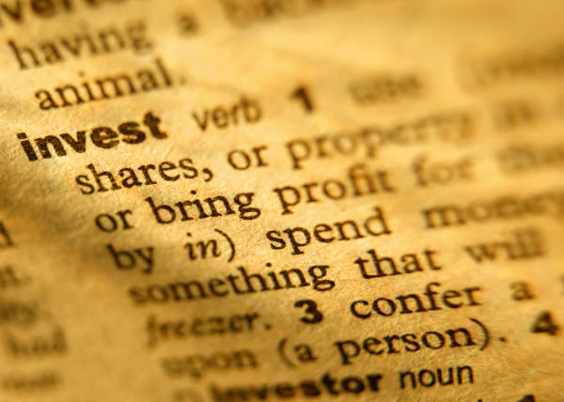
For the Rhetorical Analysis Essay
You can always fall back on DICTION but the reader will also reward you for discussing the function of syntax

Slide 8
Most Common
Multiple Choice Questions
Word in context
Main idea
Terms
Function
Organization/structure

Slide 9
How many sources must you use for the synthesis question?
3

Slide 10
Remember:
Discussing purpose & effect is more important than listing terms

Slide 11
Don’t Forget
Discussing the function of something is MUCH more important than just listing terms

Slide 12
AP Comp=AP Rhetoric
This test is assessing your thinking skills just as much as your writing skills
  Be willing to take risks

Slide 13
Analysis
If it’s an analysis of an argument (hint: words like “position” or “view” will appear in prompt), then use largely argument terms
  In addition to diction, syntax, rhetoric
Make sure you tie all analysis back to the PROMPT

Slide 14

Avoid:
“shows” – go deeper
“positive” or “negative”
  Think of the 23 terms we hammered on diction
Writing, “In conclusion…” in your conclusion

Slide 15
Vary your sentence length
If your first three sentences are the same length, you have just increased the likelihood of earning a lower ½ grade on your paper
  4, 3, 2, 1

Slide 16

Think about what the author is NOT saying
Recall the “On World War II” piece by Ernie Pyle
“I took a walk along the historic coast of Normandy in the country of France. It was a lovely day for strolling along the seashore. Men were sleeping on the sand, some of them sleeping forever…”

Slide 17

Think like the
College Board
The front line and the last line of the piece will be important
  Discuss their function

Slide 18
Analysis Essay
All that reading of the The Scarlet Letter was designed to get you ready for a pre-20th Century FRQ Passage
Remember, words and phrases meant different things back then. Figure it out from context clues
Ex. “the want of” something does not mean you want it explicitly; it means you are lacking something or “wherefore art thou a Montague” wherefore means why

Slide 19
Analysis Essay
Again, all that reading of the The Scarlet Letter was designed to get you ready for a pre-20th Century FRQ Passage
Listen for the tone of the author, and listen for shifts in tone

Slide 20
Don’t explain the terms
Remember your audience
Even though 10% of your class might not know, your AP reader knows what polysyndeton is, asyndeton is, periodic is etc. :)
Your reader is a college professor or an experienced AP Teacher

Slide 21
Compare-Contrast
If you get a compare-contrast, immediately pick the passage that is more complex, and spend more time writing about it
  Ex. Okeefenokee Swamp 1999 prompt

Slide 22
Use Effective Verbs
(present tense focusing on what the author is doing)
Stop writing “shows” and “emphasizes”
Conveys, reveals, connotes, delineates, emphasizes, accomplishes, advocates, represents, presents, implements, enhances, contrasts, demonstrates, reflects, asserts, contributes, creates, permeates, flows, illustrates, alludes, displays, paints

Slide 23
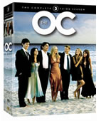
Speculate about our culture
The trend in recent years is to include essays or non-fiction pieces with prompts that ask the reader to comment on our culture
  Ex.
    Entertainment & society
    The media & its effect on democracy
    Money in America

Slide 24
Argument Question:
Recognize the complexity of the question
  That is ½ of the purpose of the argument
  That is a path to a higher score
Look for your evidence 1st & then your assertion – not vice versa
Do not use hypothetical evidence
  It must be real (use your AP History knowledge, your knowledge from reading & being an informed citizen)

Slide 25
Remember…
Who your audience is:
  College professors & experienced AP Teachers
Make sure you have a mature academic voice & a mature perspective

Slide 26
Introduction possibilities for an argument
A series of questions (not rhetorical); then you’ll need to answer them in that order later
A quote or series of quotes
Illustration (tangible)
Recent dramatic event (Boston bombing Patriot’s Day)
*Statement intended to startle (could be a stat)…use shift (high risk/high reward)

Slide 27
Introduction possibilities for rhetoric timed write
Same as argument options, plus:
Just go right into your answer to the prompt using a semicolon and longer compound-complex sentence

Slide 28
Don’t use a formula for your structure
(“5 par. Essay”)
Don't be formulaic

Slide 29
If it’s a piece of satire, don’t take it seriously
Look for the underlying points
Ex. The Onion
A Modest Proposal

Slide 30
Multiple Choice Help
No blanks
Circle your answers in the book & then, after each passage, transfer them over
If you have practiced this, then do it: put the question # next to the line(s) where that question appears before you read the passage (if you have not practiced this several times, then don’t do it in May)
If you are running out of time, quickly answer the word in context questions

Slide 31
Questions?
Ask me in class, ask me during tutorial, or e-mail me:
msmooney@capousd.org

Slide 32

Stamina
Eat and sleep right the TWO days before the test (including the day of the test)
You don’t want to burn out by the last section of the multiple choice or by the last essay
  This could make a difference between a 3 and a 4 or a 2/3

Slide 33
Other Suggested Reading for AP Lang & Lit
Invisible Man by Ellison (has appeared on AP Lit test for 15 different years)
King Lear, Heart of Darkness, & Hamlet are also often referenced on AP Lit
Five Steps to a Five
Acing the Admissions Essay (shameless plug)

