Slide 1


Maximize your ROI with All County

Slide 2

more than just property managers……
We are a real estate investment management company!

Slide 3

How All county Polk Property Management® Makes Life Easy For you and Your Residents

Slide 4

Effective rent price analysis and marketing
Be confident in the knowledge that you will rent your unit quickly and for top-dollar

Slide 5


Accurate on-demand investment analysis
All County Polk & Metro has experienced real estate analysts on staff who can accurately determine your property’s:
Market Value
Rent Price
Gross Yield
Cap Rate
Highest & Best Use
These analyses are available at any time, at no additional cost to you. Just call us!

Slide 6
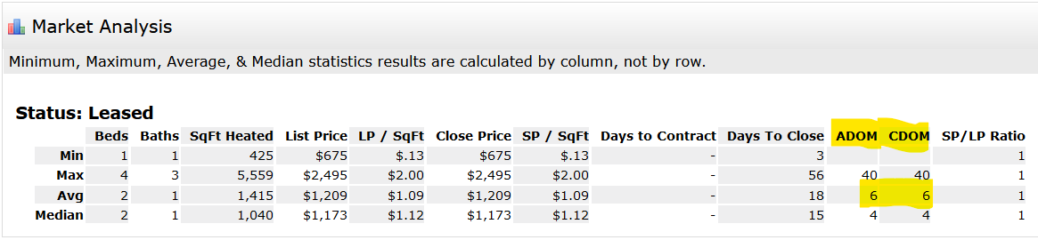
Rental Stats in Polk County
In the past 365 days, all county has rented/renewed hundreds of rental units in polk county.
“For rent” units are leased in an average of just 6 days on market

Slide 7

Maintenance: delivered on-time and on-budget

Slide 8

OUR MAINTENANCE SOFTWARE Makes a real-time impact on our ability to provide best-in-class customer service.

Slide 9
Residents, vendors, and property owners have access to direct messaging, scheduling capabilities, and automated alerts.
All messages are documented and time-stamped, AND WE KEEP YOU IN THE LOOP EVERY STEP OF THE WAY.

Slide 10

We will send you photos (when applicable) and request approvals for all expenses above $325.00

Slide 11
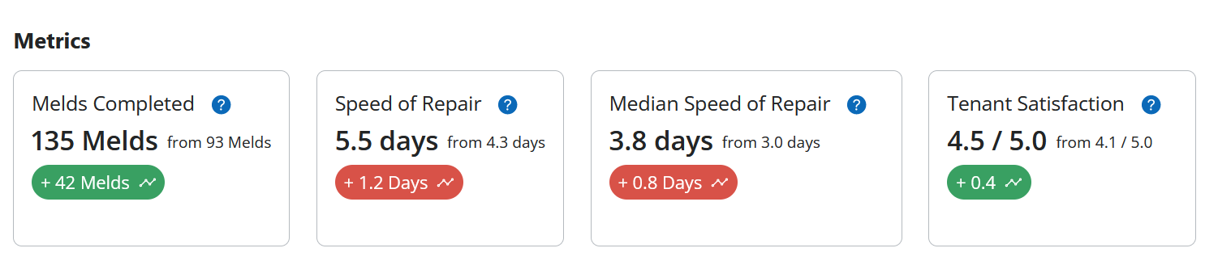
All county polk property management’s rehab/turns/maintenance department delivers results

Slide 12
How All county Polk Property Management® provides world-class management services

Slide 13
Automatic email notifications to keep you informed
ACPM Email Notifications to Owners
Online Rent Payment
Move-In Inspection
Move-Out Inspection
Annual Inspection
Lease Renewal
Work Requests

Slide 14

24/7 account access from anywhere in the world

Slide 15
● Statements
● Leases
● Inspection reports with photos
● Invoices
● Client Communications

Slide 16
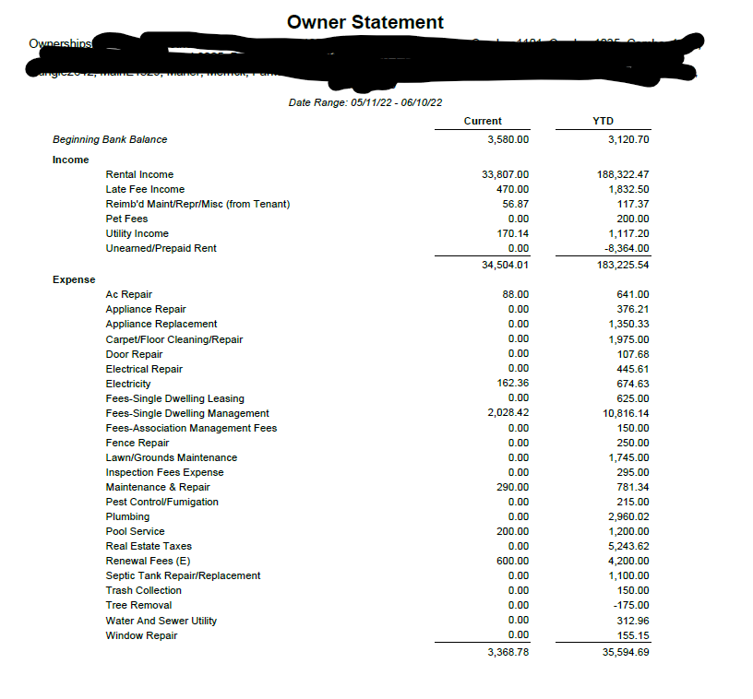
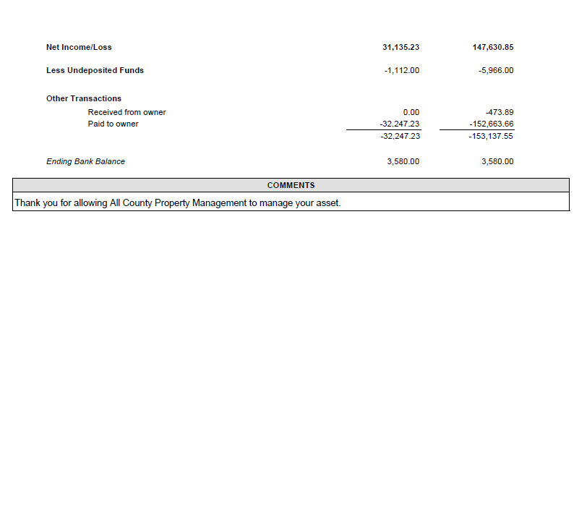
SAMPLE STATEMENT

Slide 17
Transparent Pricing – no gimmicks!
Lease
Mgmt.
Renewal
No maintenance fees
No vacancy fees
No service call fees
No set up fees
At All County, you get a simple 3-step pricing structure so there are no surprises!

Slide 18

Regular Monthly income you can depend on
You will never have to come looking for us when it comes to getting your money.
We pay out every month on or about the 10th & you will have the money in your account by the 15th

Slide 19
We screen every potential tenant on a litany of criteria before we place them in your unit
Credit Check
Civil & Criminal Search
Rental History (Last 5 Yrs.)
Employment & Income
Pets
Petscreening.com

Slide 20

There service is exceptional. Professional, organized and help you any of our needs. Had a great experience and would highly recommend there services to any owner.
- Doene, Property Owner
Did you know?
All County ® has more than 20 years’ experience managing properties just like yours.
My experience with All County has been one of total transparency, great service, and integrity.
- Dennis, Property Owner
Always prompt and courteous service. They have kept my home leased for the past six years, and have worked with me to continue upkeep services.
- Cynthia, Property Owner
I am an out of town owner and can't say enough about how great the All County Team is.
- Sean, Property Owner

Slide 21

Let’s get started!
Your All County ® Polk & Metro Team are ready To Serve you
Finding solutions for your property starts today. After you sign the management agreement, we get started immediately to make sure your property is the investment you’ve always wanted. It only takes 3 steps:
Sign agreement
Send keys
Fund reserve account

Slide 22

Finally, you’re going to have peace of mind.
Call Tim Trimbath: 863-510-5975, x107 for free rental analysis or questions about our services. Thanks for viewing this presentation, and we look forward to working with you soon.

