Slide 1
Kevin Dalton-Johnson Exploring an untold Black narrative to improve the wellbeing and resilience of Black professionals in education

Slide 3
Soleil D’Afrique Exhibition – Bamako, Mali

Slide 5
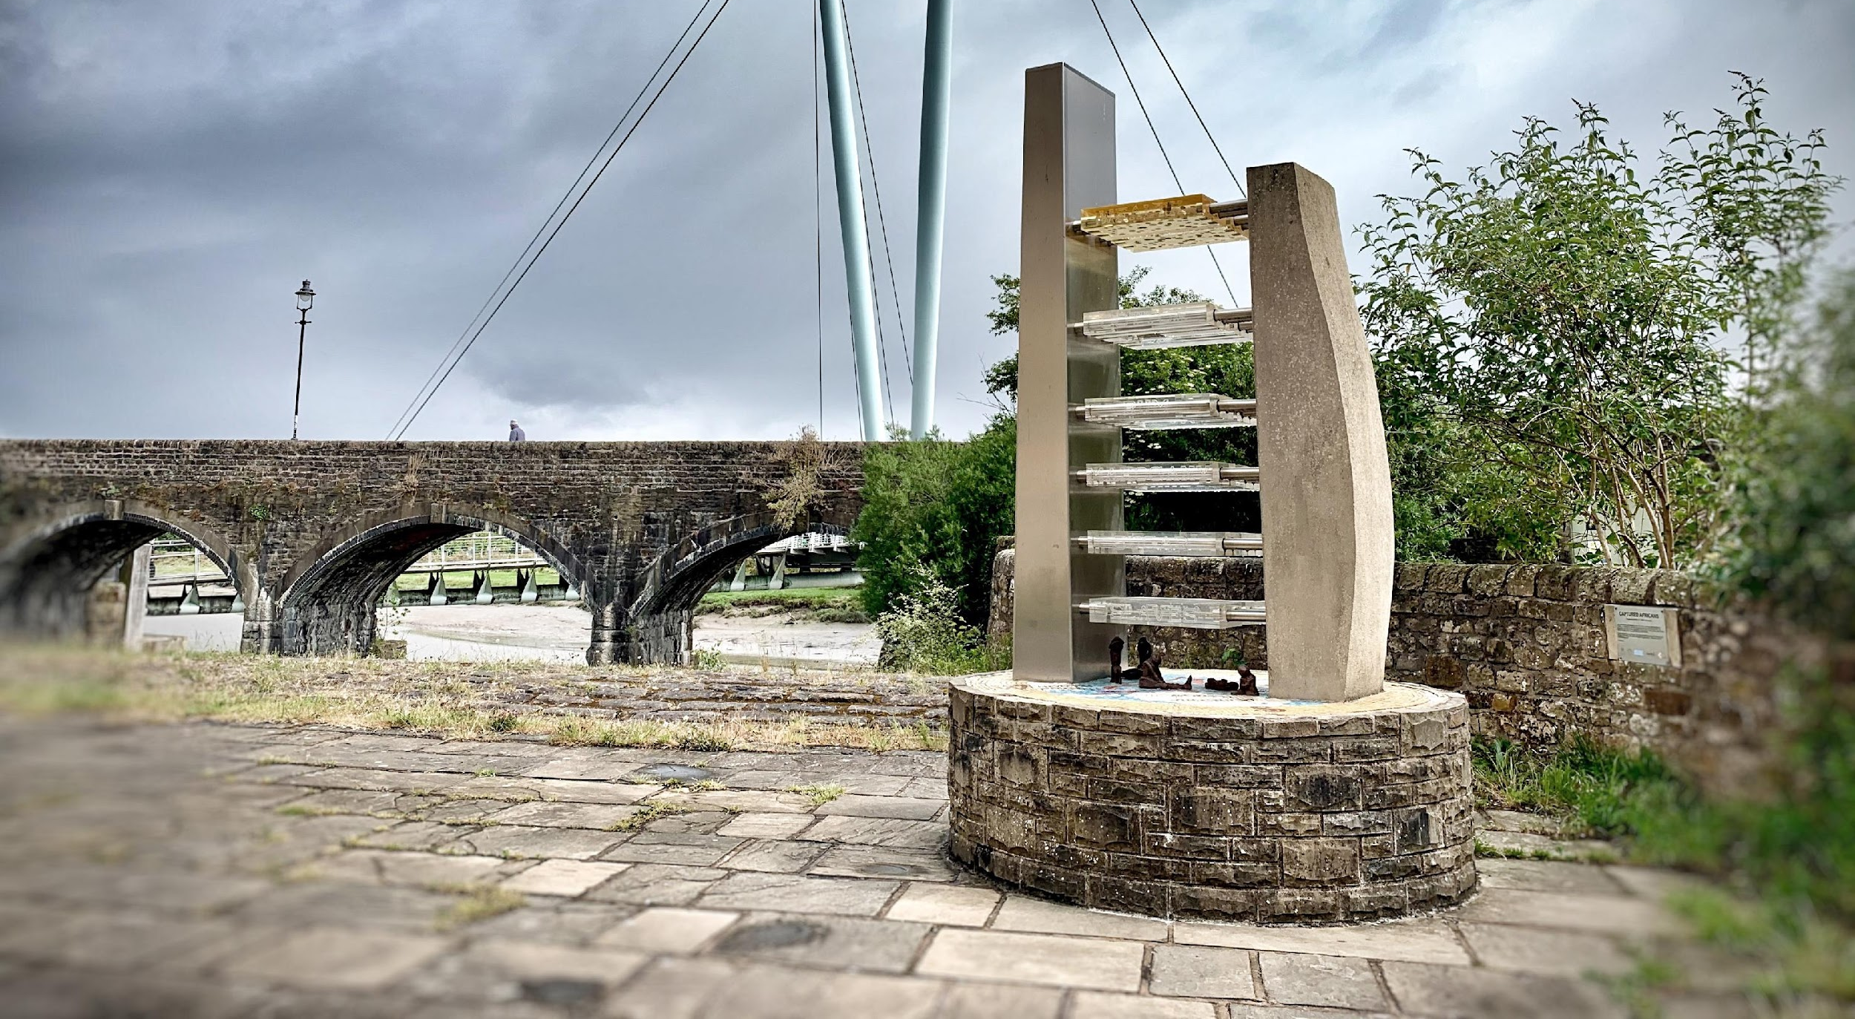
Captured African’s – Lancaster 2007 by Kevin Dalton-Johnson

Slide 7
IFA08 Art Residency – Lost Generation

