Slide 1
Paths to Success
Sherri Travisano – Principal, Phoenix High School
Emily Buffington – School Counselor, NWGA College and Career Academy

Slide 2
GAEP Standard 2
Implements a transition process to support a seamless entry to the GAEP and a seamless return to the traditional home school or external agency which includes a plan for transition success

Slide 3
Outcomes
Opportunities for reflection
Sharing of paths
Adding strategies to assist students with their Path Planning

Slide 4
How did you get to where you are today?
What did your path look like?
Were there people who help guide you and direct you?
Were resources made available to you?
What do you wish you had or wished someone had helped you with to get you to where you are today?

Slide 6
NWGA College and career academy Pathways Available
Healthcare
CNA
EMT
Law & Criminal Justice
Fire Fighter Certificate
Criminal Justice Specialist Certificate
Computer science
AP Computer Science
Automotive
Automotive Service Excellence Certificate
Mechatronics
Internships
Applied Engineering
Internships
Culinary Arts
Serve Safe Certificate

Slide 7
Dual Enrollment Opportunities
Dual Enrollment ​is designed to prepare students for college and career opportunities leading students to postsecondary institutions for an industry recognized certification or lic​ensure, an associate and/or higher college ​​​degree, and successful employment.
Eligible students may take any approved Dual Enrollment courses listed on the Course Directory, at an eligible participating postsecondary institution (USG, TCSG or private)
Dual Enrollment funding is available up to the student’s high school graduation or home study completion date or the 30 semester or 45 quarter hours Funding Cap, whichever occurs first.

Slide 8
Accelerated Career Diploma
Accelerated Career pathways offer qualified students a unique path to high school graduation. Students choose to simultaneously earn a high school diploma and a college Associate Degree, Technical Diploma, or two (2) Technical Certificates of Credit (TCC’s) in a specific career pathway. Some of the required high school courses may be taken under the state-funded Dual Enrollment program.

Slide 9
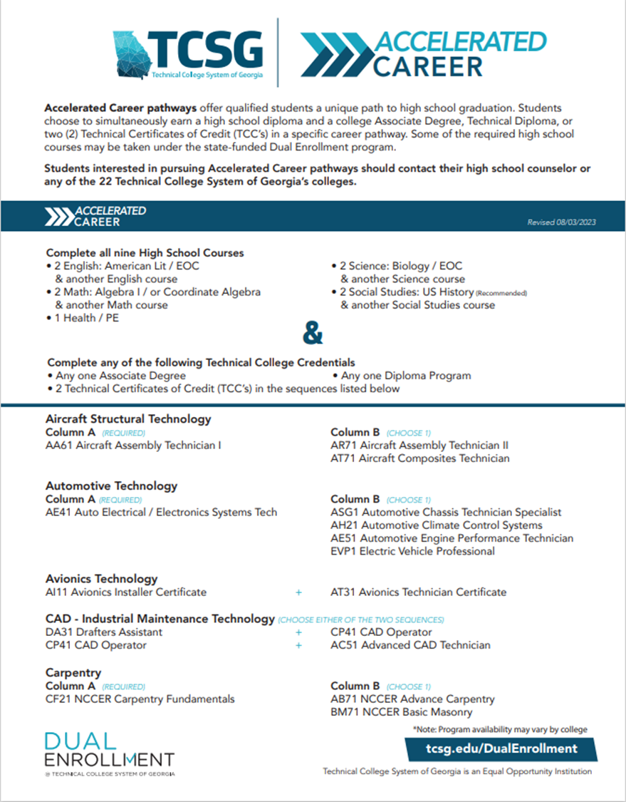
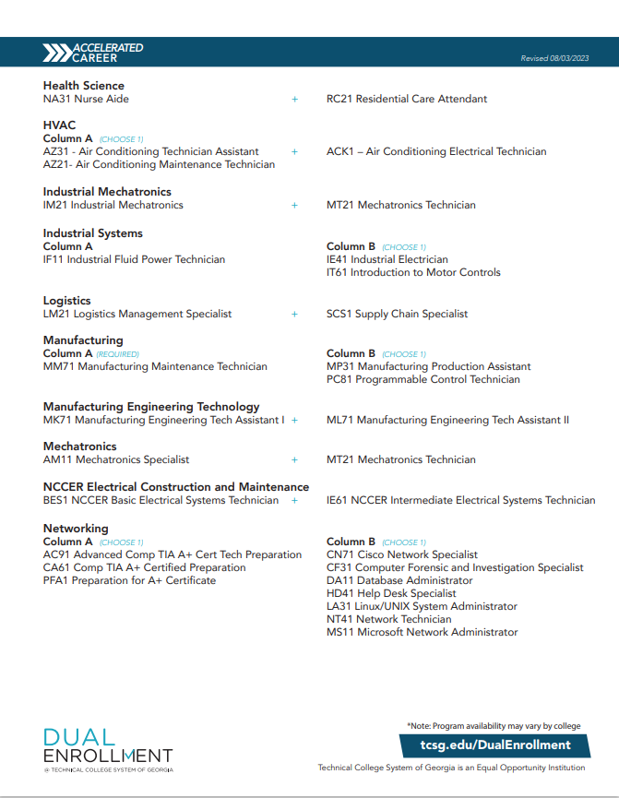

Slide 11
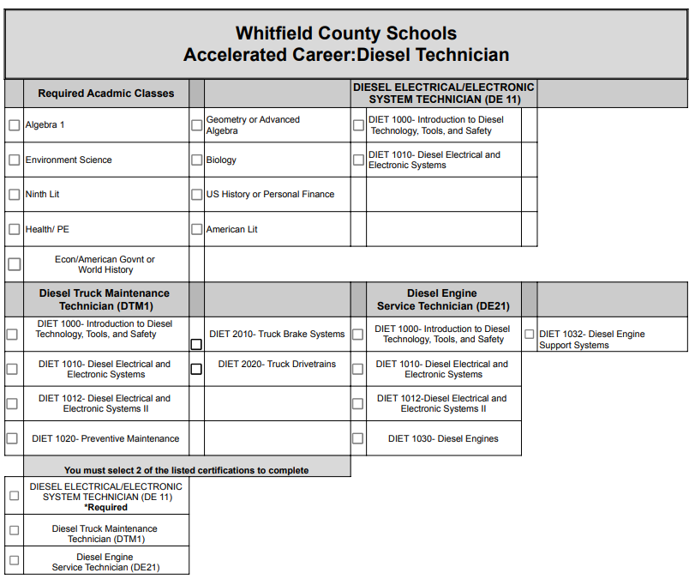

Slide 12
QUESTIONS?

Slide 13
Thank you!
Sherri Travisano – Principal, Phoenix High School
sherri.Travisano@wcsga.net
Emily Buffington – School Counselor, NWGA College and Career Academy
Emily.Buffington@wcsga.net

