Slide 1

Know your Worth and Their Worth
Leadership that:
Innovates, Elevates and Educates

Slide 2
Know your Worth and Their Worth
Leadership that:
Innovates, Elevates and Educates

Slide 3
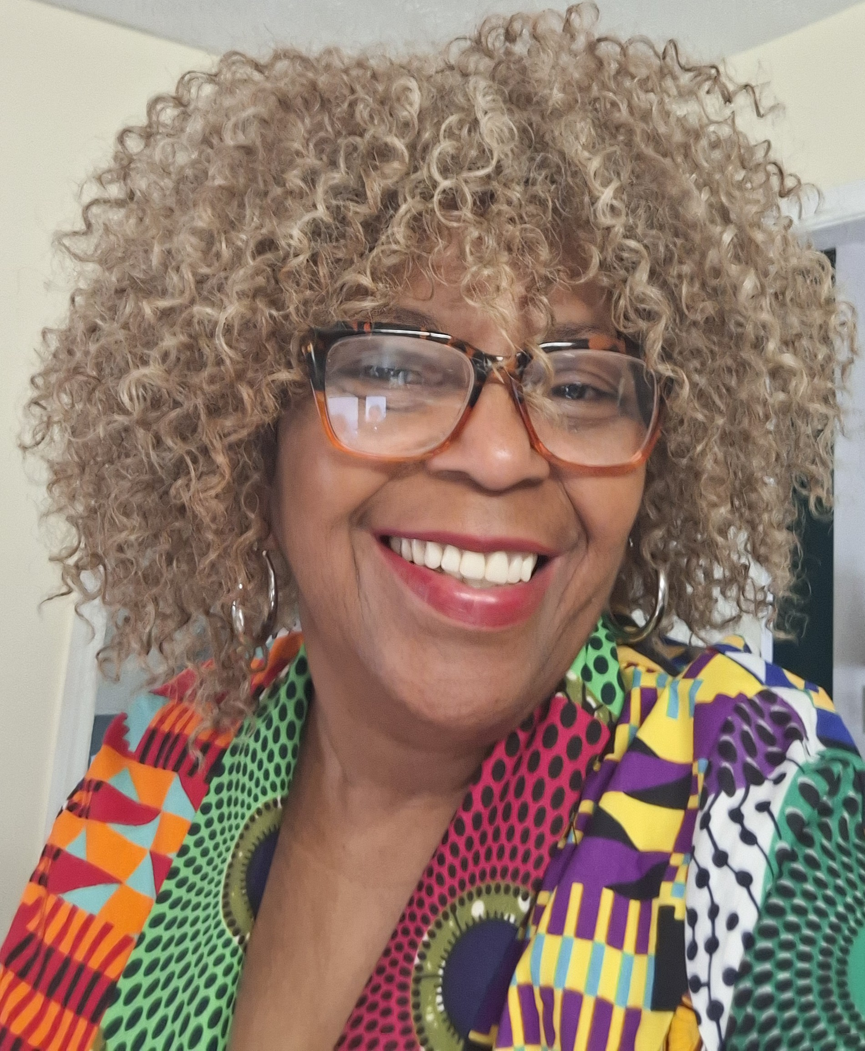
Sylvia Hooker, Leadership Coach
GAAE Board Member
Former GADOE Deputy Supt School Turnaround
Former Asst. Superintendent: Bibb and Troup County Schools
Nationally Recognized (GA and UK)Alternative School Leader

Slide 4
Know your Worth
You… Alternative Ed Leader, are the key to impacting the academic and moral (respect) fiber of your
School District/ System

Slide 5
Know your Worth
Now…. Introduce Yourselves to as many colleagues as you can in this workshop
( 2 mins)

Slide 6
Know your Worth
Why are you at your school?
Why did they pick you?
Alt Ed. Leaders have a History
What is your history?

Slide 7
Know Your Worth!!!
You hold and mold the teachers and students..
Sent
Or
Assigned

Slide 8
Know Their Worth: Teachers
“Dis-placed ( removed out of position)Thinking”: Innovation
“Mis-placed ( put in an inappropriate place)Brilliance” : Elevation
“Dis-graced ( source of shame) Knowledge”: Education

Slide 9
Know Their Worth
Know who you hired, or who is assigned to your school
Teachers: What do they have to bring to the table?
Why did you select/keep them? They have the Heart for this Work.
Why were they SENT to you? They Couldn’t cut it in Gen Ed?

Slide 10
Know Their Worth
Know who you hired, or who is assigned to your school/program.
You hold and mold their worth.
You can change reputations

Slide 11
Know Their Worth: Students
Dis-placed ( removed out of position)Thinking: Innovation
“Mis-placed ( put in an inappropriate place)Brilliance” : Elevation
Dis-graced ( source of shame) Knowledge: Education

Slide 12
Know Their Worth
Dis-placed Thinking: Innovation
( Removed out of Position)
( Out of the Box/ Thinking and Reasoning)

Slide 13
Know Their Worth
Dis-placed Thinking: Innovation
( Removed out of Position)
In most cases, our youth are the survivors!!!

Slide 14
Know Their Worth
Why?
In the first week they were assigned, they have…
Figured you and your school/ program out…

Slide 15
Know Their Worth
“Mis-placed Brilliance” : Elevation
( put in an inappropriate place)

Slide 16
Know Their Worth: Elevate
How are you utilizing these young people (offenders) in your building?
( Stories: Rebranding, April 15
Computer Hacker Site visits)

Slide 17
Know Their Worth
Disgraced ( source of shame) Knowledge: Education

Slide 18
Know Their Worth: Educate
Your students either increase or decrease graduation rates
What is expected of your school?
Stories: Principal/ Coach seeking players
Educate the School District/ Career Academies
Educate the School Community

Slide 19
Know your Worth !!
You hold and mold their worth.
You can change reputations
We are Extended Family: Last Story

Slide 20
Contact me if you need a member of your GAAE Alt Ed Family to remind you of Your Worth.
Sylvia C. Hooker
770-845-5274
email sylhook13@gmail.com

Slide 21
You’ve got the Best of GAAE’s Love!
Enjoy the Conference!!

