Slide 1


Meeting the Needs of Struggling Students in Alternative Education
“Growing Minds, Building Futures”
Mark I. Stroud, Ed.S
Principal
Second Chance Academy
Claxton, GA
912-704-9376
mstroud@evanscountyschools.org

Slide 2
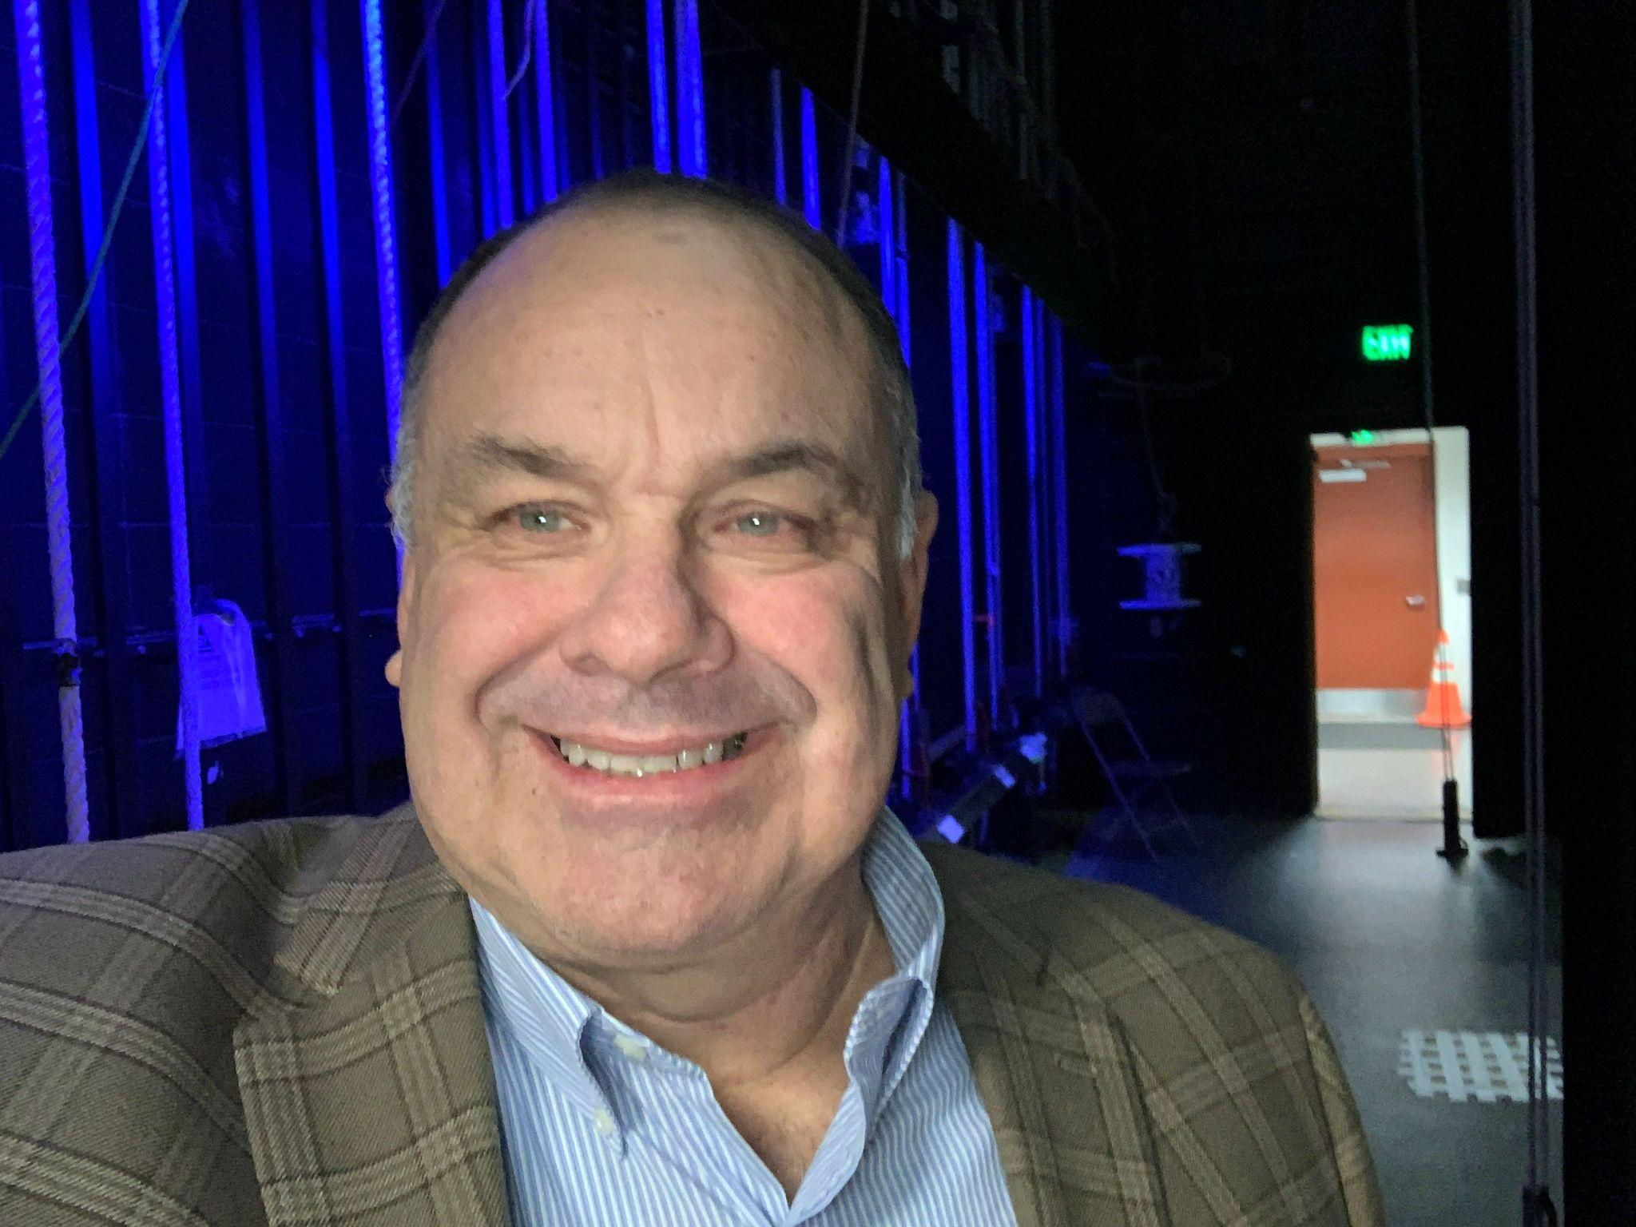








Mark I. Stroud
32 years in education
9 years in alternative education
5 years principal, Second Chance Academy
2 years board member for Georgia Association for Alternative Education
6 years district level
Coach/Athletic Director for 28 years
Savannah native
19 years in Claxton

Slide 3
History of Alternative Education in Public Schools
Alternative education has evolved to support students struggling in traditional settings.
Early Foundations (19th–20th Century): Progressive educators like John Dewey emphasized student-centered learning. Vocational schools provided hands-on training.
1960s–1980s: Civil rights movements expanded alternative programs for marginalized students. Special education laws (IDEA) and dropout prevention programs emerged.
1990s–2000s: Charter schools and online learning provided flexible options. Credit recovery programs helped students stay on track.
Present & Future: Alternative schools now integrate mental health support, trauma-informed teaching (building safe and supportive environments), and personalized learning to improve student success.

Slide 4
Today’s Alternative School
The most common type of alternative school today plays a crucial role in a school district’s comprehensive dropout prevention strategy.
These schools, typically integrated into middle and high school programs, support secondary-aged students who are often struggling academically and falling behind in the credits required for graduation or staying on track with their peers.
Additionally, many communities offer specialized completion schools that provide flexible educational opportunities for students facing unique circumstances, such as parenting, employment, caregiving responsibilities, or health challenges, allowing them to complete their education outside the traditional high school environment.

Slide 5
School Options
District Alternative Programs/Schools in Claxton (Evans County).
Second Chance Academy
Evans County Charter School System
Claxton, GA
Grades 6-12
90 students in the building (45 HS, 25 MS)
12 students virtual program (10 HS, 2 MS)
24 graduates in last two years
100% Economically Disadvantaged
Coastal Plains Education High School (others include Foothills and Mountain Ed.)
Completion School
Evans Site-same building as SCA
Grades 9-12
60 students
20 graduates in last two years

Slide 6



Non-Traditional Hours
A/B schedule for SCA High School
Evening school-Coastal Plains
Virtual-SCA & CP

Slide 7

Curriculum @ SCA
Standards Based
Computer based-Edgenuity-electives and core
Direct instruction-whole group math and science
Small group instruction-ELA and math

Slide 8
What is Tier 1 Instruction?
Universal, high-quality instruction for all students
Focuses on engagement, differentiation, and accessibility
Essential for preventing learning gaps
All students

Slide 9
Unique Challenges in Alternative Schools
Diverse academic backgrounds (different grade levels & different academic levels)
Attendance issues-20% of students miss 10% -20% of school days
51% miss 20% or more of school days
Behavioral challenges
Social emotional learning needs (ADD, ADHD, Anxiety & Depression
Poverty (23.7%)
Ethnicity-Evans County Schools; SCA
White: 33% 27%
Black: 37% 52%
Hispanic: 26% 10%
Other: 4% 11%
EL: 20% 6%
SPED: 17% 25%

Slide 10


HELP
2024 Georgia Milestones
SCA Middle School (6-8)
Content Mastery----------> 3.8 (ELA 5.0; Math 2.5)
Progress --------------------> 45.6
Closing Gap ----------------> 0
Readiness ------------------> 46.4

Slide 11
So What Did I Do as Principal?
Met with district leadership
Created a leadership team
Created a SIP with the leadership team that is data driven and academically focussed
Went to superintendent and asked for the following:
Reading interventionist
Math interventionist
Counselor
Administrative assistant who was multilingual
Sped teacher
I asked for the whole pie and got it!
Now the plan better work

Slide 12
Leadership Team Next Steps
Established team which meets 2x a week instead of the required 1x.
Sets norms, agendas, topics and timelines.
Also works together to handle the “so what, now what”.
Created a small group instructional walkthrough form Copy of Explicit Instruction Lesson Observation Tool.
District, principal and peer observations occur monthly.
Data is disaggregated monthly from walkthroughs in order to know next steps.
Professional learning teams occur two times a week for a total of 90 minutes per week. Teachers are working on lesson plans and pacing guides.
Other time is spent on collaboration and lesson planning for small groups.

Slide 13
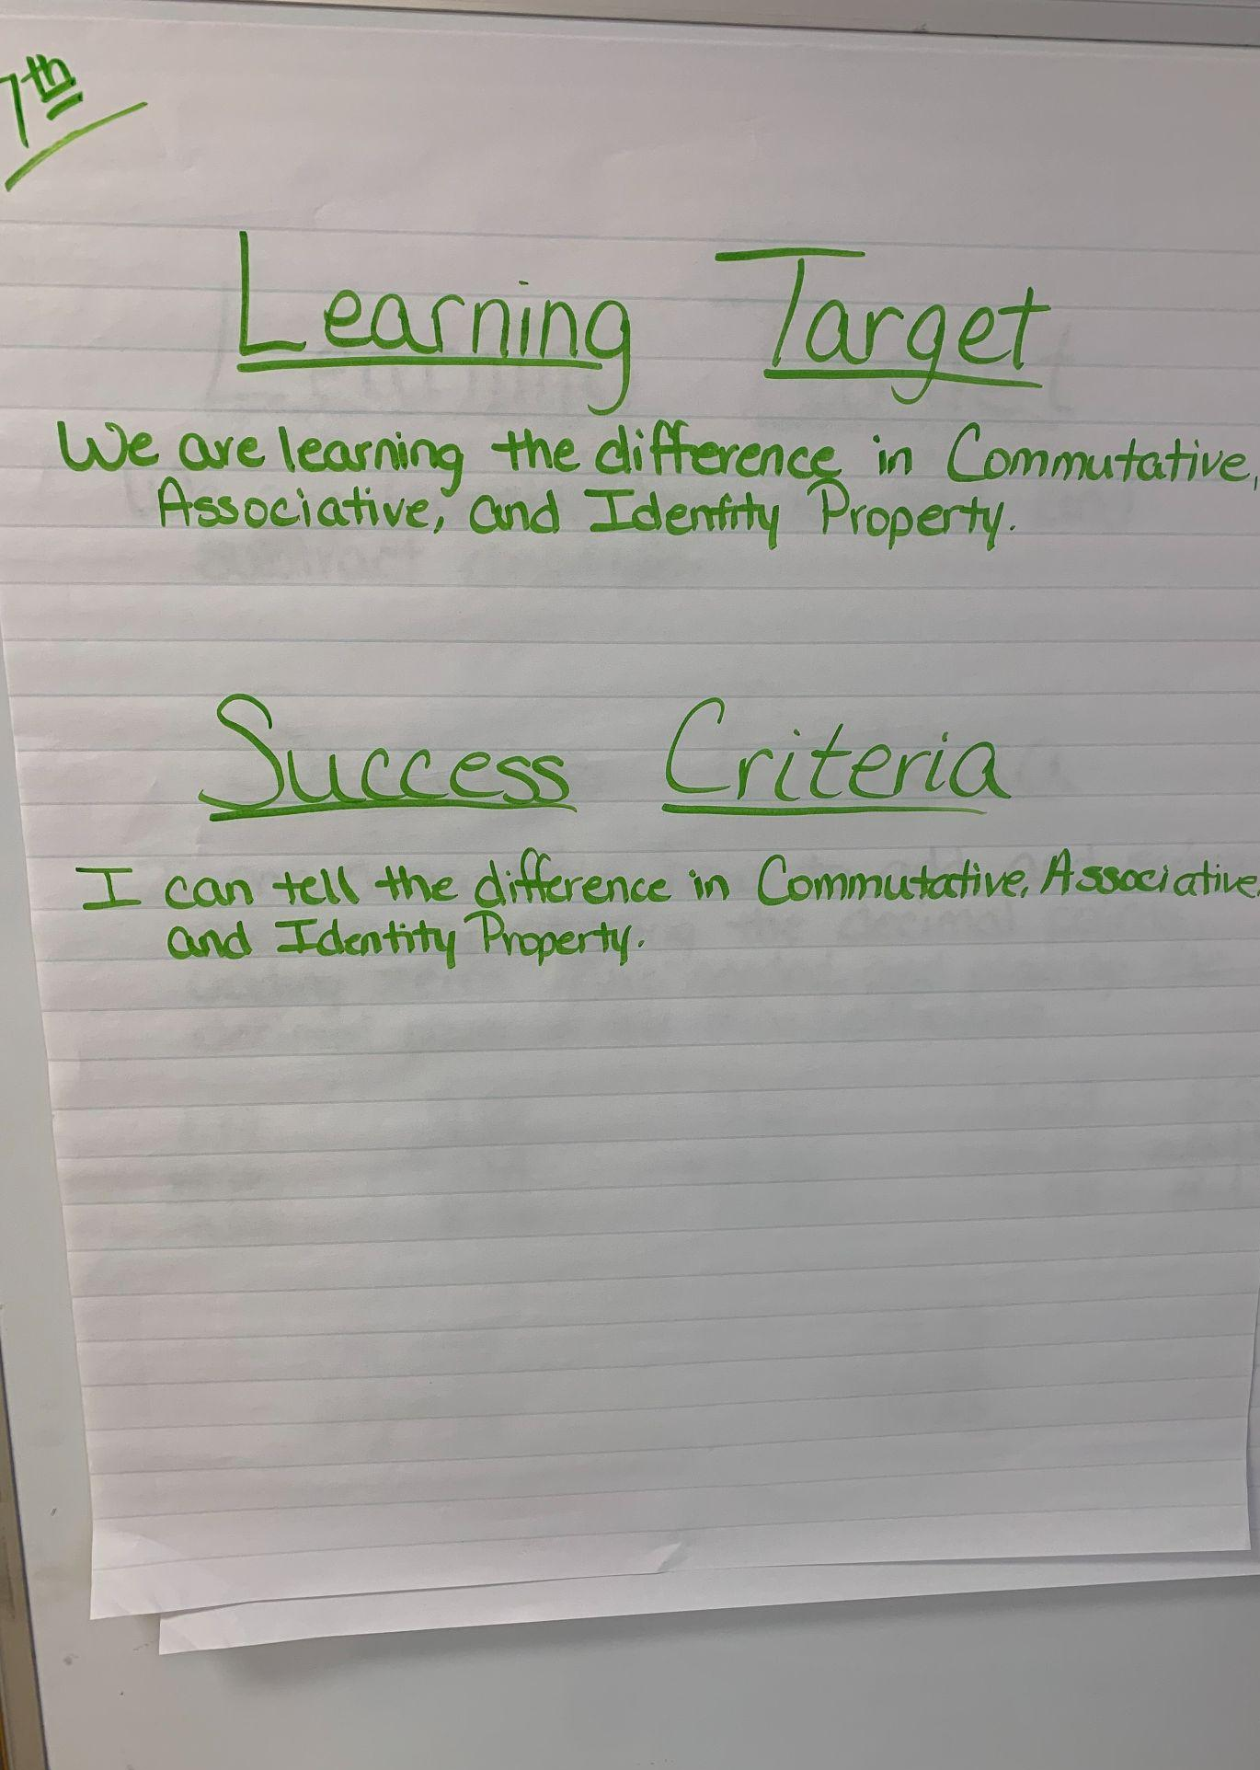

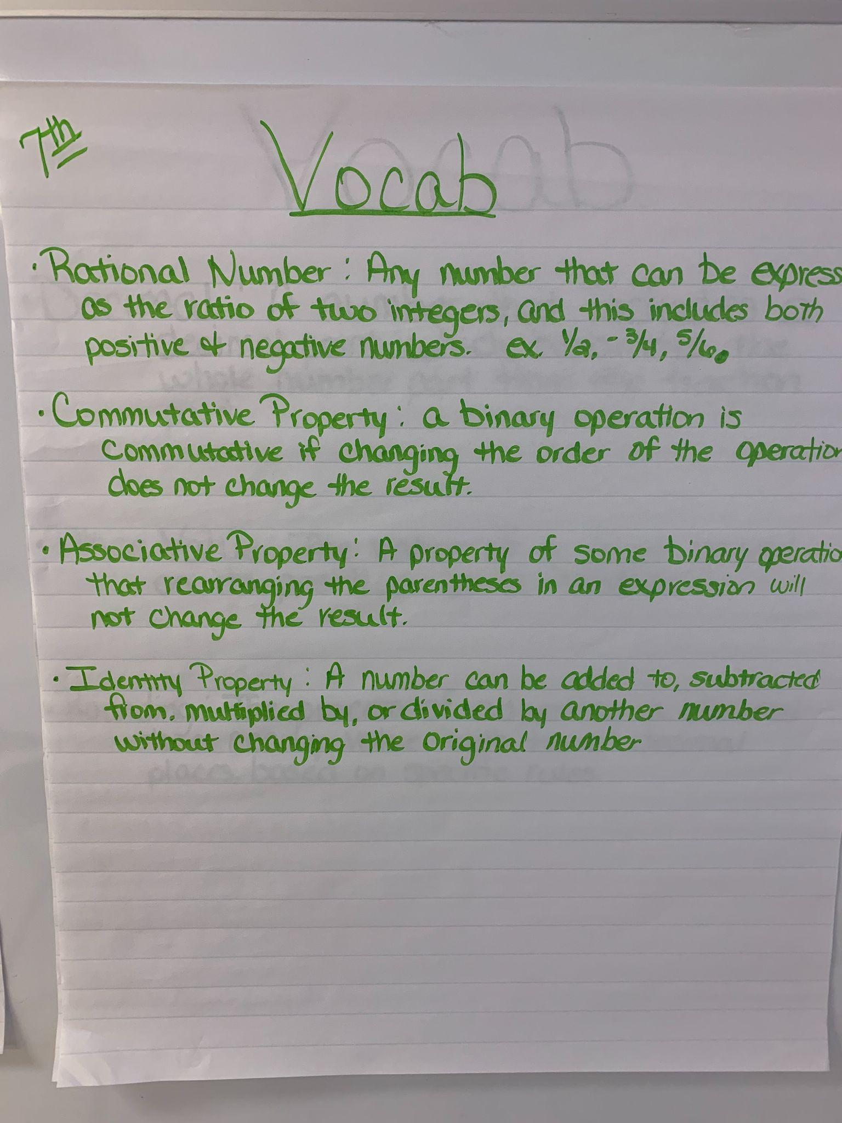


What Does Small Group Instruction Look Like in my School?
Learning Targets are introduced and posted.
Success Criteria is communicated while being aligned to the rigor of the standard.
The instructor reviews prior knowledge and skills before beginning instruction.

Slide 14



What Does Small Group Instruction Look Like in at Second Chance?
4. The instructor provides step by step instruction. (I DO)
5. Teacher and students work together to complete the problem or task. Teacher provides guidance and support as student actively participates. (WE DO)
6. Students work independently. (I Do)

Slide 15

What Does Small Group Instruction Look Like in at Second Chance?
7. The instructor provides timely and individualized feedback to students.
8. The instructor builds student capacity to self monitor.
Graphic organizers
Student self reflection
Create rubrics that students can use to evaluate themselves
9. The students are actively engaged.
10. The instructor implements strategies to meet specific learning needs of students during the course of the lesson.
Provide different ways to learn the same content
Offer a variety of activities and project options

Slide 16
Small Group Instructional Walkthrough Form
https://docs.google.com/forms/d/1OPvMmL3x5jPWkvbWade4Sm8otr2sUH8H6K0FMYVvJ04/edit
https://docs.google.com/spreadsheets/d/1Om2JT6u1xqM85G3dfr1J1ra6kpYfemzPA6Uyd94VDMo/edit?gid=318143758#gid=318143758

Slide 17
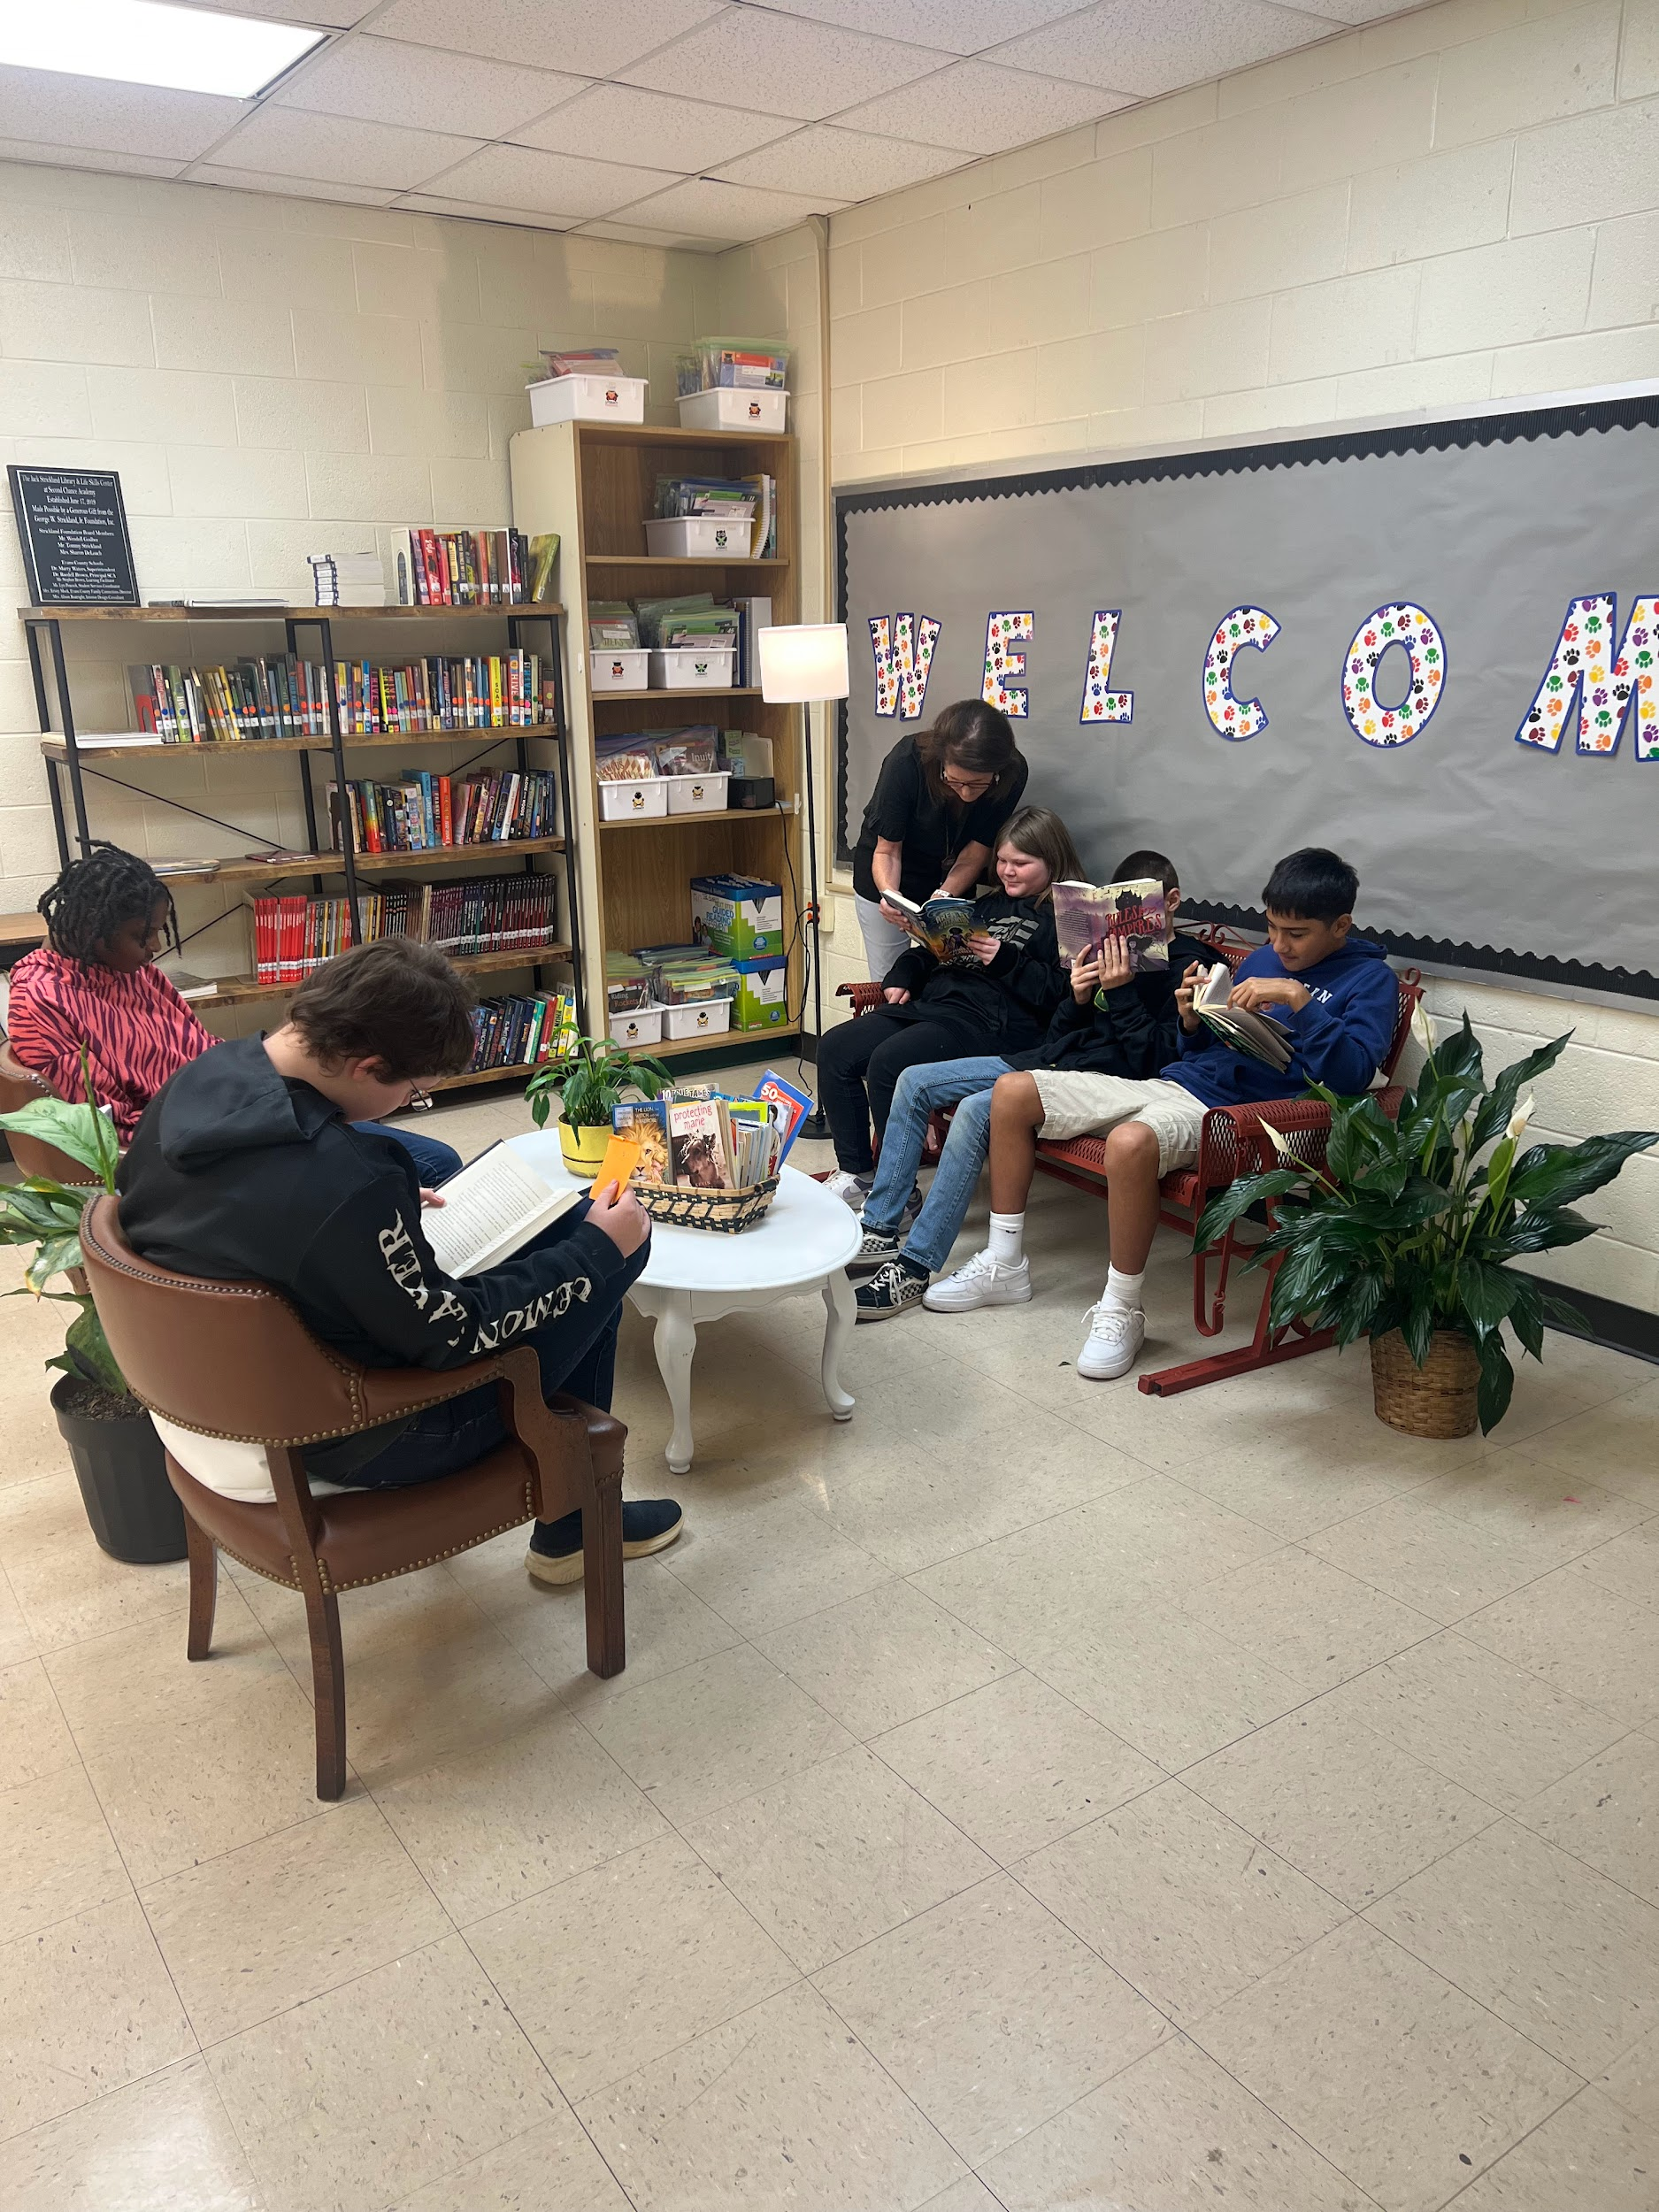
Small Groups
30 minutes segments
Tuesday, Wednesday, and Thursday
Small group
guided reading

Slide 18
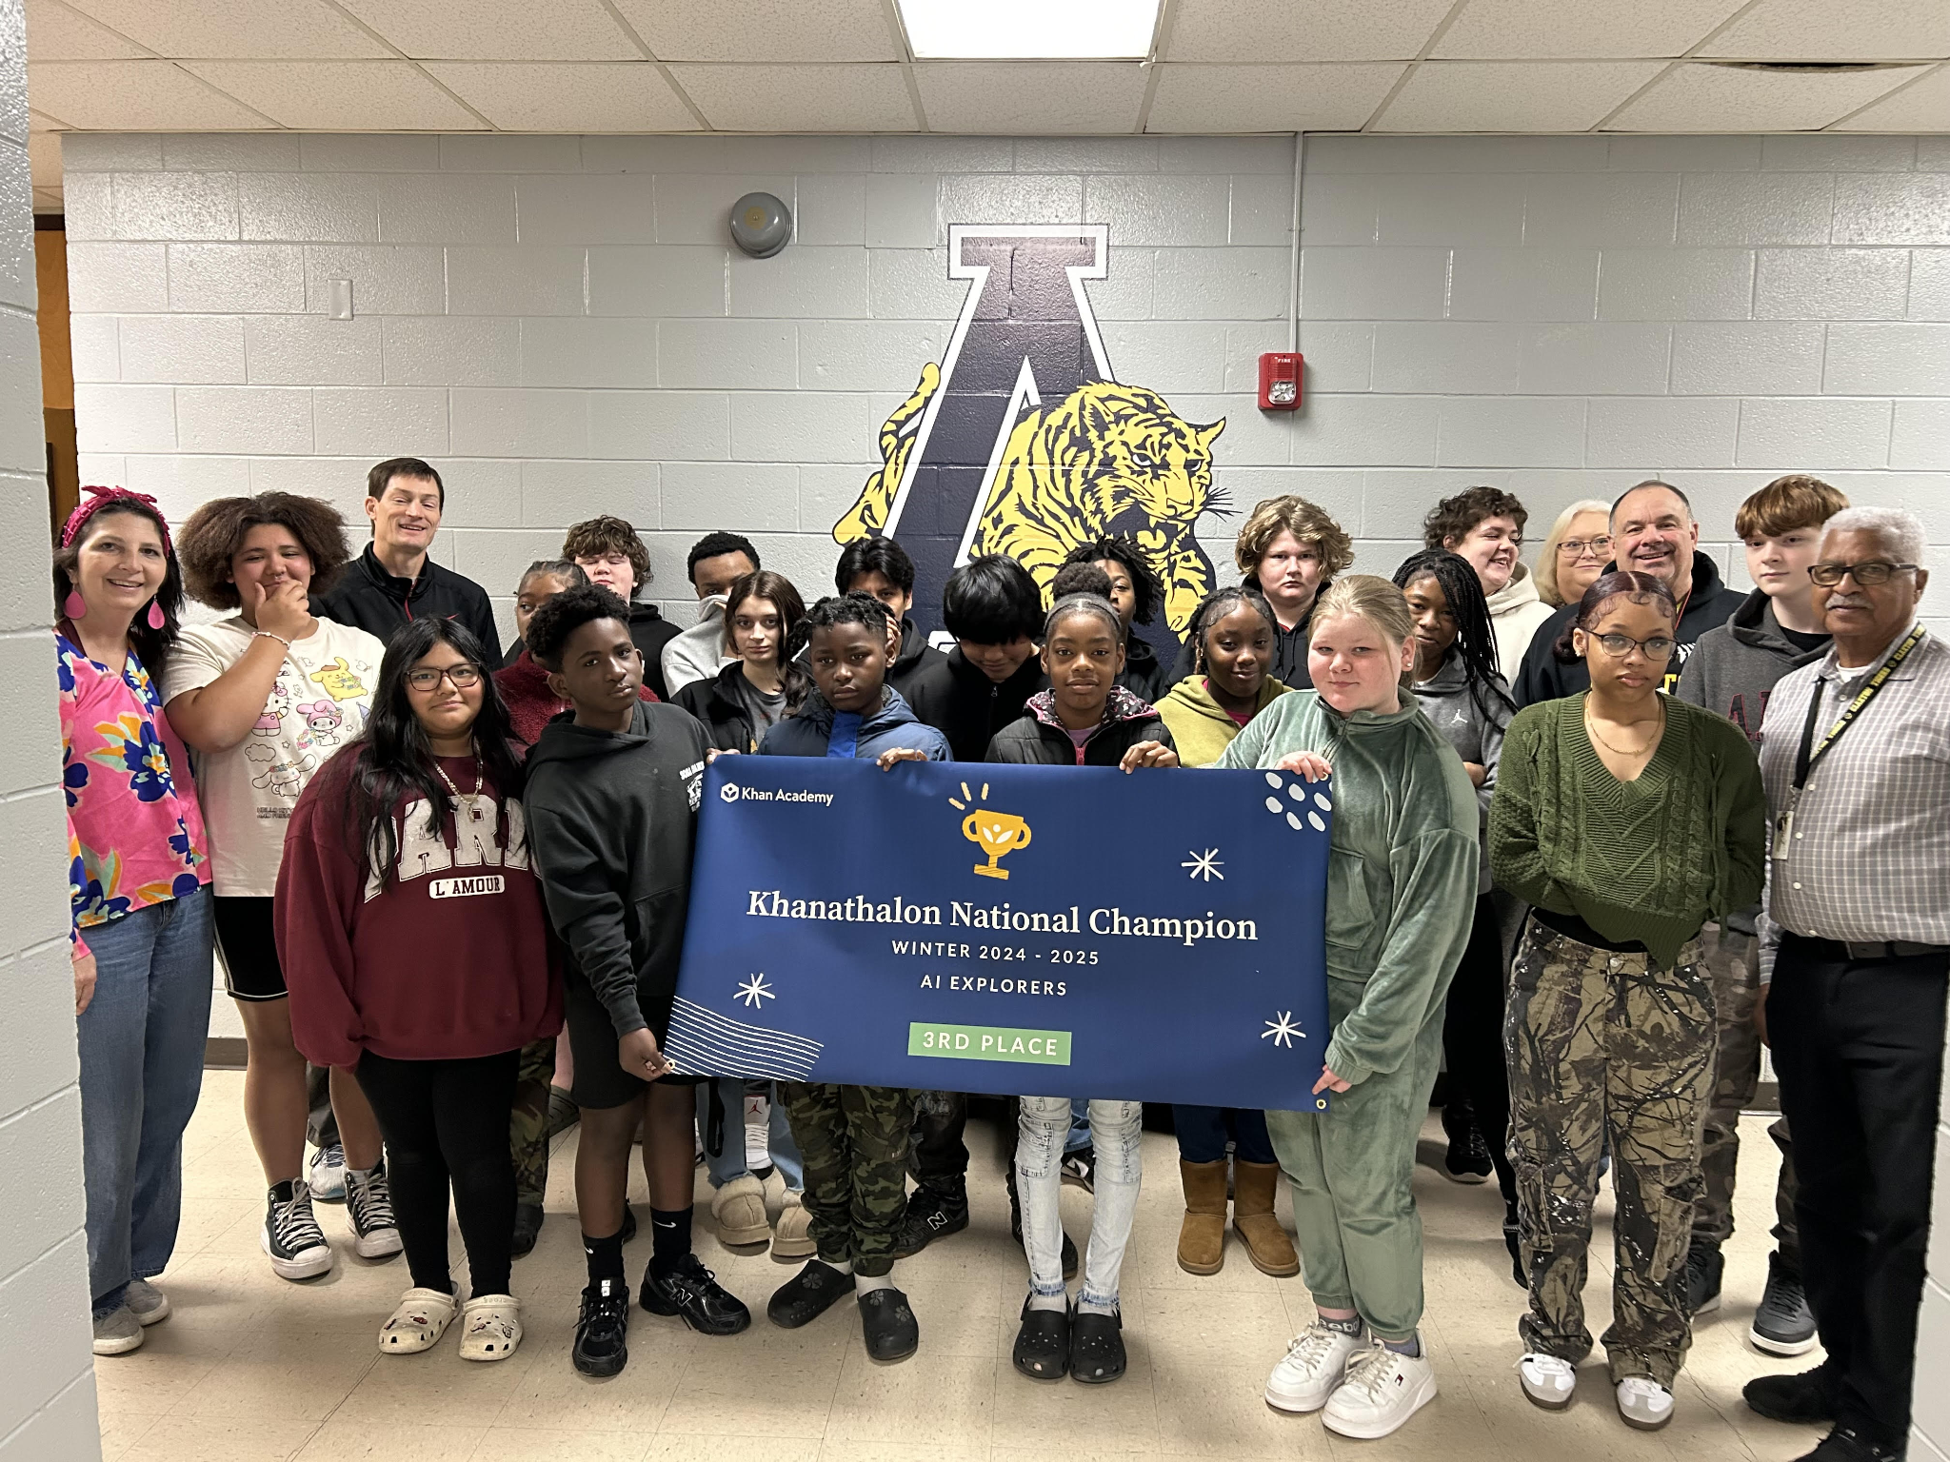
Small Groups
30 minutes segments
Tuesday, Wednesday, and Thursday
2. Khan Academy

Slide 19
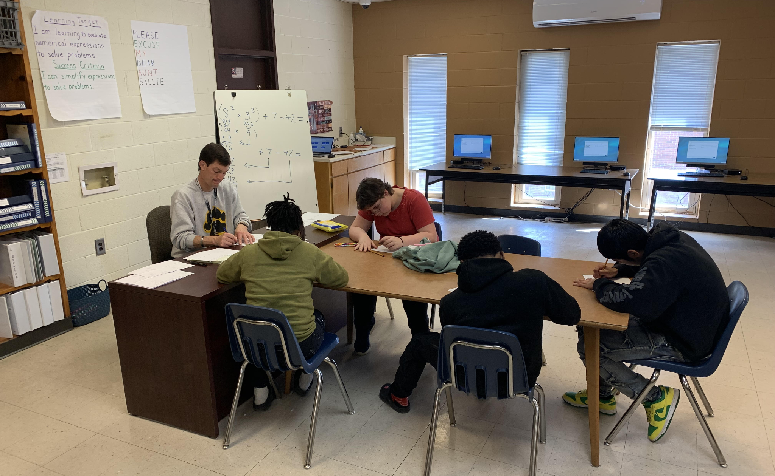
Small Groups
30 minutes segments
Tuesday, Wednesday, and Thursday
3. GRADE LEVEL MATH STANDARDS

Slide 20
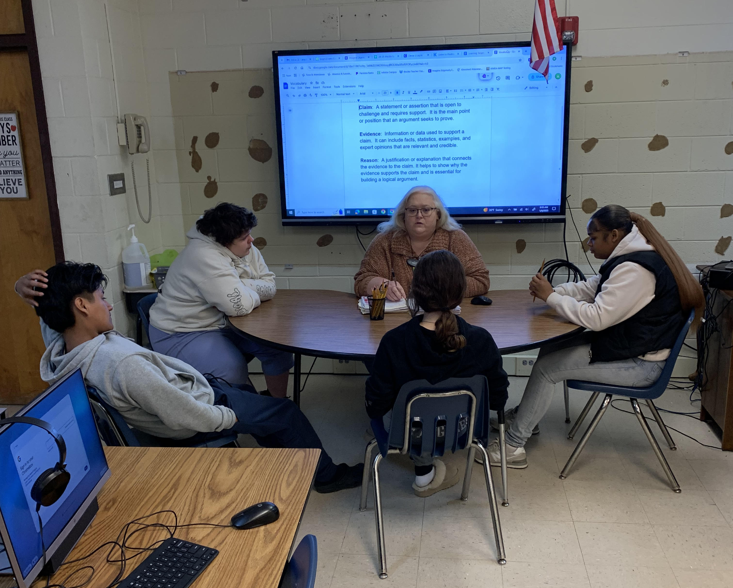
Small Groups
30 minutes segments
Tuesday, Wednesday, and Thursday
4. Grade Level Standard Writing

Slide 21
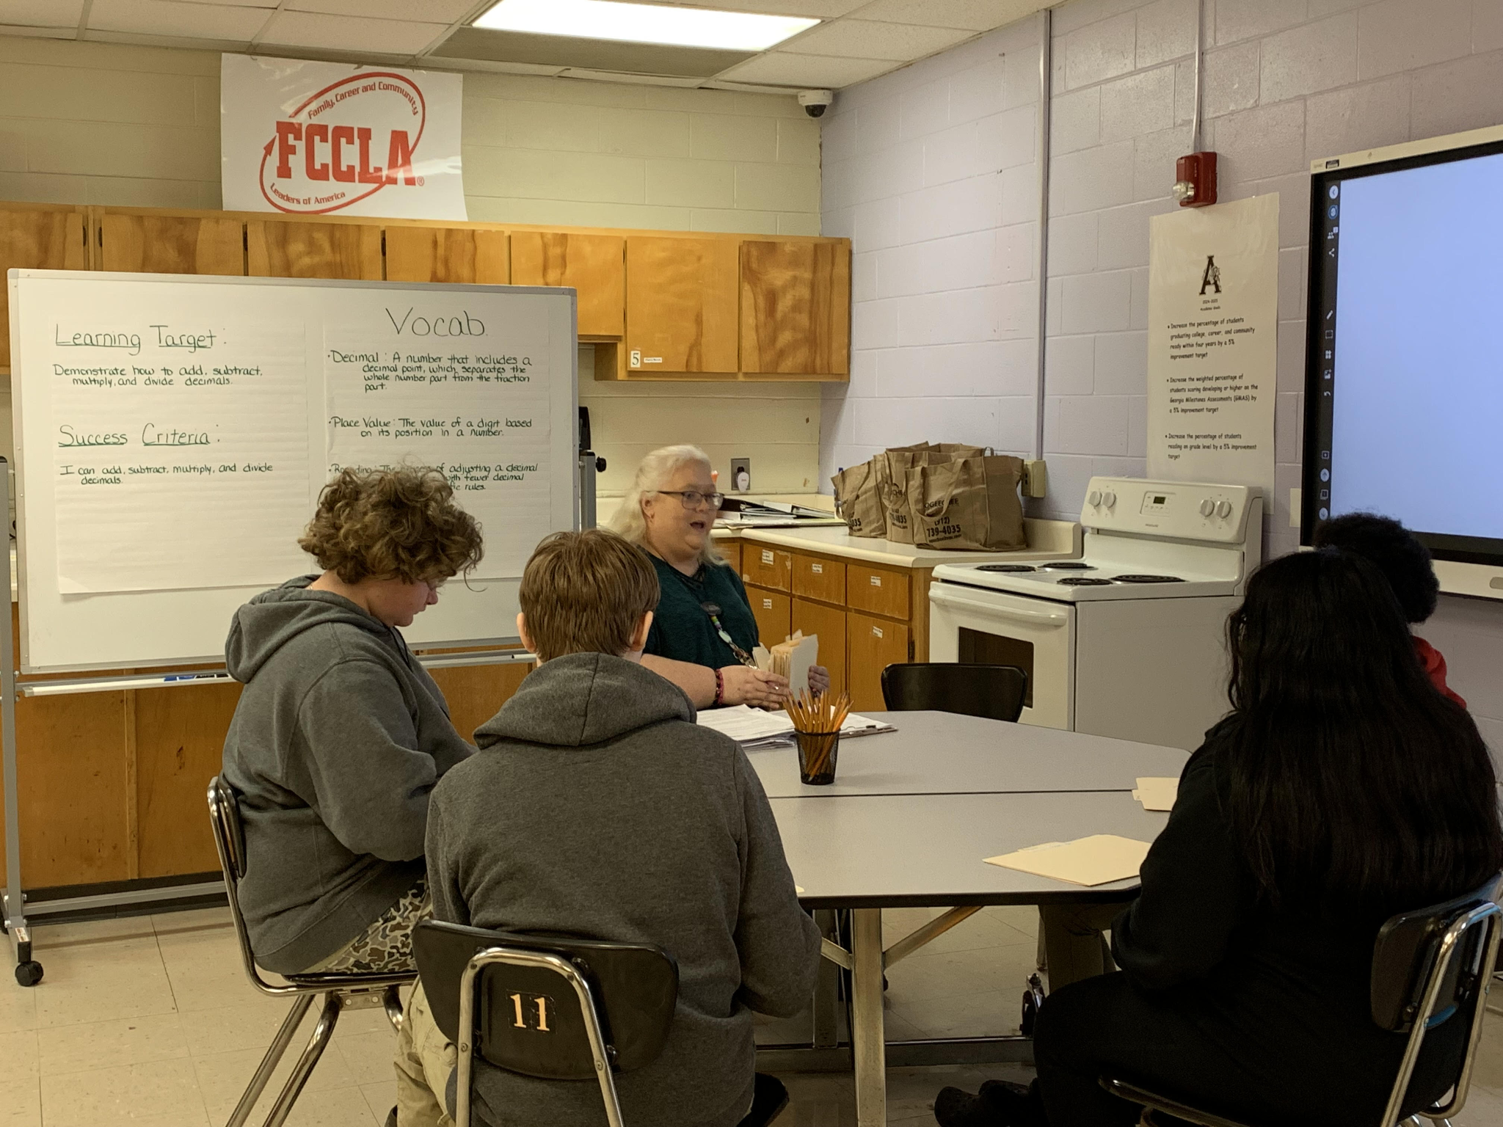
Small Groups
30 minute segments
Tuesday, Wednesday, and Thursday
5. Grade Level
ELA Standards

Slide 22

DISCLAIMER:
I AM NOT ENDORSING ANY PRODUCTS!

Slide 23

Assessments Leading to GMAS
Beacon offers benchmark assessment in Math and ELA for grades 3-8 multiple times per year.

Slide 24


Assessments Leading to GMAS
MAP TESTING OR MEASURES OF ACADEMIC PROGRESS TESTING , IS A COMPUTER BASED ASSESSMENT THAT MEASURES STUDENT GROWTH IN CORE SUBJECTS. IT IS USED BY TEACHERS TO IDENTIFY STUDENTS’ STRENGTHS AND AREAS FOR IMPROVEMENT.
MAP IS GIVEN THREE TIMES PER YEAR FOR MATH AND ELA. MAP HAS AN .86 CORRELATION TO GMAS SCORING.

Slide 25

Programs Leading to GMAS
Students work in Khan Academy 45 minutes per day.
Recommendation for growth is 30 minutes per week.
HS students work in EOC courses.

Slide 26

Programs Leading to GMAS
Jan Richardson’s Small Guided Reading Program.
This is our second year using the program.

Slide 27


Programs Leading to GMAS
BEABLE LINKS TO STUDENTS’ PERSONAL INTERESTS AND ASPIRATIONS TO LITERACY GROWTH, PERSONAL GROWTH, CAREER EXPLORATION AND ACADEMIC RIGOR.
THIS IS OUR FIRST YEAR USING BEABLE.

Slide 28

Mid Year MAP Projections for GMAS
2024 Georgia Milestones
SCA Middle School (6-8)
Content Mastery----------> 3.8
Progress --------------------> 45.6
Closing Gap ----------------> 0
Readiness ------------------> 46.4
2025 Georgia Milestones
SCA Middle School (6-8)
Content Mastery----------> 20.5
Progress --------------------> 81.23
Closing Gap ----------------> Green flag and green flag with distinction
Readiness ------------------> 46.7

Slide 29
GMAS Results (unofficial)
2024 Georgia Milestones
SCA Middle School (6-8)
Content Mastery----------> 3.8
Progress --------------------> 45.6
Closing Gap ----------------> 0
Readiness ------------------> 46.4
2025 Georgia Milestones
SCA Middle School (6-8)
Content Mastery----------> 18.9
Progress --------------------> 50.25
Closing Gap ----------------> Green flag and green flag with distinction
Readiness ------------------> 46.7

Slide 30

Questions

Slide 31
Thank You

