Slide 1


Presented by Dr. Nicholas Griffin
Building Strong Relationships with the Youth in Rural Georgia

Slide 2
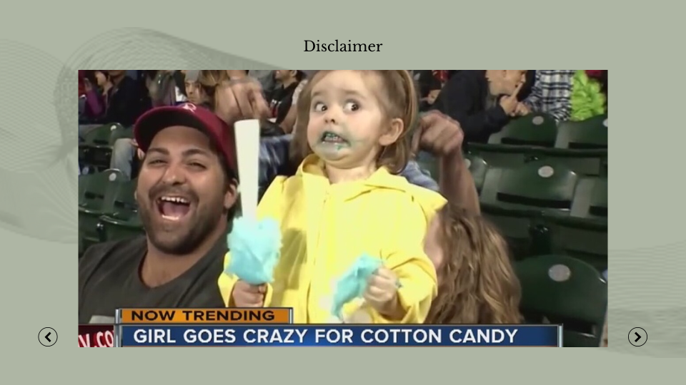

Slide 3


Presented by Dr. Nicholas Griffin
Abstract
  The role of the transition facilitator is to help students and families successfully manage the process of “transitioning,” which includes but is not limited to changing schools, integrating into the school system from out of state, going to and from alternative settings, or addressing challenges arising from other life obstacles.
  The transition facilitator meets with students to help youth achieve behavioral and academic goals, build effective social and life skills, and serve as a trusted mentor during vulnerable periods of change.

Slide 4
Overview
01
02
03
04
Who Do I Serve
How I Support
Fresh Start
Impact of an Educator
05
06
07
08
Changing Trajectories
Successful Transitions
The Data
Resources
09
10
Conclusion
Questions

Slide 5
Who
Do
I
Serve
1
Transitioning to and from the alternative settings
  2
  At-risk of long term suspension or expulsion

Slide 6
How I Support
I’m Here to Help
  Addressing Graduation
  Addressing Absenteeism
  Behavior Intervention
  Mentoring
  Relationship Building
  Life Skills
  Advocacy
  School Climate
  Student and Parent Engagement
  ISS Initiative
  Student and Parent Intervention Classes
Who Do I Serve?
  District-Wide (12,000+)

Slide 7


Slide 8

Fresh Start
Life offers us tickets to places which we have not knowingly asked for
~Maya Angelou

Slide 9


A Well Deserved Fresh Start...
Students
Parents
Students that transferred to the alternative program from regular schools felt as if their new teachers cared about them and wanted to help them (Zolkoski, 2019, p. 238).
Zolkoski (2019) states “This had a huge effect on them. They wanted to try hard for their teachers and do well” (p. 238).
Teachers’ actions are noticed as the foundation of positive teacher-student relationships and by improving these interactions it will also improve the learning environment in addition to positively influencing outcomes for students (Zolkoski, 2019, p. 240).

Slide 10
A Well Deserved Fresh Start...
Teachers
Principals
By their fifth year of teaching, teacher retention sits at 50% (Ford et al., 2020, p. 2).
Teachers are leaving the profession at such an alarming rate due to the lack of social support which in turn negatively impacts their professional stress, burnout rate, job satisfaction, and self-efficacy (Zhang et al., 2020, p. 420).
Teacher shortages in various subject areas creates teacher attrition that lessens the improvement level of a quality education (Madumere-Obike et al., 2018, p. 50).

Slide 11
Impact of an Educator

Slide 12
Impact of an Educator
You will continue to suffer if you have an emotional reaction to everything that is said to you. True power is sitting back and observing things with logic. True power is restraint. If words control you that means everyone else can control you. Breathe and allow things to pass.
~Warren Buffett

Slide 13
The Mental Health Impact
Student
Parent
Koenen et al. (2018) states “sensitive teachers can help students to feel safe to explore the environment and to cope with the demands of school, thereby impacting students’ learning behaviors and development” (p. 1).
“You notice if the mutual chemistry and respect is present, that teachers and students have respect for each other, then it’s a lot of easier for the teacher to teach and for the student to learn” (Krane & Klevan, 2018, p.77).
Teacher
Principal
Teachers spending time to grow and develop relationships with their students will be worthwhile and increase self-efficacy, student engagement and engagement efficacy (Pressley & Ha, 2021, p. 8).
Educators have listed working conditions and varying levels of self-efficacy as reasons for resignation because those factors make it harder for them to do their jobs (Dunn et al., 2017, p. 282).

Slide 14

Presented by Dr. Nicholas Griffin
Changing Trajectories
FOCUS
  Attendance
  Behavior
  Academics
  Athletics
  Career Pathway
  Student/Parent Conferences
  Social, Emotional and Life Skills
  Life Goals
  Relationship Building
  Mentoring
  Advocacy

Slide 15
My Secret Recipe
How Are You Doing?

Slide 16
The Process
  Addressing Graduation
  Addressing Absenteeism
  Behavior Intervention
  Mentoring
  Relationship Building
  Student and Parent Engagement
  Life Skills
  Advocacy
  School Climate
  Middle and High School Students
  Students in Alternative Settings

Slide 17

Successful Transitions

Slide 18
  Meet students where they are
  Relatability
  Initial meeting with school, transition facilitator, parent and student
  Meet counselor, school social worker and therapist (if needed)
  Find trusted adult in building
  Pair with a mentor
  Discussion about school activities, sports, clubs, afterschool work and/or programs, etc.
  Community involvement (self and student)
How to Make Successful Transitions

Slide 19
Products of Successful Transitions
By investing in the role of transition facilitators, schools and districts can reap long-term benefits in terms of student success and well-being.
This presentation illuminates the ripple effects of effective transition support, illustrating how it contributes to improved academic performance, enhanced social integration, and greater overall resilience among students.

Slide 20
"Data by itself is useless. It is only useful if you apply it."
~Todd Park

Slide 21


Transition Facilitator Summary
May 2024
May 2025
80%
70%
4 out of 5 transition counseling students felt Dr. Griffin helped them do better in school.
70% of transition counseling students felt Dr. Griffin helped them do better in school.
83%
89%
83% of transition counseling students felt Dr. Griffin taught them new things.
89% of transition counseling students felt Dr. Griffin taught them new things.

Slide 22


Transition Facilitator Summary
May 2024
May 2025
82%
87%
82% of transition counseling students felt comfortable talking to Dr. Griffin about all subjects.
87% of transition counseling students felt comfortable talking to Dr. Griffin about all subjects.
94%
89%
94% of transition counseling students felt having Dr. Griffin in their school was important.
89% of transition counseling students felt having Dr. Griffin in their school was important.

Slide 23


Transition Facilitator Summary
May 2024
May 2025
94%
90%
94% of transition counseling students felt having an African American male transition facilitator or mentor was important at their school.
90% of transition counseling students felt having an African American male transition facilitator or mentor was important at their school.
The majority of transition counseling students would have liked to meet with Dr. Griffin more often.
The majority of transition counseling students would have liked to meet with Dr. Griffin more often.

Slide 24




Curriculum Resources
Troup County School System Student Success Department
troup.org
Mountain Education
Dr. David Hicks
770-856-4945
mymec.org
IDEALS
Jack Williams
nextstepprogram.org
The Pathfinder Club
thepathfinderclub.org

Slide 25
School Site Resources
SHARE (Supporting Student Health And Resilience)
Dr. Myriam Forster
shareprojectcsun.net
Hope Givers
Tamlin Hall
hopegiversga.org
Universal Tech Institute
www.uti.edu
Cinema Drive
Kenneth Bain
336-740-0530 cell

Slide 26
DIY Resources
Mentoring and/or youth networking groups
Food, Hygiene and Clothing Closet
Community Resources
Community Donations

Slide 27
References
Dunn, A. H., Farver, S., Guenther, A., & Wexler, L. J. (2017). Activism through attrition?: An
exploration of viral resignation letters and the teachers who wrote them. Teaching and Teacher Education, 64, 280-290. http://doi.org/10.1016/j.tate.2017.02.016
Ford, L., Gumus, O., Harrison, J. D., & Coehoorn, C. J. (2020). Effects of principal’s gender,
leadership, and teacher’s certification type on teacher self-efficacy. Journal of Educational Leadership and Policy Studies, 4(1), 1-21.
Koenen, A. K., Vervoort, E., Verschueren, K., & Spilt, J. L. (2018). Teacher-student
relationships in special education: The value of the teacher relationship interview. Journal of Psychoeducational Assessment, 1-13. http://doi.org/10.1177%2F0734282918803033
Krane, V., & Klevan, T. (2018). There are three of us: Parents’ experiences of the importance of
teacher-student relationships and parental involvement in upper secondary school. International Journal of Adolescence and Youth, 24(1), 74-84. http://doi.org/10.1080/02673843.2018.1464482
Madumere-Obike, C. U., Ukala, C. C., & Nwabueze, A. I. (2018). Managing teacher attrition
rate for quality education in public senior secondary schools in Rivers State, Nigeria. Educational Planning, 25(4), 47-58.
Pressley, T., & Ha, C. (2021). Teaching during a pandemic: United States teachers’ self-efficacy
during COVID-19. Teaching and Teacher Education, 106, 1-9. http://doi.org/10.1016/j.tate.2021.103465
Zhang, M., Zhang, Y., Wang, L., Liu, H., & Cheng, P. (2020). Occupational support and mental
health in special education teachers: Resilience and years of teaching experience as mediator and moderator. Revista Argentina de Clínica Psciológica, 29(5), 420-426.
Zolkoski, S. M. (2019). The importance of teacher-student relationships for students with emotional and behavioral disorders. Preventing School Failure: Alternative Education for
Children and Youth, 63(3), 236-241.

Slide 28
Conclusion
Presented by Dr. Nicholas Griffin

Slide 29
Questions?
Presented by Dr. Nicholas Griffin

Slide 30
Thank You
Dr. Nicholas Griffin
Troup County School System
706-812-7900 x1126
griffinnm@troup.org

