Slide 1
Social Emotional Needs of Afghan Refugees
Sarah Bazemore
School Counseling Specialist
Office of Student Services
Sarah.Bazemore@doe.virginia.gov

Slide 2
TRAUMA=
EVENTS + EXPERIENCES + EFFECTS
Notes:
EVENTS includes circumstances- The trauma our students have experienced is not isolated to just the day they left. It has more longevity than that- remember even just the threat of physical harm is traumatizing as well as the withholding of resources for healthy development.
EXPERIENCE - An event may be experienced as traumatic by one person and not another. The experience may be influenced by cultural beliefs and the developmental stage of the individual.
EFFECTS- may not occur immediately- can include: physical, mental, emotional, cognitive, behavioral, social, and spiritual challenges.

Slide 3
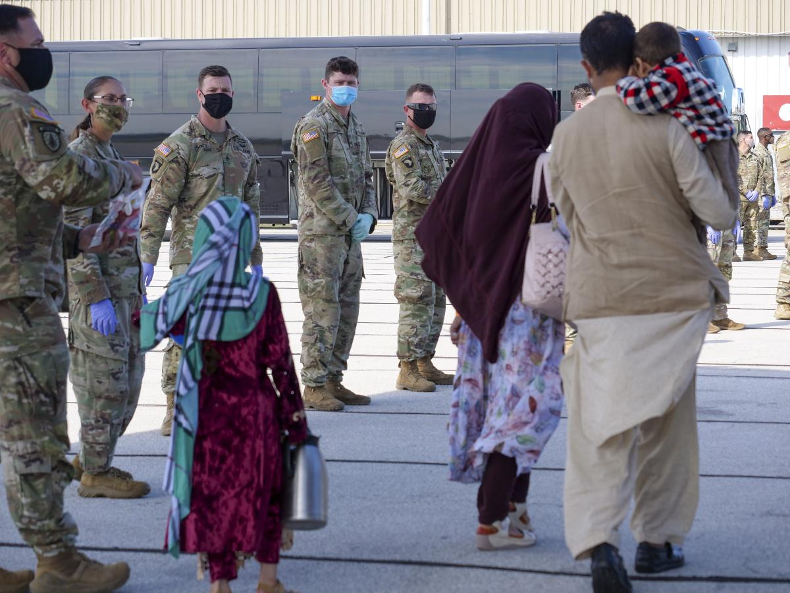
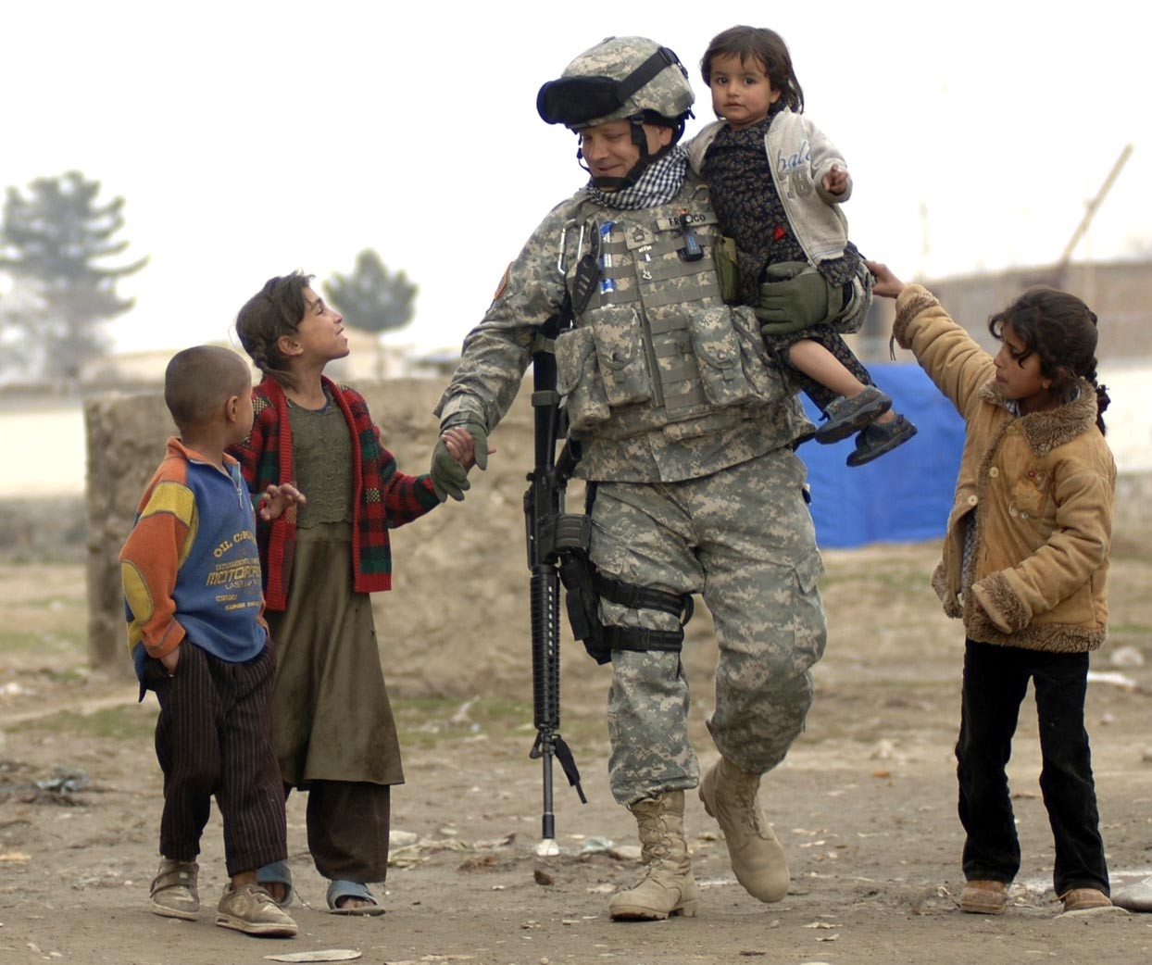
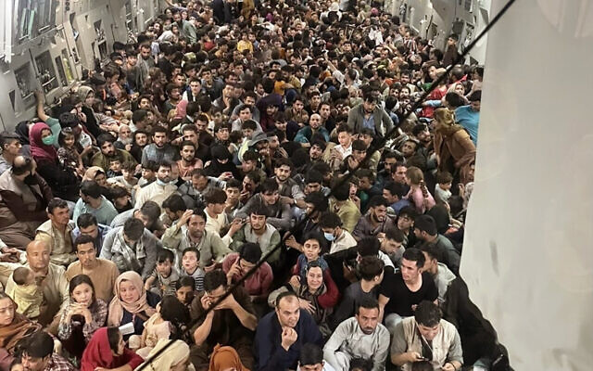
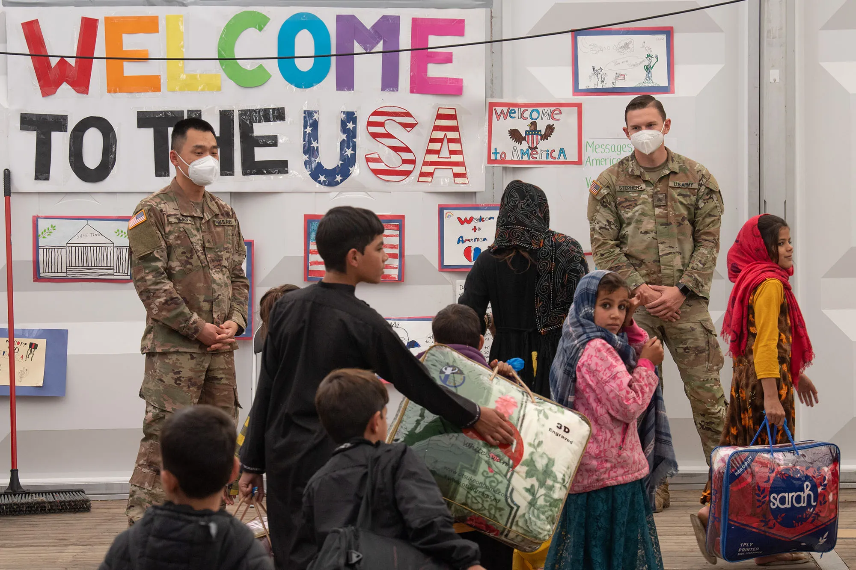
MIGRATION STAGES
PRE-MIGRATION TRAUMA
TRAUMA DURING TRANSIT
RESETTLEMENT TRAUMA
Foster, R. P. (2001).When immigration is trauma: Guidelines for the individual and family clinician. American
Journal of Orthopsychiatry, 71(2), 153-170. doi:10.1037//0002-9432.71.2.153
Notes:
LAYERS of TRAUMA
Pre-Migration Trauma- these students were experiencing trauma long before their migration. Fear of violence but also lack of resources. Culture belief not to complain about little things because life was never to be taken for granted.
Trauma during transit- airport “cautious” and then the flight circumstances - over 13 hours in plane
Resettlement- They will continue to experience trauma as they adjust to a new culture, country and home.
Everyone has a unique background and story- be careful not to overgeneralize- it is important to get to know each student on an individual level. Know their story but be careful we don’t retraumatize them by forcing disclosure.

Slide 4
Traumatic Stress
Occurs when a child experiences an intense event that threatens or causes harm to his or her emotional and physical well-being.
War and persecution
Displacement from their home
Flight and migration
Poverty
Family/community violence
Resettlement Stress
Stressors that refugee children and families experience as they try to make a new life for themselves. Examples include:
Financial stressors
Difficulties finding adequate housing
Difficulties finding employment
Loss of community support
Lack of access to resources
Transportation difficulties
Acculturation Stress
Stressors that children and families experience as they try to navigate between their new culture and their culture of origin.
Conflicts between children and parents over new and old cultural views
Conflicts with peers related to cultural misunderstandings
The necessity to translate for family members who are not fluent in English
Problems trying to fit in at school
Struggle to form an integrated identity including elements of their new culture and their culture of origin
Isolation Stress
Stressors that children and families experience as minorities in a new country.
Feelings of loneliness and loss of social support network
Discrimination
Experiences of harassment from peers, adults, or law enforcement
Experiences with others who do not trust the refugee child and family
Feelings of not fitting in with others
Loss of social status
CORE STRESSORS
ZONE OF INFLUENCE
The National Child Traumatic Stress Network

Slide 5
Trauma-Informed School
“In a trauma-informed school, the adults in the school community are prepared to recognize and respond to those who have been impacted by traumatic stress. Those adults include administrators, teachers, staff, parents, and law enforcement. In addition, students are provided with clear expectations and communication strategies to guide them through stressful situations. The goal is not to only provide tools to cope with extreme situations but to create an underlying culture of respect and support.”
Trauma Aware Schools

Slide 6
COMMON TRAUMA TRIGGERS
Unpredictability
Sudden Changes or Transitions
Loss of Control
Sensory Overload
Vulnerability
Being Confronted
Rejection
Physical Touch
Recent studies have shown that traumatic experiences in childhood can diminish...
concentration,
memory, and
the organizational and language abilities children need to succeed in school.
Helping Traumatized Children Learn

Slide 7
Immediate Supports to Consider
Learn how to properly pronounce student’s names
Find ways for students to feel helpful to the classroom, school, and community (Funds of Knowledge Toolkit).
Provide students with a peer buddy (that has been trained) to help them throughout the day.
Help students find things they have in common with each other
Sensitize mainstream students to newcomers’ challenges. Prepare peers to understand and support (build the cultural awareness of fellow students)
Create calm, predictable transitions. Children need to know…
  When the transition will happen and what the transition is going to look like,
  What they are supposed to be doing, and
  What’s next.
Maintain daily routines and limit unnecessary changes. STRUCTURE IS KEY
Build relationships with families, ask about communication preferences, invite them to tell you more about their children’s strengths, talents, personalities, learn about the families’ strengths and interests.
Learn about Afghan culture and your student’s specific culture so you can be generally sensitive to classroom practices that may conflict with cultural values.
Notes:
For example: offering a quiet place to go and pray when needed- specific prayers may fall during school day (Muslims pray five times a day). An activity that involves holding hands or working with a peer of the opposite gender.

Slide 8
Immediate Supports to Consider
Recognize the signs that a student is going into survival mode and be prepared to respond compassionately.
Make adjustments to assignments to be sensitive to students’ current level of functioning.
Find extracurricular activities, projects or clubs that students can be involved in.
“Check-in” with students on a regular basis.
Praise publicly and redirect privately.
Consider physical changes to classroom environments. A few tweaks to the spaces in your school can promote calm, safety, and security for your most vulnerable students.
VTSS 10 Practices Are Trauma Informed
RESOURCES FOR ADMINISTRATORS, SCHOOL COUNSELORS AND TEACHERS:
Strategies for ELL Success: A Guide for Educators
Communicating with ELL Families: 10 Strategies for Schools
THE SOLUTION: TRAUMA SENSITIVE SCHOOLS
How to Help a Traumatized Child in the Classroom
Trauma-Informed Design in the Classroom
How to Make ELLs Feel Welcome in the Classroom

Slide 9
Wrap Around Supports
Action Steps:
Resource Map
Pull together a committee with community leaders, providers, and organizations
Consult with families and liaisons to determine needs
Revisit and revise your supports as needs will change
Continual check-ins with families
Possible Supports:
Financial Literacy Workshop
American Norms Class
Family Mentor
Refugee Welcome Kits
English Tutoring
Translation Support
Transportation
Shopping Assistance
Medical Needs
Mental Health Support
Access to Museums, community centers, libraries, etc.
Virginia Framework for Community Schools
Notes:
Sources:
An Afghan Refugee Family Reflects on Their Journey in the US (NPR, 09/05/2021)

Slide 10
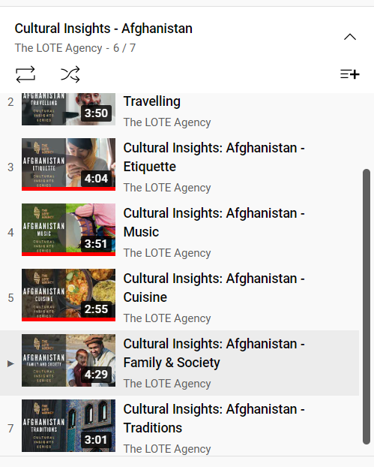
Afghan Culture
Cultural Orientation Resource Exchange
Current Situation
Operation Allies Welcome
Special Immigration Visa
History
Languages
Interethnic Tensions
Cultural Insights - Afghanistan YouTube Video Playlist (Australia)
Notes:
Louise

Slide 11
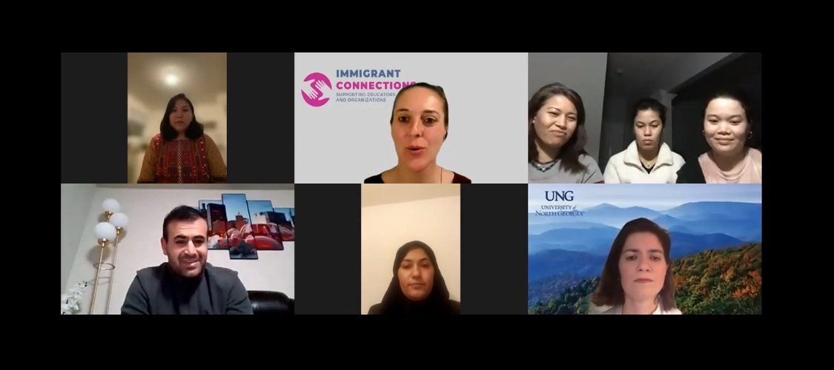
School in Afghanistan
An Educational Experiences of Afghans: Learning from Afghan Refugee Students and Families. 3 minutes (38-41 minutes)
Notes:
35.30 what are the schools like in Afghanistan
38:00 An girls Afghan experience in school 40.46 stop at months of year.
Tell me bout a day in the life at school. No mentor
Parents not involved in school
Access to school

Slide 12
Professional Development
VTSS Trauma Trainings
Virginia Career and Learning Center for School Mental Health Professionals
Trauma Sensitive Schools
Creating a Welcoming and Healing Environment for Newly Arriving Afghan Children and Families
Creating a Welcoming and Healing Environment for Newly Arriving Afghan Children and Families: Strategies for School Personnel

Slide 13
“The Core Experiences of psychological trauma are disempowerment and disconnection. Recovery, therefore, is based upon empowerment of the survivor and the creation of new connections.
Recovery can take place only in the context of relationships; it cannot occur in isolation.
In her renewed connections with other people, the survivor re-creates the psychological faculties that were damaged or deformed by the traumatic experience.These faculties include the basic capacities for trust, autonomy, initiative, competence, identity and intimacy.”
-Judith Herman, M.D.
Trauma and Recovery, The Aftermath of Violence
Notes:
One of the most powerful interventions- provide connections
Helping students find things they have in common with each other
Training peers to understand and support (build their cultural awareness)

