Slide 1
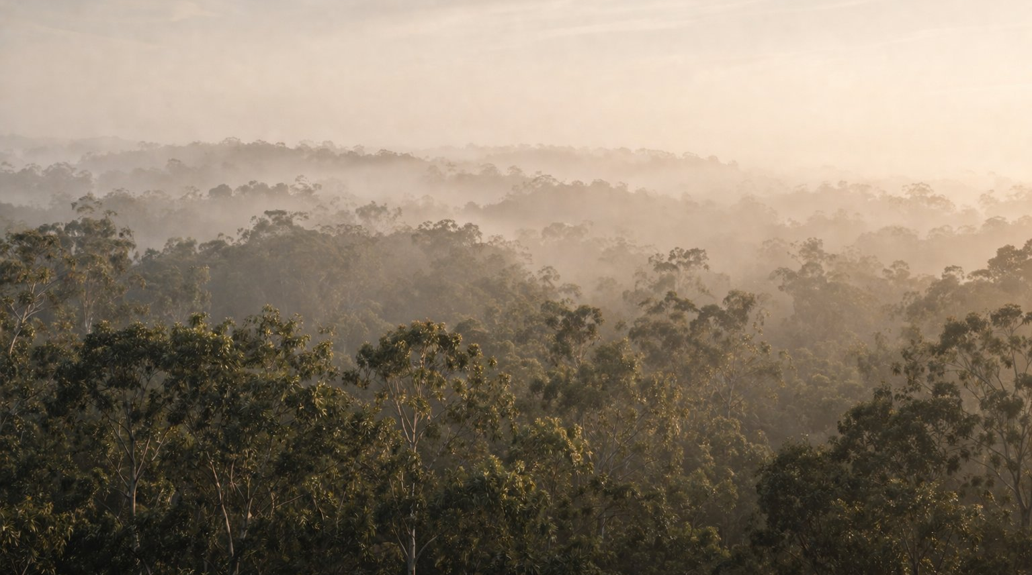

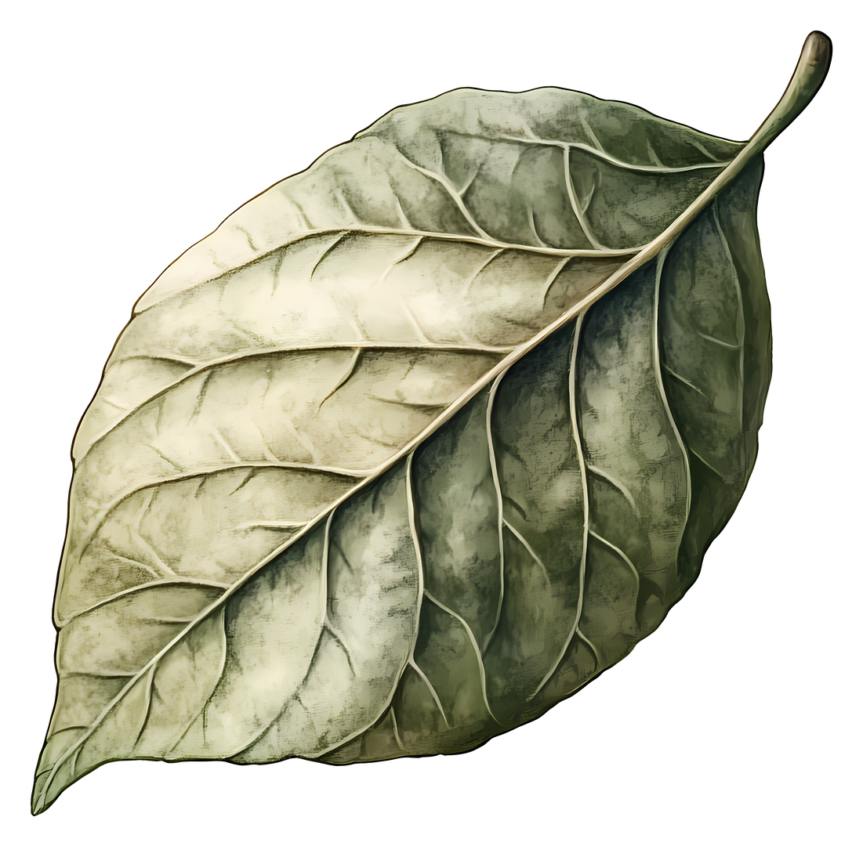

MAXIMUS’S
FOREST
Why habitats matter
Springfield
Notes:
PROMPTS:
"Look at this place. What do you notice about it?”
"What kinds of animals do you think might live here?”
"Has anyone ever visited a place like this?"
“Cany anyone recognise where this place might be? If so, how do you know?”

Slide 2
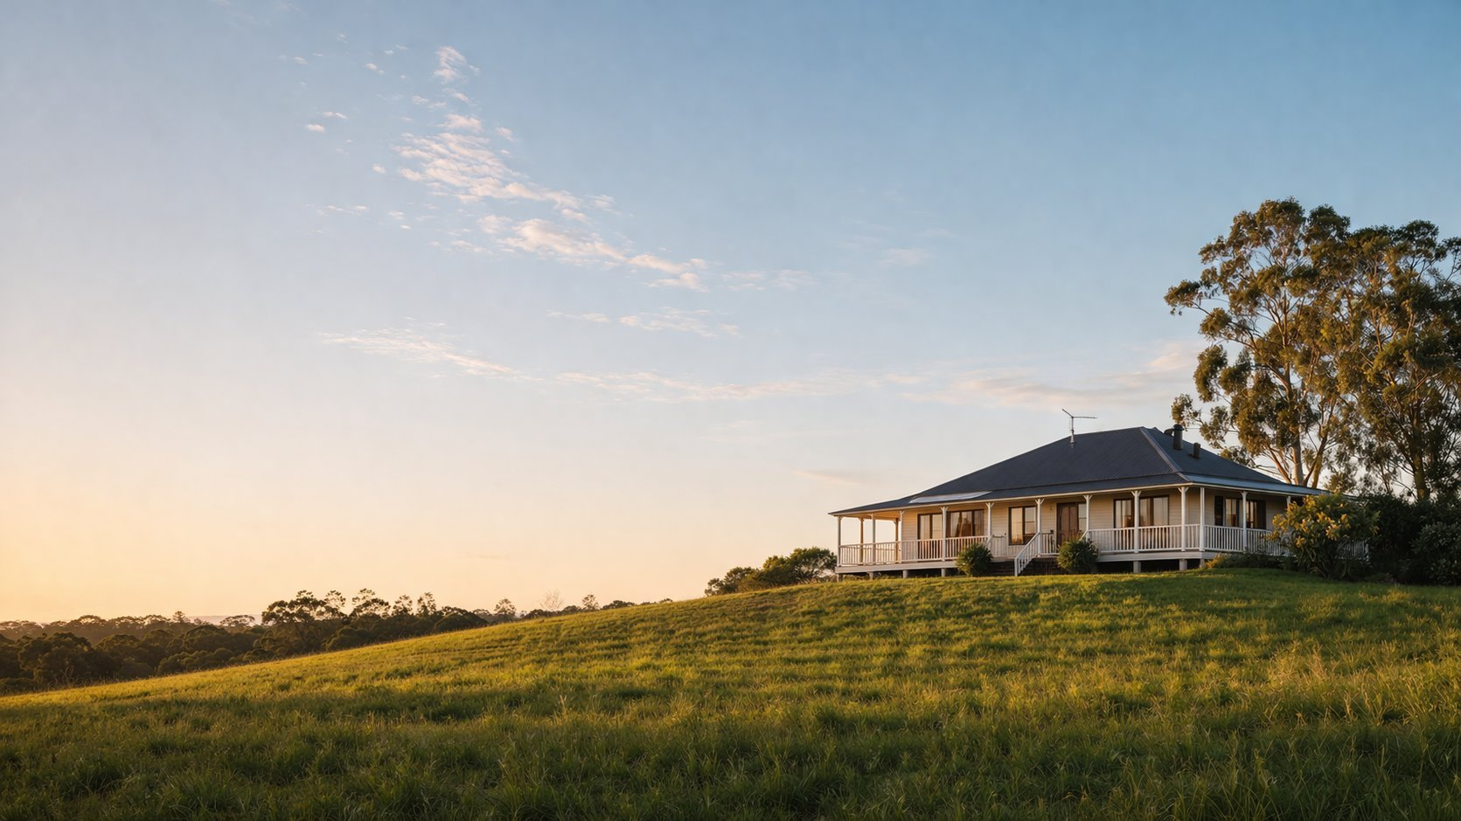
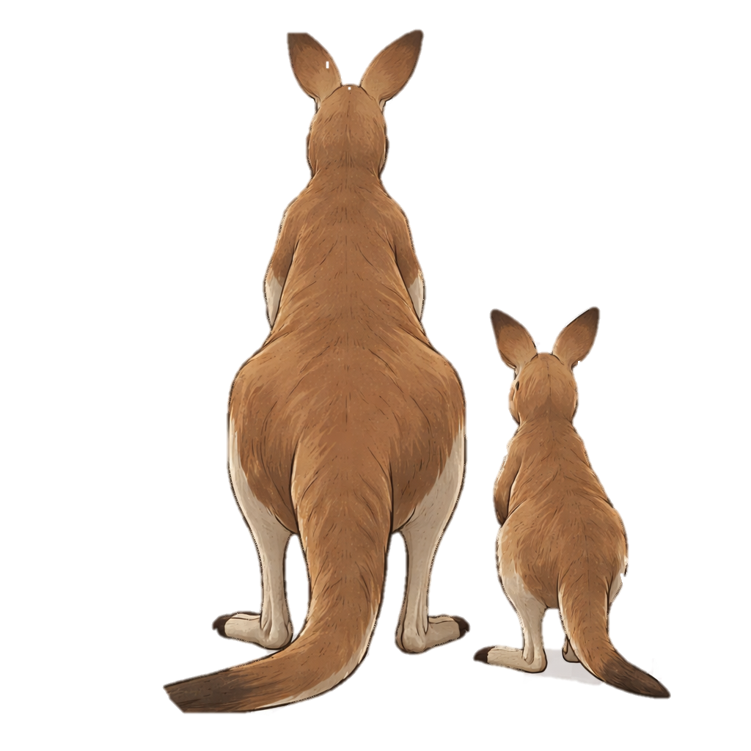
Think about your home...
What do you need to survive?
Now, imagine this…
Notes:
PROMPTS:
"What do you need every single day to survive?”
"Where do you get those things from?"
"What would happen if your home suddenly disappeared - where would you go?"

Slide 3
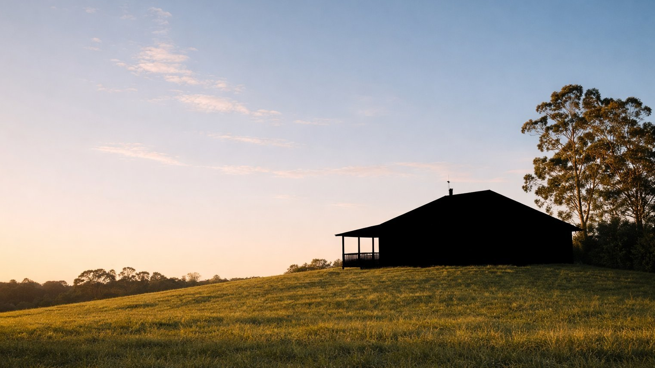
Your home disappears!
Where do you go?
What do you need?
Notes:
PROMPTS:
”Where do you go if your home disappears?”
"How do you think you would feel?"
"Keep that feeling in mind - we're going to meet someone who faces exactly this."

Slide 4
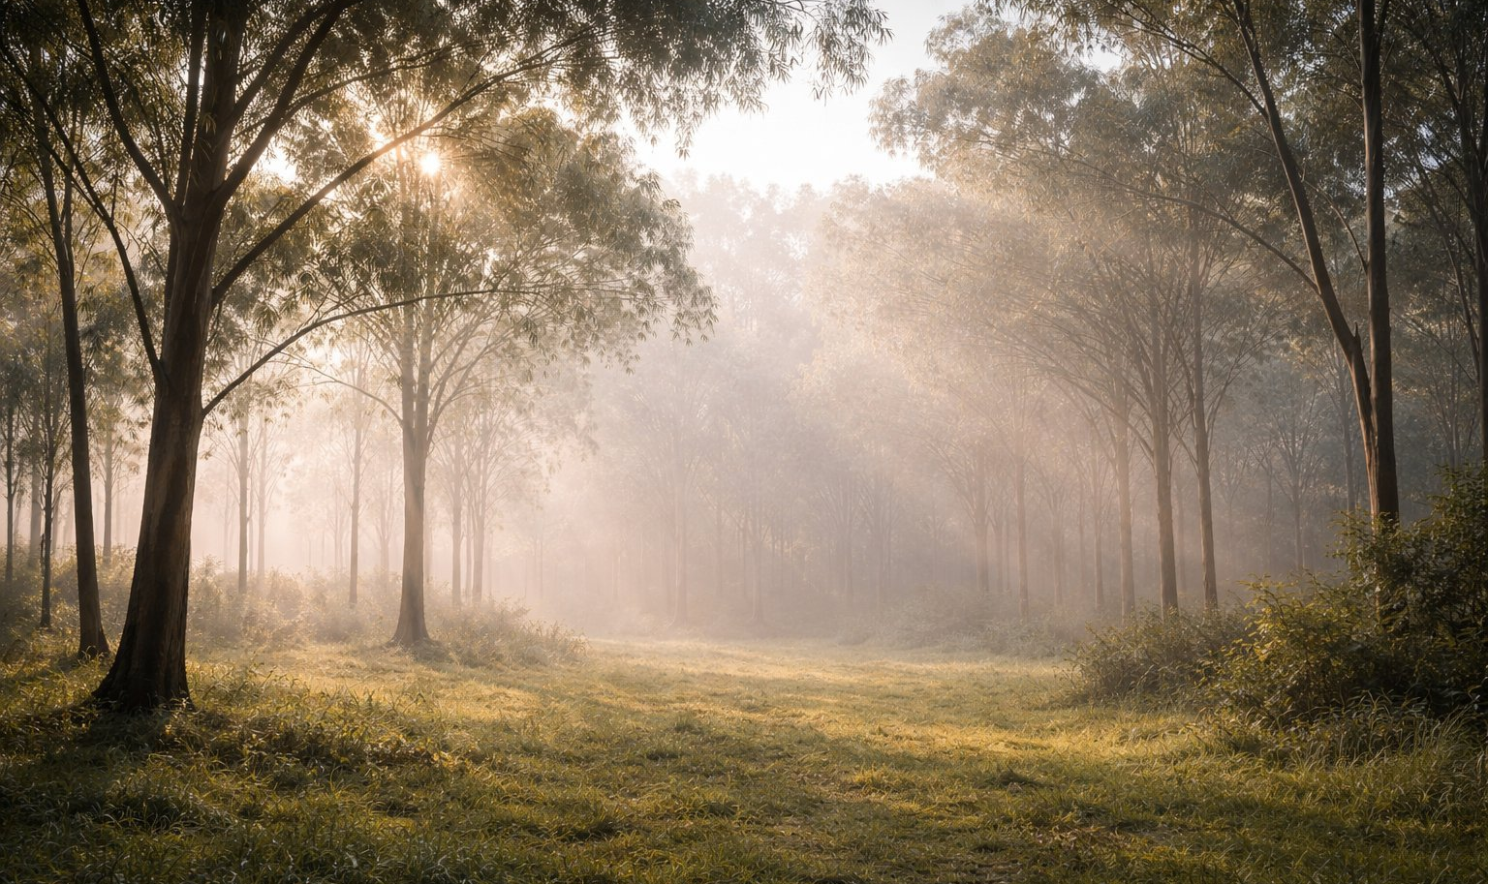
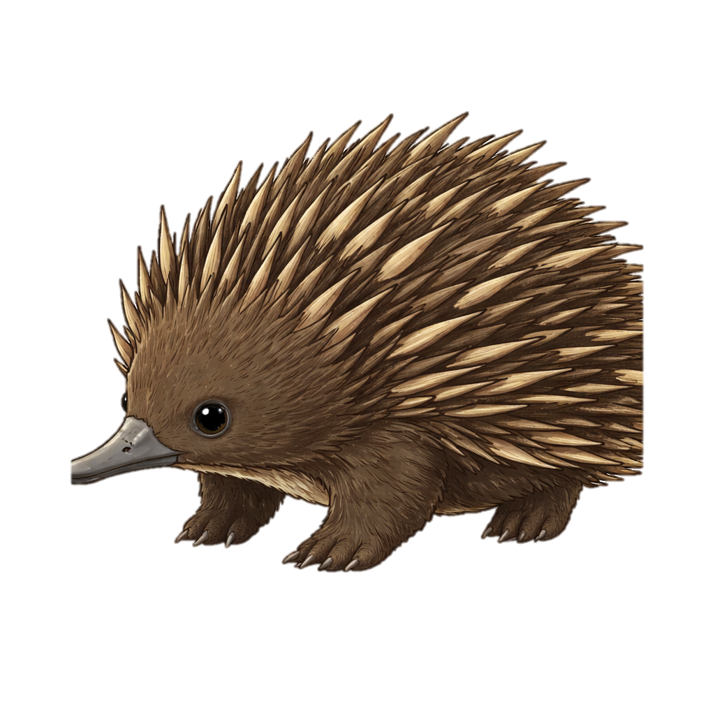
Animals have homes too.
These are called
habitats.
Notes:
PROMPTS:
"Has anyone heard the word 'habitat' before?”
"Just like you have a home, animals have habitats - places where everything they need is found."
"Where do you think different animals might live?"

Slide 5
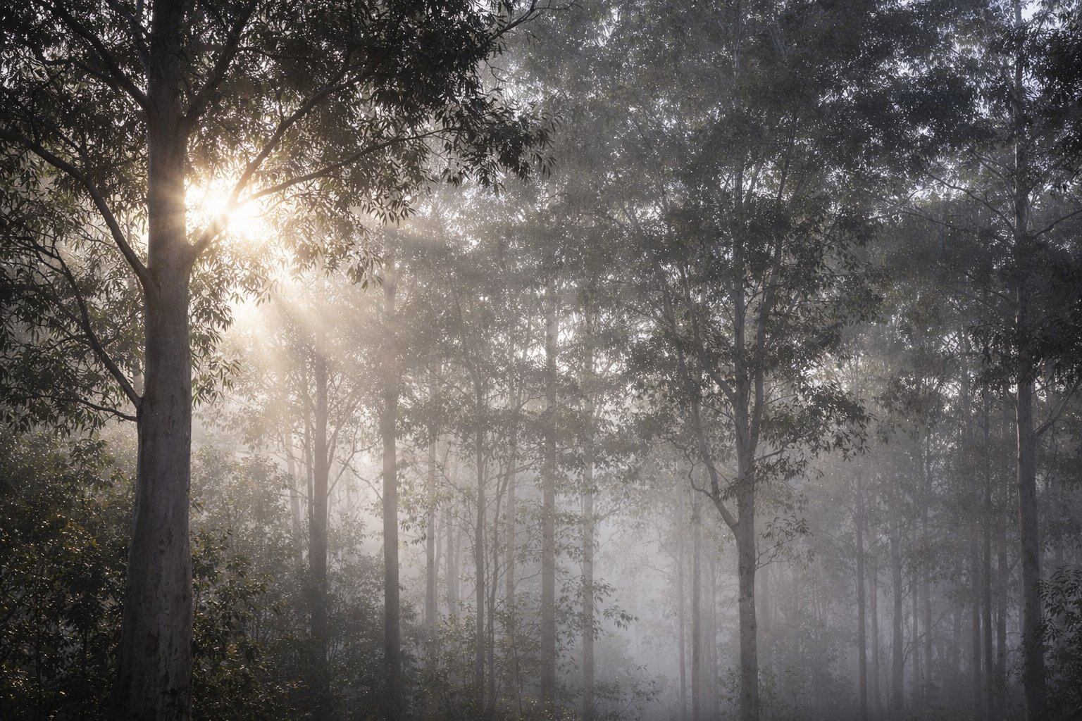
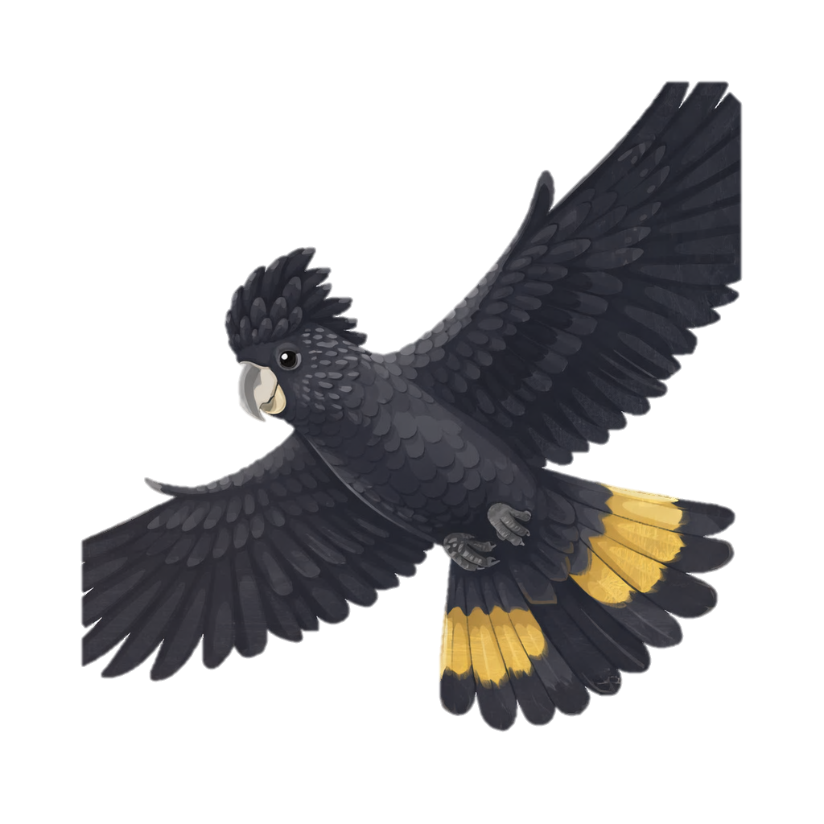
What is a habitat?
Habitats are natural places that provide:
🌿
💧
🏠
🌳
Food
Water
Shelter
Space
Something to eat
Something to drink
A safe place to rest
Room to live & grow
Notes:
PROMPTS:
"Point to each card as we say it together: food, water, shelter, space.”
"Which of these do YOU also need?" (All four - make the link explicit.)”
"Can an animal survive without even one of these? Why not?"

Slide 6
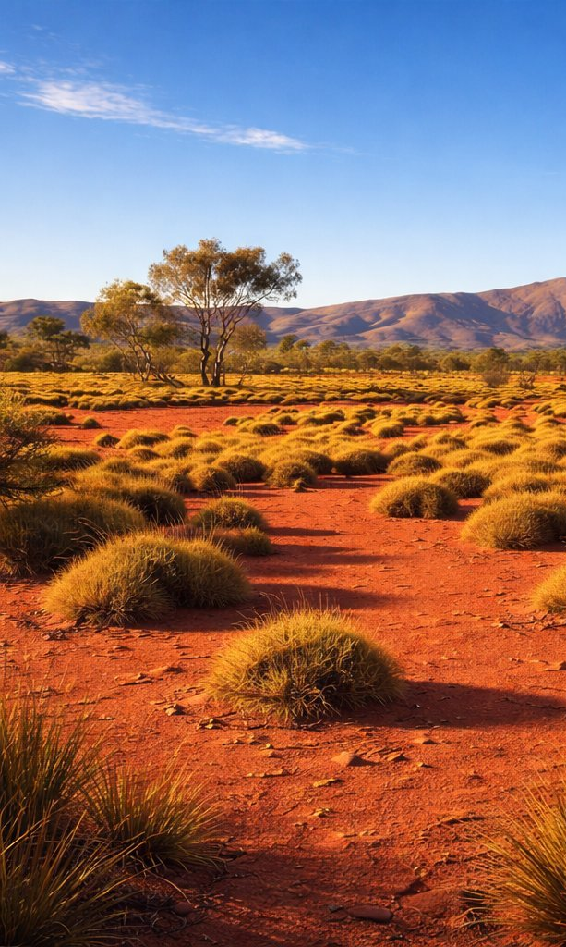
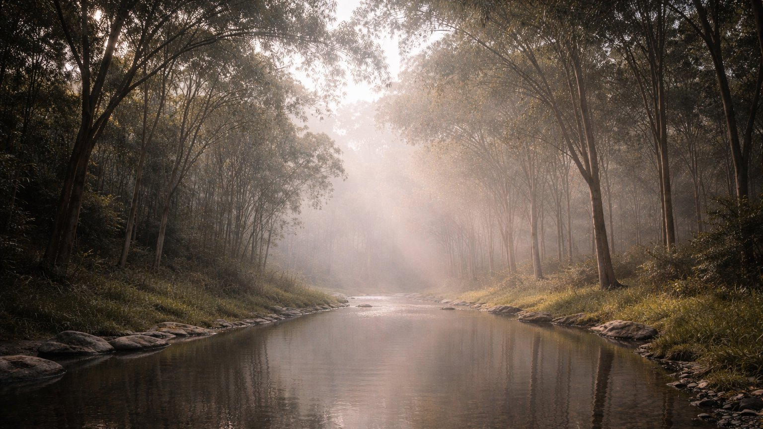
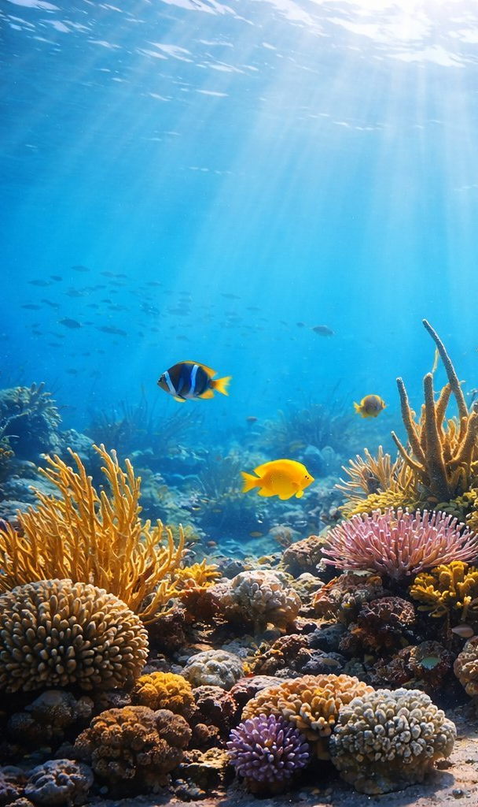
Not all habitats are the same.
Notes:
PROMPTS:
"Can you name some different types of habitats?" (Ocean, rainforest, desert, grassland, wetland.)
"Why would a fish's habitat be different from a koala’s?”
"What would happen if you put a fish in a desert? Would it survive?"

Slide 7
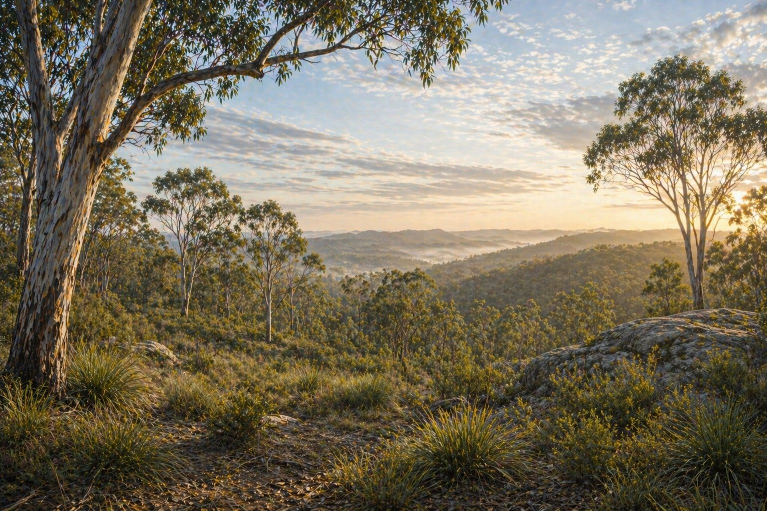
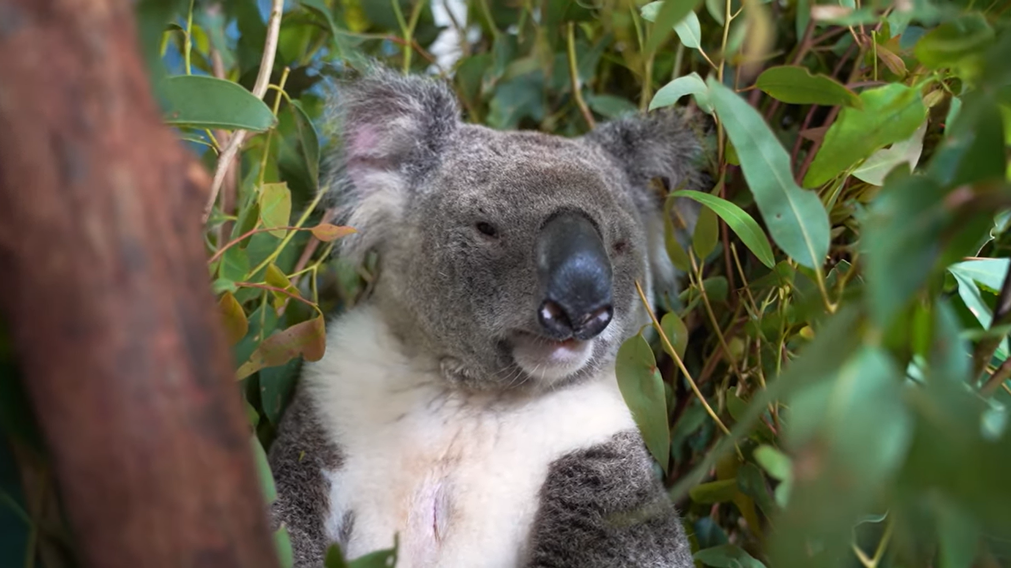
Meet Maximus
Maximus is a koala who lives in a forest near us.
Notes:
PROMPTS:
"This is Maximus. He is a real koala who lives in a forest near us.”
"What do you already know about koalas?"
"Look at where he is - what can you see around him?"
*Feel free to mention Maximus lives in Woogaroo Forest, Springfield, with his other animal friends.

Slide 8
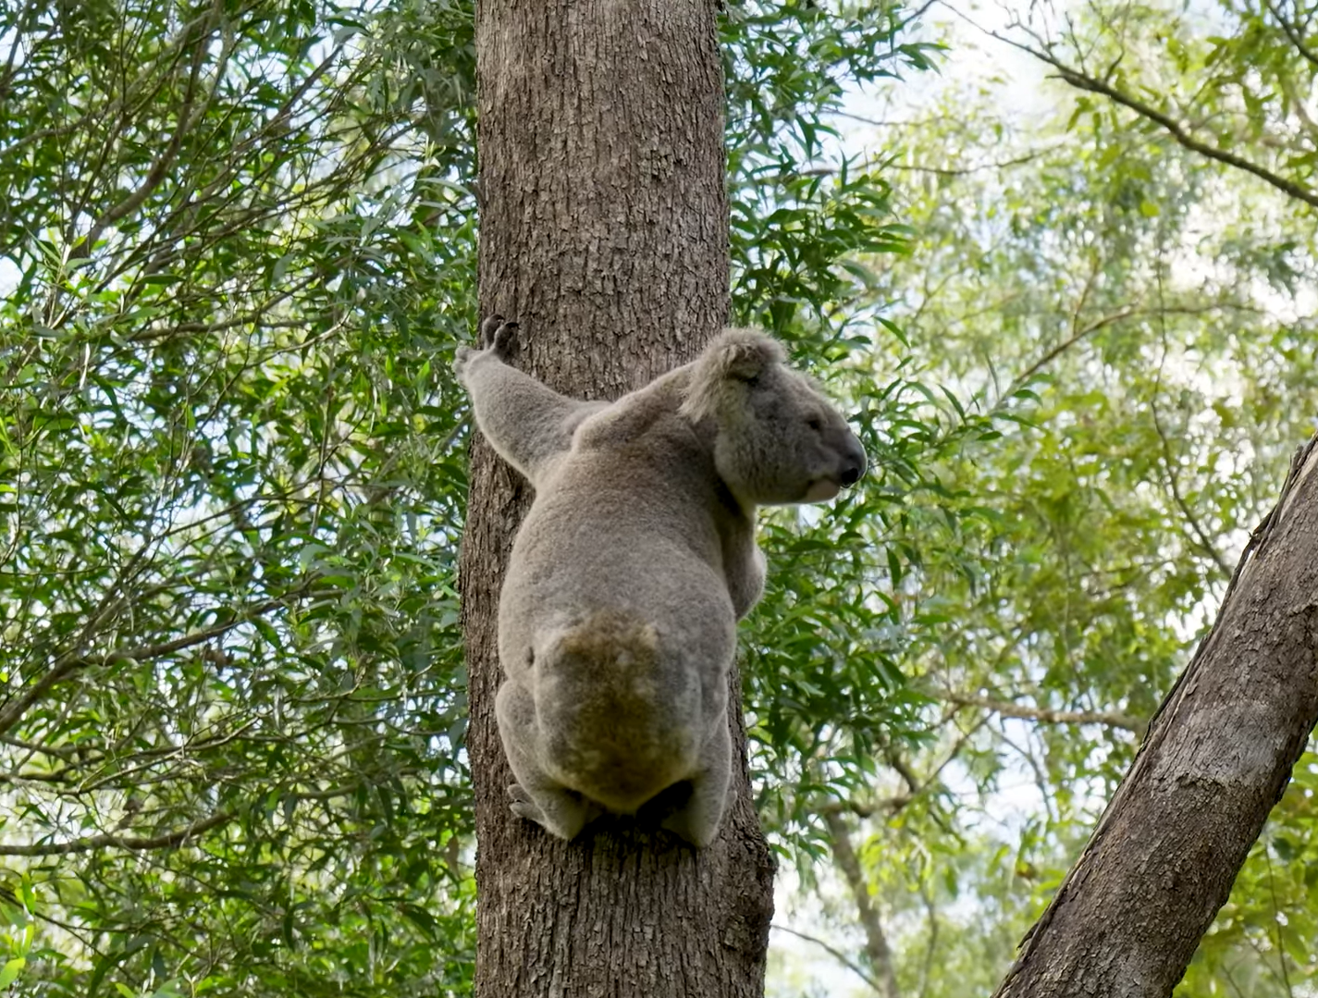
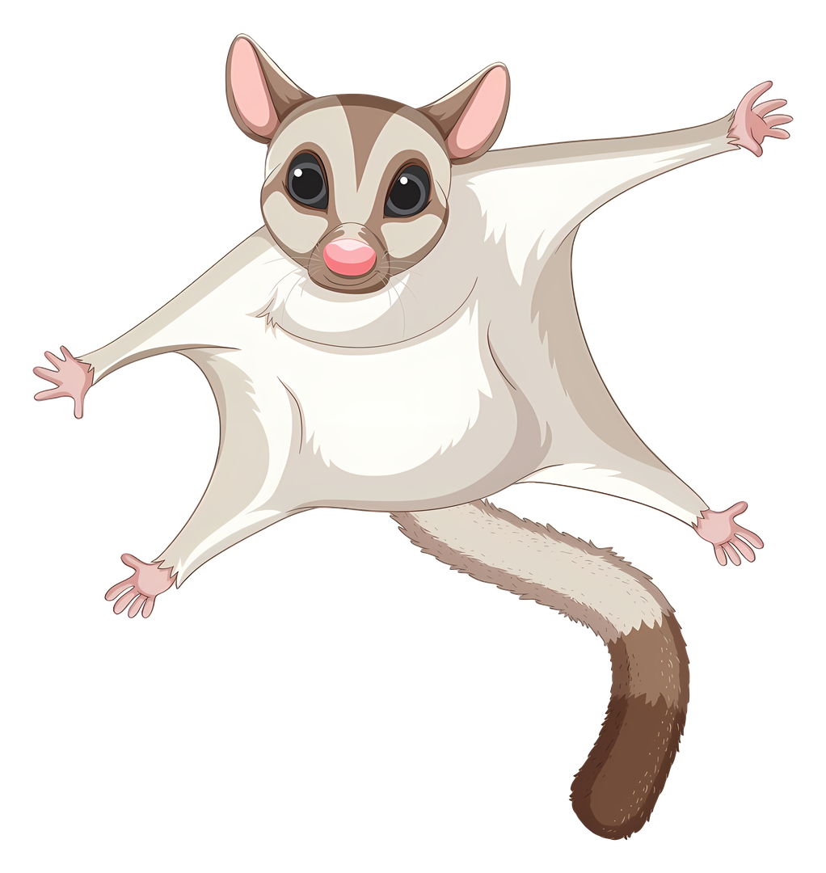
What does Maximus need to survive?
Notes:
PROMPTS:
"Let's go back to our four habitat needs - food, water, shelter, space.”
"What does Maximus eat?" (Eucalyptus leaves - he is a specialist.)
"Where does he sleep? What protects him?"
"How much space does a koala need?"

Slide 9
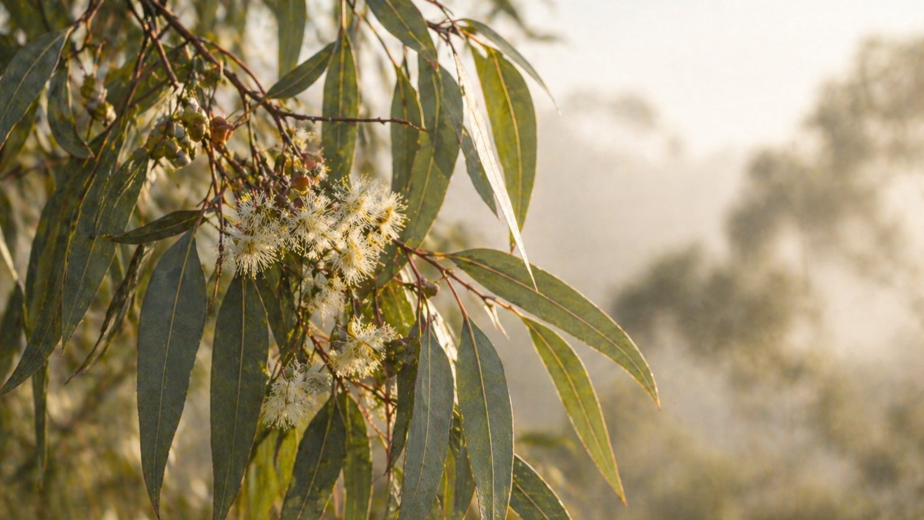
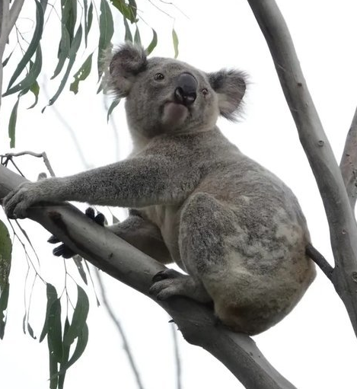
Describe what Maximus’s habitat would look like.
Notes:
PROMPTS:
"Close your eyes. Imagine you are walking through Maximus's forest. What do you see? Hear? Smell?”
"What types of trees would you find?"
"What else might live there alongside Maximus?"

Slide 10
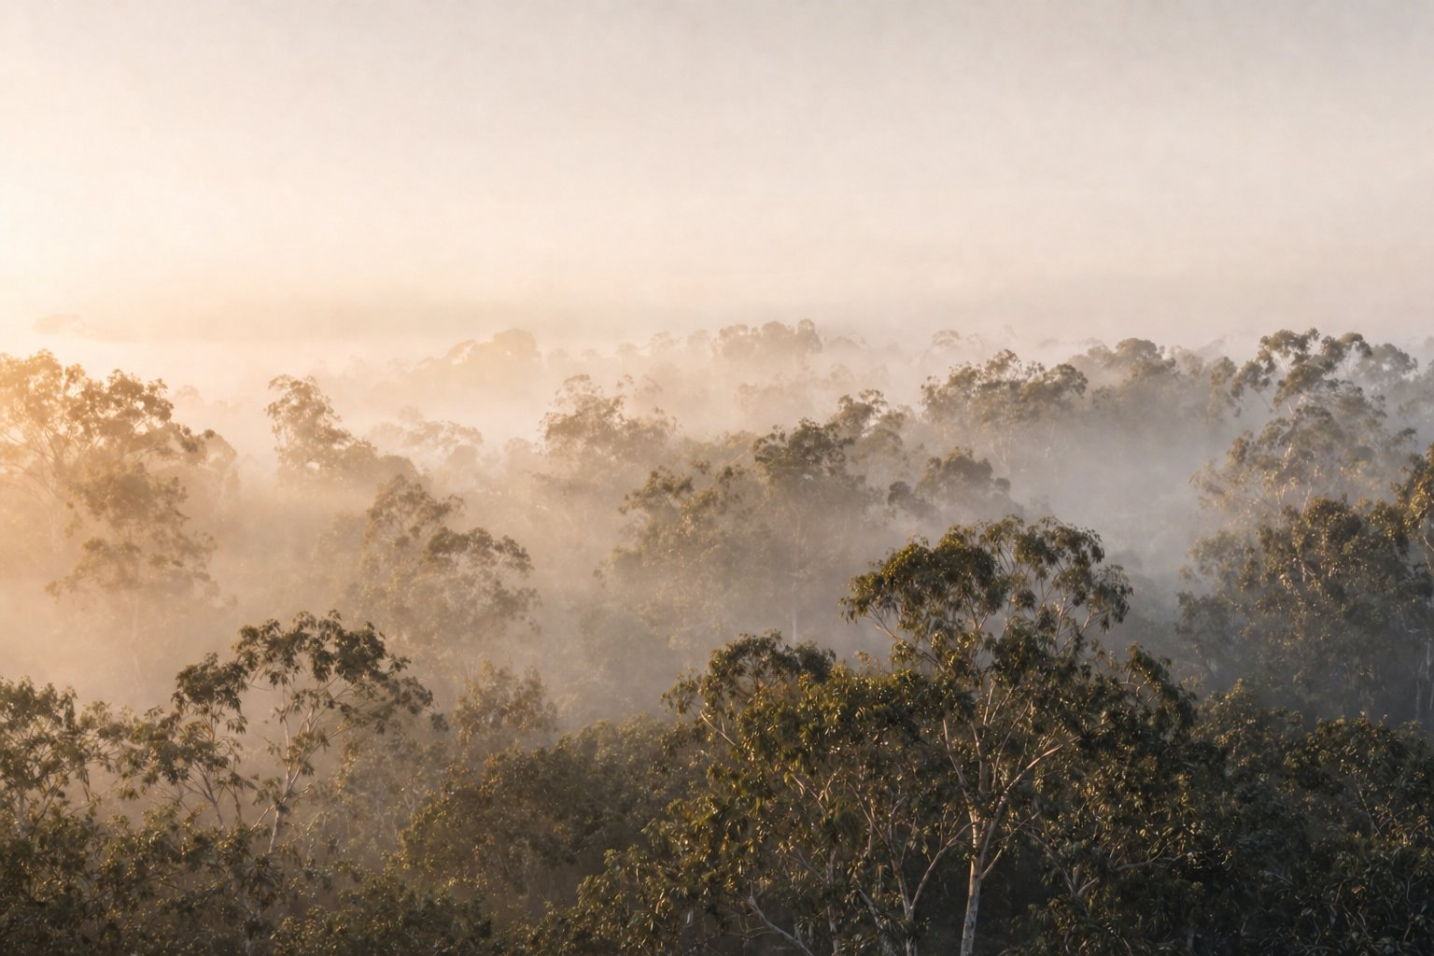
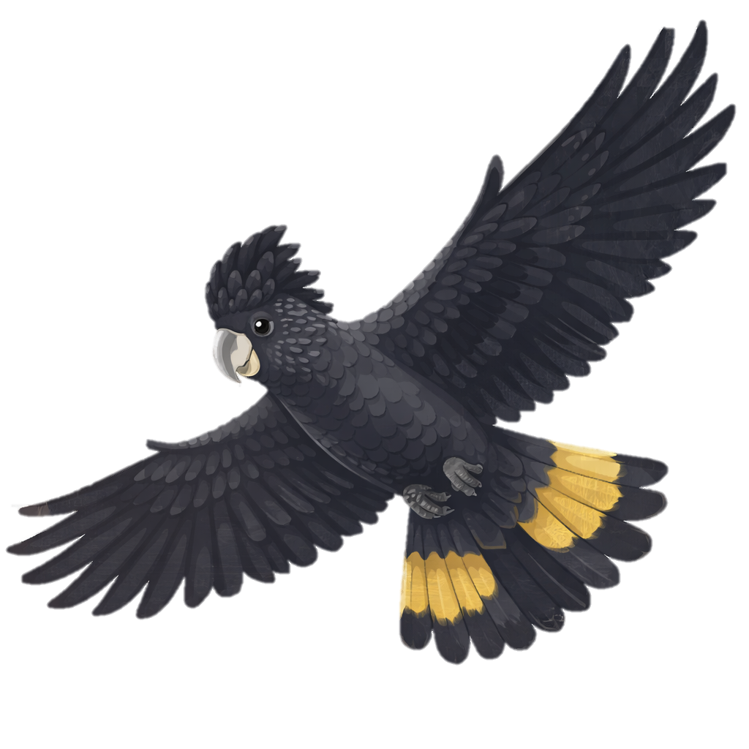
What happens if habitats change?
For example, less food or shelter.
Notes:
PROMPTS:
"What might cause a habitat to change?" (Fire, drought, development, land clearing.)
“If trees are removed, what does Maximus lose?" (Food, shelter, home.)
"What do you think Maximus would do if his forest disappeared?"

Slide 11
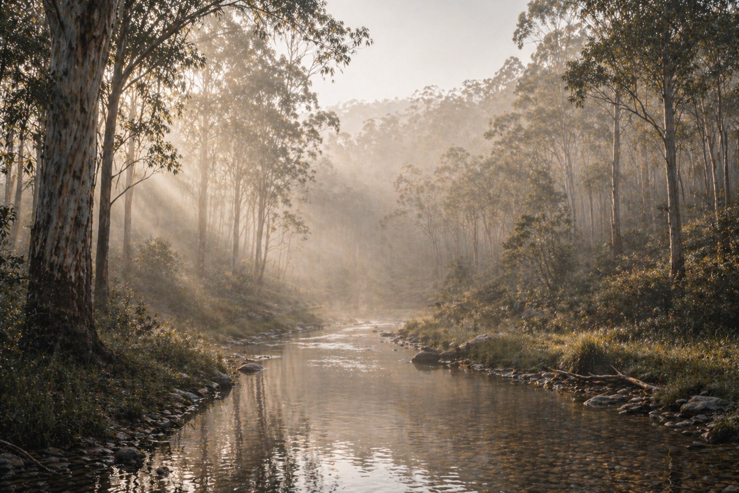
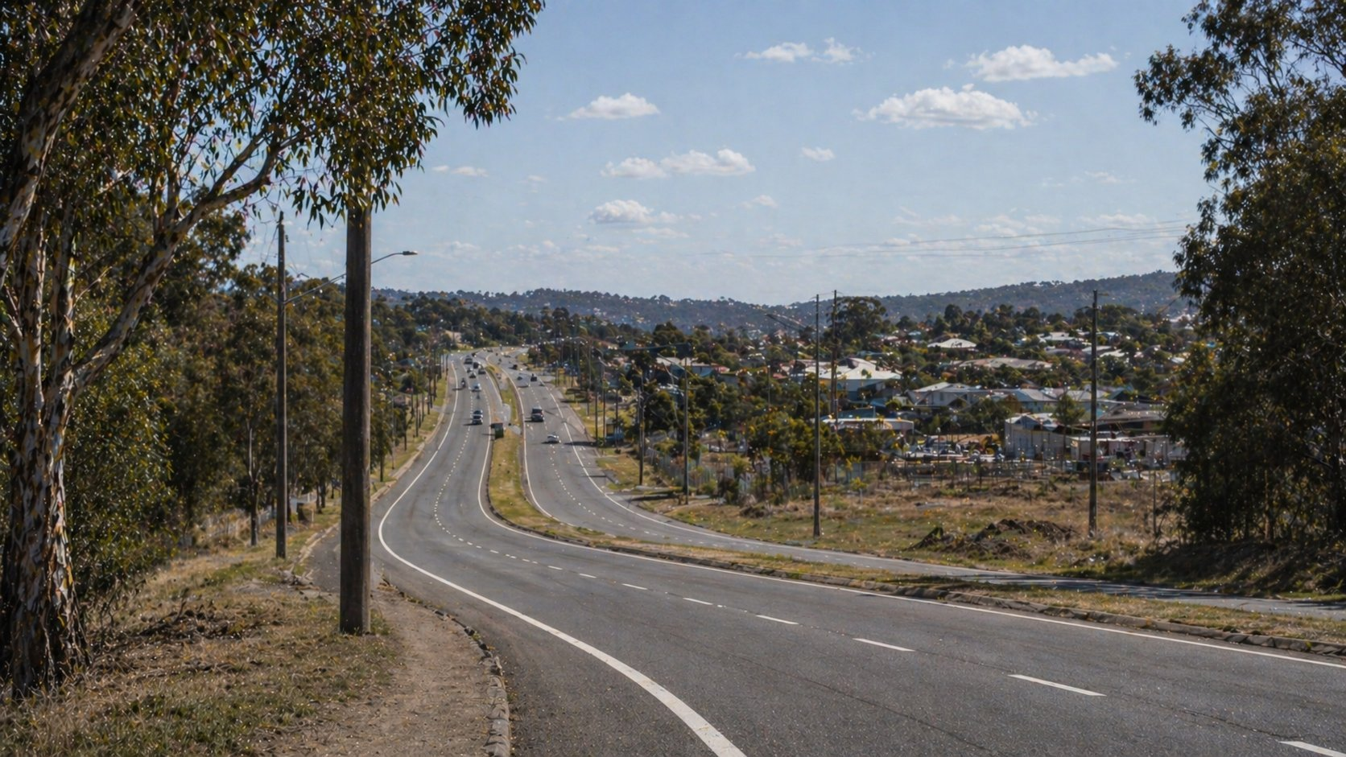
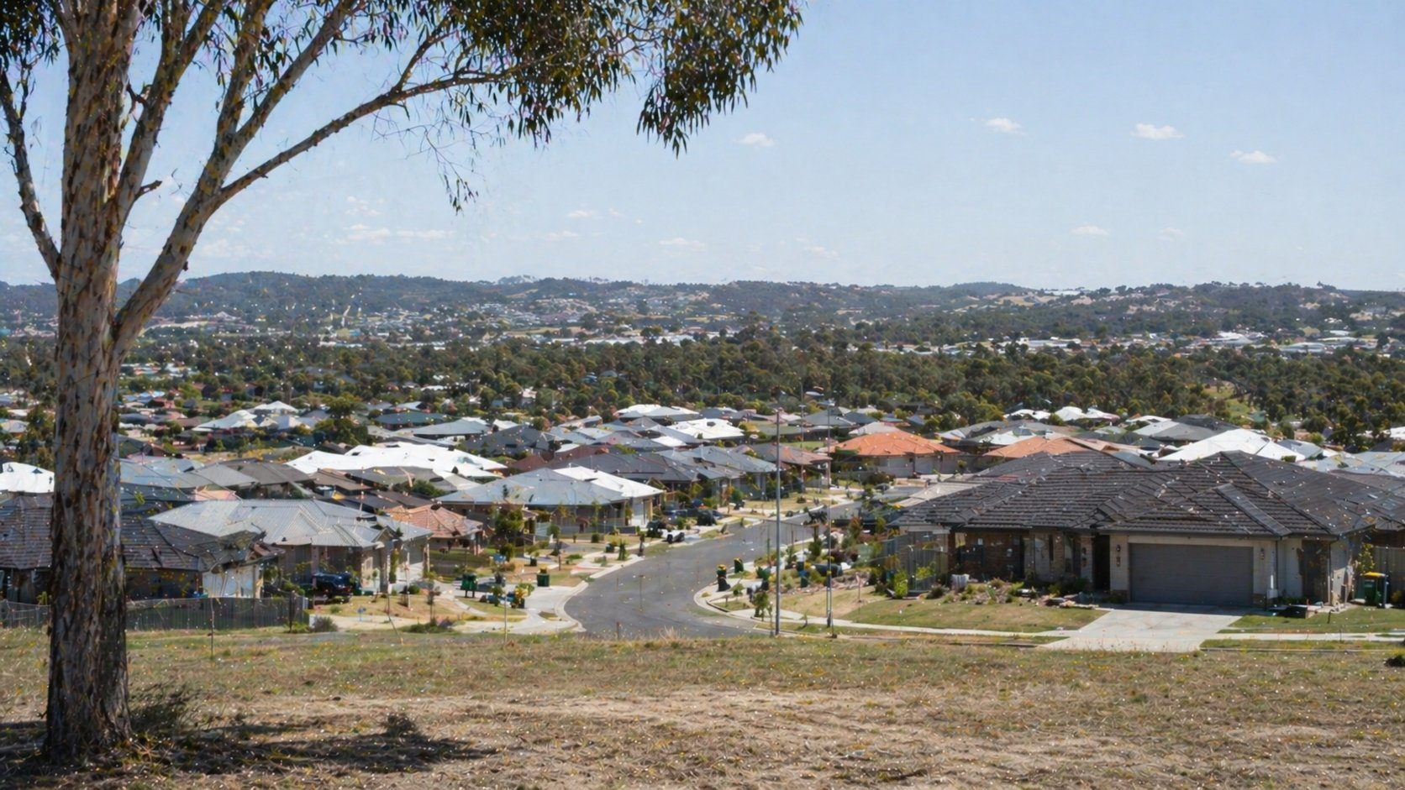
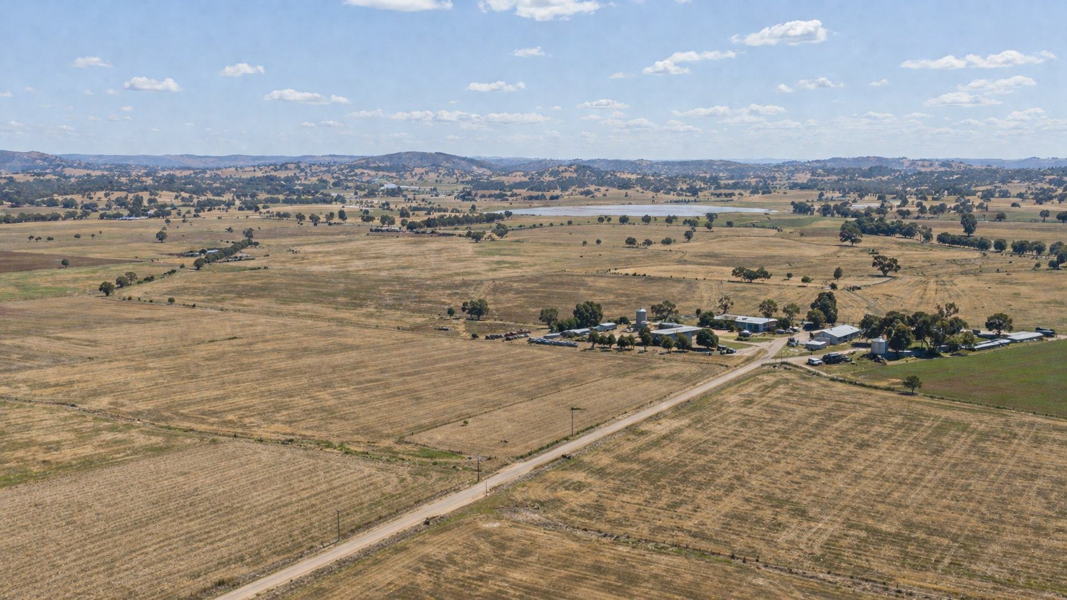
What are some ways people also need land?
Notes:
PROMPTS:
"We need houses, schools, roads and shops — all of these use land.”
"Is it wrong for people to use land?" (No - but we need to think carefully about how.)
"Is there a way we can meet people's needs AND protect animal habitats?"

Slide 12
The BIG Question
People, animals and plants often need to share the same space to live.
How can we ensure everyone gets a home?
Notes:
PROMPTS:
"People, animals and plants all need space to live. How can we make sure everyone gets a home?”
"If you were in charge of planning a new neighbourhood, what would you do to make sure animals still had space?"
"Can you think of places where people have made room for nature?"

Slide 13
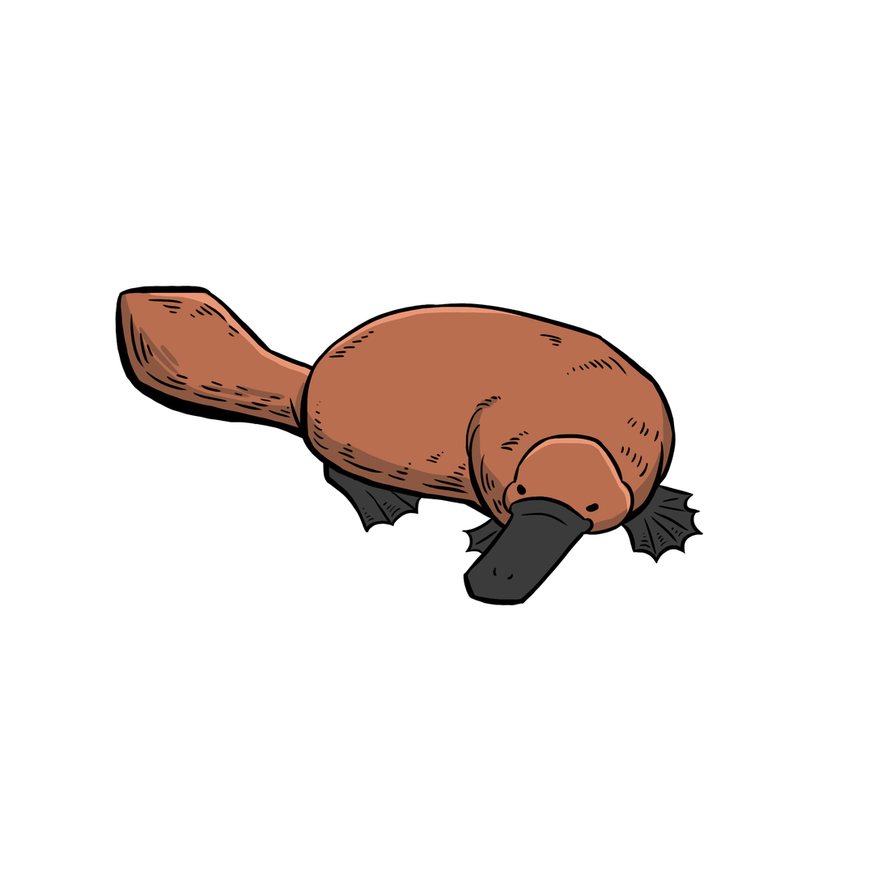
Why natural habitats are important.
🏠 Animals need habitat to find food, water and shelter.
🐨 Without it, they cannot survive or raise their young.
🌿 Healthy habitats clean our air and water, benefiting people too.
🤝 When we protect nature, people and animals thrive together.
Notes:
PROMPTS:
"Let's read each dot point together.”
"Which one surprises you the most? Why?”
"Healthy habitats clean our air and water - what does that mean for us?"

Slide 14
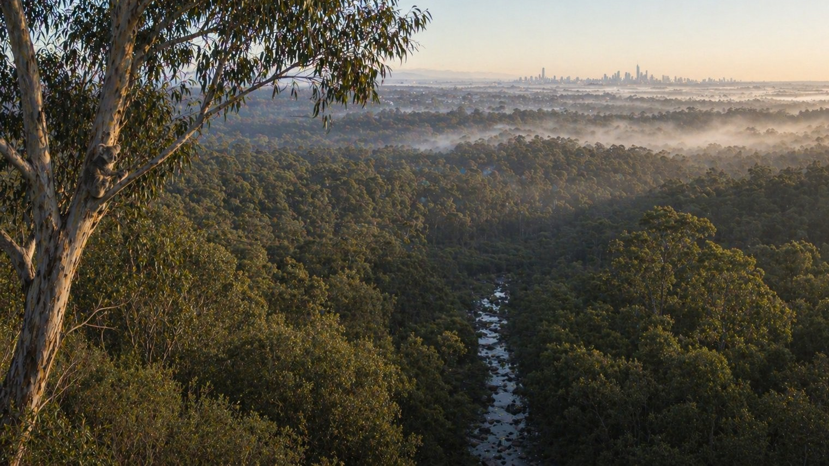
All living things need a home.
Notes:
PROMPTS:
"All living things need a home. That includes Maximus. That includes you. That includes every plant and animal on Earth.”
"Now it's your turn. Draw Maximus in his forest home and write about why his home is important to him."
"Your words and pictures matter - they tell Maximus's story."

