Slide 1
Pinterest
Introducing Pin reminders
Michelle Anderson November 2020

Slide 2
Pinsight Headlines:
The Power of Pinterest:
1 in 4 Pinterest households in the UK earn >£100k (>$75k US)
27% of users are main household spenders
72% of Pinners get inspired even when not looking
66% go on to purchase after seeing a Pin
1.6x more average spend than customers not on Pinterest
>240B
416m
90%
Notes:
Headlines
More than 240billion pins (Oct 2020)
416million monthly active users (Oct 2020)
90% of weekly Pinners make purchase decisions on Pinterest

Slide 3
Pinsight Headlines:
2020 Trend Prediction:
The Pinterest 100
All US Pins split between future optimism and information for right now
Record peak for Global engagement
Christmas comes early
Increased Advertising
Shoppable UK Pins
8/10 mums
80% mobile users
2Billion
Notes:
Headlines
More than 80% of U.S. women ages 18-64 with children use Pinterest
80% of all users access mobile app – growing YoY
Over 2 billion text-based searches every month, across 8 different searches
Trends
Dec 2019 Pinterest produced it’s annual list of 100 emerging trends. A “trend” shows significant search volume and an upward trajectory for at least six months, comparing search volumes from August 2017-July 2018 to August 2018-July 2019.
Proved more insightful than ever, providing advertisers and marketers with insights other platforms couldn’t generate
Since Covid hit in January all US pins have been almost equally split between users looking for reassurance over the current situation and planning for future events
60% uplift in searches and 40% uplift in saves YoY
Christmas came early in 2020 with 147% uplift in Christmas related searches and saves by April (5 months earlier than normal)
Release of UK shoppable Pins in September 2020 – in time to make the most of the festive trading period, further enhanced by a second lockdown
Revenue currently tracking at +58% Y/Y, closing Q32020 more than $120m up on the same period LY
Highly likely to hit $1B for the second year in a row

Slide 4
Pinsight Headlines:
Pinterest Analytics
4/6 Pinterest recommended key metrics to track relate to Pin interaction
Increased tracking of conversions and traffic through specific campaigns
Improved targeting using Pinterest-specific categories
70% of feedback on TrustPilot UK relates to poor UX
Finding a saved pin can be frustrating
14 mins
2m saves
3B boards
144.5M
Notes:
Headlines
Average visit duration (2018)
More than 2M daily shopping saves to boards
3B total Pinterest boards
Pinterest ads can reach 144.5M people
Pinterest Analytics
Pinterest has created a promoted ad strategy that charges advertisers on the engagement or action. This means that an advertiser only pays when an existing user engages with a promoted pin, which has the potential to increase the advertiser's ROI.
In addition, with Pinterest's unique use of pinboards, advertisers can target users based on their interests, personas, or life stages. Doing so gives advertisers the chance to target potential customers on a more granular level than they can on other social sharing platforms, which can provide an added boost toward a positive return on investment (ROI) on advertising budgets.

Slide 5
Pinsight Headlines:
Pinterest Analytics
In 2 years, visit duration dropped by 65%
50% of saved pins are for future events
Currently no way of returning to saved pins other than search
Saved pins demonstrate intent – to what extent?
Passive UX – what happens next?
5 mins
2m saves
4B boards
144.5M
Notes:
Headlines
Average visit duration (Oct 2020)
More than 2M daily shopping saves to boards
4B total Pinterest boards
Pinterest ads can reach 144.5M people
Pinterest Analytics
Users typically start to save pins 6 months before an event, returning monthly to repeat their search

Slide 6
Pinsight Headlines:
Pinterest Analytics
Purely Ad generated Revenue
How to increase MAU interactivity?
How to increase visit time?
How to demonstrate conversion from Saved Pins?
How to engage more positively with MAUs?
$443M
442
$1.03pp
Notes:
Headlines
Q32020 Revenue
MAUs
ARPU

Slide 7
Pinterest vision statement:
Introducing Pin Reminders
Pin reminders encourage active interaction
Pin reminders demonstrate an intent to re-visit saved Pins
Pin reminders encourage MAUs to return at a later time, driving up visit time
Pin reminders can demonstrate conversion/traffic uplift from saved Pins
Pin reminders are set by the user, therefore more relevant to them
Pinterest is the visual discovery engine. Our mission is to bring everyone the inspiration to create a life they love.

Slide 8
Pinterest Vision Statement:
Introducing Pin Reminders:
MVP Requirements
Ability to set a reminder for a Pin from all available Pin presentations
Reminders should appear as push notifications through to selected devices
Ability to dismiss notifications from devices but have them appear in app
Ability to postpone a reminder
Ability to see an overview of all reminders
Ability to cancel any reminders
Pinterest is the visual discovery engine. Our mission is to bring everyone the inspiration to create a life they love.

Slide 9
Pinterest Vision Statement:
Introducing Pin Reminders: Roadmap
183m Pins over New Year
439m for Valentine’s Day
Utilises existing product functionality & push notification structure
No additional infrastructure investment for MVP, just development resource
Pinterest is the visual discovery engine. Our mission is to bring everyone the inspiration to create a life they love.

Slide 10
Pinterest Vision Statement:
Introducing Pin Reminders: Roadmap
Regular release schedule rolling out new features 2/3 times a year
Introducing new icon set
Introducing new push notification preference
Introducing new Reminders section
Introducing Reminder functionality
Pinterest is the visual discovery engine. Our mission is to bring everyone the inspiration to create a life they love.

Slide 11
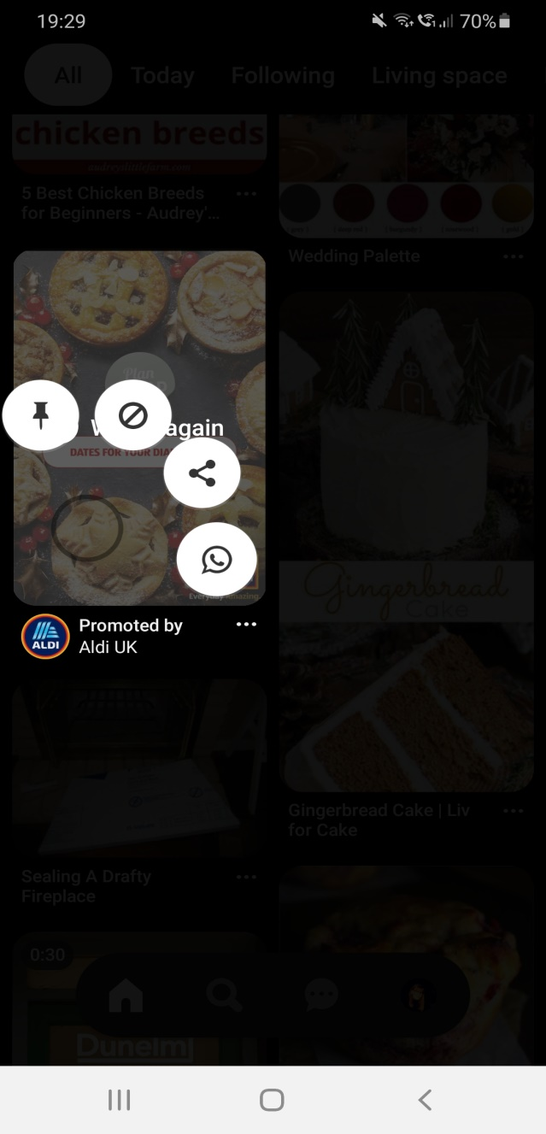
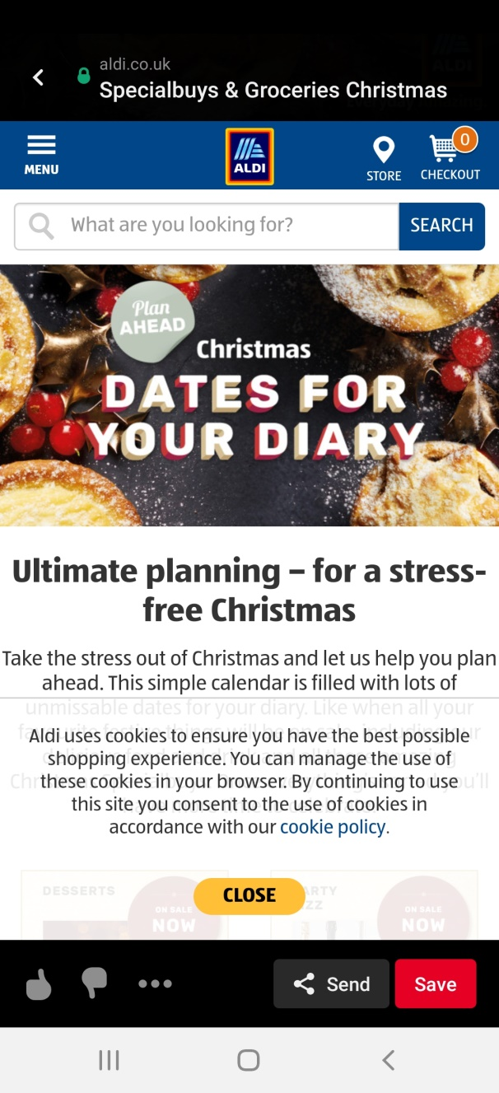
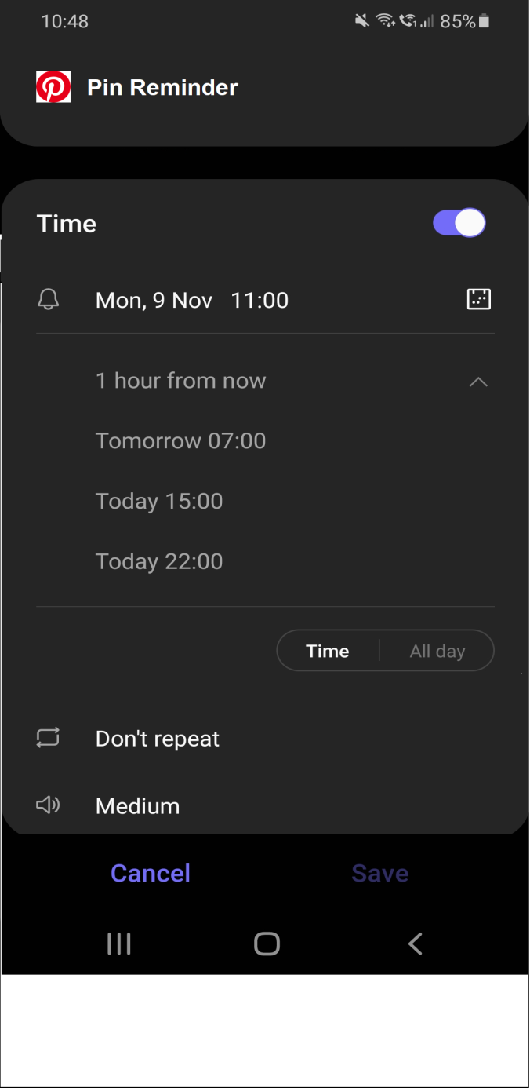
Pinterest reminder icons:
Introducing Pin Reminders: Design

Slide 12
Pinterest Vision Statement:
Introducing Pin Reminders: Launch
Launch to a limited market with potential to demonstrate conversion
UK best placed for this
Native language
Fully-featured
Roll-out with a closed user group
Mums active on other social platforms (YouTube, Instagram)
Pinterest is the visual discovery engine. Our mission is to bring everyone the inspiration to create a life they love.

Slide 13
Pinterest Vision Statement:
Introducing Pin Reminders: P&L
$1 spent on promoted Pins yields $2 in profit. (Analytic Partners)
Pinners spend 1.6 more than consumers not on Pinterest
Promoted Pins drive 5x more sales
Passive UX – don’t want to overwhelm users
Promoted Pins combined with Pin Reminders demonstrates active intent therefore will provide uplift in the above numbers
Pinterest is the visual discovery engine. Our mission is to bring everyone the inspiration to create a life they love.

Slide 14
Pinterest Vision Statement:
Introducing Pin Reminders: P&L
Current Pricing model:
Building brand awareness: $2.00-5.00 for 1000 impressions
Boosting engagement: $0.10 - $1.50 per engagement
Driving web traffic: $0.10 - $1.50 per engagement
The first option doesn’t rely on interaction with Pins so there is no additional ROI to be gained
The second and third options do rely on interaction with the pin therefore there is a strong business case to identify increased ROI from active intent
Ultimately Pinterest could charge more for combining Promoted Pins with Pin Reminders
Pinterest is the visual discovery engine. Our mission is to bring everyone the inspiration to create a life they love.

Slide 15
Pinterest Vision Statement:
Introducing Pin Reminders: P&L
Localised rollouts provides opportunity for bug-fixing, iterations on small scale
No additional expenditure required
Uses existing functionality
Look at React native, Ionic, Firebase for implementation
Pure profit based on Pinterest’s existing business model
Increased intent = improved ROI = increased cost for advertising
Pinterest is the visual discovery engine. Our mission is to bring everyone the inspiration to create a life they love.

