Slide 1

New York
Tech Valley Regional Chairman’s Exchange
Day 1

Slide 2
What is The Chairman’s Award?
The Chairman’s Award is FIRST’s most prestigious award and is given to a single team at each event that best exemplifies the FIRST message and values.
Notes:
Give brief overview of FIRST
Link to “this is not a robot” video

Slide 3
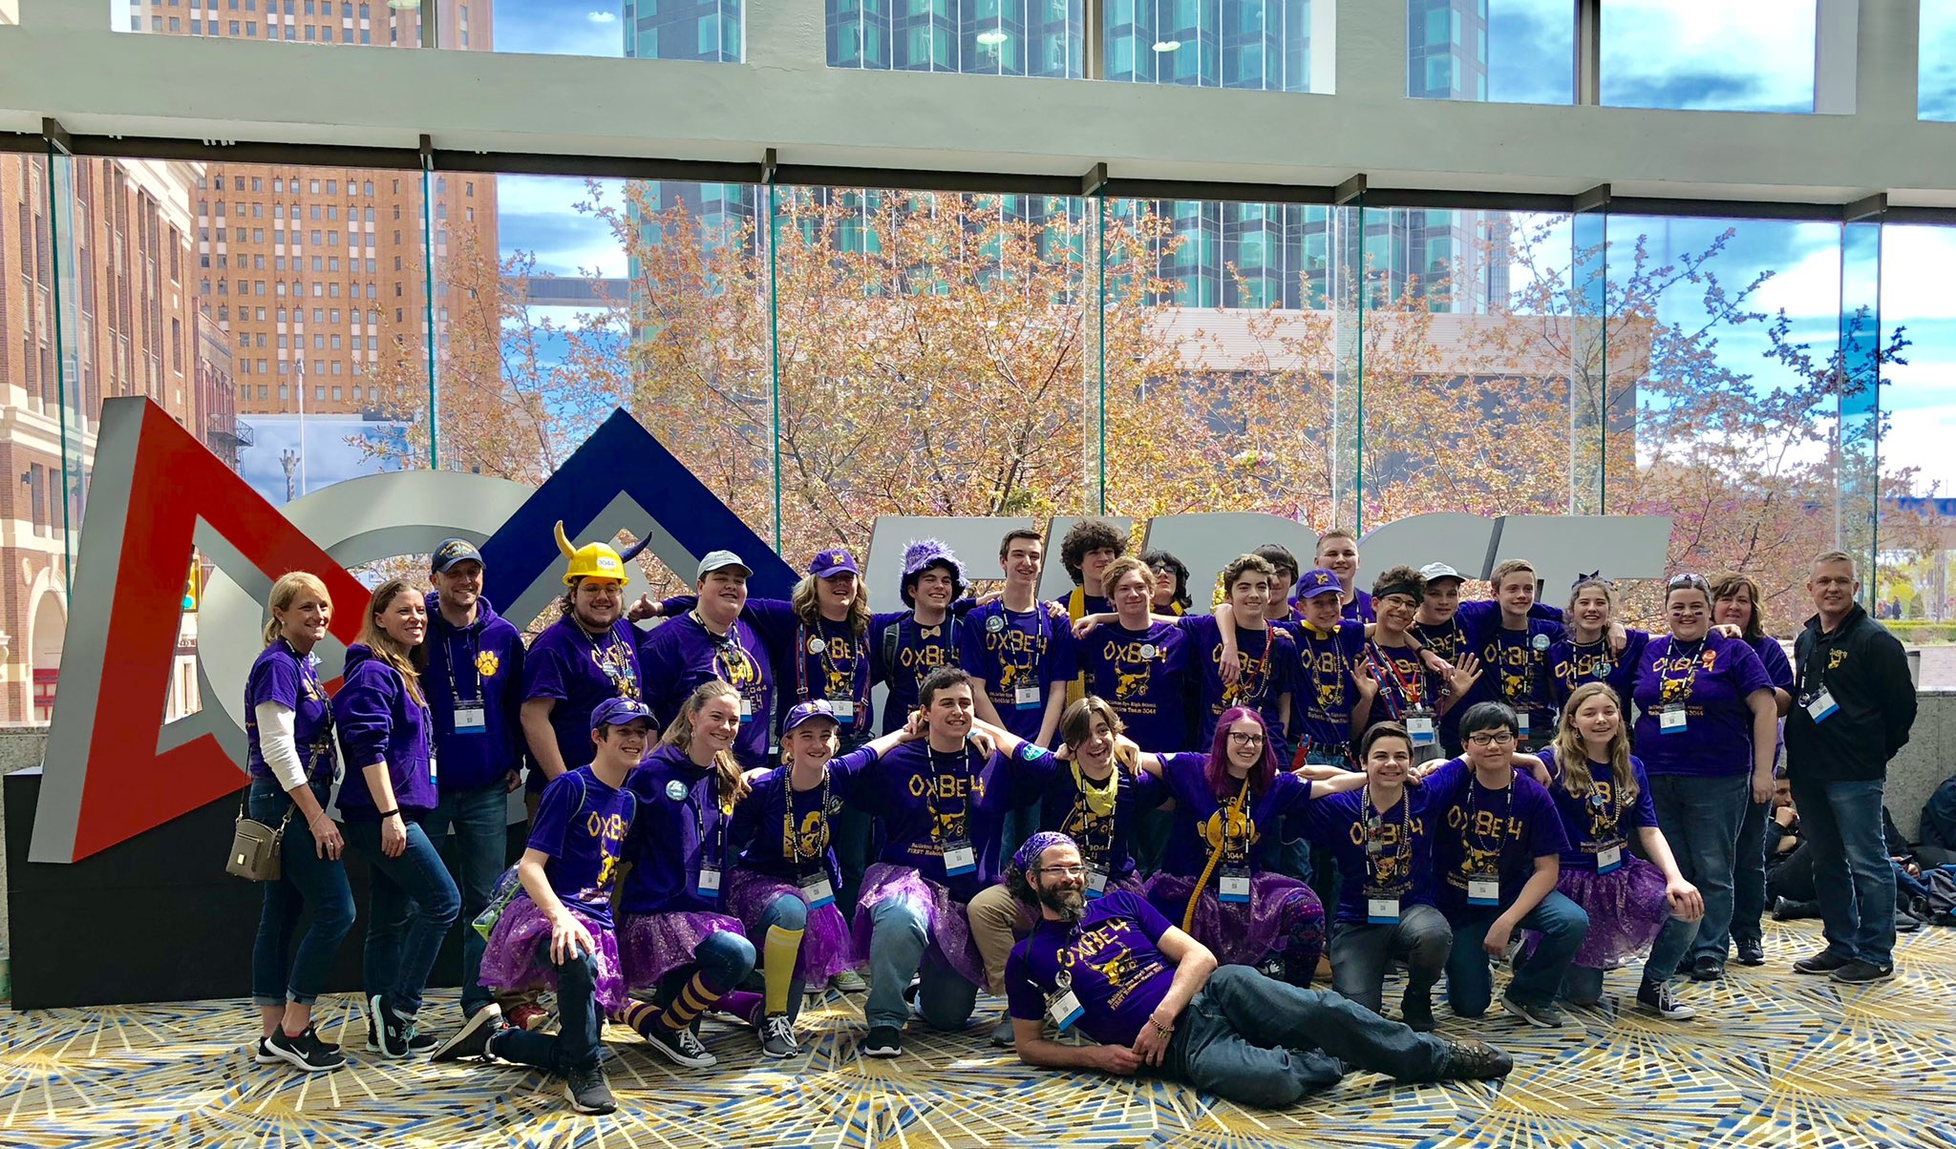
Who is FRC Team 3044?

Slide 4
Chairman’s Award
Components:
Executive Summary
Essay
Presentation
Video
Notes:
Overview of this week’s schedule

Slide 5
Why should your team apply?
Helps you document your growth and accomplishments each year
Gives opportunity for more students to be involved
Focuses team on the real meaning of FIRST
Builds better partnership with your community which brings more support for the team

Slide 6
Getting started...
A Chairman’s team meets year round
Start documenting:
  Take pictures and videos
  Keep a record of your activities: dates and hours
  Collect articles/publications featuring your team
  Compile a list of your alumni

Slide 7
Getting started...
Create your Chairman’s Team:
  Writers - executive summary and essay
  Presenters - 7 minute presentation
  Media/video editing - 1 to 3 minute video

Slide 8
Getting started...
Writing - Executive Summary
  15 questions
  Answer each question with a 500 character summary
  Use numbers in place of words
  Abbreviate if possible
  Creatively answer the question to include as much information as possible

Slide 9
Getting started...
Writing - Essay
  10,000 characters
  Tell your story
  Use a theme
  Include specific figures and details

Slide 10
Getting started...
Presentation to Panel of 3 Judges
  7 minute time limit
  Select charismatic speakers
  Use visuals
  Include specific figures and details
  Be passionate about what you doing and share your story with the judges

Slide 11
Getting started...
Video
  1-3 minute time limit
  Identify students that have editing knowledge
  Use your best pictures and videos
  Find free music that fits your theme
  Start early - finding the right pictures and video clips and editing the material is time consuming
  Make sure your video tells your amazing story

Slide 12
Suggestions...
Watch videos from winning teams
Read essays from winning teams
Research the award and use the FIRST website
Attend Chairman’s Exchange sessions
Ask other teams about their successes and failures
Believe that you are capable of winning this award

Slide 13
Opportunities for Outreach
Support a community event
Share your robot at community events
Mentor an FLL team
Host a summer camp
Talk to other schools about starting a FIRST team
...

Slide 14
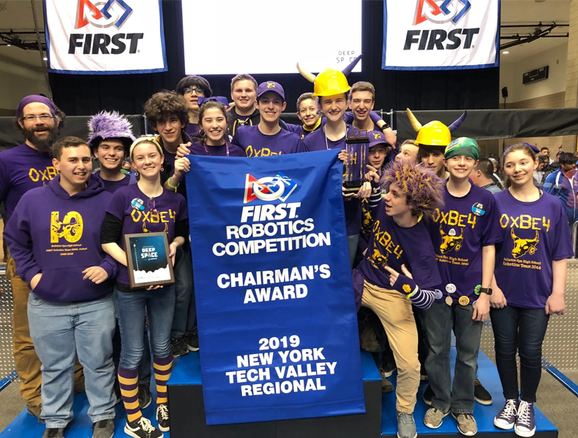
Questions...

