Slide 1
New York
Tech Valley Regional Impact Exchange
Day 1

Slide 2
What is The Impact Award?
The Impact Award is FIRST’s most prestigious award and is given to a single team at each event that best exemplifies the FIRST message and values.
Notes:
Give brief overview of FIRST
Link to “this is not a robot” video

Slide 3
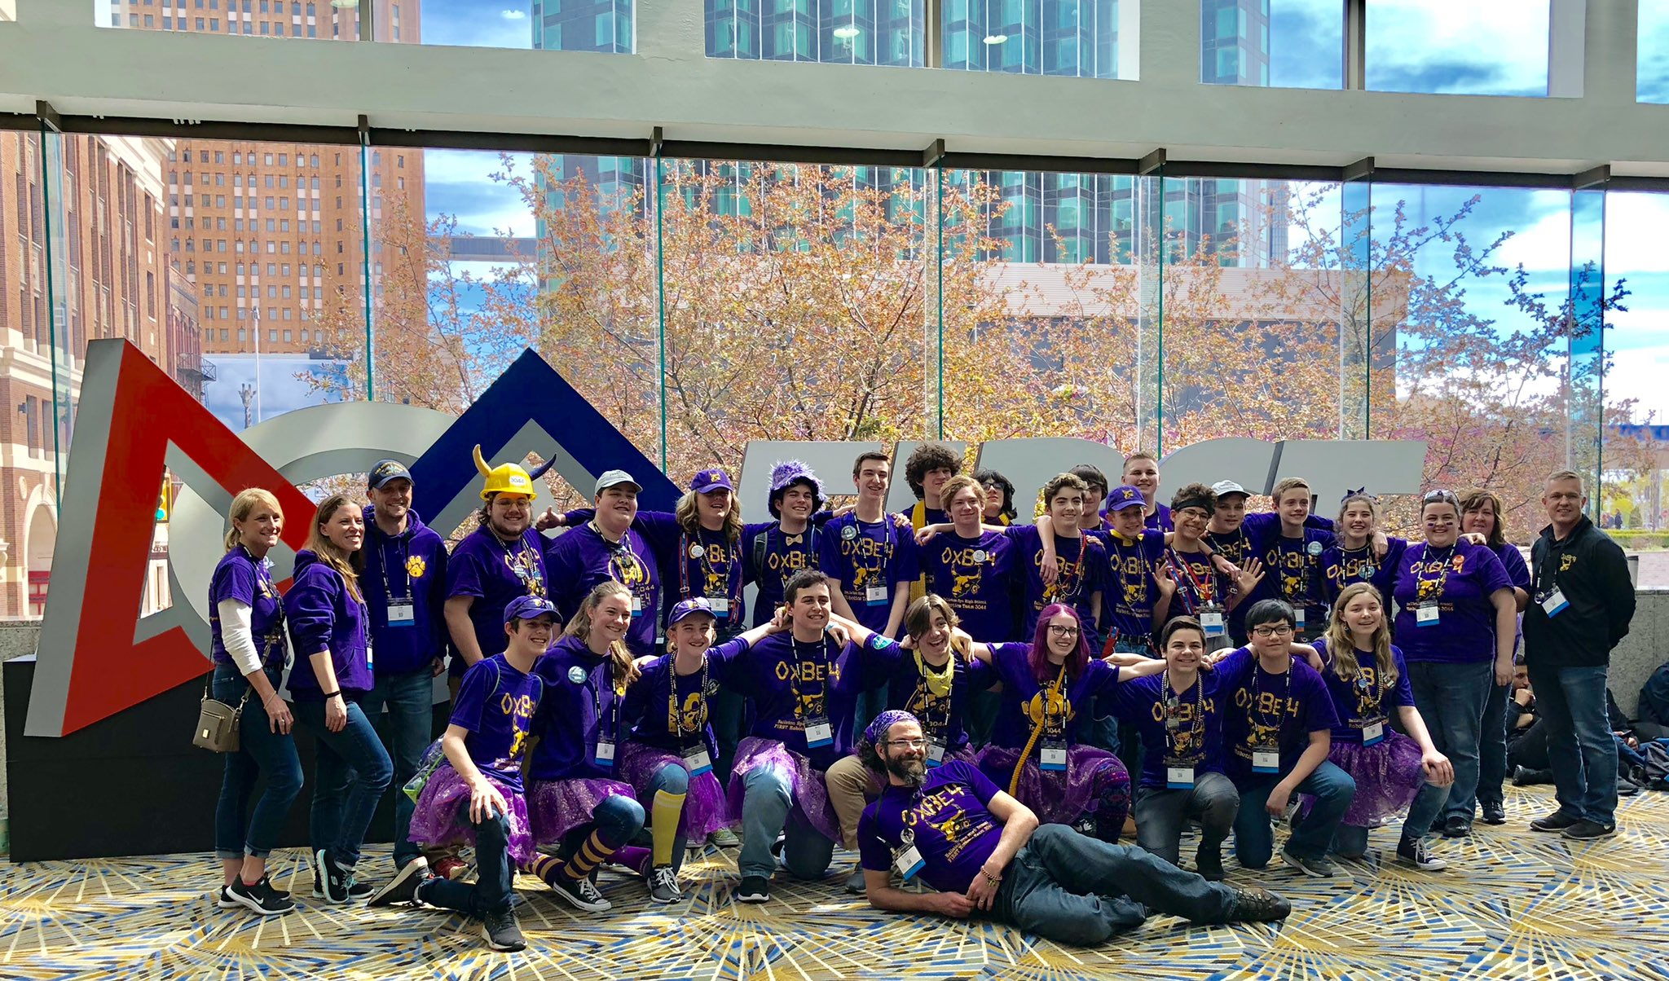
Who is FRC Team 3044?

Slide 4
Impact Award
Components:
Executive Summary
Essay
Presentation
Video
Notes:
Overview of this week’s schedule

Slide 5
Why should your team apply?
Helps you document your growth and accomplishments each year
Gives opportunity for more students to be involved
Focuses team on the real meaning of FIRST
Builds better partnership with your community which brings more support for the team

Slide 6
Getting started...
An Impact team meets year round
Start documenting:
Take pictures and videos
Keep a record of your activities: dates and hours
Collect articles/publications featuring your team
Compile a list of your alumni

Slide 7
Getting started...
Create your Impact Team:
Writers - executive summary and essay
Presenters - 7 minute presentation
Media/video editing - 1 to 3 minute video

Slide 8
Getting started...
Writing - Executive Summary
15 questions
Answer each question with a 500 character summary
Use numbers in place of words
Abbreviate if possible
Creatively answer the question to include as much information as possible

Slide 9
Getting started...
Writing - Essay
10,000 characters
Tell your story
Use a theme
Include specific figures and details

Slide 10
Getting started...
Presentation to Panel of 3 Judges
7 minute time limit
Select charismatic speakers
Use visuals
Include specific figures and details
Be passionate about what you doing and share your story with the judges

Slide 11
Getting started...
Video
1-3 minute time limit
Identify students that have editing knowledge
Use your best pictures and videos
Find free music that fits your theme
Start early - finding the right pictures and video clips and editing the material is time consuming
Make sure your video tells your amazing story

Slide 12
Suggestions...
Watch videos from winning teams
Read essays from winning teams
Research the award and use the FIRST website
Attend any Impact Exchange sessions
Ask other teams about their successes and failures
Believe that you are capable of winning this award

Slide 13
Opportunities for Outreach
Support a community event
Share your robot at community events
Mentor an FLL team
Host a summer camp
Talk to other schools about starting a FIRST team
...

Slide 14
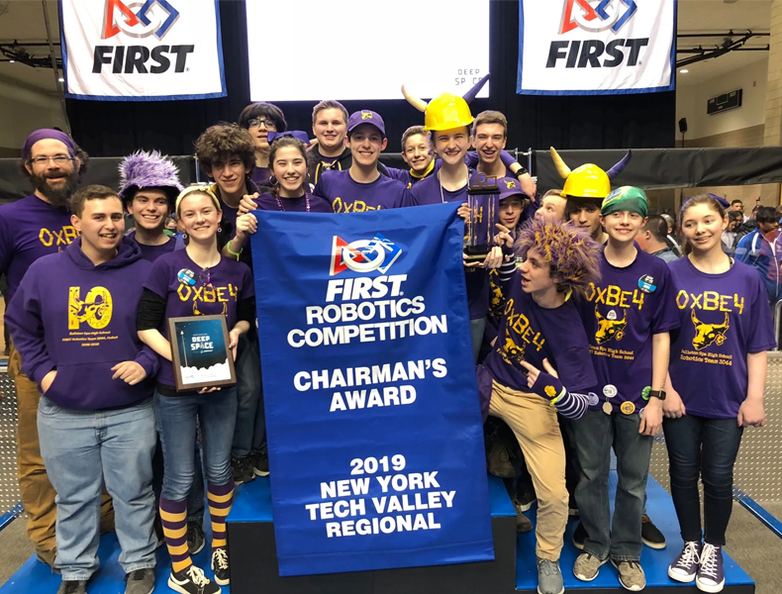
Questions...

