Slide 1
Chiaroscuro
The Interplay of Light and Darkness

Slide 3
“Man is divided in himself. As a result, the whole life of men, both individual and social, shows itself to be a struggle, and a dramatic one, between good and evil, between light and darkness.”
Gaudium et Spes, 13; CCC 1707

Slide 4
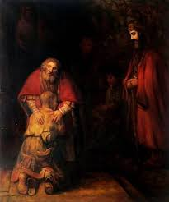
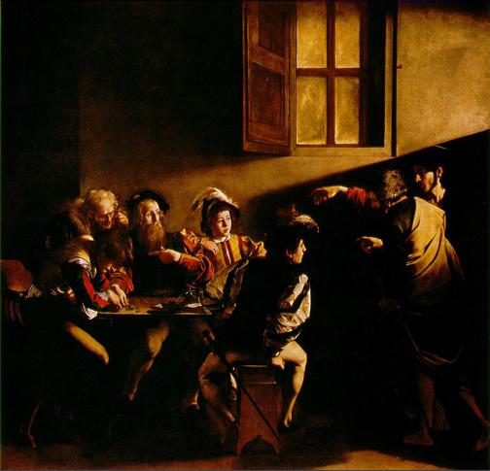
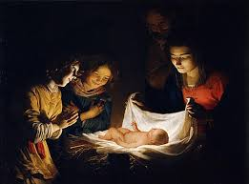
Chiaroscuro: the interplay of light and darkness

Slide 5
Peter
Then Peter got out of the boat and started walking toward Jesus across the water …
But as soon as he felt the force of the wind he took fright and began to sink.

Slide 6
Peter
You are Peter, and upon this rock I will build my Church.
Get thee behind me, Satan.

Slide 7
James & John
Jesus took Peter, James, and John his brother, and led them up a high mountain by themselves.
Grant that in your glory we may sit one at your right and the other at your left…

Slide 8
Romans 7
What I do, I do not understand.
For I do not do what I want, but I do what I hate.
The willing is ready at hand, but doing the good is not.
For I do not do the good I want, but I do the evil I do not want.
I take delight in the law of God, in my inner self, but I see in my members another principle at war with the law of my mind, taking me captive to the law of sin.

Slide 9
All who die in God's grace and friendship, but still imperfectly purified, are indeed assured of their eternal salvation; but after death they undergo purification, so as to achieve the holiness necessary to enter the joy of heaven.
Catechism of the Catholic Church, 1030

Slide 10
How does Jesus deal with the interplay of light and darkness?
How do you want him to deal with the interplay of light and darkness in you?
How do you deal with the interplay of light and darkness in others (whether it’s individuals or institutions)?

Slide 11
In a world characterized by the interplay of light and darkness: How are we called to bring Jesus into the world?

Slide 12
St. Thomas Aquinas
Yes …
and …
No!

Slide 14
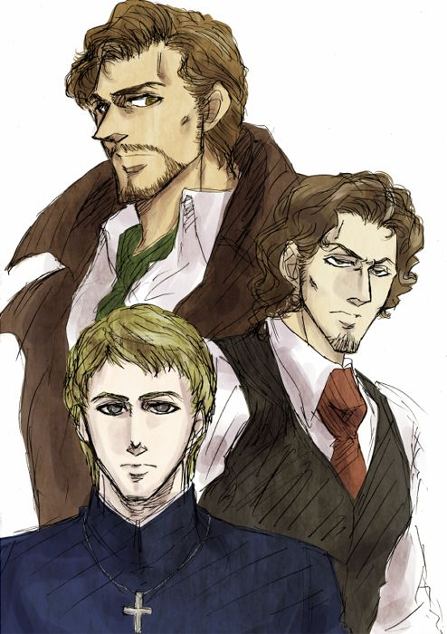
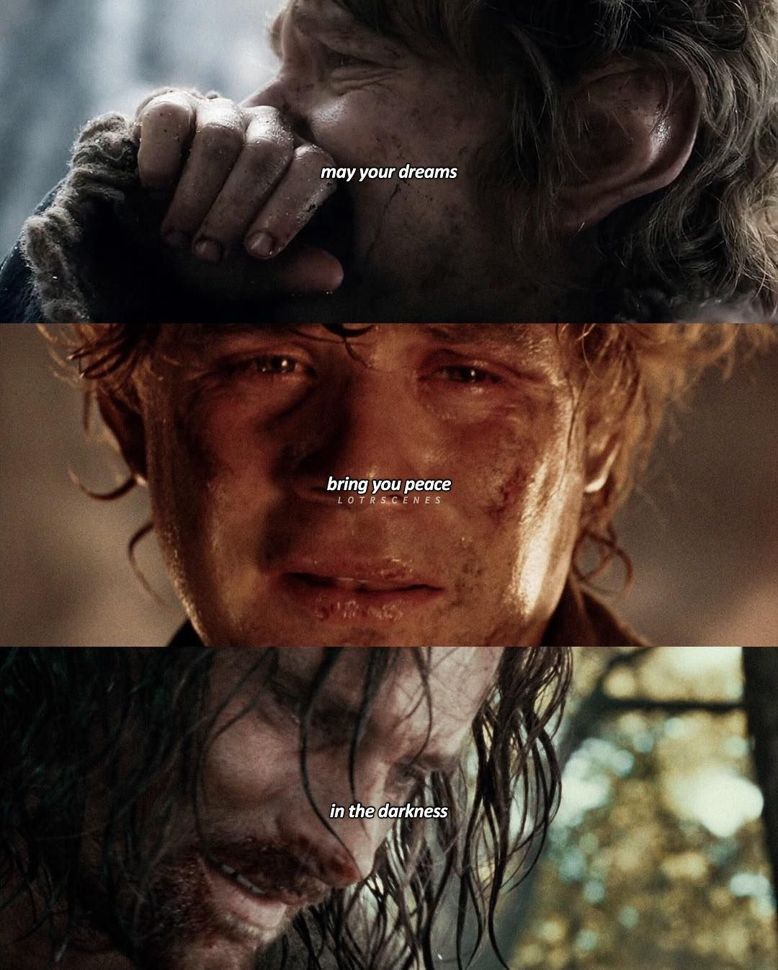
Reflect on:
Great Books
Great Movies
Our Own
Experience

