Slide 1

THE PURSUIT OF SIMPLICITY
Church Accounting Process Improvements

Slide 2
INTRODUCTION
Our church leaders are diligently working to inspire people to embrace God's purpose for their lives in service to others.
Our Churches are experiencing a period of dramatic change – attendance is recovering from COVID or still flat. For many churches, inflationary costs are impacting available resources.
Technology is continuing to bring new tools to our hands, but costs are escalating.
Knowledge workers are in high demand and it is getting harder to retain and replace them.
In the secular world, we see large companies keep growing through aggressive pursuit of efficiencies and use of new tools.
Accounting is necessary, but is a support to our ministries, not the focus of our ministries which serve others.
Given these conditions, how can we change things for the better?

Slide 3

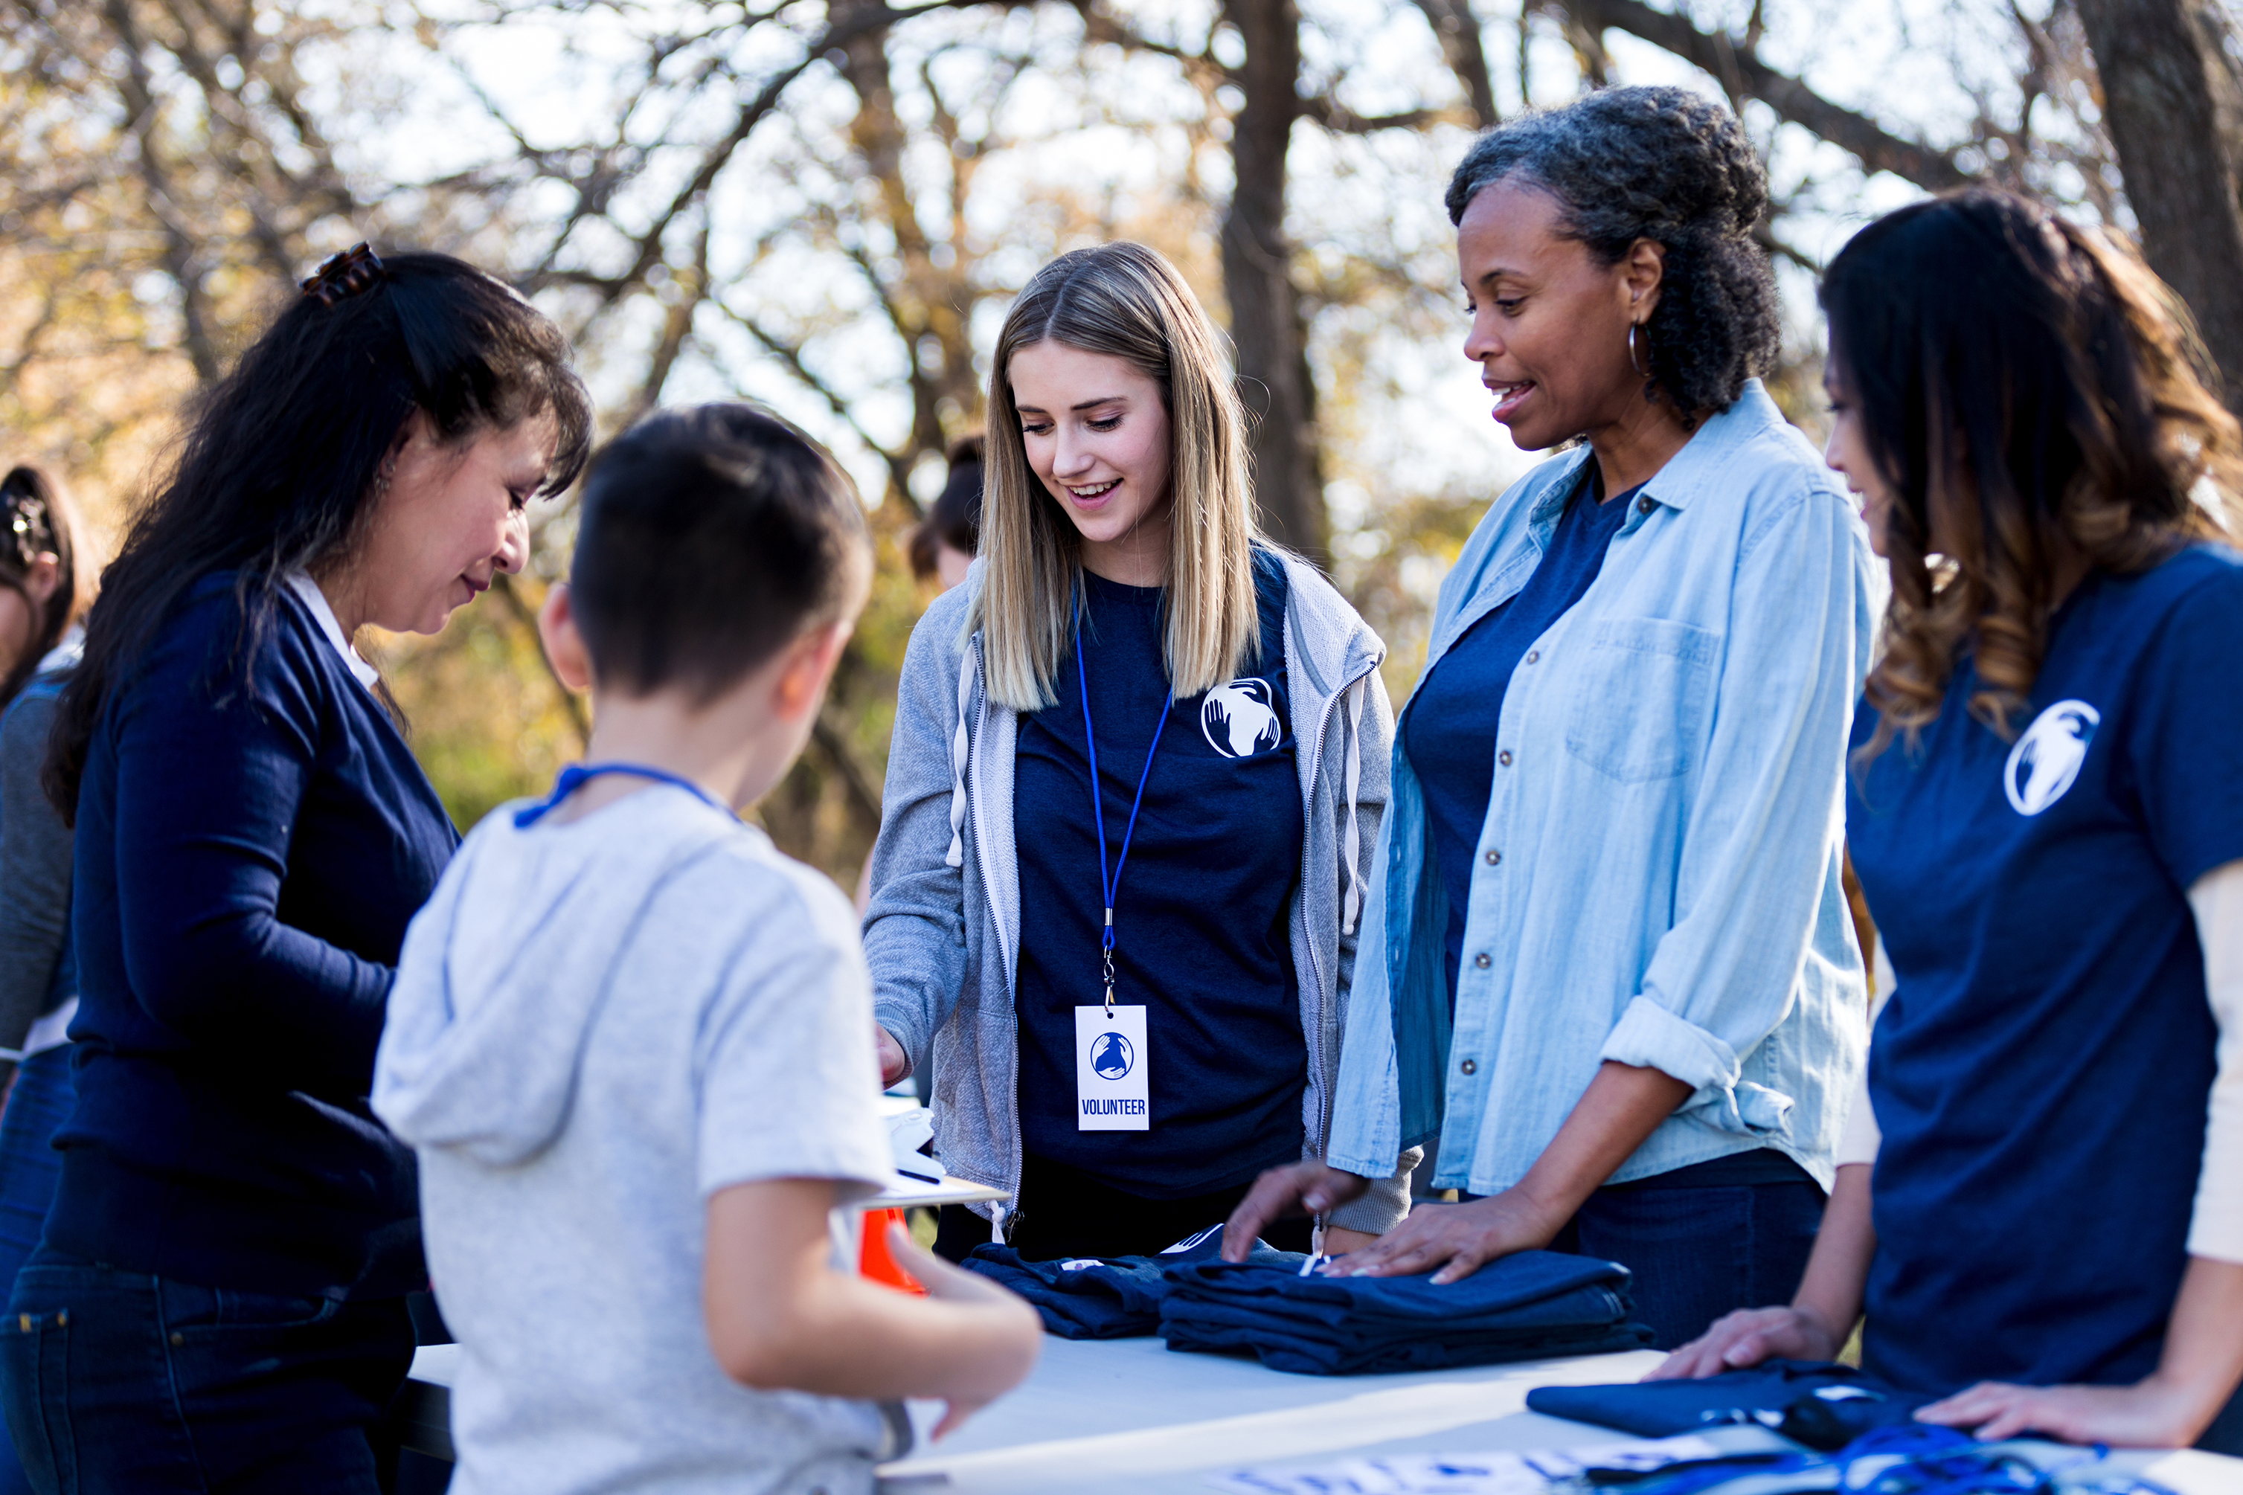


THE WAY TO
GET STARTED
IS TO QUIT TALKING AND BEGIN DOING.
Walt Disney

Slide 4


So, Let's consider change . . .
As Walt Disney pointed out, we need to take action to change our current status for the better.
Wisdom dictates that we consider our options and select the best path toward attaining our goals.
At the Southern Baptist of Texas Foundation, our mission is to serve the Church! We seek to bring useful concepts and services to church leaders and aid them in implementing useful change.
Our Accounting Services group can aid you in understanding the tools available and how to successfully implement them into your accounting process or we can provide out-sourced accounting services to do this work for you.

Slide 5
Emerging efficiencies
Simplified cloud-based accounting systems with integrations
Payables processing automation
Purchase card automation
QuickBooks Online has matured into a simple to use, but powerful accounting product. Many integrations exist to add useful tools to this platform. This product will meet the accounting need of most Churches and ministries
Sage Intacct is another cloud-based system that targets larger organizations. If you have complex consolidations, this is a strong tool to use.
Products like Bill.com, Ramp, and Airbase provide cloud-based solutions to process the payables approval/payment process for churches. This simplifies the "back office" work of most church accounting groups and it is very cost effective.
Tools like Divvy.com, Ramp and Brex provide Visa cards that they issue that allow a church to equip staff with cards, then capture their receipts through the app on their phone and code the expense. This eliminates the "paper chase" of receipts and makes this process simple and elegant.

Slide 6
Things to consider
Cost of Full-Time Accounting Personnel
Out-sourced Accounting Personnel
Salary (low end) $35,000/yr
Benefit costs (15-18% of salary) $6,300
Base Accounting personnel Cost $41,300
Benefits – Insightful individuals who can help in other areas
Negatives – Usually have excess time but can be hard to harness that time on other tasks
Competition in the labor market is causing the cost of these individuals to rise and to lower their availability
Systems can be designed to promote efficiency
Outsourced accountant spends half the time doing the same work
No human resource issues. Outsourced accounting team provides services each week with no time off/interruptions

Slide 7
RECENT CASE STUDY
Cost of Full-Time Accounting Personnel
Out-sourced Accounting Personnel
A church experienced an unexpected retirement of their financial assistant.
This employee was paid wages of $41K per year and had $8,200 in benefits and taxes, for a total cost of $49,027
SBTF was able to transition the church to QBO, implement Bill.com, and Divvy.com, as well as provide monthly accounting support for $30,000 per year.
This resulted in a savings of $19,000 per year, along with the other benefits of having shifted the normal HR burden (onboarding, benefit administration, payroll, etc.) that each staff member creates from the Church staff to the SBTF.

Slide 8
SUMMARY
Luke 14:28 (HCSB)
28 “For which of you, wanting to build a tower, doesn’t first sit down and calculate the cost to see if he has enough to complete it?29 Otherwise, after he has laid the foundation and cannot finish it, all the onlookers will begin to make fun of him, 30 saying, ‘This man started to build and wasn’t able to finish.’
It might not be the right season for you to implement a change in your accounting processes, but it is an excellent time to become aware of the changing environment.
Technology and innovation has greatly changed how Churches can operate their accounting systems and there are likely time and cost savings that can be realized over your existing methods.
Please reach out to SBTF to review your existing accounting process and explain if opportunities exist.

Slide 9

THANK
YOU
Curtis Boozer, DMin
Cboozer@sbtexasfoundation.com
sbtexasfoundation.com

