Slide 1
Maine Mine Stewardship Site Design Proposal
Presented by the Silver Plume Mountain Park Commission

Slide 2
Introduction
Who: Silver Plume Mountain Park Commission, along with the Town of Silver Plume and the Historic District Land Commission (HDPLC)
What: Design, Construction, and Implementation of a Stewardship Site Located at the Maine Mine Shaft, directly off the 730 Mine Road
When: Summer/Fall 2026
Where: Republican Mountain’s South Flank, West of Cherokee Gulch. If Traveling up the 730 Mine Road, Located West of the Fourth Switchback
Why: To Meet the Stewardship Goals Outlined in the Silver Plume Mountain Park Master Plan. Additionally, to Provide Hikers a Safe Place to Rest, to Provide Interpretive Signage for Visitors, and to Effectively Block Access to the Ruin Blacksmith Building Located on Site, Ensuring Public Safety and Protecting the Ruin from Further Damage

Slide 3
Silver Plume Mountain Park- Brief Overview
The Silver Plume Mountain Park (SPMP) surrounds the Town of Silver Plume on its north and south sides. The Mountain Park is divided into two distinct areas, separated by the I-70 corridor and the Town of Silver Plume itself.
Silver Plume Mountain Park South (SPMPS) is comprised of public land south of I-70, which was granted for public use through the Bureau of Land Management (BLM) Recreation and Public Purpose patent process. In 1988, the Town of Silver Plume and several other partners formed the Historic District Public Land Commission (HDPLC) in order to apply for the patents for the BLM lands within and adjacent to the Georgetown-Silver Plume National Historic Landmark District. Among other provisions, the patents were granted with the understanding that the lands will be used in perpetuity for the recreational purposes for which they were acquired.
Silver Plume Mountain Park North (SPMPN) is the area to the north I-70, encompassing a total acreage of 264.78 acres **SOON TO GROW!!**. These lands include 200.88 acres of Jack Pine Mining Claim lands, purchased by the Town of Silver Plume in 2023, as well as BLM lands transferred to the Town of Silver Plume and other donated land. SPMPN will be protected in perpetuity with a Conservation Easement held by the Colorado Historical Foundation. This park will be available to the public at no cost.

Slide 4
SPMP Ownership and Management
SPMPN is owned and managed by the Town of Silver Plume
Management and conservation of the SPMPN will be shared with the HDPLC
SPMPN is overseen by the CHF through a Conservation Easement
Guidance and recommendations regarding the management and use of the SPMP will be provided to the Town of Silver Plume from the Silver Plume Mountain Park Commission. The SPMP Commission was established by Ordinance as the official advisory Commission for the entire SPMP.
SPMP Commission Members: Martin Gitlin, Michael Frey, Chelsea Nihiser, Mark Morris, and Ryan Redfield. Term June 2025-June 2027

Slide 5
Goals and Values of the SPMP
Goals and values of the SPMP and the SPMP Commission are centered around protecting and preserving the natural and man-made attributes of the SPMP.
The SPMP Master Plan identifies five goals that are pivotal to this vision. They are:
Conserve Key Cultural Resources
Conserve the Historical Landscape
Protect Wildlife
Provide Additional Interpretive Opportunities
Provide Additional Recreation Opportunities

Slide 6
Preservation and Stabilization
Preservation of the cultural resources in the SPMPN varies depending on site condition, accessibility, and use.
All cultural resources have been inventoried and separated into three categories to identify what resources are to be maintained and what resources are allowed to naturally deteriorate. These categories are:
Interpretive Sites- These sites are intended to receive the most visitors. Interpretive sites should be preserved and maintained in the condition as noted in the deed of the CE
Stewardship Sites- These sites are intended to only be seen but not to be accessed by visitors. Stabilization methods should be used to preserve the standing structures/equipment and limit the visual impact
Ruins- These sites are generally located at inaccessible points where preservation efforts are hindered. Ruins are allowed to naturally continue to degrade

Slide 7
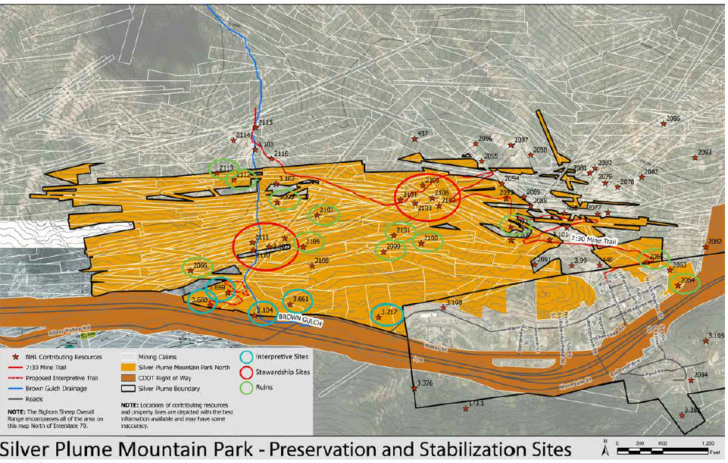
Cultural Resource Inventory

Slide 8
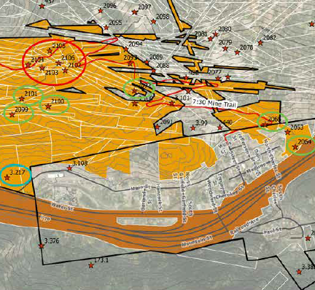
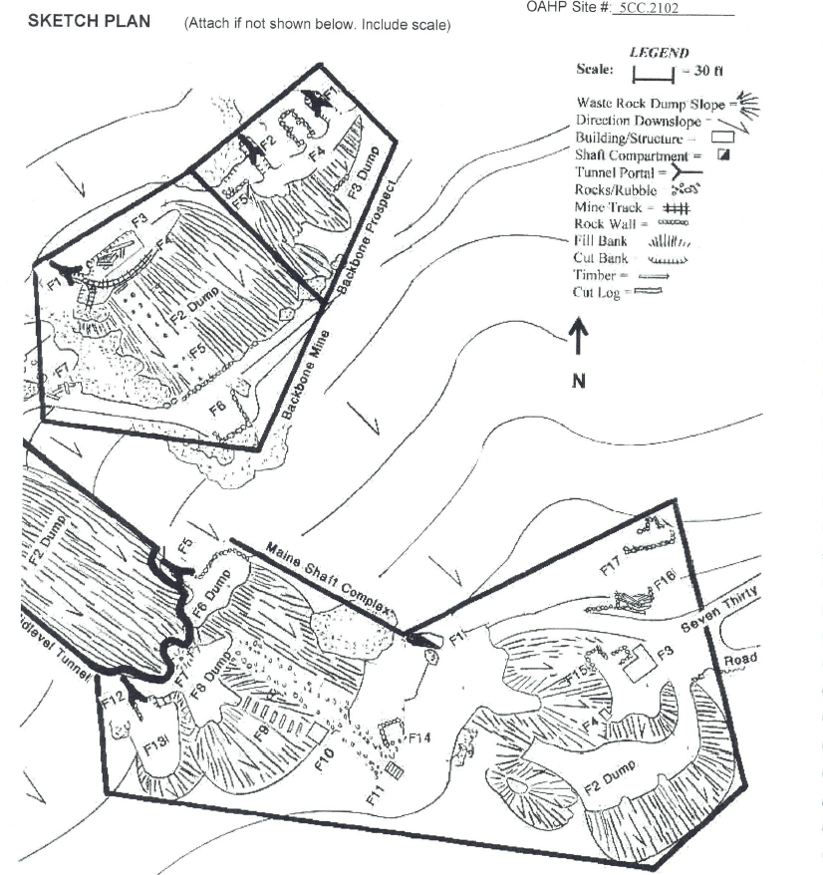
Maine Mine Stewardship Site

Slide 9
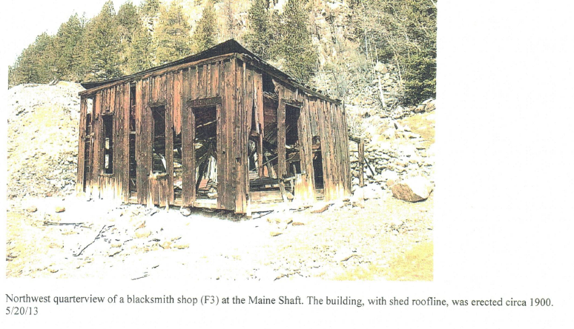
Goals of the Maine Mine Stewardship Site
To Meet the Stewardship Goals Outlined in the Silver Plume Mountain Park Master Plan.
Provide Hikers a Safe Place to Rest
Provide Interpretive Signage for Visitors
Effectively Block Access to the Ruin Blacksmith Building Located on Site, Ensuring Public Safety and Protecting the Ruin from Further Damage

Slide 10
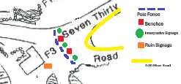
Scope of Work
Install Pole Fence to separate Stewardship Site from the 7:30 Mine Road
Build 1-2 benches to provide an area for hikers to rest
Install 2-3 Interpretive Node signs, detailing Historical Significance of Maine Mine
Install 2-3 “Danger, Ruin” signage, designating the site off limits past the pole fence, and making the condition of the Blacksmith shop clear to visitors

Slide 11
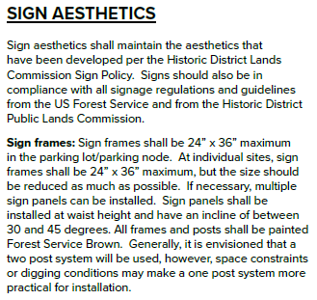
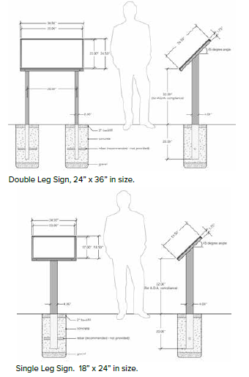
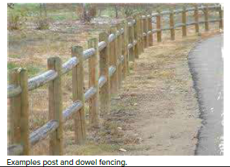
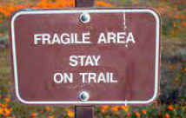

Design Elements

Slide 12
Maine Mine Site “Interpretive” Opportunities
Maine Shaft Site (2102) is a complex resource involving:
two tunnels,
two shafts,
remnants of their surface plants,
two waste rock dumps,
a blacksmith building,
an ore chute and bin,
and four boardinghouse platforms.
*** Not all of these features can be seen from the stewardship site***

Slide 13
Interpretive Options-Blacksmith Shop

Slide 14
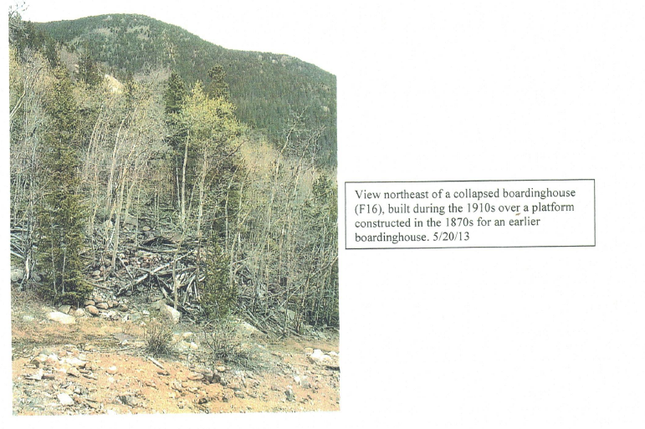
Interpretive Options- Boarding House

Slide 15
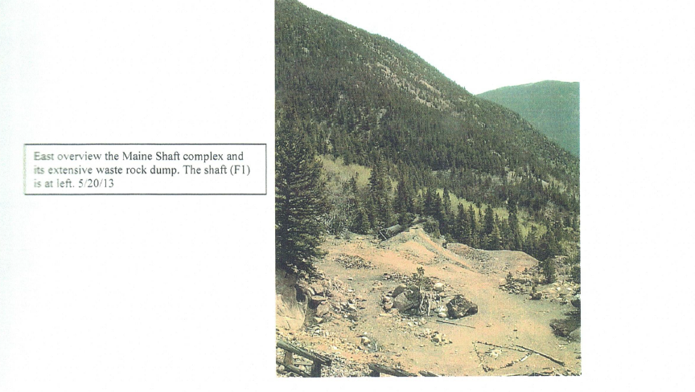
Interpretive Options-Maine Shaft

Slide 16
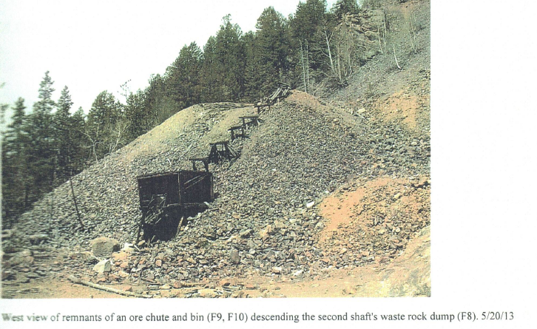
Interpretive Options-Ore Chute and Bin **Out of Sight from Stewardship Site**

Slide 17
BRIEF Historical Context and Significance
This group of workings was a principal point of production for the greater Maine Mine during the 1870’s and 1880’s.
Maine Mine property was consolidated with the Pelican Mine in the 1880’s
Shafts (not tunnels) were worked again around 1905 and 1915
The Maine Shaft (F1) had its own surface plant consisting of a shaft house, steam hoisting system, and ore car track. None remain, however the foundation and bricks from the boiler are still evident.
Maine Shaft Waste Rock dump was used for sorting low-grade ore around 1905
Frame Blacksmith shop still stands, to the east of the Maine Shaft Waste Rock Dump, dated circa 1905
Privy pit (F4) built into the Waste Rock for surface workers. Pit is a plank box, intended to be buried with the waste rock. The box was never buried and was left completely exposed

Slide 18
Conclusion
All work to be done by the SPMP Commission, after design approval from TOSP, HDPLC, and CHF
Labor will be volunteer based. SPMP Commission will source all material, build fence/benches, and install signage. Assistance from HDPLC finalizing the design of, and installation of, interpretive signage.
Funding for signage will come from TOSP. TOSP has specific funding for stewardship within the SPMP. SPMP Commission will request donations from vendors for bench/fence lumber if need be.
All Interpretive Node Signage information to be provided to Clear Creek County Library Archivist for review of historical accuracy.
Provided approval is granted from all management authorities, work will commence as early as possible, most likely Spring/Summer 2026. Project to be concluded Fall 2026.

