Slide 1
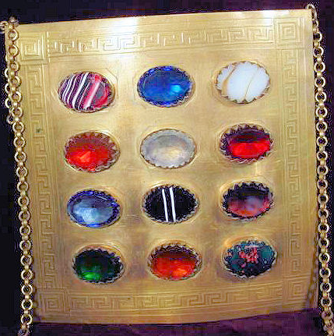
High Priest BreastPlate
Companion Andrew D. White #36
(several sources and special thanks to PMEGHP D. Murray #3)

Slide 2
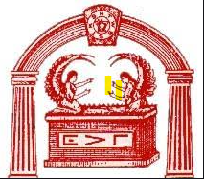
Priestly Breastplate
The priestly breastplate (Hebrew: חֹשֶׁן‎ ẖošen) was a sacred breastplate worn by the High Priest of the Israelites, according to the Book of Exodus. In the biblical account, the breastplate is sometimes termed the breastplate of judgment, because the Urim and Thummim were placed within it. These stones were, at times, used to determine God's will in a particular situation (see Exodus 28:30).

Slide 3
Hebrew Bible
According to the description in Exodus, this breastplate was attached to the tunic-like garment known as an ephod by gold chains/cords tied to the gold rings on the ephod's shoulder straps, and by blue ribbon tied to the gold rings at the belt of the ephod. The biblical description states that the breastplate was also to be made from the same material as the Ephod—embroidery of 3 colors of dyed wool and linen—and was to be ​¹⁄₃ of a cubit squared, two layers thick, and with four rows of three engraved gems embedded in gold settings upon it, one setting for each stone. The description states that the square breastplate was to be formed from one rectangular piece of cloth—​¹⁄₃ of a cubit by ​²⁄₃ of a cubit, folded so that it formed a pouch to contain the Urim and Thummim

Slide 4
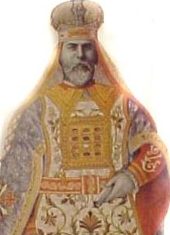
High Priest BreastPlate
This Breastplate was worn by a High Priest who represented Joshua, or Jeshua, who was the son of Josedech, and the High Priest of the Jews when they returned from Babylonian exile. He was seated in the East and clothed in the apparel of the ancient High Priest of the Jews. He wore a robe of blue, purple, scarlet, and white linen, (think of the vails) and was decorated with a breastplate and miter. On the front of the miter was inscribed the words, Holiness to the Lord

Slide 5
High Priest BreastPlate
The stones in this breastplate represent the Twelve Tribes of Israel. This dress, as the Rabbis describe it, consisted of eight parts, namely, the breastplate, the ephod, with its curious girdle, the broidered coat, the robe of the ephod, the miter, and the girdle. The vestments of a High Priest of a Royal Arch Chapter are intended to represent

Slide 6
High Priest BreastPlate
Upon the breastplate were set four rows of precious stones, three in each row, and upon them were engraved the names of the twelve tribes, and as the great Jewish historian Josephus adds, "in the order of their birth", but we are not told which stone to which tribe. So which stones were used? This is a 2,000 year old question. Although the Hebrew names of the 12 stones are not in question, their translation is, and despite numerous attempts, the various translators cannot, to date, agree to a single translation. G. W. Kunz in "The Curious Lore of Precious Stones" says "In the Midrash Bemidbar, the Rabbinical commentary on numbers, the tribes are given in their order, with the stones appropriate to each and the color of the tribal standard pitched in the desert camp, this color corresponding in each case with that of the tribal stone."

Slide 7
In the Midrash Rabba it states the colors of the stones:

Slide 8
In the Midrash Rabba it states the colors of the stones
1. Odem- red (Reuvain).
2. Pitida - green (Shimeon).
3. Barekes - one third white, one third black and one third red (Levi).
4. Nofech - sky blue (Yehudah).
5. Sapir - bluish black (Yisaschar).
6. Yahalom - white (Zevulun).
7. Leshem - same color as Sapir (Dan).
8. Shevo - a mixture of black and white (Naftali).
9. Achlama - wine red (Gad).
10. Tarshish - same color as Yahalom (Asher).
11. Shoham - black (Yosef).
12. Yashfeh - was a multicolored stone (Binyamin).
The stones were in the following order:
3 2 1
6 5 4
9 8 7
12 11 10

Slide 9
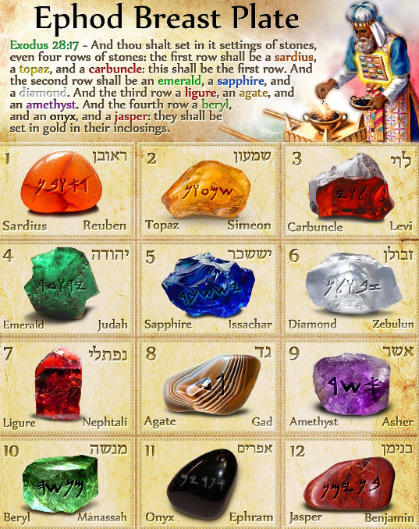
Ephod Breast plate
The first row contains the following precious stones:
Carbuncle: This is a reddish looking precious stone that looks like burning coal.
Topaz: This is a yellow or yellow-green translucent precious stone.
Sardius: Also called carnelian, this is a blood-red or brownish-red stone.
The second row contains the following precious stones:
Diamond: This is usually clear or white as diamonds were mostly uncut as at then.
Sapphire: This is a stone colored in a saturated shade of blue, but it might not have been an actual sapphire stone as the stone was hardly used or known in those days.
Emerald: This might not have been an exact emerald stone, as it was described as a green stone.
The third row contains the following stones:
Amethyst: This is a purple stone with the literal meaning of ‘not intoxicating,’ and it was thought that it could stop one from becoming intoxicated.
Agate: These are sky blue stones that were commonly used in Assyria and Egypt as talismans.
Ligure: This is a pale yellowish mineral.
The fourth row contains the following stones:
Jasper: This is a red stone that was sometimes confused as a ruby.
Onyx: This is an opaque banded stone.
Beryl: This is a blue-green stone that looked like the color of the sea

Slide 10
In the Bible we learn that
And thou shalt set in it settings of stones, even four rows of stones: the first row shall be a sardius, a topaz, and a carbuncle: this shall be the first row.
And the second row shall be an emerald, a sapphire, and a diamond. And the third row a ligure, an agate, and an amethyst. And the fourth row a beryl, and an onyx, and a jasper; they shall be set in gold in their enclosings.
And the stones shall be with the names of the children of Israel, twelve, according to their names, like the engravings on a signet; every one with his name shall they be according to the twelve tribes....
And Aaron shall bear the names of the children of Israel in the breastplate of judgement upon his heart, when he goeth in unto the holy place, for a memorial before the Lord continually."

Slide 11
The Urim and Thummim
The breastplate was actually made of two pieces, which formed a sort of purse, or bag, in which also was kept the two sacred stones, named the Urim (representing light and excellence) and the Thummim (representing perfection and completion). These stones were some divinely appointed instruments by which the High Priest inquired of God about matters concerning the welfare of the Children of Israel. The Bible makes several references to these miraculous stones, but not anything physical, like the shape or size.

Slide 12
The Urim and Thummim
They were probably two jewels. When someone had to make an important decision, the request was made known to the high priest. He would stand before the lampstand near the altar, holding the Urim in one hand and the Thummin in the other. As the light from the candle reflected from the Urim and the Thummin onto the stones of the Breastplate, this flash of light provided up to 24 combinations (2 x 12). Since there are 22 letters in the Hebrew alphabet, the flashes of light could produce strings of letters. It was said that God breathed through the wind, which in turn causes the veil to move, permitting a breeze to flicker the flames in the Lampstand to momentarily alter the angle of direction of the light onto the Urim and Thummin, and thence to the Breastplate. Thus God was able to communicate directly, but not audibly, to the high priest and answer the enquiry.

Slide 13
12 jewels in the New Testament
12 jewels in the New Testament
In the New Testament Book of Revelation is the description of a city wall, with each layer of stones in the wall being from a different material; in the original Koine Greek, the layers are given as iaspis, sapphiros, chalcedon, smaragdos, sardonyx, sardion, chrysolithos, beryllos, topazion, chrysoprason, yacinthos, amethystos. This list appears to be based on the Septuagint's version of the list of jewels in the Breastplate – if the top half of the breastplate was rotated by 180 degrees, and the bottom half turned upside down, with Onchion additionally swapping places with Topazion, the lists become extremely similar; there are only four differences:
Onchion (literally onyx) has become sardonyx (red onyx)
Anthrax has become chalcedon (literally meaning chalcedony, of which the red variety is the most common). Anthrax literally means coal, presumably meaning the red colour of burning coal.
Ligurios has become chrysoprason. Scholars suspect that ligurios was a pale yellowish mineral, and although chrysoprase now refers to a specific gemstone which is generally apple-green in colour, in earlier times it referred to gems of a yellowish leek-green, such as peridot; chrysoprase literally means golden leek.
Achates (agate) has been replaced by yacinthos (jacinth). According to classical rabbinical literature, the specific agate was of a sky-blue colour, and though jacinth now refers to a red-tinted clear gem, this was not the case at the time the Book of Revelation was written, and at that time jacinth appears to have referred to a bluish gem; Pliny describes jacinth as a dull and blueish amethyst, while Solinus describes it as a clear blue tinted gem – the modern sapphire.

Slide 14
Pattern
Whether there is any pattern to the choice of gemstones depends on their identity. Taking the majority view of scholars in regard to the identity of the gems, and including the implication from the Book of Revelation that the onyx at the end of the fourth row was a sardonyx, there are four colours – red, green, yellow, and blue – each represented by a clear gem (red – carbuncle, green – heliodor, yellow – chrysolite, blue – amethyst), an opaque gem (red – carnelian/red jasper, green – green jasper, yellow – yellow jasper/yellow serpentine, blue – lapis lazuli), and a striped gem (red – sardonyx, green – malachite, yellow – pale golden agate, blue – sky-blue agate). The four colours of red, green, yellow, and blue, are the first four colours (apart from black and white) distinguished by languages, and are distinguished in all cultures with at least six colour distinctions (the other two being black and white). These colours roughly correspond to the sensitivities of the retinal ganglion cells. (The retinal ganglia process colour by positioning it within a blue to yellow range, and separately positioning it within a red to green range.

Slide 15
Fraternally shared, Companion Andrew D. White #36

