Slide 9
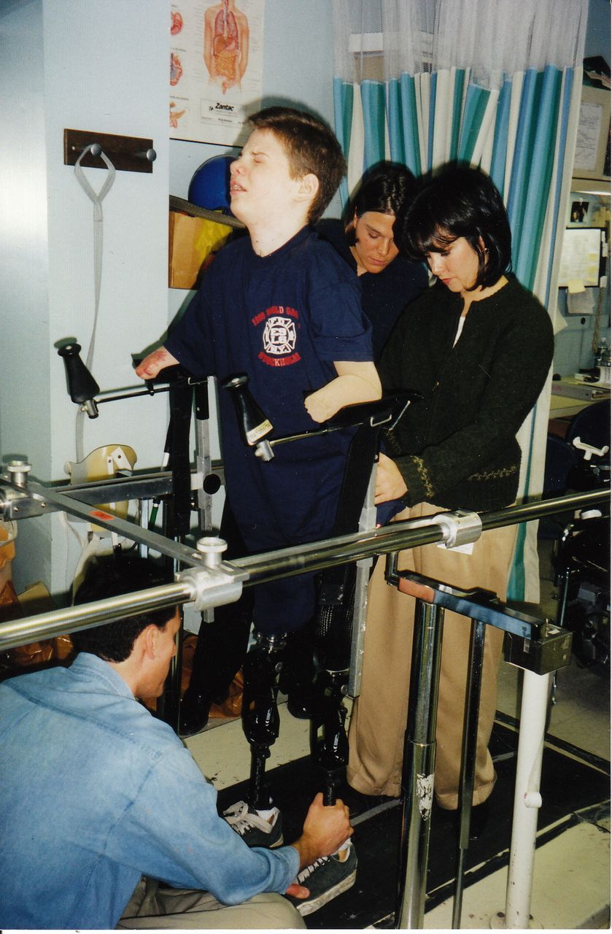

Slide 10
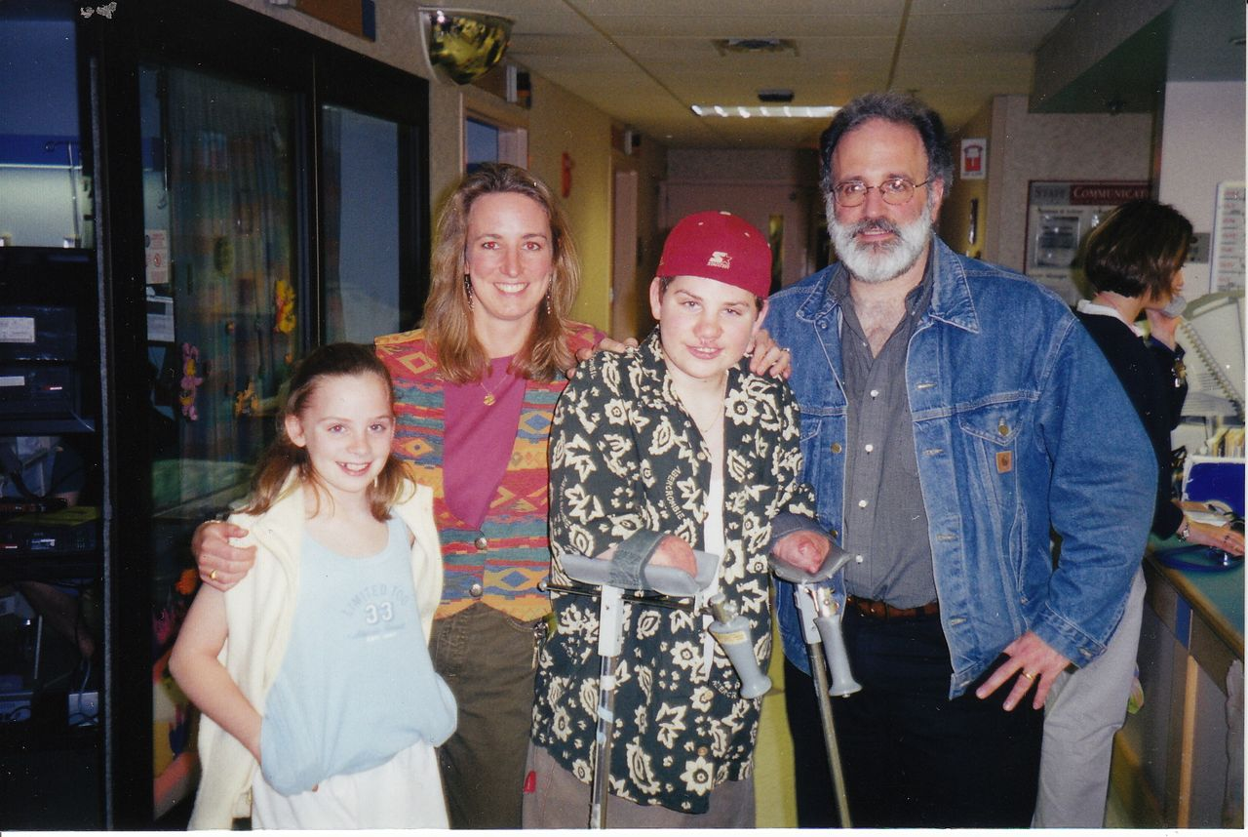

Slide 11
WHY IS THE VACCINE IMPORTANT?
- FAST ACTING, AGGRESSIVE DISEASE
-MASKS ITSELF AS THE FLU
-OVERWHELMS MEDICAL STAFF WITH LITTLE TIME TO ACT
-VERY UNCOMMON NAME IN MANY HOUSEHOLDS

Slide 13
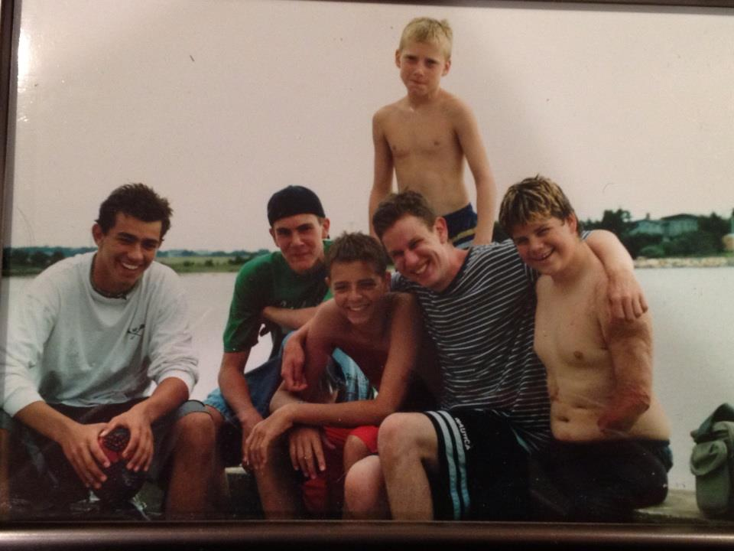

Slide 16
