Slide 9
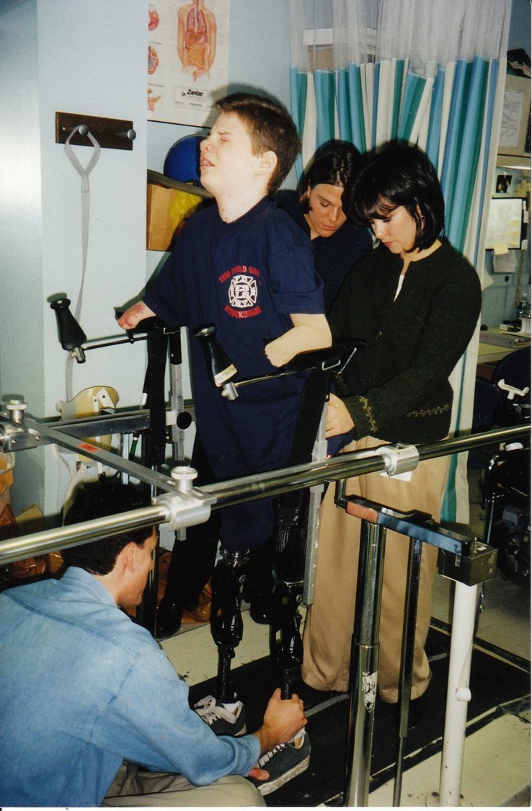

Slide 12
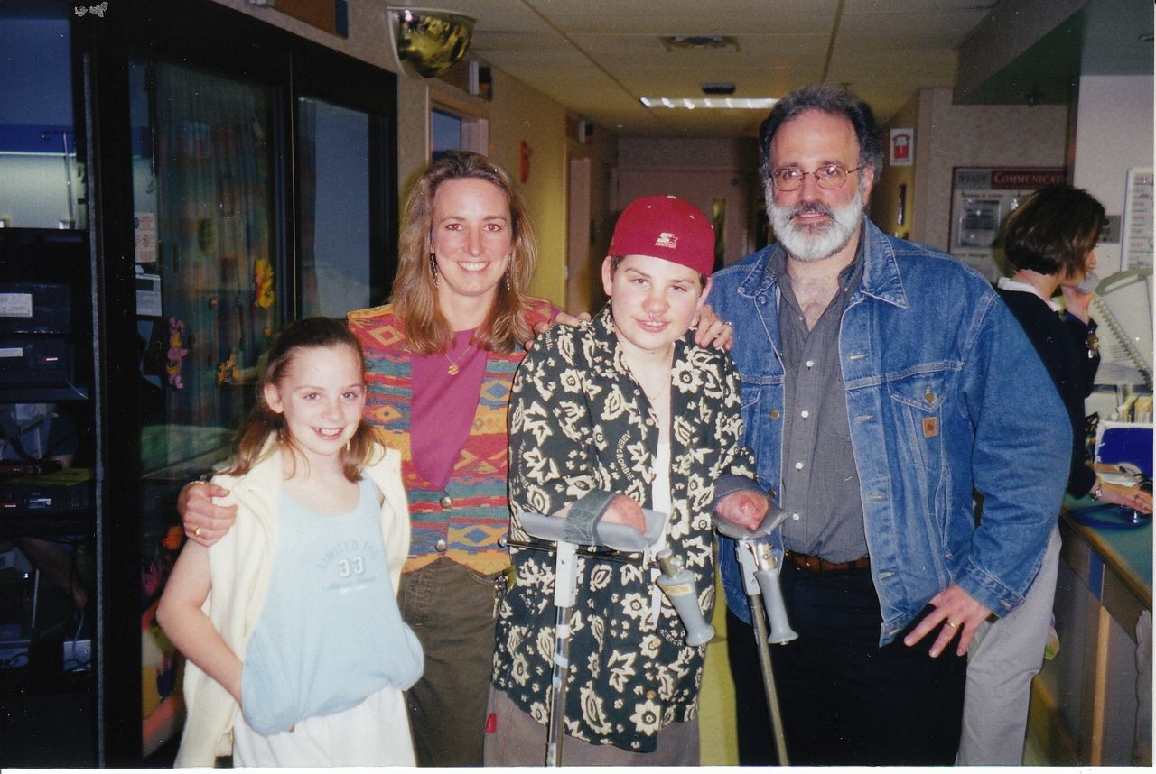

Slide 13
WHY IS THIS VACCINE IMPORTANT?
- FAST ACTING, AGGRESSIVE DISEASE
-MASKS ITSELF AS THE FLU
-OVERWHELMS MEDICAL STAFF WITH LITTLE TIME TO ACT
-VERY UNCOMMON NAME IN MANY HOUSEHOLDS

Slide 15
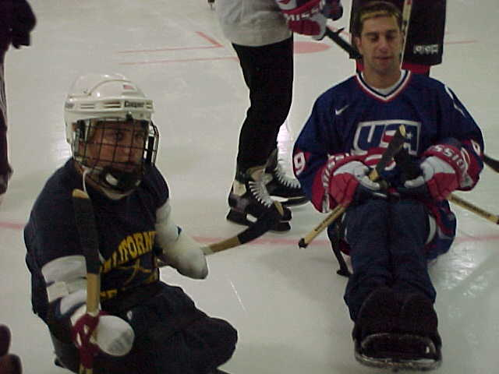

Slide 17
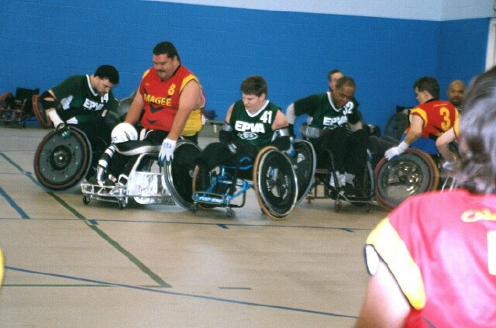

Slide 25
