Slide 1
Overview of Adolescent Immunization Schedule Ages 11 – 18 Years of Age, Including Disease State Information and Vaccinations
Nadine Miller RN, MS, BSN
School Nurses Organization of Arizona (SNOA) President
Jason McCanless, PharmD
Medical Science Liaison
GlaxoSmithKline Vaccines
June 7, 2021
Notes:
**Note: Product brand names can appear on the title slide, but generic names/abbreviations will be used throughout the presentation.

Slide 2
This presentation on an Overview of Adolescent Immunization Schedule Ages 11 – 18 Years of Age, Including Disease State Information and Vaccinations was created at the request of Nadine Miller. It may contain off-label or pre-approval information. This is not a sales, marketing, or promotional presentation.
Notes:
Master Example for Non-Promotional Disclaimer Slide:
This presentation on the mechanism of action, effectiveness, and safety for GSK Product was created at the request of Dr. John Doe, MD. It may contain off label or pre-approval information. This is not a sales, marketing, or promotional presentation.

Slide 3
Agenda
Review of Vaccine Preventable Diseases for Children and Adolescents Ages 11-18 Years Old
ACIP/CDC Recommendations
Brief overview of Diseases for Vaccine Preventable Disease – Ages 11 -18 Years Based on ACIP Recommendations
Influenza
Tetanus, diphtheria, & acellular pertussis (Tdap: ≥7 yrs)
Human papillomavirus (HPV)
Meningococcal Disease (Serogroups ACWY and B)

Slide 4
Recommended Child and Adolescent Immunization Schedule for Ages 18 Years or Younger, United States, 2021

Slide 5
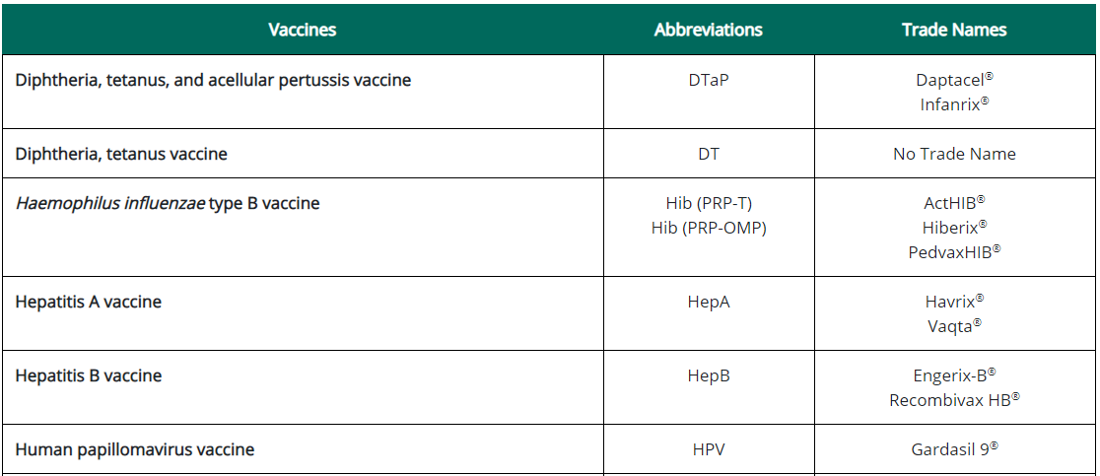
Recommended Child and Adolescent Immunization Schedule for Ages 18 Years or Younger, United States, 2021
Vaccines in the Child and Adolescent Immunization Schedule*:
*Administer recommended vaccines if immunization history is incomplete or unknown. Do not restart or add doses to vaccine series for extended intervals between doses. When a vaccine is not administered at the recommended age, administer at a subsequent visit. The use of trade names is for identification purposes only and does not imply endorsement by the ACIP or CDC
Centers for Disease Control and Prevention. Recommended Child and Adolescent Immunization for Ages 18 Years or Younger, US, 2021. Available at 2021 Recommended Child and Adolescent Immunization Schedule (cdc.gov). Accessed February 13, 2021
.

Slide 6
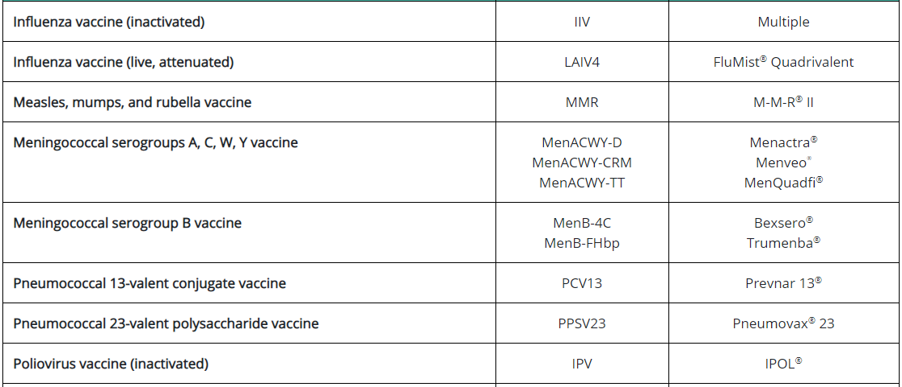
Recommended Child and Adolescent Immunization Schedule for Ages 18 Years or Younger, United States, 2021
Vaccines in the Child and Adolescent Immunization Schedule – Cont.:*
*Administer recommended vaccines if immunization history is incomplete or unknown. Do not restart or add doses to vaccine series for extended intervals between doses. When a vaccine is not administered at the recommended age, administer at a subsequent visit. The use of trade names is for identification purposes only and does not imply endorsement by the ACIP or CDC
Centers for Disease Control and Prevention. Recommended Child and Adolescent Immunization for Ages 18 Years or Younger, US, 2021. Available at 2021 Recommended Child and Adolescent Immunization Schedule (cdc.gov) Accessed February 13, 2021
.

Slide 7
Recommended Child and Adolescent Immunization Schedule for Ages 18 Years or Younger, United States, 2021
Vaccines in the Child and Adolescent Immunization Schedule – Cont.:*
*Administer recommended vaccines if immunization history is incomplete or unknown. Do not restart or add doses to vaccine series for extended intervals between doses. When a vaccine is not administered at the recommended age, administer at a subsequent visit. The use of trade names is for identification purposes only and does not imply endorsement by the ACIP or CDC
Centers for Disease Control and Prevention. Recommended Child and Adolescent Immunization for Ages 18 Years or Younger, US, 2021. Available at 2021 Recommended Child and Adolescent Immunization Schedule (cdc.gov) Accessed February 13, 2021
.

Slide 8
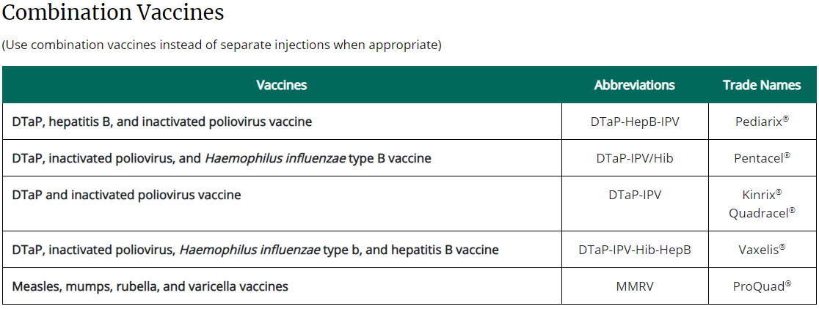
Recommended Child and Adolescent Immunization Schedule for Ages 18 Years or Younger, United States, 2021
Vaccines in the Child and Adolescent Immunization Schedule – Cont.:*
*Administer recommended vaccines if immunization history is incomplete or unknown. Do not restart or add doses to vaccine series for extended intervals between doses. When a vaccine is not administered at the recommended age, administer at a subsequent visit. The use of trade names is for identification purposes only and does not imply endorsement by the ACIP or CDC
Centers for Disease Control and Prevention. Recommended Child and Adolescent Immunization for Ages 18 Years or Younger, US, 2021. Available at 2021 Recommended Child and Adolescent Immunization Schedule (cdc.gov). Accessed February 13, 2021
.

Slide 9
Table 1: Recommended Child and Adolescent Immunization Schedule for Ages 18 Years or Younger, US, 2021, BY AGE
Centers for Disease Control and Prevention. Recommended Child and Adolescent Immunization for Ages 18 Years or Younger, US, 2021. Available at https://www.cdc.gov/vaccines/schedules/downloads/child/0-18yrs-child-combined-schedule.pdf. Accessed February 13, 2021
.

Slide 10
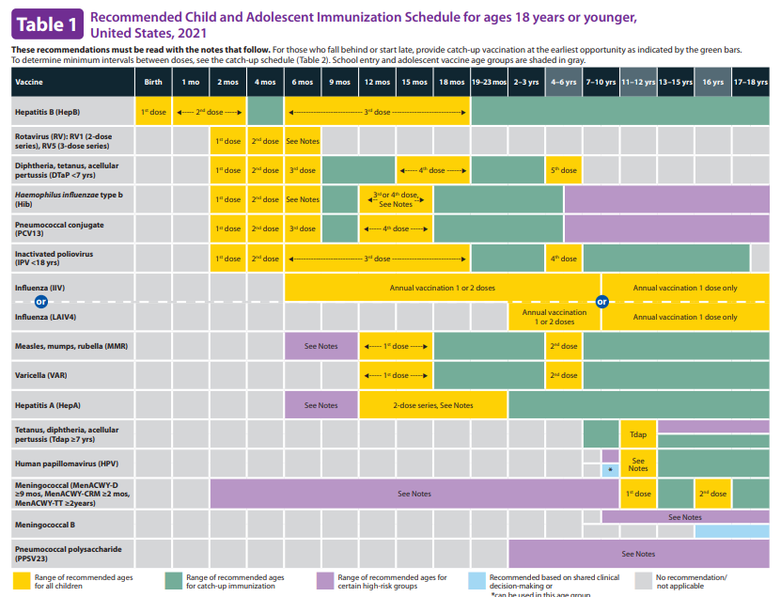
Centers for Disease Control and Prevention. Recommended Child and Adolescent Immunization for Ages 18 Years or Younger, US, 2021. Available at https://www.cdc.gov/vaccines/schedules/downloads/child/0-18yrs-child-combined-schedule.pdf. Accessed February 13, 2021
.

Slide 11
Centers for Disease Control and Prevention. Recommended Child and Adolescent Immunization for Ages 18 Years or Younger, US, 2021. Available at https://www.cdc.gov/vaccines/schedules/downloads/child/0-18yrs-child-combined-schedule.pdf. Accessed February 13, 2021
.

Slide 13
Influenza
Notes:
Script
We’ve reviewed meningococcal disease and the vaccines available to help prevent it. Now let’s move to a deep dive into how meningococcal vaccines are recommended to be used in the US. In this next section I will walk you through the ACIP recommendations for both MenACWY and Men B vaccines. They are complex and not the same as each other, but by the end, you will feel much more familiar with all of them.

Slide 14
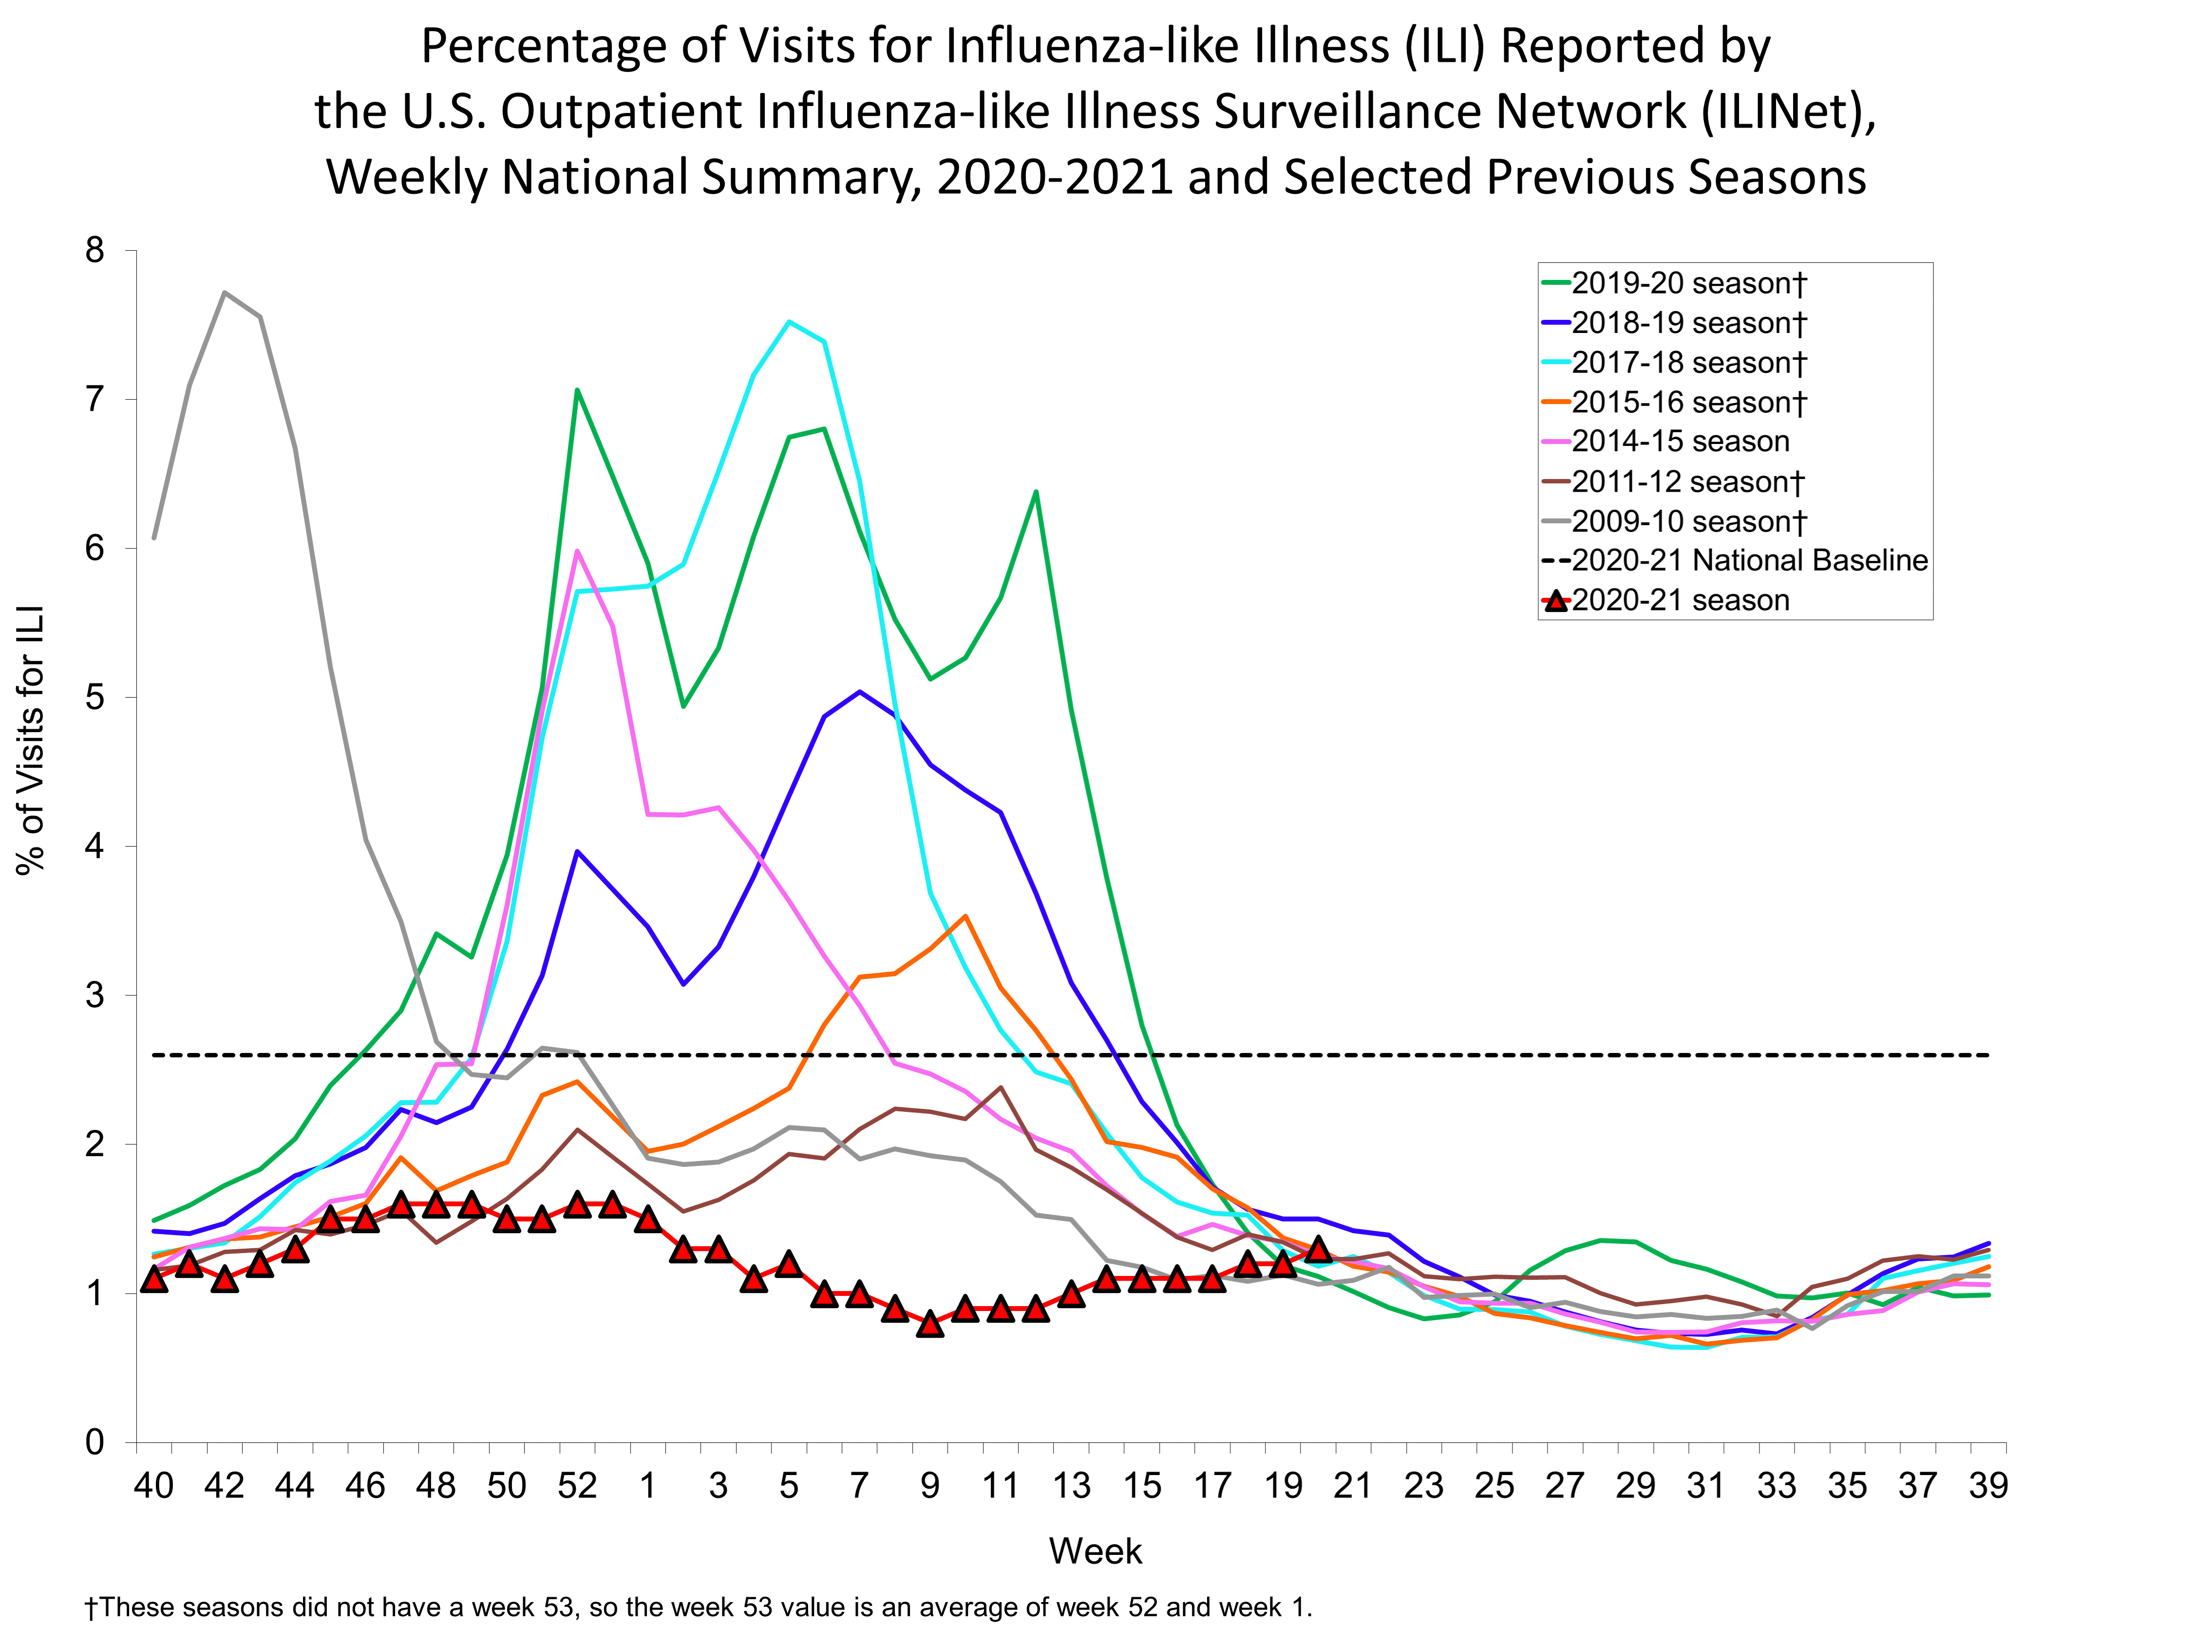
Centers for Disease Control and Prevention (CDC) FluView Interactive
https://www.cdc.gov/flu/weekly/
Key Updates for Week 20, ending May 22, 2021
Accessed 03Jun2021
https://www.cdc.gov/flu/weekly/fluviewinteractive.htm

Slide 15
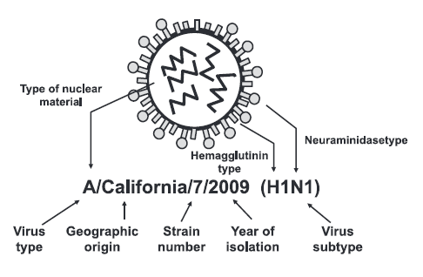
Influenza Virus
CDC. Epidemiology and Prevention of Vaccine-Preventable Diseases. 13th ed. 2015.

Slide 16
Seasonal Influenza Places a Substantial Healthcare Burden on the United States Each Season
Annual disease burden of seasonal influenza in the USA¹
Annual economic burden of seasonal influenza in the USA²
Direct medical costs
$10.4 billion
Projected lost earnings*
$16.3 billion
Deaths
12,000–79,000
$$$
$16.3 billion
Hospitalizations
140,000–960,000
Total economic burden**
$87.1 billion
Cases
9,300,000–49,000,000
*Due to illness and loss of life; **using projected statistical life values
1. Centers for Disease Control and Prevention (CDC), 2017. Disease burden of influenza. https://www.cdc.gov/flu/about/disease/burden.htm (accessed Sept 12, 2019); 2. Molinari NA et al. Vaccine 2007;25:5086–5096

Slide 17
Influenza Landscape and Disease Burden
During past influenza seasons, approximately 80% of influenza-associated deaths in children occurred in those who were not vaccinated^{1,2}
In children 6 months–17 years of age, influenza vaccine coverage was only 45.6% at the start of the 2018/2019 influenza season³
In the 2010–2016 seasons, 9.3% of children on average contracted influenza each year⁴, contributing to their role as a key demographic for spreading the disease
. CDC. https://www.cdc.gov/flu/about/season/flu-season-2017-2018.htm; 2. CDC. https://www.cdc.gov/flu/about/burden/faq.htm; 3. CDC. https://www.cdc.gov/flu/fluvaxview/nifs-estimates-nov2018.htm; All accessed June 2020; 4. Tokars JI et al. Clin Infect Dis 2018;66:1511–1518
Over the last 5 years, more than 719 children have died from influenza-associated disease in the US⁴
1. Centers for Disease Control and Prevention (CDC) https://www.cdc.gov/flu/about/burden/2018-2019.html; 2. Miller IF et al. Nat Med. 2020. Epub ahead of print. https://doi.org/10.1038/s41591-020-0952-y; 3. CDC. https://www.cdc.gov/flu/highrisk/index.htm; 4. CDC. https://gis.cdc.gov/GRASP/Fluview/PedFluDeath.html; All accessed June 2020
Notes:
From SE-GBL-IVX-PPT-200001

Slide 18
Estimated Influenza Vaccine Effectiveness 2004-2005 Through 2019-2020
In the United States, overall vaccine effectiveness has ranged from 10% to 60% since the 2004-2005 influenza season.^{1,2}
Influenza Season | Study Site(s) | No. of Patients | Adjusted Overall VE, % (95%CI)
2004-05 | WI | 762 | 10 (-36, 40)
2005-06 | WI | 346 | 21 (-52, 59)
2006-07 | WI | 871 | 52 (22 ,70)
2007-08 | WI | 1914 | 37 (22, 49)
2008-09 | WI, MI, NY, TN | 6713 | 41 (30, 50)
2009-10 | WI, MI, NY, TN | 6757 | 56 (23, 75)
2010-11 | WI, MI, NY, TN | 4757 | 60 (53, 66)
2011-12 | WI, MI, PA, TX, WA | 4771 | 47 (36, 56)
2012-13 | WI, MI, PA, TX, WA | 6452 | 49 (43, 55)
2013-14 | WI, MI, PA, TX, WA | 5999 | 52 (44, 59)
2014-15 | WI, MI, PA, TX, WA | 9311 | 19 (10, 27)
2015-16 | WI, MI, PA, TX, WA | 6879 | 48 (41, 55)
2016-17 | WI, MI, PA, TX, WA | 7410 | 40 (32, 46)
2017-18 | WI, MI, PA, TX, WA | 8436 | 38 (31, 43)
2018-19 | WI, MI, PA, TX, WA | 2795 | 29 (21, 35)
2019-20* | WI, MI, PA, TX, WA | 2723 | 39 (32, 45)*
CI = Confidence interval
*Preliminary estimates of the 2019-2020 seasonal influenza effectiveness from the Advisory Committee on Immunization Practices
Centers for Disease Control and Prevention. Seasonal influenza vaccine effectiveness, 2005-2020. Available at https://www.cdc.gov/flu/vaccines-work/past-seasons-estimates.html Last reviewed January 29, 2020. Accessed April 28, 2020.
Grohskopf L. Centers for Disease Control and Prevention. US flu VE data for 2019-2020, June 2020. https://www.cdc.gov/flu/vaccines-work/2019-2020.html. Reviewed June 29, 2020. Accessed September 3, 2020.

Slide 19
The Impact of Vaccination in Reducing the Burden of Influenza Should be Emphasized Over the VE Endpoint
Benefits of influenza vaccination in the 2014–2015 US flu season (overall VE: 19%)¹
Deaths averted²
1419
Hospitalizations averted²
47,000
Medical visits averted²
793,000
Cases averted²
1.6 million
Even during seasons when VE is reduced, vaccination substantially reduces the number of influenza cases and severe outcomes
1. Centers for Disease Control and Prevention (CDC), CDC Seasonal Flu Vaccine Effectiveness Studies.. https://www.cdc.gov/flu/professionals/vaccination/effectiveness-studies.htm (accessed Sept 2019); 2. Rolfes MA, Foppa IM, Garg S, et al. Influenza Other Respir Viruses. 2018;12(1):132–137. doi:10.1111/irv.12486

Slide 20
Estimated Number of Illnesses, Medical Visits, and Hospitalizations Averted by Influenza Vaccination in Children
For the 2014-15, 2015-16, 2016-17 influenza seasons, the CDC used updated estimates of influenza vaccination coverage, vaccine effectiveness, and influenza hospitalization rates to model and estimate averted illnesses, medical visits, and hospitalizations by influenza vaccination in children 6 months to 17 years of age.
Season | Age | Averted Illnesses | Averted Medical Visits | Averted Hospitalizations
2014-15 | 6 months – 4 years | 143,118 | 95,889 | 998
 | 5 – 17 years | 359,203 | 186,785 | 985
2015-16 | 6 months – 4 years | 980,052 | 656,635 | 6,832
 | 5 – 17 years | 1,281,134 | 666,190 | 3,513
2016-17 | 6 months – 4 years | 602,000 | 403,000 | 4,200
 | 5 – 17 years | 1,920,000 | 999,000 | 5,270
Centers for Disease Control and Prevention. 2014-2015 Estimated influenza illnesses and hospitalizations averted by vaccination in the United States, Available at: http://www.cdc.gov/flu/about/disease/2014-15.htm .Accessed September 5, 2019.
2. Centers for Disease Control and Prevention. 2015-2016 Estimated Influenza Illnesses, Medical Visits, Hospitalizations Deaths Averted by Vaccination in the United States, Available at: https://www.cdc.gov/flu/about/disease/2015-16.htm. Accessed September 5, 2019.
3. Centers for Disease Control and Prevention. 2016-2017 Estimated Influenza Illnesses, Medical visits, and Hospitalizations Averted by Vaccination in the United States. Available at: https://www.cdc.gov/flu/about/disease/2016-17.htm. Accessed September 5, 2019.

Slide 21
Influenza Vaccine Coverage in the USA is Below Target Levels for all Age Groups Except Children Aged 6–23 Months^{1–4}
Children
Adults
Healthy People 2020* target: 70%
Despite national recommendations for vaccination of all individuals aged ≥6 months without contraindications, vaccine coverage remains low⁵
*Healthy People 2020 is a US government body that provides science-based, 10-year national objectives for improving the health of Americans
1. Centers for Disease Control and Prevention (CDC), 2016. Flu vaccination coverage, United States, 2013–14 influenza season. http://www.cdc.gov/flu/fluvaxview/coverage-1314estimates.htm (accessed August 2017); 2. Centers for Disease Control and Prevention (CDC), 2016. Flu vaccination coverage, United States, 2014–15 influenza season. http://www.cdc.gov/flu/fluvaxview/coverage-1415estimates.htm (accessed August 2017); 3. Centers for Disease Control and Prevention (CDC), 2016. Flu vaccination coverage, United States, 2015–16 influenza season. http://www.cdc.gov/flu/fluvaxview/coverage-1516estimates.htm (accessed August 2017); 4. Healthy People 2020, 2014. Immunization and infectious diseases objectives. http://www.healthypeople.gov/2020/topics-objectives/topic/immunization-and-infectious-diseases/objectives (accessed August 2017); 5. Centers for Disease Control and Prevention (CDC). MMWR Morb Mortal Wkly Rep 2016;65:1–54

Slide 22
Barriers to Vaccination: Reasons for Non-Vaccination
Analysis of data from the National Flu Survey for the 2011-2012 influenza season
*Parents reported reasons for non-vaccination for their children
Santibanez TA, Kennedy ED. Reasons given for not receiving an influenza vaccination, 2011-12 influenza season, United States. Vaccine. 2016;34:2671-2678.

Slide 23
Centers for Disease Control and Prevention. Recommended Child and Adolescent Immunization for Ages 18 Years or Younger, US, 2021. Available at https://www.cdc.gov/vaccines/schedules/downloads/child/0-18yrs-child-combined-schedule.pdf. Accessed February 13, 2021
.

Slide 24
Centers for Disease Control and Prevention. Recommended Child and Adolescent Immunization for Ages 18 Years or Younger, US, 2021. Available at https://www.cdc.gov/vaccines/schedules/downloads/child/0-18yrs-child-combined-schedule.pdf. Accessed February 13, 2021
.

Slide 25
Recommended Child and Adolescent Immunization Schedule for Ages 18 Years or Younger, United States, 2021
Vaccines in the Child and Adolescent Immunization Schedule – Cont.:*
*Administer recommended vaccines if immunization history is incomplete or unknown. Do not restart or add doses to vaccine series for extended intervals between doses. When a vaccine is not administered at the recommended age, administer at a subsequent visit. The use of trade names is for identification purposes only and does not imply endorsement by the ACIP or CDC
Centers for Disease Control and Prevention. Recommended Child and Adolescent Immunization for Ages 18 Years or Younger, US, 2021. Available at 2021 Recommended Child and Adolescent Immunization Schedule (cdc.gov) Accessed February 13, 2021
.

Slide 26
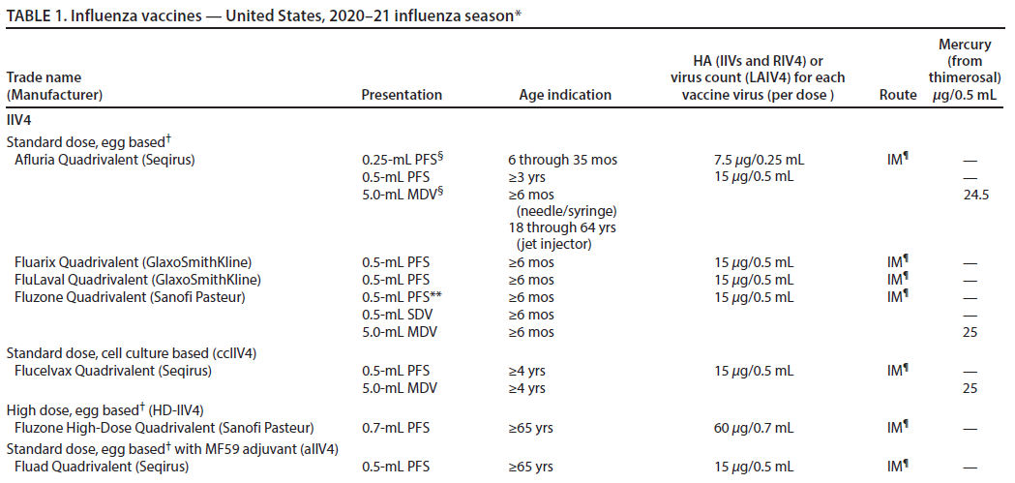
Available Influenza Vaccine Products for 2020-2021
See references on following page
CDC.Prevention and Control of Seasonal Influenza with Vaccines: Recommendations of the Advisory Committee on Immunization Practices – United States, 2020-21 Influenza Season. MMWR Aug 21, 2020;69(8).

Slide 27
Available Influenza Vaccine Products for 2020-2021 – Cont.
See references on following page
CDC.Prevention and Control of Seasonal Influenza with Vaccines: Recommendations of the Advisory Committee on Immunization Practices – United States, 2020-21 Influenza Season. MMWR Aug 21, 2020;69(8).

Slide 28
Tetanus, Diphtheria, and Pertussis (Tdap)
Notes:
Script
We’ve reviewed meningococcal disease and the vaccines available to help prevent it. Now let’s move to a deep dive into how meningococcal vaccines are recommended to be used in the US. In this next section I will walk you through the ACIP recommendations for both MenACWY and Men B vaccines. They are complex and not the same as each other, but by the end, you will feel much more familiar with all of them.

Slide 29
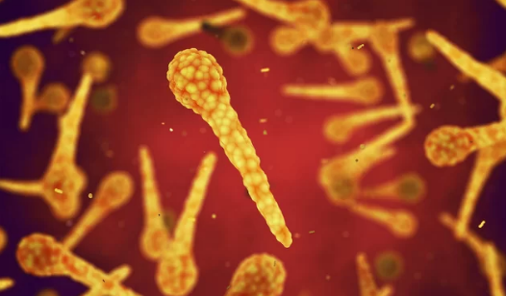
Tetanus
Bacterium called Clostridium tetani
Not transmitted person-to-person
Spores found in soil, dust, and manure
Enters the body through breaks in the skin
usually cuts or puncture wounds caused by contaminated objects
https://www.cdc.gov/tetanus/about/causes-transmission.html
Notes:
Colorado 2004-2014: 5 cases
US: 18 cases in 2009
2001-2008: Average 29 cases
Case fatality rate 13%

Slide 30
Tetanus
Spores can get into the body through broken skin
Wounds contaminated with dirt, feces, or saliva
Wounds caused by an object puncturing the skin (puncture wounds), like a nail or needle
Burns
Crush injuries
Injuries with dead tissue
Other Ways Tetanus Gets Into Your Body
Clean superficial wounds (when only the topmost layer of skin is scraped off)
Surgical procedures
Insect bites
Dental infections
Compound fractures (a break in the bone where it is exposed)
Chronic sores and infections
Intravenous (IV) drug use
Intramuscular injections
https://www.cdc.gov/tetanus/about/causes-transmission.html
Notes:
Only vaccine preventable disease that is infectious but not contagious
Colorado 2004-2014: 5 cases
US: 18 cases in 2009
2001-2008: Average 29 cases
Case fatality rate 13%
https://health.wyo.gov/wp-content/uploads/2017/05/2016WDHAnnualReport.pdf

Slide 31
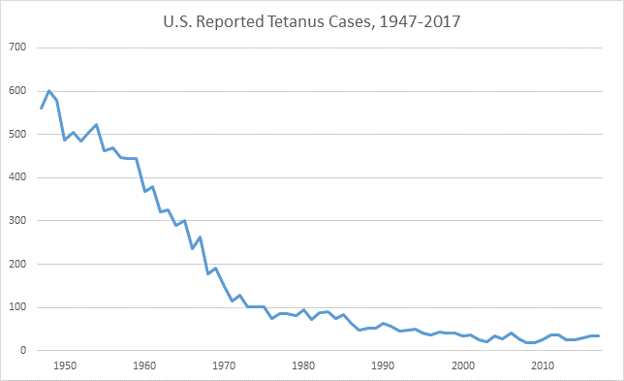
Tetanus
Today, tetanus is uncommon in the United States, with an average of about 30 reported cases each year.
Nearly all cases of tetanus are among people who did not get all the recommended tetanus vaccinations.
https://www.cdc.gov/tetanus/

Slide 32
Diphtheria

Slide 33
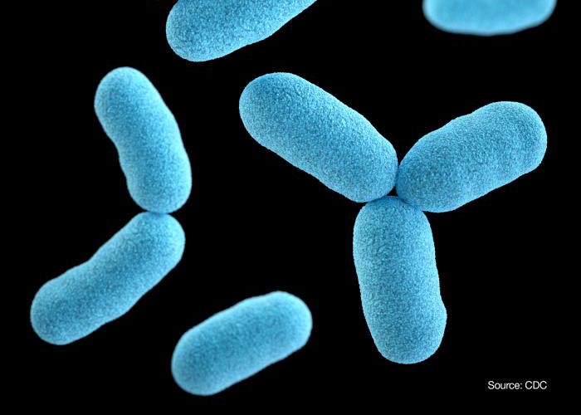
Diphtheria
Acute, toxin-mediated disease caused by the bacterium Corynebacterium diphtheriae.
Overall case-fatality rate for diphtheria is 5%–10%
persons younger than 5 and older than 40 years of age: higher death rates (up to 20%)
Incubation period usually 2–5 days (range: 1–10 days)
Can involve almost any mucous membrane
For clinical purposes, it is convenient to classify diphtheria into a number of manifestations, depending on the site of disease:
Respiratory diphtheria
Nasal diphtheria
Pharyngeal and tonsillar diphtheria
Laryngeal diphtheria
Cutaneous diphtheria
https://www.cdc.gov/diphtheria/surveillance.html

Slide 34
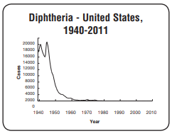
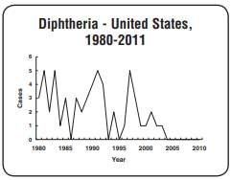
Diphtheria
Was one of the most common causes of illness and death among children before a vaccine was available.
206,000 cases recorded in US in 1921, resulting in 15,520 deaths
Since the introduction of diphtheria vaccines, which began in the 1920s and 1930s, and implementation of universal childhood immunization in the late 1940s, diphtheria has been well-controlled in the United States.
Between 2004 and 2017, state health departments reported 2 cases of diphtheria in the United States.
https://www.cdc.gov/diphtheria/surveillance.html
https://www.cdc.gov/vaccines/pubs/pinkbook/downloads/dip.pdf

Slide 35
Pertussis

Slide 36
Pertussis (Whooping Cough)
CDC. Pertussis Whooping Cough. Available at )https://www.cdc.gov/pertussis/index.html Accessed on January 30, 2019.

Slide 37
Bordetella Pertussis History
˂ Pertussis Overview
Acute, infectious disease caused by Bordetella pertussis
Outbreaks first described in 16th century
Bordetella pertussis isolated in 1906
Estimated 195,000 deaths worldwide in 2008
CDC. Epidemiology and Prevention of Vaccine-Preventable Diseases. 13th ed. 2015.

Slide 38
Bordetella Pertussis
˂ Pertussis Overview
Fastidious gram-negative bacteria
Reservoir
Human, adolescents and adults
Transmission
Respiratory droplets
Communicability
Maximum in catarrhal stage
Secondary attack rate up to 80%
CDC. Epidemiology and Prevention of Vaccine-Preventable Diseases. 13th ed. 2015.

Slide 39
Pertussis Pathogenesis
˂ Pertussis Overview
Primarily a toxin-mediated disease
Bacteria attach to cilia of respiratory epithelial cells, releasing toxins that paralyze the cilia
Inflammation occurs as a result which interferes with clearance of pulmonary secretions
Pertussis antigens allow evasion of host defenses (lymphocytosis promoted but impaired chemotaxis)
CDC. Epidemiology and Prevention of Vaccine-Preventable Diseases. 13th ed. 2015.

Slide 40
Disease Progression
˂ Pertussis Clinical Features
Weeks
0 | 1 | 2 | 3 | 4 | 5 | 6 | 7 | 8 | 9 | 10 | 11 | 12
Stage 1
Catarrhal Stage
May last 1 to 2 weeks
Symptoms: runny nose, low-grade fever, mild, occasional cough – Highly contagious
Stage 2 Paroxysmal Stage
Lasts from 1-6 weeks; may extend to 10 weeks
Symptoms: fits of numerous, rapid coughs followed by “whoop” sound; vomiting and exhaustion after coughing fits (called paroxysms)
Stage 3 Convalescent Stage
Lasts about 2-3 weeks; susceptible to other respiratory infections for many
Recovery is gradual. Coughing lessens but fits of coughing may return
Centers for Disease Control and Prevention. Signs & Symptoms. Available at:
http://www.cdc.gov/pertussis/about/signs-symptoms.html. Accessed July 10, 2018.

Slide 41
Adults Can Transmit Pertussis to Infants
˂ Pertussis Transmission
Source of Infection by Age¹
Source of Infection within Family²
56% are ≥20 years old
Bisgard KM, et al. Pediatr Infect Dis J. 2004;23:985-989. 2) Skoff TH, et al. Pediatrics 2015, 136(4), 635-641.

Slide 42
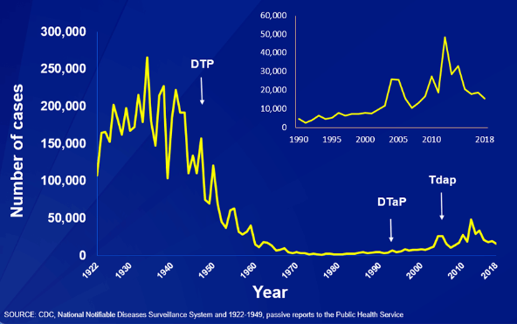
Pertussis Cases - United States, 1922-2018
˂ Pertussis Epidemiology
National Notifiable Diseases Surveillance System (NNDS)
Year
Centers for Disease Control and Prevention. Reported NNDS Pertussis Cases (1922-2018). Available at: https://www.cdc.gov/pertussis/surv-reporting.htmll. Accessed March, 2020.
Notes:
This graph illustrates the number of pertussis cases reported to CDC from 1922 to 2018. Following the introduction of pertussis vaccines in the 1940s when case counts frequently exceeded 100,000 cases per year, reports declined dramatically to fewer than 10,000 by 1965. During the 1980s pertussis reports began increasing gradually, and by 2018 more than 15,000 cases were reported nationwide.

Slide 43
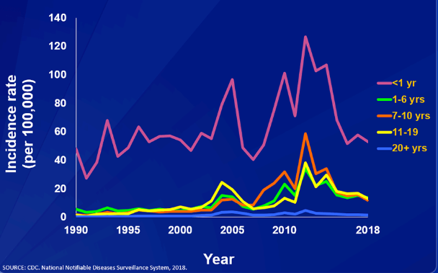
Reported Pertussis Incidence by Age Group in the United States,1990-2018
˂ Pertussis Epidemiology
Centers for Disease Control and Prevention. Reported Pertussis Incidence by Age Group (1990-2018). Available at: https://www.cdc.gov/pertussis/surv-reporting.htmll. Accessed March, 2020.
Notes:
This graph shows reported pertussis incidence (per 100,000 persons) by age group in the United States from 1990–2018. Infants aged <1 year, who are at greatest risk for serious disease and death, continue to have the highest reported rate of pertussis.

Slide 44
Centers for Disease Control and Prevention. Recommended Child and Adolescent Immunization for Ages 18 Years or Younger, US, 2021. Available at https://www.cdc.gov/vaccines/schedules/downloads/child/0-18yrs-child-combined-schedule.pdf. Accessed February 13, 2021
.

Slide 45
Centers for Disease Control and Prevention. Recommended Child and Adolescent Immunization for Ages 18 Years or Younger, US, 2021. Available at https://www.cdc.gov/vaccines/schedules/downloads/child/0-18yrs-child-combined-schedule.pdf. Accessed February 13, 2021
.

Slide 46
Changes in the Recommended Child and Adolescent Immunization Schedule for ages 18 years or younger. United States, 2021
˂ Pertussis Vaccination Recommendations
Centers for Disease Control and Prevention. Recommended Child and Adolescent Immunization Schedule for Ages 18 Years or Younger, US, 2021. Available at https://www.cdc.gov/vaccines/schedules/hcp/imz/child-adolescent.html. Accessed March 5, 2021.

Slide 47
Recommended Child and Adolescent Immunization Schedule for Ages 18 Years or Younger, United States, 2021
Vaccines in the Child and Adolescent Immunization Schedule – Cont.:*
*Administer recommended vaccines if immunization history is incomplete or unknown. Do not restart or add doses to vaccine series for extended intervals between doses. When a vaccine is not administered at the recommended age, administer at a subsequent visit. The use of trade names is for identification purposes only and does not imply endorsement by the ACIP or CDC
Centers for Disease Control and Prevention. Recommended Child and Adolescent Immunization for Ages 18 Years or Younger, US, 2021. Available at 2021 Recommended Child and Adolescent Immunization Schedule (cdc.gov) Accessed February 13, 2021
.

Slide 48
Human Papillomavirus (HPV)

Slide 49
Centers for Disease Control and Prevention. Recommended Child and Adolescent Immunization for Ages 18 Years or Younger, US, 2021. Available at https://www.cdc.gov/vaccines/schedules/downloads/child/0-18yrs-child-combined-schedule.pdf. Accessed February 13, 2021
.

Slide 50
Centers for Disease Control and Prevention. Recommended Child and Adolescent Immunization for Ages 18 Years or Younger, US, 2021. Available at https://www.cdc.gov/vaccines/schedules/downloads/child/0-18yrs-child-combined-schedule.pdf. Accessed February 13, 2021
.

Slide 51
Human Papillomavirus Vaccination (Minimum Age: 9 Years) – Notes
Routine and catch-up vaccination
HPV vaccination routinely recommended at age 11–12 years (can start at age 9 years) and catch-up HPV vaccination recommended for all persons through age 18 years if not adequately vaccinated
2- or 3-dose series depending on age at initial vaccination:
Age 9–14 years at initial vaccination: 2-dose series at 0, 6–12 months (minimum interval: 5 months; repeat dose if administered too soon)
Age 15 years or older at initial vaccination: 3-dose series at 0, 1–2 months, 6 months (minimum intervals: dose 1 to dose 2: 4 weeks / dose 2 to dose 3: 12 weeks / dose 1 to dose 3: 5 months; repeat dose if administered too soon)
Interrupted schedules: If vaccination schedule is interrupted, the series does not need to be restarted.
No additional dose recommended after completing series with recommended dosing intervals using any HPV vaccine.
Centers for Disease Control and Prevention. Recommended Child and Adolescent Immunization for Ages 18 Years or Younger, US, 2021. Available at https://www.cdc.gov/vaccines/schedules/downloads/child/0-18yrs-child-combined-schedule.pdf. Accessed February 13, 2021
.

Slide 52
Human Papillomavirus Vaccination (Minimum Age: 9 Years) – Notes (cont.)
Special situations
Immunocompromising conditions, including HIV infection: 3-dose series as above
History of sexual abuse or assault: Start at age 9 years.
Pregnancy: HPV vaccination not recommended until after pregnancy; no intervention needed if vaccinated while pregnant; pregnancy testing not needed before vaccination
Centers for Disease Control and Prevention. Recommended Child and Adolescent Immunization for Ages 18 Years or Younger, US, 2021. Available at https://www.cdc.gov/vaccines/schedules/downloads/child/0-18yrs-child-combined-schedule.pdf. Accessed February 13, 2021
.

Slide 53
Recommended Child and Adolescent Immunization Schedule for Ages 18 Years or Younger, United States, 2021
Vaccines in the Child and Adolescent Immunization Schedule*:
*Administer recommended vaccines if immunization history is incomplete or unknown. Do not restart or add doses to vaccine series for extended intervals between doses. When a vaccine is not administered at the recommended age, administer at a subsequent visit. The use of trade names is for identification purposes only and does not imply endorsement by the ACIP or CDC
Centers for Disease Control and Prevention. Recommended Child and Adolescent Immunization for Ages 18 Years or Younger, US, 2021. Available at 2021 Recommended Child and Adolescent Immunization Schedule (cdc.gov). Accessed February 13, 2021
.

Slide 54
Meningococcal Disease Meningococcal ACWY (MenACWY) and Meningococcal B (MenB)
Notes:
Script
We’ve reviewed meningococcal disease and the vaccines available to help prevent it. Now let’s move to a deep dive into how meningococcal vaccines are recommended to be used in the US. In this next section I will walk you through the ACIP recommendations for both MenACWY and Men B vaccines. They are complex and not the same as each other, but by the end, you will feel much more familiar with all of them.

Slide 55
Two different types of meningococcal vaccines are needed for active immunization against the 5 most prevalent serogroups
5
Historically, 5 serogroups have caused a majority of cases of meningococcal disease: A, C, W, Y, and B
2
For active immunization against the 5 vaccine-preventable serogroups, adolescent or young adult patients need 2 different types of meningococcal vaccines: 1 for serogroups A, C, W, and Y, and 1 for serogroup B
Centers for Disease Control and Prevention. Meningococcal vaccination for adolescents: information for healthcare professionals. https://www.cdc.gov/vaccines/vpd/mening/hcp/adolescent-vaccine.html. Reviewed July 26, 2019. Accessed January 1, 2020.

Slide 56
Meningococcal disease progresses rapidly
Hours* after the start of symptoms in adolescents
HOURS
0–8
HOURS
9–12
HOURS
13–20
HOURS
21†–24+
Headache
Sore throat/Coryza
Thirst
General aches
Fever
Decreased appetite
Nausea
Vomiting
Leg pain
Irritability
Drowsiness
Difficulty breathing
Diarrhea
Neck stiffness
Cold hands and feet
Photophobia
Abnormal skin color
Rash
Confusion/Delirium
Unconsciousness
Seizure‡
Death
NOTE: This list of clinical features and their average onset is representative of what may be experienced by adolescents 15 to 16 years of age; clinical symptoms may vary by age group.
*Hours expressed as medians.
†Median time from onset of symptoms until hospital admission was 19 hours.
‡Seizure was noted at a median of 26 hours.
Thompson MJ, Ninis N, Perera R, et al. Clinical recognition of meningococcal disease in children and adolescents. Lancet. 2006;367:397-403.

Slide 57
Clinical Manifestations of Invasive Meningococcal Disease¹
1
ªPneumonia incidence ranges 5-15%
Adapted from .CDC. Epidemiology and Prevention of Vaccine-Preventable Diseases. Hamborsky J, et al, eds. 13th ed. Washington, DC: Public Health Foundation; 2015.
McNamara LA, Blain A. Meningococcal Disease in: Roush SW, Baldy LM, Hall MAK, eds. Manual for the Surveillance of Vaccine-Preventable Diseases (italics). National Center for Immunization and Respiratory Diseases. Reviewed December 27, 2019. Accessed March 12, 2020. https://www.cdc.gov/vaccines/pubs/surv-manual/chpt08-mening.html.
Notes:
Common clinical manifestations of invasive meningococcal disease include meningitis, bacteremia, and pneumonia. Meningitis is observed in approximately 47.3% of invasive cases. Approximately 43.3% of meningococcal disease cases present as bacteremia. A portion of these cases (5%–20%) will present as meningococcemia.¹
Meningococcemia is characterized by abrupt onset of fever and a petechial or purpuric rash. It is often associated with hypotension, shock, acute adrenal hemorrhage, and multiorgan failure. Meningococcemia may occur with or without meningitis.¹
Pneumonia occurs in approximately 5% to 15% of cases and occurs most frequently in older persons. Much less common manifestations of invasive meningococcal disease include myocarditis, endocarditis or pericarditis, otitis media, epiglottitis, arthritis, conjunctivitis, panophthalmitis, urethritis, pharyngitis, and cervicitis.^{1,2}
CDC Meningococcal 2012, p.194, C1, Figure
Paragraphs 1-2: CDC Meningococcal 2012, p.194, C1, Figure; C2, P5-7
Paragraph 3: CDC Meningococcal 2012, p.194, C1, Figure; C2, P5-7; MacNeil 2012, p.13, P7

Slide 58
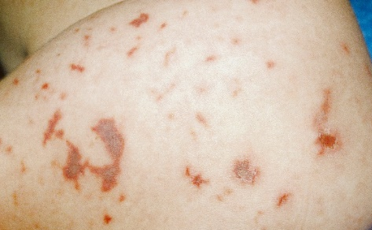
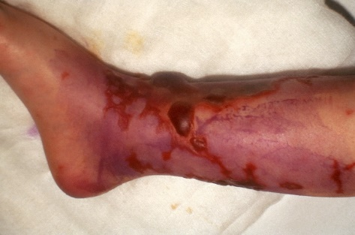
Although uncommon, once symptoms appear, meningococcal disease can progress rapidly and is potentially fatal^{1,2}
In as few as
24 hours
the symptoms related to meningococcal disease can sometimes progress to death¹
Among those who contract meningococcal disease,
10%–15%
die from meningococcal disease, despite antibiotic treatment³
Of those who survive,
11%–19%
suffer permanent consequences— including seizures, limb loss, kidney damage, hearing loss, and skin scarring³⁻⁶
References: 1. Pelton SI. Meningococcal disease awareness: clinical and epidemiological factors affecting prevention and management in adolescents. J Adolesc Health. 2010;46:S9-S15. 2. Thompson MJ, Ninis N, Perera R, et al. Clinical recognition of meningococcal disease in children and adolescents. Lancet. 2006;367(9508):397-403. 3. Meningococcal disease: technical and clinical information. Centers for Disease Control and Prevention website: www.cdc.gov/meningococcal/clinical-info.html. Reviewed May 31, 2019. Accessed January 1, 2020. 4. Meningococcal disease. In: Hamborsky J, Kroger A, Wolfe C, eds. Epidemiology and Prevention of Vaccine-Preventable Diseases. 13th ed. Washington, DC: Public Health Foundation; 2015:231-245. www.cdc.gov/vaccines/pubs/pinkbook/mening.html. Accessed January 1, 2020. 5. Slack R, Hawkins KC, Gilhooley L, Addison GM, Lewis MA, Webb NJ. Long-term outcome of meningococcal sepsis-associated acute renal failure. Pediatr Crit Care Med. 2005;6(4):477-479. 6. Vyse A, Anonychuk A, Jäkel A, Wieffer H, Nadel S. The burden and impact of severe and long-term sequelae of meningococcal disease. Expert Rev Anti Infect Ther. 2013;11(6):597-604.

Slide 59
Case-Fatality Rates for IMD are Higher Than Many Other Vaccine-Preventable Diseases
Overall case-fatality rate for IMD is 10%-15%, with rates as high as 16.7% in 21-to-25-year-olds³
IMD^{a1}
Diphtheria¹
Estimated CFR (%)
Pneumococcal pneumonia¹
Paralytic polio^{a1}
Hib meningitis^{a1}
Measles^{a1}
Rotavirus^{a2}
Varicella^{a1}
ªMeningococcal disease and Hib meningitis: despite appropriate antimicrobial therapy; Paralytic polio: in children; Varicella: in children and adolescents; Measles: US 1985-1992; Rotavirus: US general population.
Atkinson W, et al, eds. Epidemiology and Prevention of Vaccine-Preventable Diseases. 13th ed. http://www.cdc.gov/vaccines/pubs/pinkbook/index.html#chapters.
Gerba CP, et al. Water Res. 1996:30;2929-2940.
MacNeil JR, et al. Clin Infect Dis. 2018;66:1276-1281.
59

Slide 60
Neurological Sequelae Associated With All Cause Bacterial Meningitis
More than 2/3 of patients exhibit neurologic or neuropsychological deficits after acute bacterial meningitis (non-pathogen-specific)¹
Nearly 1/5 of children with meningitis have a permanent severe or moderate severe disability, and subtle deficits are also more prevalent (non-pathogen-specific)²
Merkelbach et al., Acta Neurol Scand 2000, 102: 118-123.
Bedford et al., BMJ 2001, 323: 533-537.

Slide 61
Carriage and Risk Factors
Asymptomatic Carriage
Risk Factors
Impaired immune system²
Social behaviors in adolescents and young adults, such as^{1,3-6}:
Kissing
Coughing
Spending time in close quarters
Sharing food, drinks, and utensils
Infancy⁷
Other factors, such as^{3,4}:
Smoking and second-hand smoke
Respiratory tract infection
Traveling to endemic areas
Prevalence: 5% to 10% in adolescents and young adults¹
Incidence of carriage peaks in adolescence and young adulthood¹
Invasive disease is an infrequent consequence of nasopharyngeal carriage¹
References: 1. McNamara LA, Blain A. Meningococcal Disease. In: Roush SW, Baldy LM, Hall MAK, eds. Manual for the Surveillance of Vaccine-Preventable Diseases. National Center for Immunization and Respiratory Diseases. https://www.cdc.gov/vaccines/pubs/surv-manual/chpt08-mening.html. Reviewed December 27, 2019. Accessed March 12, 2020. 2. Cohn AC, MacNeil JR, Clark TA, et al. Prevention and control of meningococcal disease: recommendations of the Advisory Committee on Immunization Practices (ACIP). MMWR. 2013;62(2):1-28. 3. Meningococcal disease. In: Hamborsky J, Kroger A, Wolfe C, eds. Epidemiology and Prevention of Vaccine-Preventable Diseases. 13th ed. Washington, DC: Public Health Foundation; 2015:231-245. www.cdc.gov/vaccines/pubs/pinkbook/mening.html. Accessed January 1, 2020. 4. Cohn AC, MacNeil JR, Harrison LH, et al. Changes in Neisseria meningitidis disease epidemiology in the United States, 1998-2007: implications for prevention of meningococcal disease. Clin Infect Dis. 2010;50(2):184-191. 5. Centers for Disease Control and Prevention. Causes and spread to others. https://www.cdc.gov/meningococcal/about/causes-transmission.html. Reviewed May 31, 2019. Accessed January 1, 2020. 6. Meningitis. Mayo Clinic website. www.mayoclinic.org/diseases-conditions/meningitis/symptoms-causes/syc-20350508. Updated January 8, 2019. Accessed January 1, 2020. 7. Rosenstein NE, Perkins BA, Stephens DS, Popovic T, Hughes JM. Meningococcal disease. N Engl J Med. 2001;344(18):1378-1388.

Slide 62
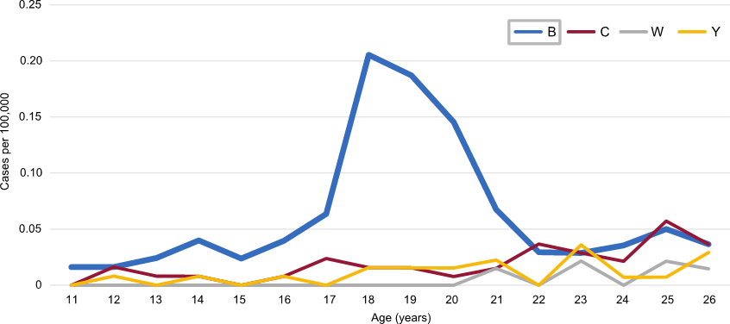
Incidence of Meningococcal Disease Among Adolescents and Young Adults by Serogroup, According to the CDC, 2014-2016
˂ Select BEXSERO Speaker Deck Slides
Source: National Notifiable Diseases Surveillance System (NNDSS) data, with additional serogroup data from Active Bacterial Core surveillance (ABCs) and state health departments.
Unknown serogroup and other serogroups excluded.
Reference: 1. Meyer S. Epidemiology of meningococcal disease among college students—United States, 2014-2016. https://stacks.cdc.gov/view/cdc/59918. Presented at the Advisory Committee on Immunization Practices; February 22, 2018. Accessed January 1, 2020.

Slide 63
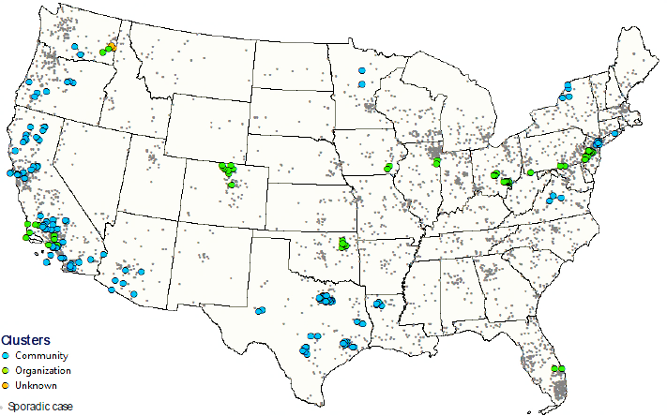
Distribution of Cluster-associated and Sporadic Meningococcal Cases in the US
UNITED STATES¹
2009-2013
4.9% of reported cases were associated with an outbreak²
CLUSTERS:
Community
Organization
Unknown
Sporadic case
Organization- and community-based: N=180
Sporadicª: N=3506
47.1% of organization-based outbreaks were caused by serogroup B²
100% of university outbreaks from 2011 through March 2019 were caused by serogroup B³
NOTE: No clusters reported in Alaska and Hawaii.
ªSporadic cases with known serogroup reported to the National Notifiable Diseases Surveillance System (NNDSS) and not reported in association with a cluster.
Meyer S. Epidemiology of Meningococcal Disease Outbreaks in the United States. Presentation to the Advisory Committee on Immunization Practices. June 26th, 2014. Source data: National Notifiable Diseases Surveillance System (NNDSS) with additional serogroup data provided by state and local health departments. Meeting minutes available at: http://www.cdc.gov/vaccines/acip/meetings/downloads/min-archive/min-2014-06.pdf#page=19&zoom=auto,0,42
Mbaeyi SA, Blain A, Whaley MJ, et al. Epidemiology of meningococcal disease outbreaks in the United States, 2009-2013. Clin Infect Dis 2018. Available at: https://doi.org/10.1093/cid/ciy548
Marshall GS, Dempsey AF, Srivastava A, et al. US college students are at increased risk for serogroup B meningococcal disease. J Pediatr Infect Dis Soc. 2019;9(2):244-247. http://doi.org/10.1093/jpids/piz024.
Notes:
Map: Meyer ACIP June 2014/slide 20
Data for bar graph: Meyer ACIP June 2014/slide 22

Slide 64
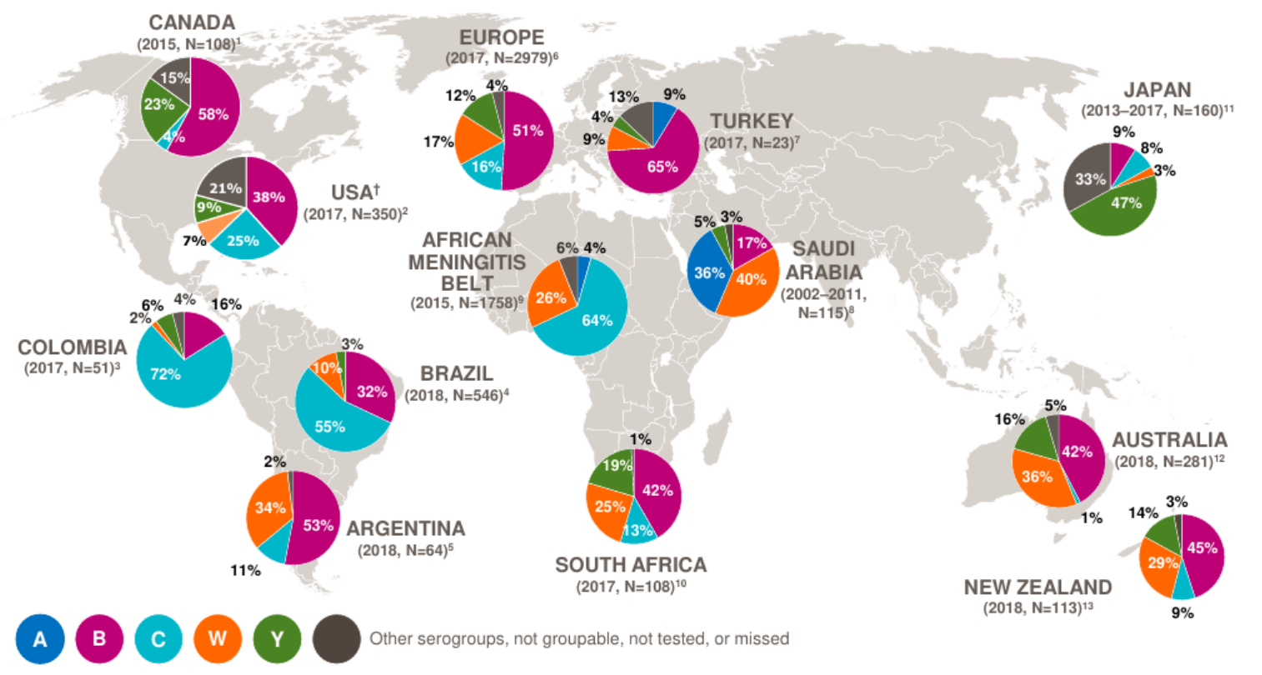
Global Serogroup Distribution of Invasive Meningococcal Disease
References shown on following slide

Slide 65
Meningococcal Vaccination Rates in the US (1 of 3)
Individuals 13-17 years old, 2019
According to the 2019 CDC National Immunization-Teen Survey (NIS)
86.6%
88.9%
Subjects receiving (%)
53.7%
50.8%
17.2%
21.8%
†
†
MenACWY Vaccination*
MenB Vaccination‡
Adolescent vaccination coverage in the US continues to improve for meningococcal vaccines, with some disparities.
Among adolescents living at or above the poverty level, those living outside a metropolitan statistical area (MSA) had lower coverage with meningococcal vaccines than those in MSA principal cities.
*Includes percentages receiving MenACWY and meningococcal-unknown type vaccine.
†≥2 doses of MenACWY or meningococcal-unknown type vaccine. Calculated only among adolescents aged 17 years at interview. Does not include adolescents who received 1 dose of MenACWY at age ≥16 years.
‡≥1 dose of MenB, administered, based on individual clinical decision; calculated only among adolescents aged 17 years at interview.
Elam-Evans LD, et al. MMWR Morb Mortal Wkly Rep. 2020;69(33):1109-1116.

Slide 66
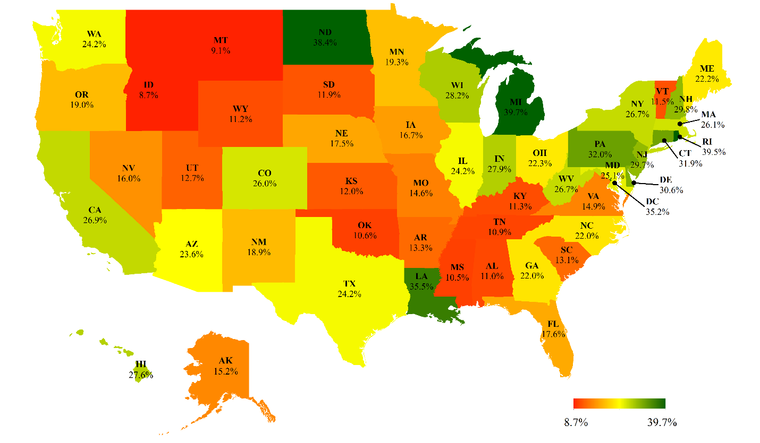
MenACWY Vaccination Completion Rates (2011-2016)
The overall national completion rate was 23.2%, with completion rates ranging from 8.7% (Idaho) to 39.7% (Michigan).
Cheng WY, et al. Meningococcal ACWY (MENACWY) Vaccination of Adolescents in the US: How Compliant are We with the Advisory Committee on Immunization Practices (ACIP) Recommendations? IDWeek 2018; 3-7 October, San Francisco, CA, US. Poster #2459

Slide 67
Centers for Disease Control and Prevention. Recommended Child and Adolescent Immunization for Ages 18 Years or Younger, US, 2021. Available at https://www.cdc.gov/vaccines/schedules/downloads/child/0-18yrs-child-combined-schedule.pdf. Accessed February 13, 2021
.

Slide 68
Centers for Disease Control and Prevention. Recommended Child and Adolescent Immunization for Ages 18 Years or Younger, US, 2021. Available at https://www.cdc.gov/vaccines/schedules/downloads/child/0-18yrs-child-combined-schedule.pdf. Accessed February 13, 2021
.

Slide 69
Centers for Disease Control and Prevention. Recommended Child and Adolescent Immunization for Ages 18 Years or Younger, US, 2021. Available at https://www.cdc.gov/vaccines/schedules/downloads/child/0-18yrs-child-combined-schedule.pdf. Accessed February 13, 2021
.

Slide 70
Centers for Disease Control and Prevention. Recommended Child and Adolescent Immunization for Ages 18 Years or Younger, US, 2021. Available at https://www.cdc.gov/vaccines/schedules/downloads/child/0-18yrs-child-combined-schedule.pdf. Accessed February 13, 2021
.

Slide 71
Recommended Child and Adolescent Immunization Schedule for Ages 18 Years or Younger, United States, 2021
Vaccines in the Child and Adolescent Immunization Schedule – Cont.:*
*Administer recommended vaccines if immunization history is incomplete or unknown. Do not restart or add doses to vaccine series for extended intervals between doses. When a vaccine is not administered at the recommended age, administer at a subsequent visit. The use of trade names is for identification purposes only and does not imply endorsement by the ACIP or CDC
Centers for Disease Control and Prevention. Recommended Child and Adolescent Immunization for Ages 18 Years or Younger, US, 2021. Available at 2021 Recommended Child and Adolescent Immunization Schedule (cdc.gov) Accessed February 13, 2021
.

Slide 72
Recommended Child and Adolescent Immunization Schedule for Ages 18 Years or Younger, United States, 2021
Vaccines in the Child and Adolescent Immunization Schedule – Cont.:*
*Administer recommended vaccines if immunization history is incomplete or unknown. Do not restart or add doses to vaccine series for extended intervals between doses. When a vaccine is not administered at the recommended age, administer at a subsequent visit. The use of trade names is for identification purposes only and does not imply endorsement by the ACIP or CDC
Centers for Disease Control and Prevention. Recommended Child and Adolescent Immunization for Ages 18 Years or Younger, US, 2021. Available at 2021 Recommended Child and Adolescent Immunization Schedule (cdc.gov) Accessed February 13, 2021
.

Slide 73
Number of Doses, Dosing Schedule, Administration, Approved Age, Antigens*
˂ Outer Cartons, Indications and Usage, Dosage & Administration, and Description
BEXSERO¹
TRUMENBA²
Number of
Doses
2 doses
2 or 3 doses
Dosing
Schedule
≥1 month
apart
At months
0 and 6 or 0, 1-2, 6
Administration
Intramuscular
Intramuscular
Approved Age
10 to 25 years of age
10 to 25 years of age
NadA, fHbp (subfamily B), NHBA, PorA P1.4 (found in OMV)
fHbp (subfamilies A and B)
Antigens
fHbp = Factor H binding protein, NadA = Neisserial adhesin A, NHBA = Neisserial Heparin Binding Antigen, PorA P1.4 = Porin A subtype P1.4), OMV= Outer Membrane Vesicle
*Please see Prescribing Information for complete product information
1. Prescribing Information for Bexsero. 2. Prescribing Information for Trumenba
73
1. Prescribing Information for BEXSERO. 2015. 2. Prescribing Information for Trumenba. 2015.

Slide 74
Vaccine Hesitancy
https://www.who.int/immunization/programmes_systems/vaccine_hesitancy/en/
https://www.who.int/emergencies/ten-threats-to-global-health-in-2019
https://www.aap.org/en-us/advocacy-and-policy/aap-health-initiatives/immunizations/Pages/vaccine-hesitant-parents.aspx
https://pediatrics.aappublications.org/content/138/3/e20162146

Slide 75
COVID-19 Vaccines
Coadministration with other vaccines
Interim Clinical Considerations for Use of COVID-19 Vaccines Currently
Authorized in the United States” found at the following link:
https://www.cdc.gov/vaccines/covid-19/info-by-product/clinical-considerations.html#Coadministration
Or
https://www.cdc.gov/vaccines/covid-19/clinical-considerations/covid-19-vaccines-us.html?CDC_AA_refVal=https%3A%2F%2Fwww.cdc.gov%2Fvaccines%2Fcovid-19%2Finfo-by-product%2Fclinical-considerations.html#Coadministration

Slide 76
Why?
Notes:
Script
We’ve reviewed meningococcal disease and the vaccines available to help prevent it. Now let’s move to a deep dive into how meningococcal vaccines are recommended to be used in the US. In this next section I will walk you through the ACIP recommendations for both MenACWY and Men B vaccines. They are complex and not the same as each other, but by the end, you will feel much more familiar with all of them.

Slide 77
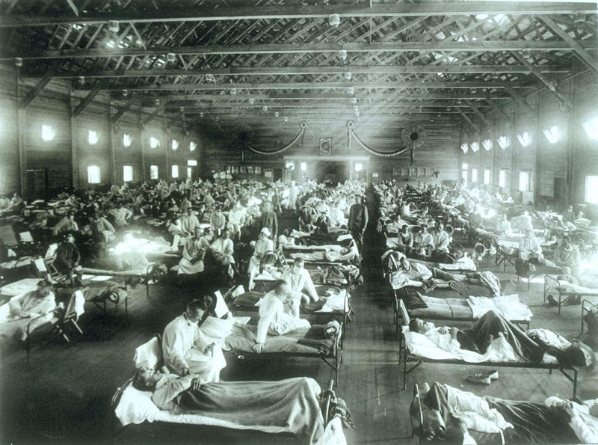
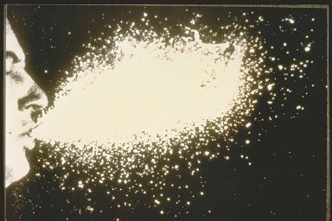
Influenza
"Emergency hospital during 1918 influenza epidemic, Camp Funston, Kansas"
Shows how influenza germs spread through the air when someone coughs
http://www.vaccineinformation.org/influenza/photos.asp
Notes:
https://www.cdc.gov/features/1918-flu-pandemic/index.html
This year marks the 100th anniversary of the 1918 influenza (flu) pandemic that swept the globe in what is still one of the deadliest disease outbreaks in recorded history.
It is estimated that about 500 million people or one-third of the world’s population became infected with this virus, and the number of deaths was estimated to be at least 50 million worldwide with about 675,000 occurring in the United States. The pandemic was so severe that from 1917 to 1918, life expectancy in the United States fell by about 12 years, to 36.6 years for men and 42.2 years for women. There were high death rates in previously healthy people, including those between the ages of 20 and 40 years old, which was unusual because flu typically hits the very young and the very old more than young adults.

Slide 78
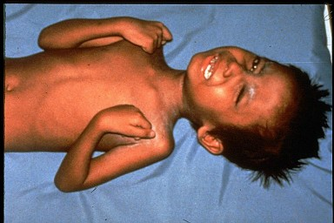
Tetanus
Adult with classic signs of tetanus
Child has painful muscle contractions from tetanus
Baby has neonatal tetanus with complete rigidity
http://www.vaccineinformation.org/tetanus/photos.asp

Slide 79
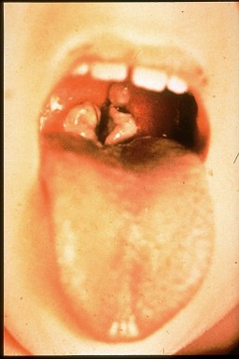
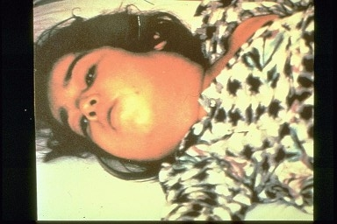
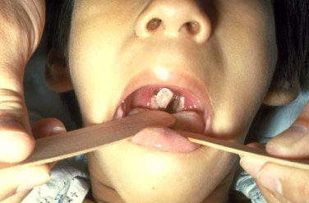
Diphtheria
Child has "bullneck diphtheria"
Pharyngeal diphtheria with membranes covering the tonsils and uvula
Child has diphtheria, thick gray coating over back of throat
http://www.vaccineinformation.org/diphtheria/photos.asp

Slide 80
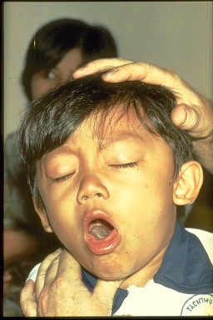
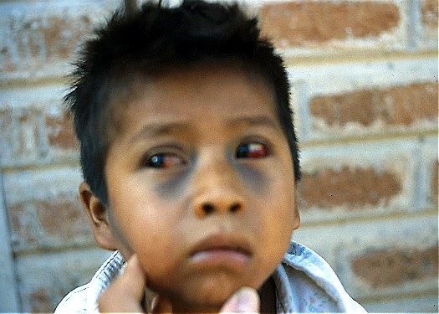
Pertussis
Child with broken blood vessels in eyes and bruising on face due to pertussis coughing.
Child has pertussis difficult for him to stop coughing and to get air
http://www.vaccineinformation.org/photos/

Slide 81
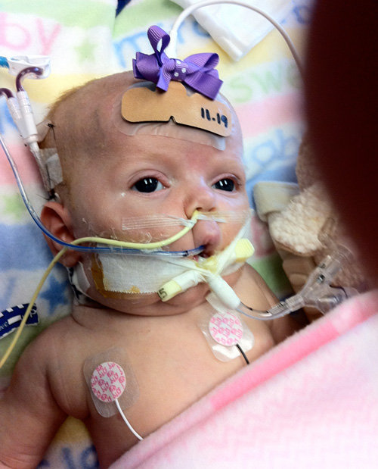
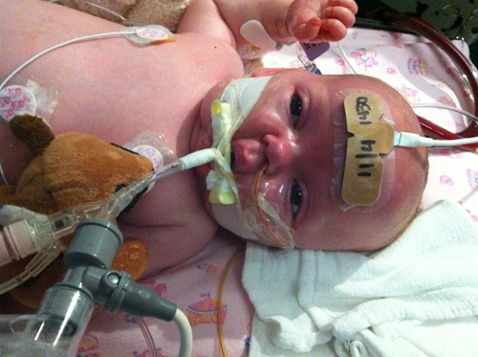
Pertussis
https://www.cdc.gov/pertussis/about/photos.html

Slide 82
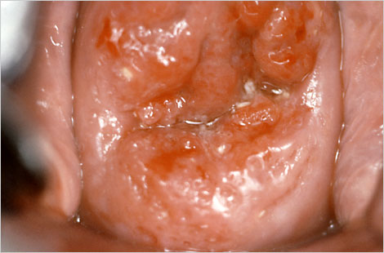
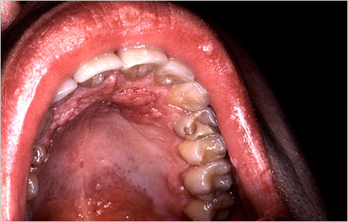
Human Papillomavirus (HPV)
This patient presented with erosion to her cervix due to what turned out to be low grade cervical carcinoma
This HIV-positive patient was exhibiting signs of a secondary condyloma acuminata infection, i.e., venereal warts
http://www.immunize.org/photos/hpv-photos.asp

Slide 83
Frequency and Complications of Invasive Meningococcal Disease

Slide 84
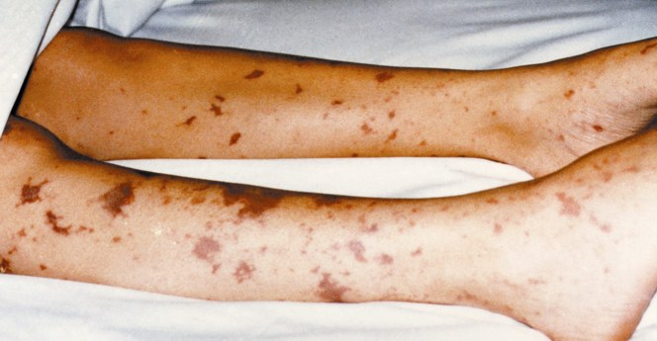
Meningococcal Disease
http://www.vaccineinformation.org/meningococcal/photos.asp
Notes:
Script
We’ve reviewed meningococcal disease and the vaccines available to help prevent it. Now let’s move to a deep dive into how meningococcal vaccines are recommended to be used in the US. In this next section I will walk you through the ACIP recommendations for both MenACWY and Men B vaccines. They are complex and not the same as each other, but by the end, you will feel much more familiar with all of them.

Slide 85
Why?
Notes:
Script
We’ve reviewed meningococcal disease and the vaccines available to help prevent it. Now let’s move to a deep dive into how meningococcal vaccines are recommended to be used in the US. In this next section I will walk you through the ACIP recommendations for both MenACWY and Men B vaccines. They are complex and not the same as each other, but by the end, you will feel much more familiar with all of them.

Slide 86
Why!
Notes:
Script
We’ve reviewed meningococcal disease and the vaccines available to help prevent it. Now let’s move to a deep dive into how meningococcal vaccines are recommended to be used in the US. In this next section I will walk you through the ACIP recommendations for both MenACWY and Men B vaccines. They are complex and not the same as each other, but by the end, you will feel much more familiar with all of them.

Slide 87
Polio
Aerial view of a crowd awaiting polio immunization, San Antonio, 1962
Source: Centers for Disease Control and Prevention
http://www.immunize.org/photos/polio-photos.asp

Slide 88
Questions?

Slide 89
Extra Slides

Slide 90
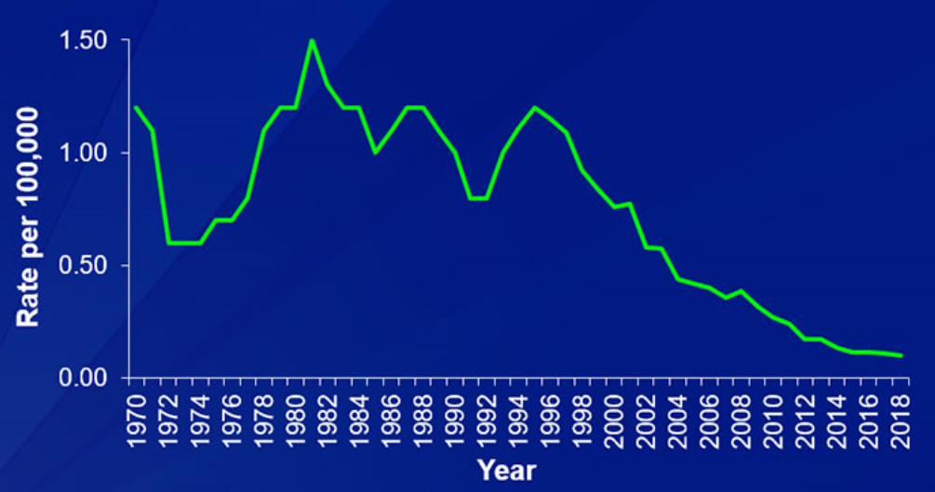
Historical Cases of Meningococcal Disease
United States, 1970–2018
Source: CDC. National Notifiable Diseases Surveillance System
Available at: https://www.cdc.gov/meningococcal/images/meningococcal-disease-incidence.jpg. Accessed October 16, 2020.
Notes:
2. Number of Cases 1981- 2012: MMWR 2012/p105-11/Tables 8-11
1. Number of Cases 1970-1980: MMWR 1981/p11-17/Tables of reported cases
1/Meyer ACIP Jun 2014/slide 22
59 outbreaks/2490 cases total over 2009-2013 = ~2 % outbreaks
~98% sporadic

Slide 91
Serogroup Distribution of IMD Cases in the US (1 of 2) (2007-2016)
Other^{a,b}
Serogroup B^{b}
Serogroup C^{b}
Serogroup Y^{b}
ªIncludes serogroup W and serogroups unable to be identified.
^{b}In patients aged <1 to $≥$65 years from 2007 to 2016; N=731.
Adapted from Centers for Disease Control and Prevention. Active Bacterial Core surveillance (ABCs). Neisseria meningitidis. Available at: http://www.cdc.gov/abcs/reports-findings/surv-reports.html. Accessed July 15, 2016.
Notes:
4/Stephens/ p 10/col 1/ para 2
2/CDC-ABCs /p 1-10/ tables 1-10
1/Pollard/S275/ col 1/ para 4
1/Pollard/S275/ col 2/ para 2; S274/col 2/ para 1
2/CDC-ABC 2002 and 2012/col 2/Table
3/Jackson/p 25/para 3
1/Jackson/p 25/para 2,3

Slide 92
Serogroup Distribution of IMD Cases in the US (2 of 2) (2015-2018)
62%
62%
Among adolescents and young adults aged 16-23 years, serogroup B caused over 60% of all meningococcal disease cases from 2015 to 2018 (N=223)
N=223
Centers for Disease Control and Prevention website. Enhanced Meningococcal Disease Surveillance Reports, 2015-2018. www.cdc.gov/meningococcal/surveillance/index.html#enhanced-reports. Accessed January 28, 2019.

