Slide 1
School Nurses Organization of Arizona Annual Conference June 21, 2019
The Role of the School Nurse
in Emergency Preparedness

Slide 2
Kaylee Sorensen Emergency management consultant The Trust ksorensen@the-trust.org
PRESENTED BY...

Slide 3
Background and Experience
Kaylee Sorensen has worked for the Arizona School Risk Retention Trust (Trust) for seven years. She earned her master of arts in emergency management and homeland security from Arizona State University and oversees the Trust Emergency Management Program.
Kaylee conducts trainings, assists districts with planning, and facilitates regional school safety consortiums around the state. She also serves on the Arizona Department of Education’s Emergency Preparedness Advisory Council, and as secretary of the International Association of Emergency Manager’s Children in Disaster Caucus.

Slide 4
The Development of a School Emergency Response Plan…
What is included in a school ERP plan?
Who should be involved with plan development?
Is prior experience in emergency operations planning required?
What roles and expertise do these people bring to the planning process?

Slide 5
ERP Plan—3 Main Components:
Basic Plan – Provides an overview of your school’s/district’s approach to emergency operations.
Functional Annexes – A standardized procedure that is implemented for several different hazards or threats such as evacuations, reverse evacuations, lockdowns, etc.
Hazard Specific Annexes – Address specific procedures, for a particular hazard or threat (power outage, bee swarm, intruder, etc.)

Slide 6
Who Should Be Involved With Plan Development—District Level?
Business & Finance
Student Services
Transportation
Health & Nutrition
Human Resources
Information Technology
Facilities
Community Education
Communication Office (PIO)
School Custodial Services

Slide 7
Who Should Be Involved With Plan Development—School Level?
Principal
Assistant Principal
Administrative Assistant
Custodian
School Nurse
Social Worker
Teacher
Psychologist
Counselor
Parent(s)

Slide 8
Best Approach? District and School Personnel!
Business & Finance
Student Services
Transportation
Health & Nutrition
Human Resources
Information Technology
Facilities
Community Education
Communication Office (PIO)
School Custodial Services
Warehouse
Principal
Assistant Principal
Administrative Assistant
Custodian
School Nurse
Social Worker
Teacher
Psychologist
Counselor
Parent(s)
Student(s)

Slide 9
What Can Each Potential Team Member Below Bring to Planning Process?
Business & Finance
Student Services
Transportation
Health & Nutrition
Human Resources
Information Technology
Facilities
Community Education
Communication Office (PIO)
School Custodial Services
Warehouse
Principal
Assistant Principal
Administrative Assistant
Custodian
School Nurse
Social Worker
Teacher
Psychologist
Counselor
Parent(s)
Student(s)

Slide 10
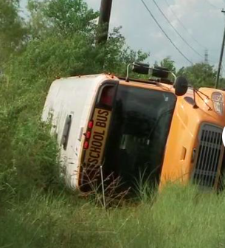
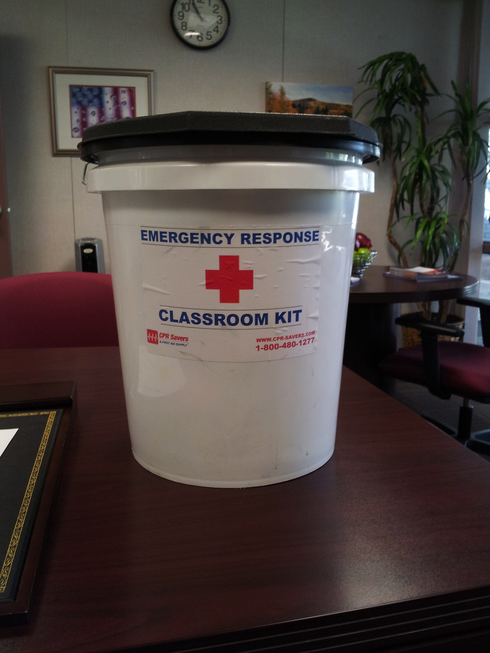
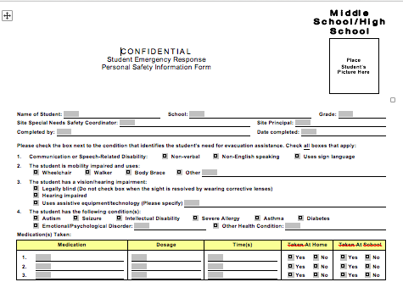
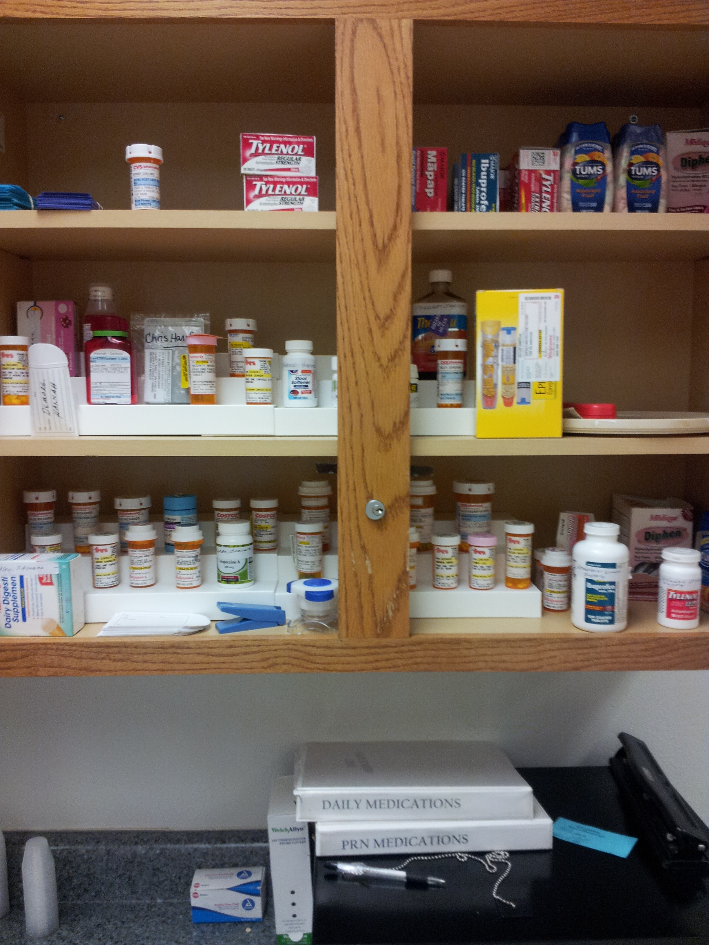
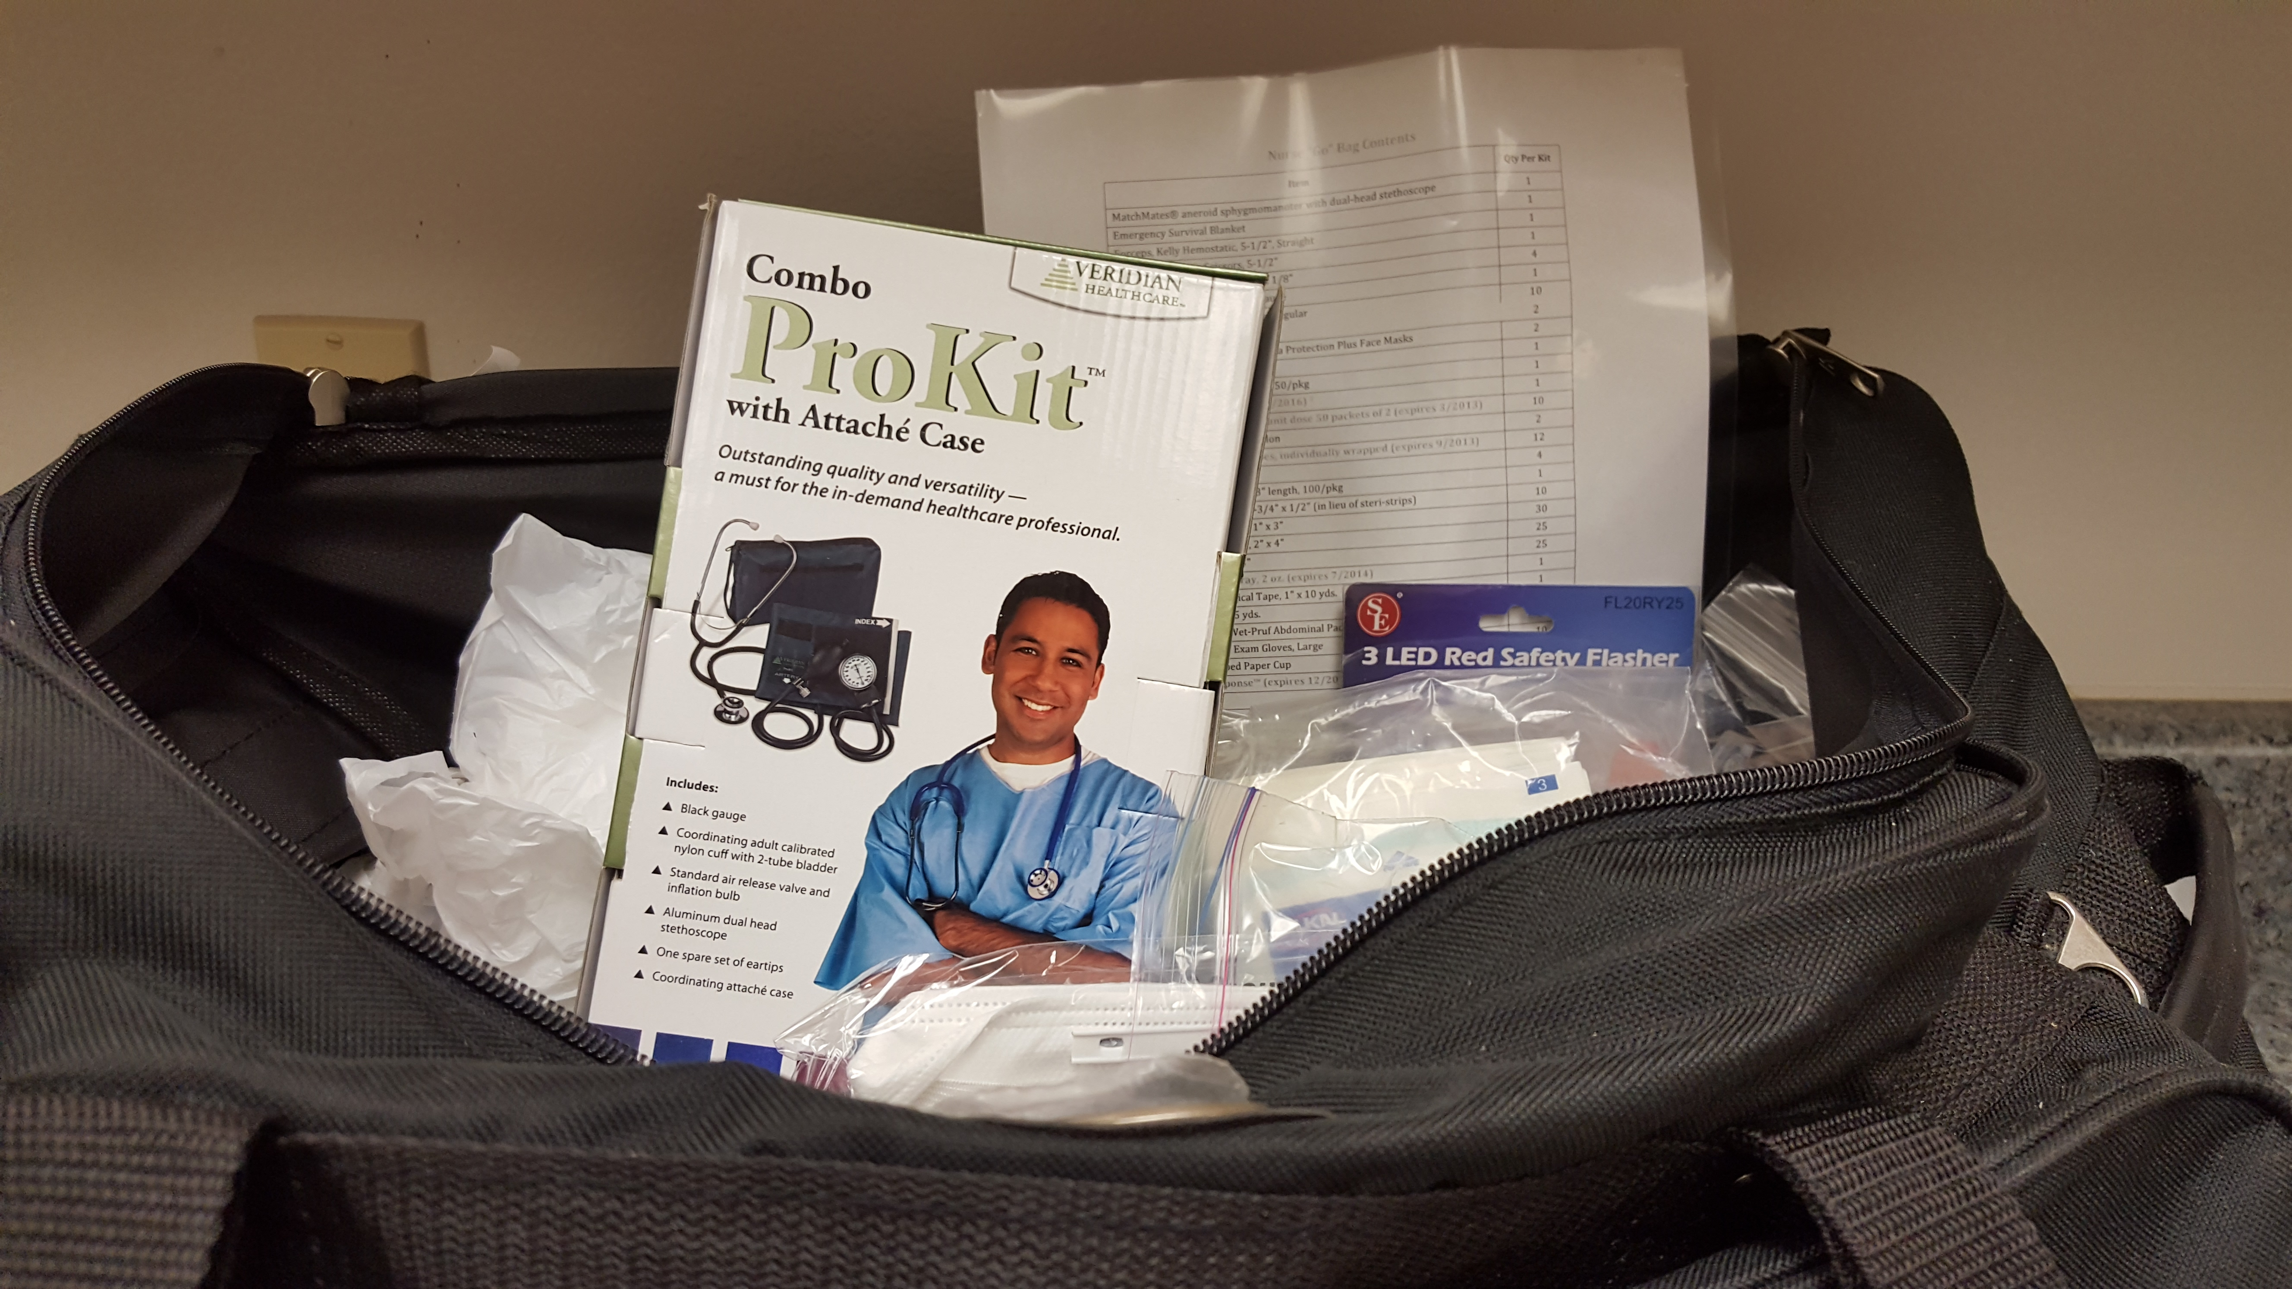
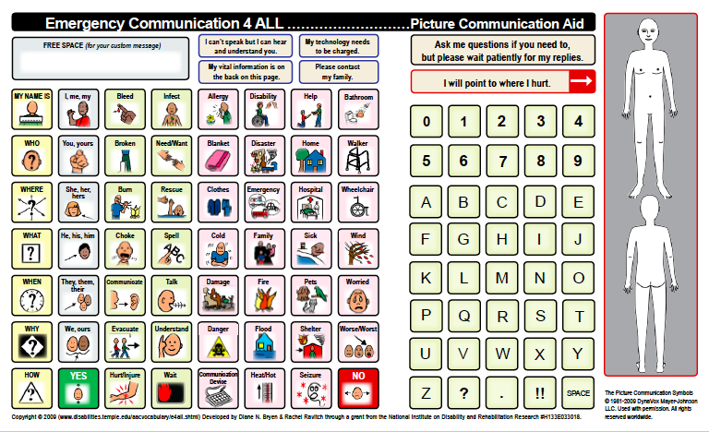
What Expertise Does the School Nurse Bring to the Planning Process?

Slide 11
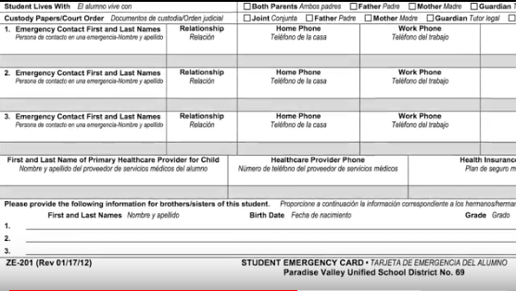
Knows the Medical Conditions and Medication Needs of the Students

Slide 12
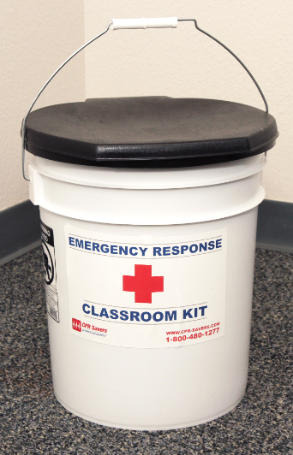
Assists, Facilitates, and/or Organizes the Nurses & Classroom “Go Kits”

Slide 13
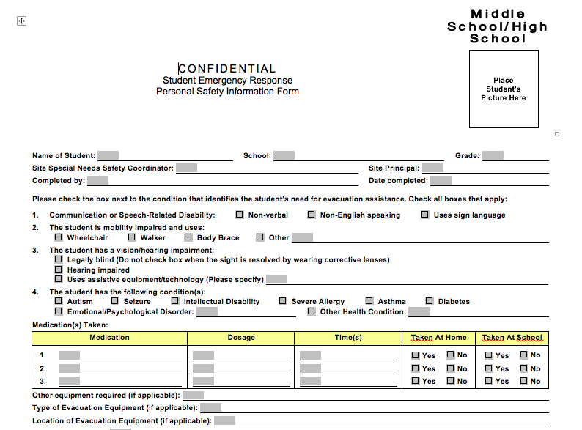
Participates in the Development of Assistance Plans for Students With Disabilities

Slide 14
Develop Protocols i.e…. Pandemic Influenza and Heat Related Illnesses

Slide 15
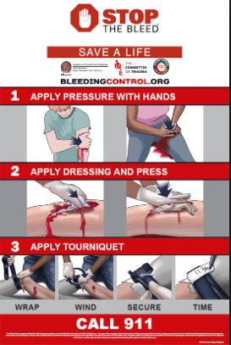
Organize and/or facilitate Stop the bleed trainings for staff

Slide 16
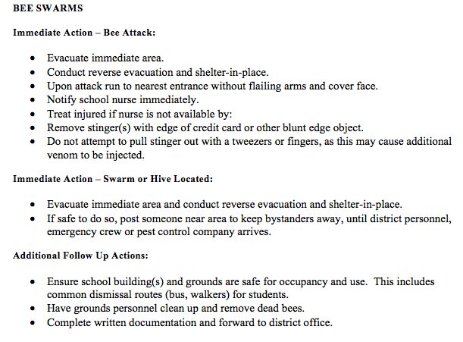
Participates in the Development and/or Renewal of Functional & Threat/Hazard Annexes

Slide 17
Member of the School Incident Command Team

Slide 18
School Disaster Reception ICS Chart Medical Unit
Source: School District Planning Reunification Guide 2017 – Coyote Collaborative

Slide 19
Checklist for the Medical Unit Leader
1. Equipment and Supplies:
Use Equipment and Supply Checklist in Attachment B to validate equipment and supply availability.
Obtain from Division Supervisor maps, logistical information, and plans
Check equipment and supplies.
Communicate to Division Supervisor needed equipment and supplies.
Identify and communicate space needs for medical care.
Bring first aid supplies to dedicated space

Slide 20
Medical Team Leader
Mission: It is the mission of the Medical Unit Supervisor to staff, equip, supply, and oversee the Medical Unit.
The Medical Unit Leader …… This Leader participates in disaster team planning to meet goals and objectives.

Slide 21
Additional Checklist Items:
2. Staffing:
Work closely with Student Care.
3. External Contacts Made.
4. Training
5. Assessments:
Determine planning priorities.
Determine if there are any medical needs specifically needed by staff entering the facility, including whole community needs.
Determine estimated length of time for the expected operational period.
Identify the plan for distribution of medications, including those for handling minor illness in children.
Identify and provide minor first aid as appropriate.
Consider student food and water needs.

Slide 22
Checklist Items continued…
6. Communications:
Report planning priorities to the Division Supervisor.
Communicate with Division Supervisor for planning and resource needs.
Submit medical distribution protocols to the Division Supervisor for distribution.
Document all action/decisions and send a copy to the Division Supervisor.

Slide 23
Valued Team Member of the School/District Crisis Intervention Team

Slide 24
”8” PFAS Core Actions…

Slide 25
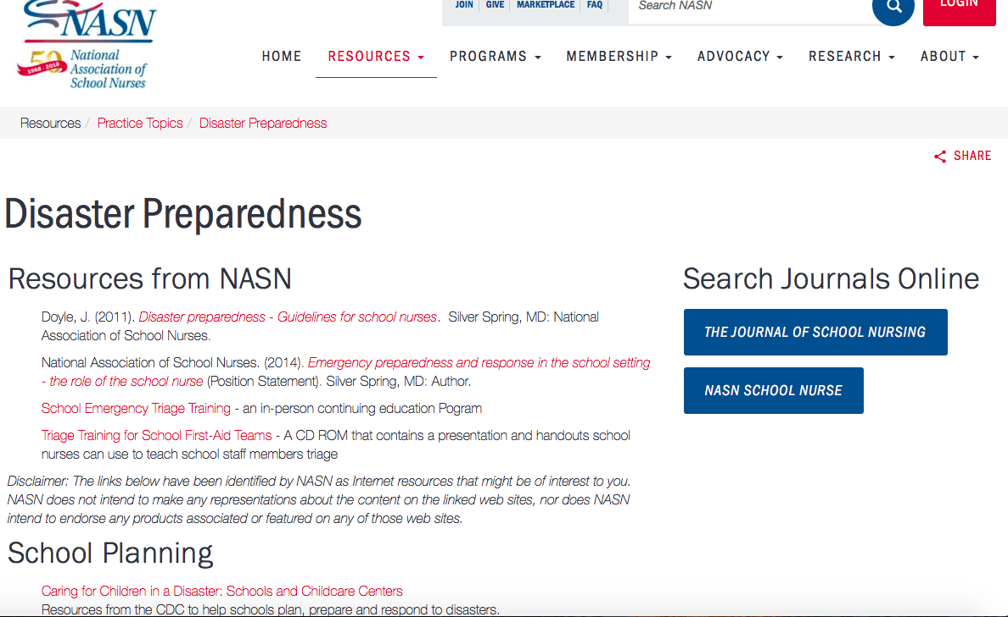
Great Resource for School Nurses: http://www.nasn.org/home

Slide 26
NASN -- Emergency Preparedness and Response in the School Setting The Role of the School Nurse Position Statement
It is the position of the National Association of School Nurses (NASN) that the registered professional school nurse provides leadership in all phases of emergency preparedness and response.
School nurses are a vital part of the school team responsible for developing emergency response procedures for the school setting using an all‐hazards approach.
The school nurse is often the first health professional who responds to an emergency. The school nurse has the education and knowledge to identify emergent situations, manage the emergency until relieved by emergency medical services (EMS) personnel, communicate the assessment and interventions to EMS personnel, and follow-up with the health care provider.

Slide 27
PREVENTION/ MITIGATION
School nurses should participate in an ongoing assessment to identify hazards from all possible sources and to reduce the potential for an emergency to occur. Examples include:
Educating students and staff about recognizing and reporting suspicious behaviors and persons.
Implementing and maintaining an effective immunization program for students and staff.
Improving security measures to control access to school facilities and using metal detectors at entry points if appropriate (Doyle, 2011).

Slide 28
PREPAREDNESS
School nurse participation on community‐ wide planning groups is helpful in the facilitation of a rapid, coordinated, effective emergency response within the framework of the ICS. This includes establishing standard emergency response plans and practicing skills, drills and other exercises to evaluate the response capabilities of a school, as well as the effectiveness of the plan (e.g., medical emergency, evacuation, shelter‐ in‐ place, lock down, and intruder).
Specifically, the school nurse can be instrumental in identifying unique emergency preparedness needs for children with special health care needs, as well as specific equipment and supplies needed to respond, and to assess for and provide first aid.

Slide 29
RESPONSE
The school nurse is knowledgeable about her or his role in responding to an emergency, which may include triage, training of first aid response teams, and direct physical and mental health care for all victims of an emergency, including linking them to medical and public health resources. The school nurse also serves a vital role in reuniting families during and after a crisis (RWJ, 2012).
NASN’s School Emergency Triage Training (SETT) program, (NASN, 2012) provides school nurses with the knowledge, skills and resources to perform as leaders of First‐ Aid teams in response to mass casualty events occurring in the school setting.

Slide 30
RECOVERY
After a disaster, the school nurse assists students, parents, and school personnel, providing direct support and serving as the liaison between community resources and those in need. This includes both short and long‐ term recovery, and may include maintenance of student and staff health status, as well as mental health issues and psychological response.

Slide 31
Questions? Thank you!
Kaylee Sorensen Emergency management consultant The Trust ksorensen@the-trust.org

