Slide 1

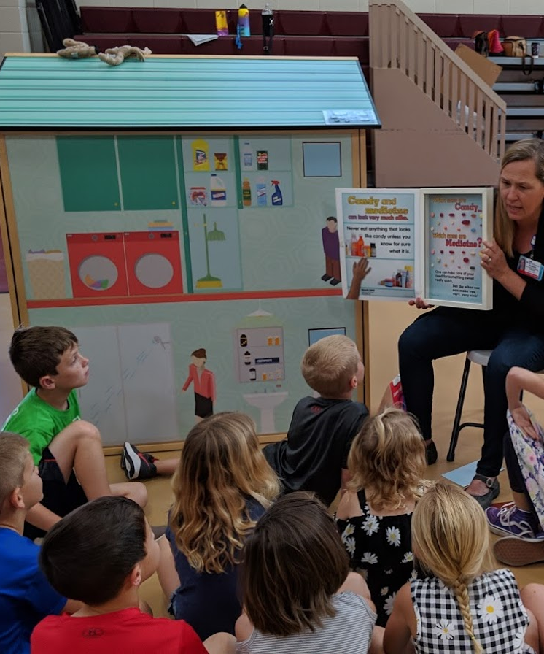
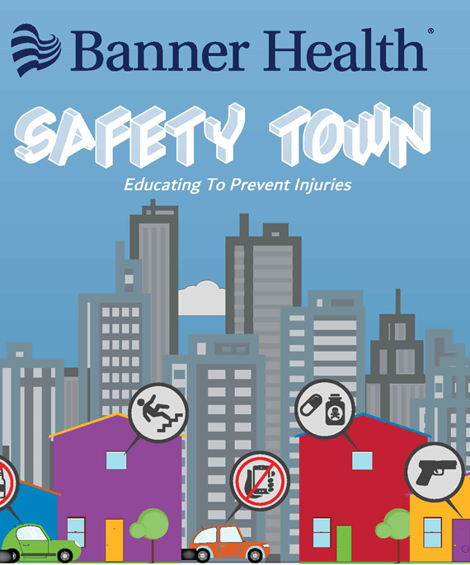
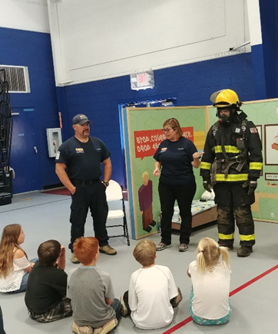
Safety Town: A Statewide Mobile Injury Prevention Program
Tracey Fejt, RN
Trauma Outreach/Injury Prevention Coordinator
Banner Desert/Cardon Children’s Medical Center
Melissa Luxton, MSN, RN
Trauma Outreach/Injury Prevention Coordinator
Banner University Medical Center Phoenix

Slide 2
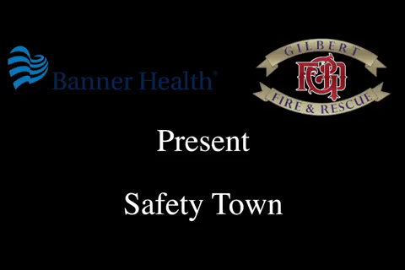

Slide 3
History
Over 30 years ago the program was started by ED physicians with an array of funding through out the year
Cardon Children’s Injury Prevention was in 14 elementary schools kinder to fifth grade approximately 1500 children in four east valley cities
30 minute presentation were given each month August- April and in May helmets were fitted to each student
Topics included healthy living/germs – pedestrian – fire- stranger danger – poison – bike/helmets – car seat/booster/seatbelt – gun – water safety

Slide 4
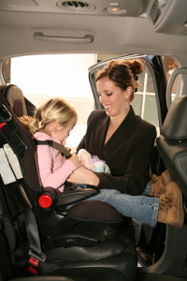
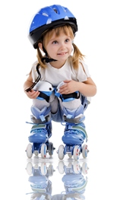

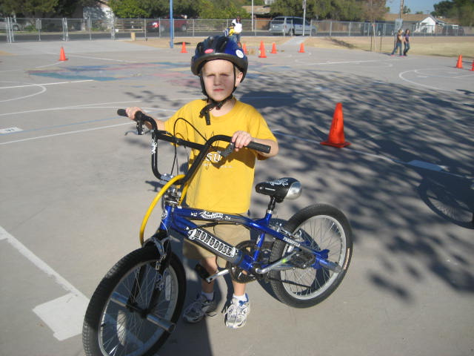
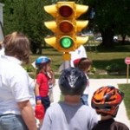

Safety Town – An Injury Prevention Program
Cost: $300,000
Build Safety Town to be an interactive educational destination for kids, teens and adults.
Anchored at Cardon Children’s Medical Center a Mobile Safety Town to take to events around the metro area and state to teach injury prevention.
Safety topics to be included:
Water & Fire
Booster Seat
Bicycle & Pedestrian
Stranger Danger
Distracted Driving
Fall Prevention

Slide 5
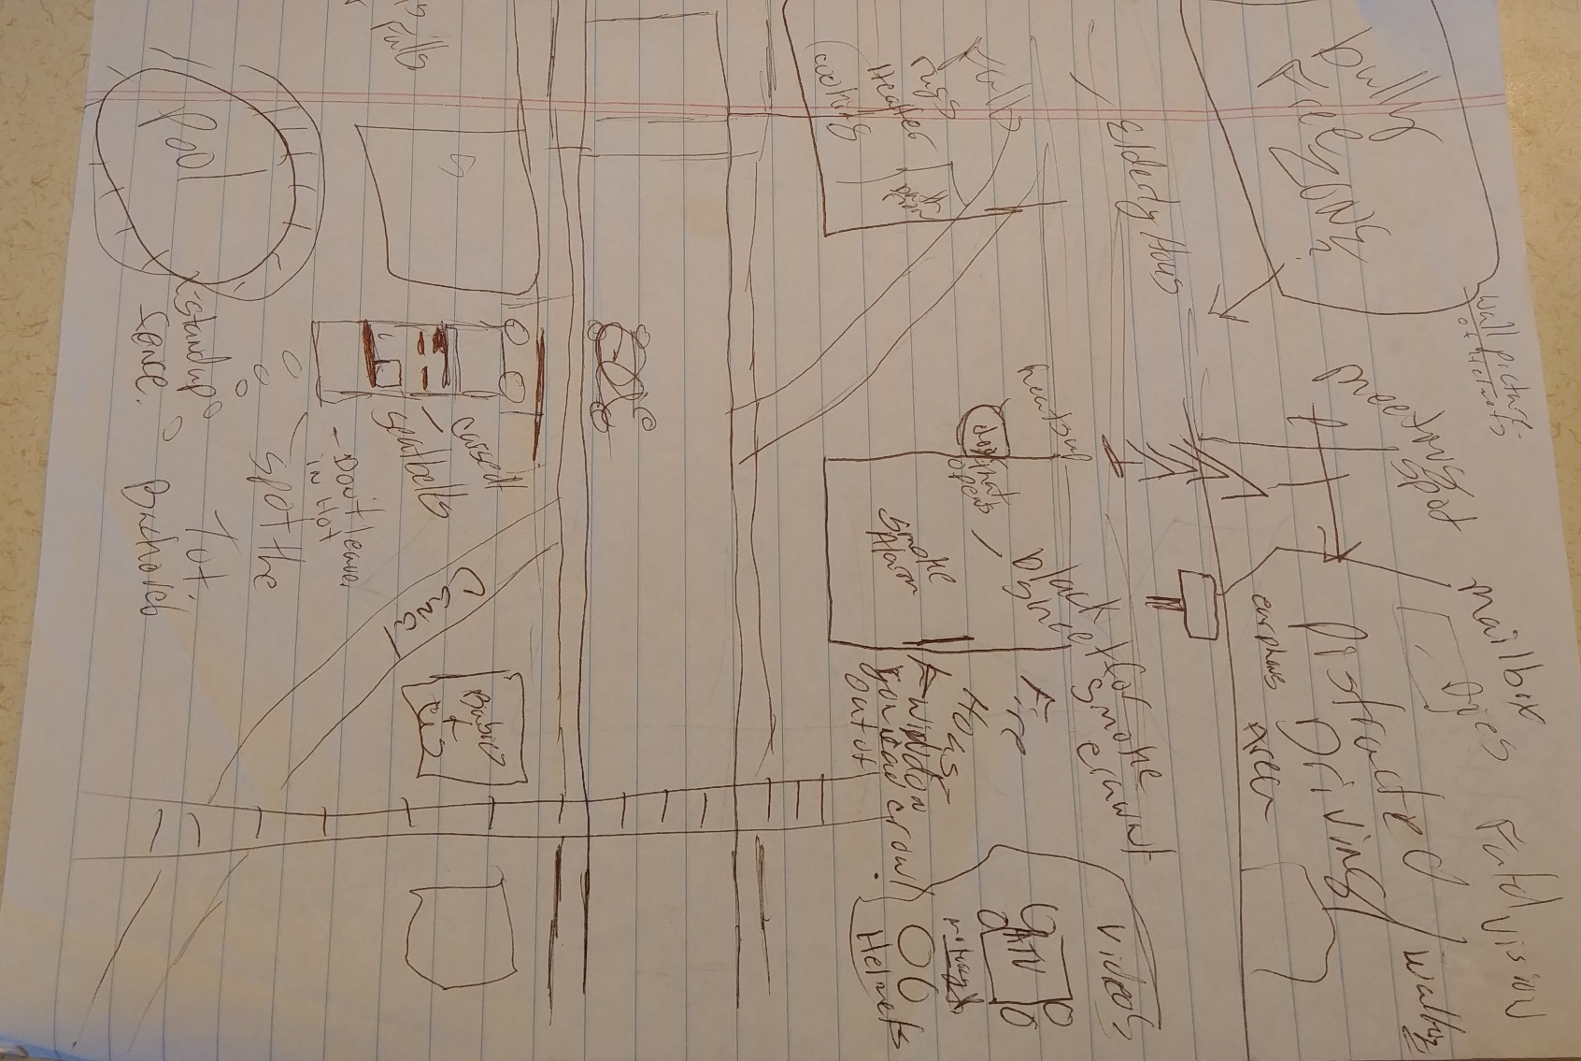
And So It Begins
Hey, I’m a nurse not an artist…

Slide 6
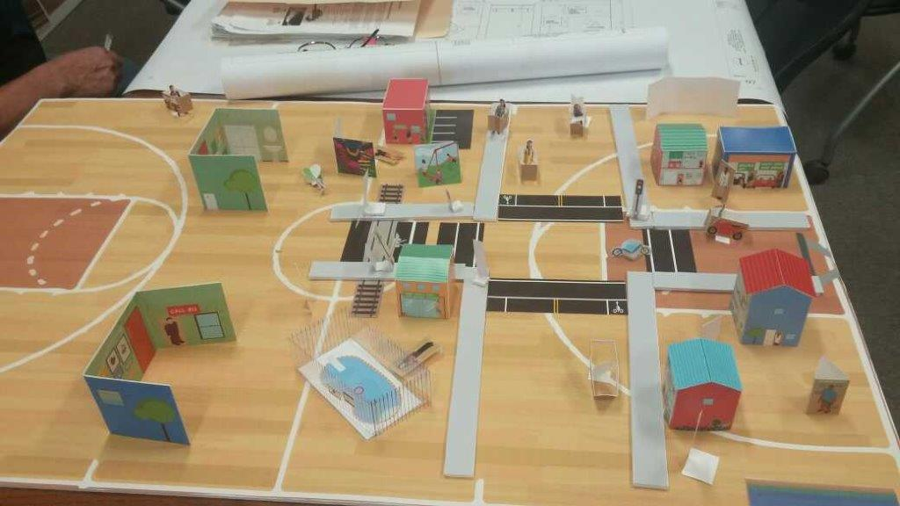
The Design Process

Slide 7
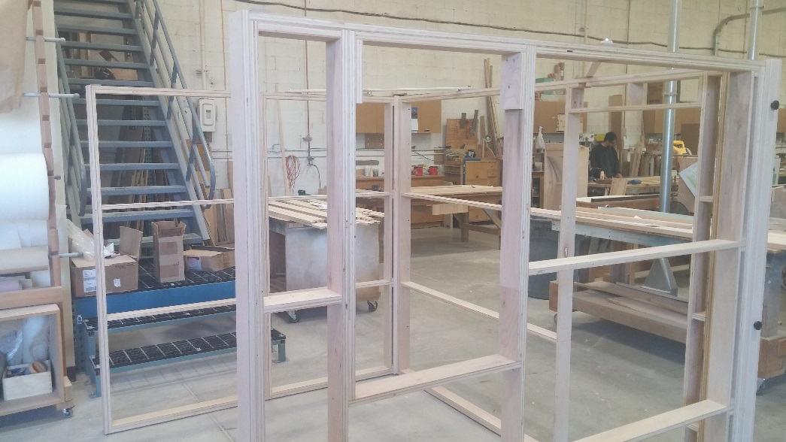
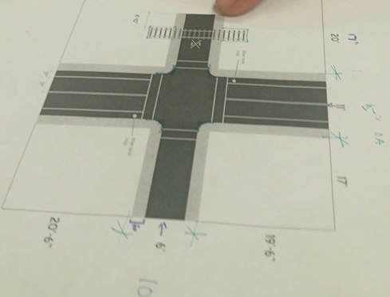
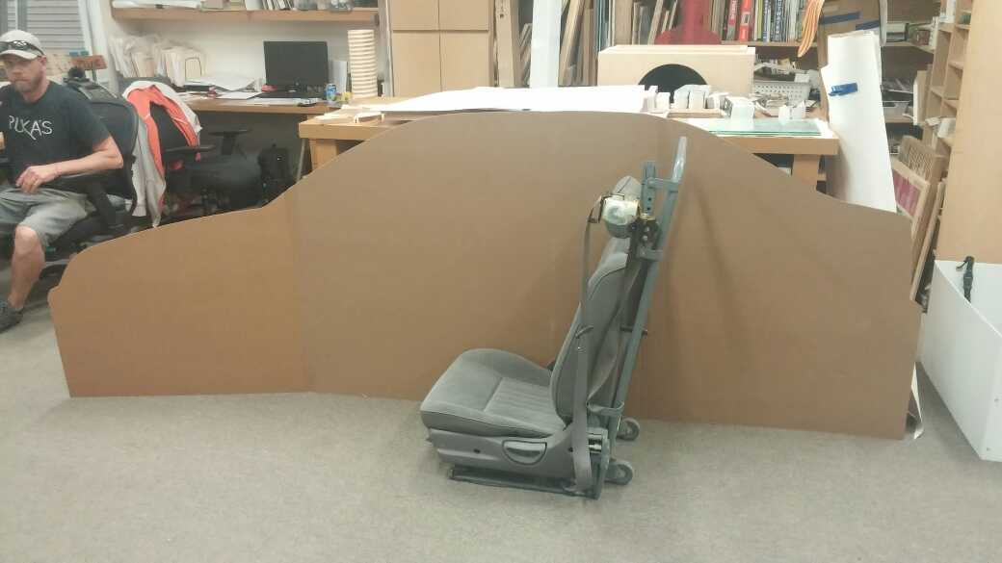
The Design Process

Slide 8
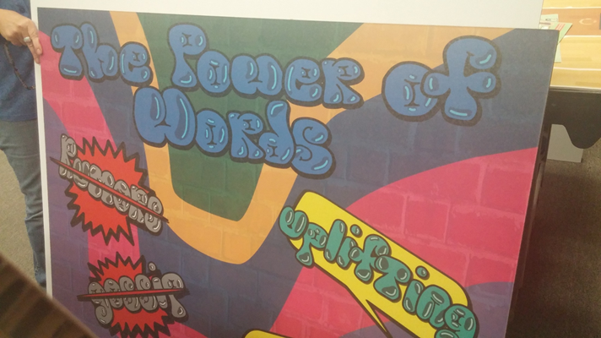
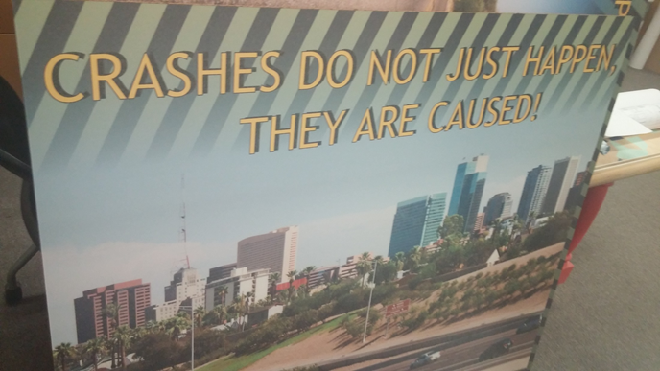
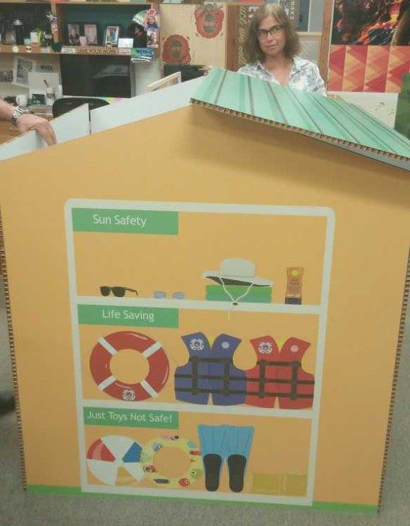
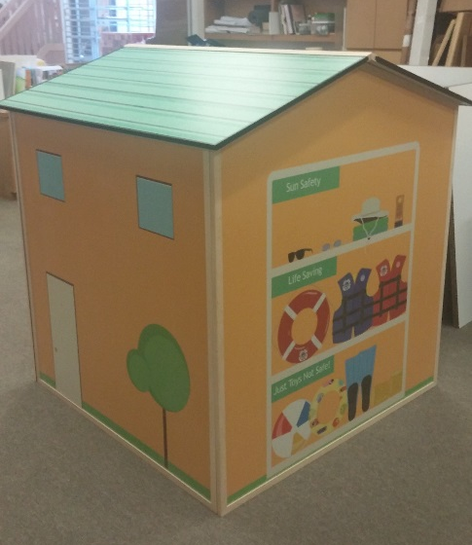
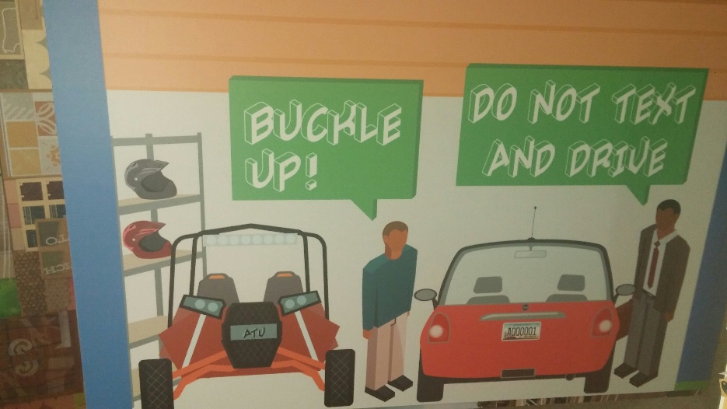
The Design Process

Slide 9
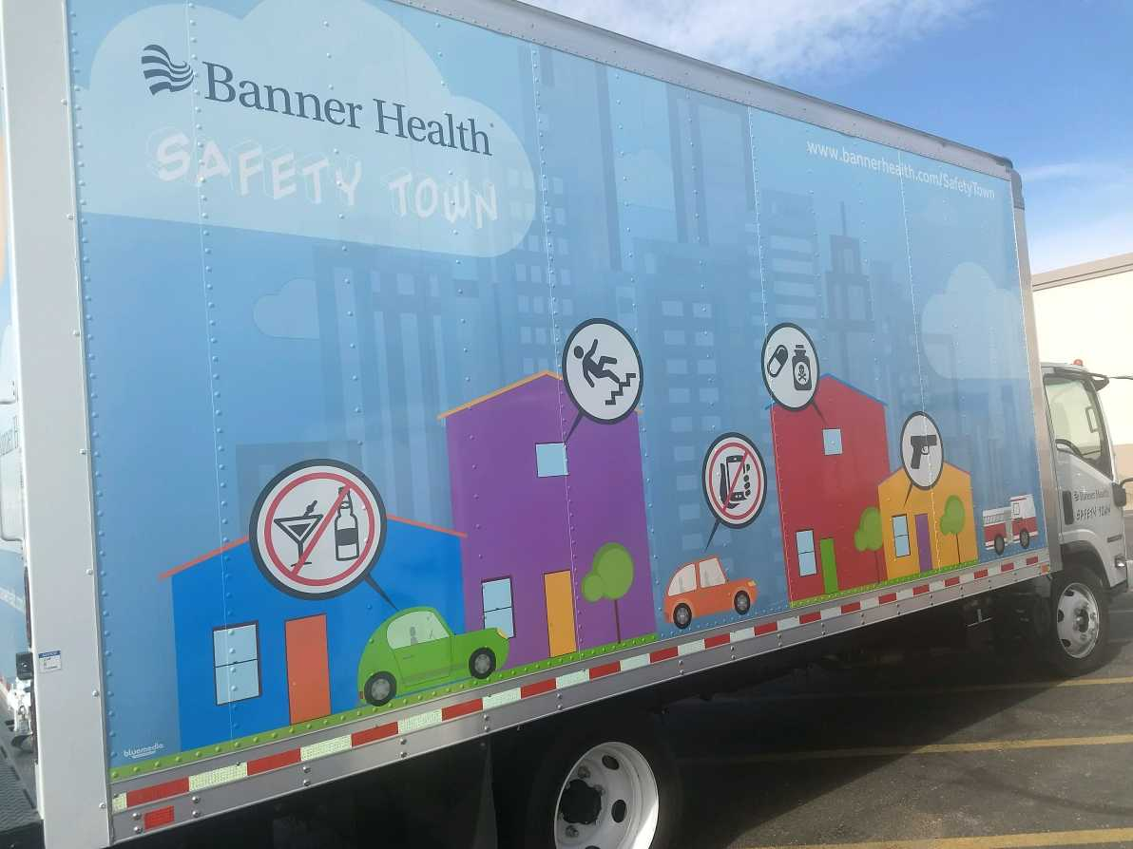
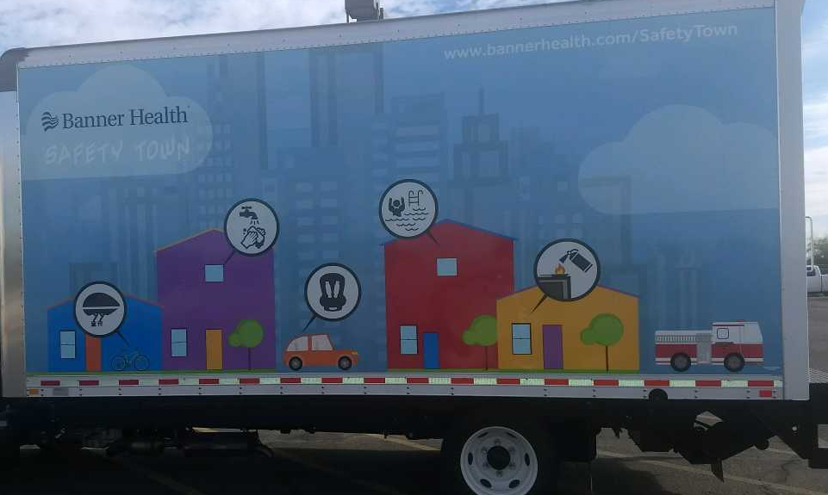
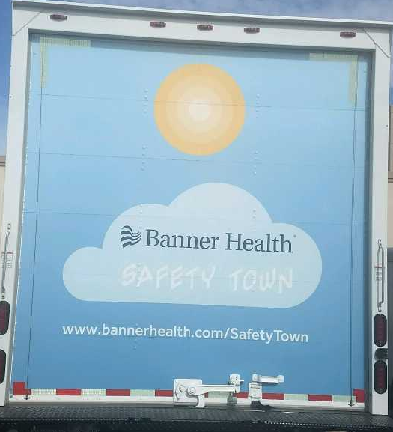
The Truck
Teen/ Adult
Children
The truck is designed to transport all of the components of safety town. All of the components are light-weight, easy to set-up, and designed to travel anywhere…. making this Arizona’s first ever mobile safety town.

Slide 10

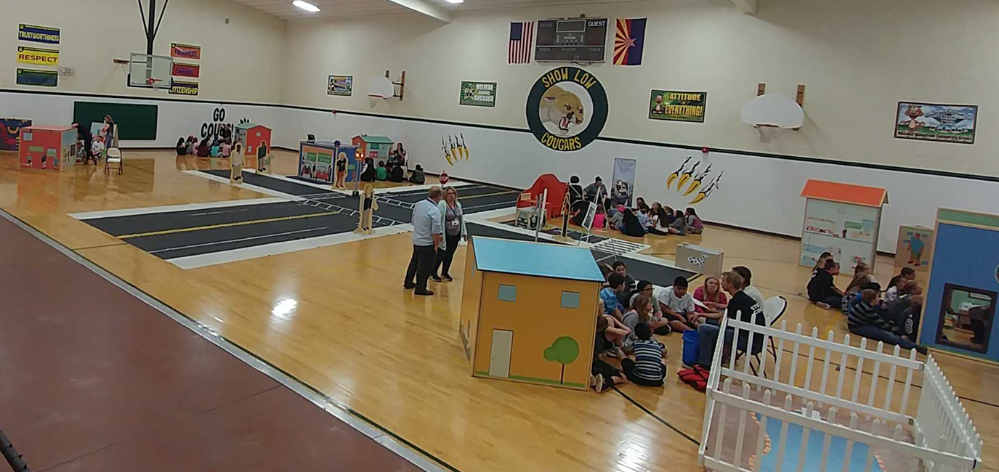
An interactive safety experience for the entire family
Notes:
9 injury prevention stations for elementary schools- Helmet, Healthily living, car- seatbelt/car seat /booster, bike/pedestrian/railroad, Stanger danger, playground falls/anti-bulling, fire, poison, gun.

Slide 11
According to the National Action Plan for Child Injury Prevention
Childhood unintentional injuries are the leading cause of death among children ages 1 to 19 years, representing nearly 40 percent of all deaths in this age group.
Each year, an estimated 8.7 million children and teens from birth to age 19 are treated in emergency departments (EDs) for unintentional injuries and more than 9,000 die as a result of their injuries—one every hour.
Common causes of fatal and nonfatal unintentional childhood injuries include: drowning, falls, fires or burns, poisoning, suffocation, and transportation-related injuries.
Injuries claim the lives of 25 children every day. While tragic, many of these injuries are predictable and preventable.
Banner Health’s Safety Town was created to address preventable injuries

Slide 12
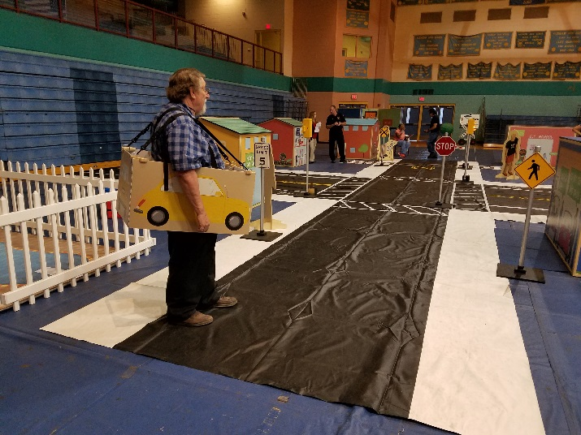
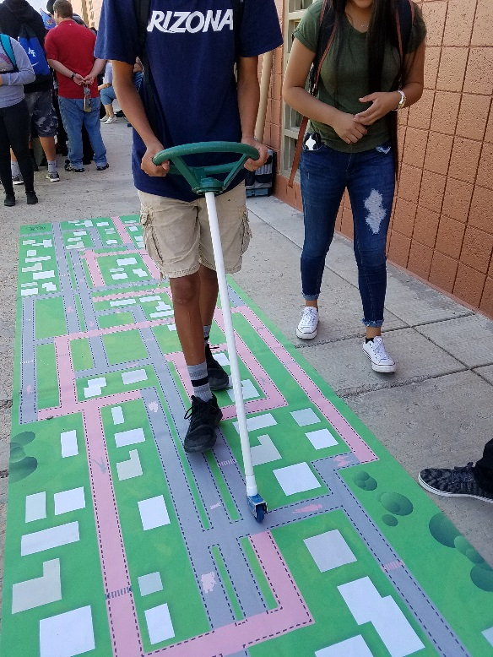
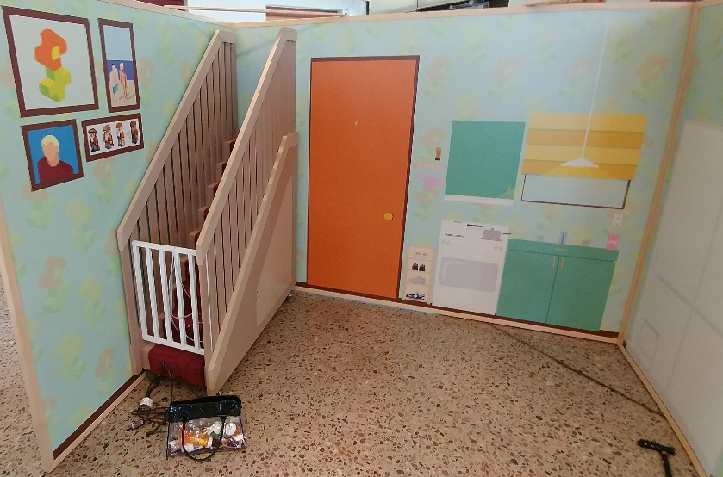
The Town Has Multiple Education Stations When Use As A Whole.
It can also be broken down into three different areas
Safety Town Elementary
Distracted Driving
Senior Education

Slide 13
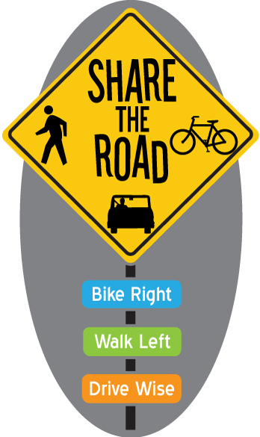
Bike & Pedestrian Safety
can be use with the entire town or as a bike rodeo

Slide 14
Bicycle Safety
How big is the problem?
In 2015 in the United States over 1,000 bicyclists died and there were almost 467,000 bicycle-related injuries
Data from 2010 show fatal and non-fatal crash-related injuries to bicyclists resulted in lifetime medical costs and productivity losses of $10 billion
Bicycle trips account for only 1% of all trips in the United States. However, bicyclists face a higher risk of crash related injury and deaths than occupants in motor vehicles.
(CDC, 2017)

Slide 15
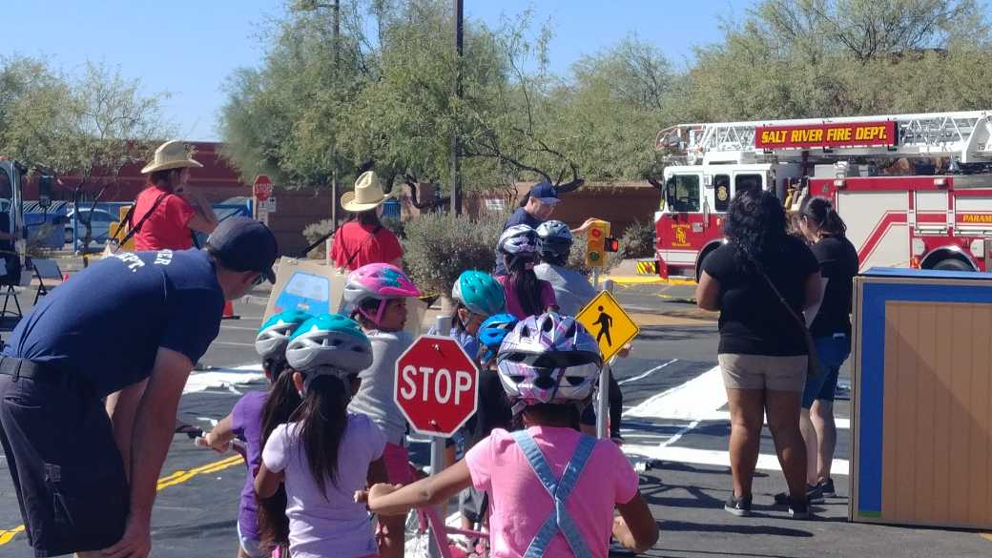
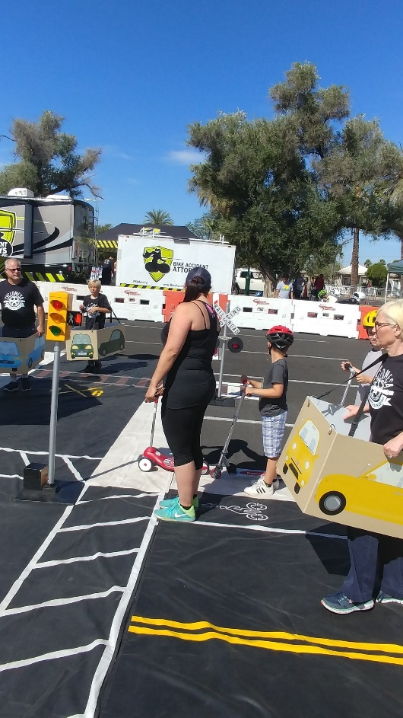
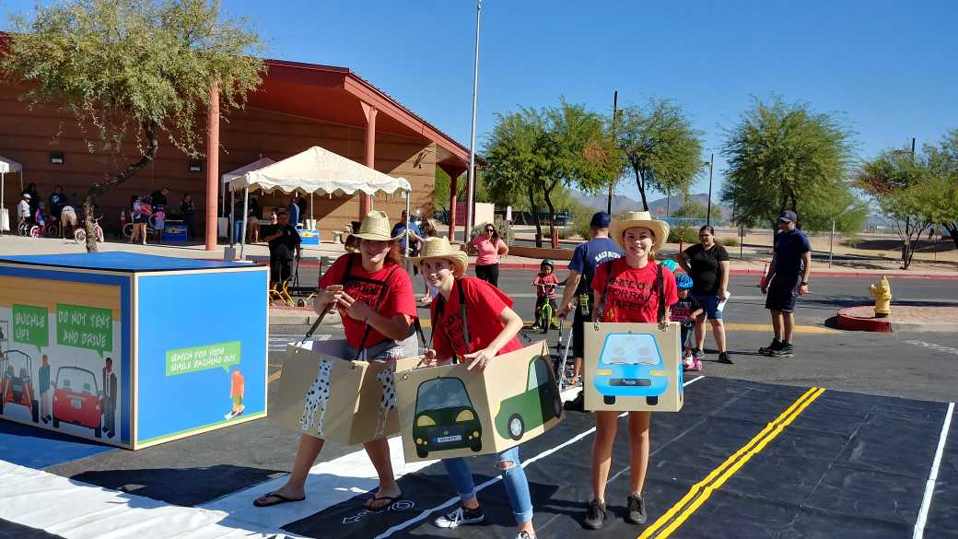
Safety Town/Bike Rodeo
Safety town features working traffic lights, pedestrian crosswalks, and railroad crossings. Helmet safety is done as it’s own station.
Cars, motorcycles, and emergency vehicles give a life-like simulation of real-life obstacles to be aware of.

Slide 16
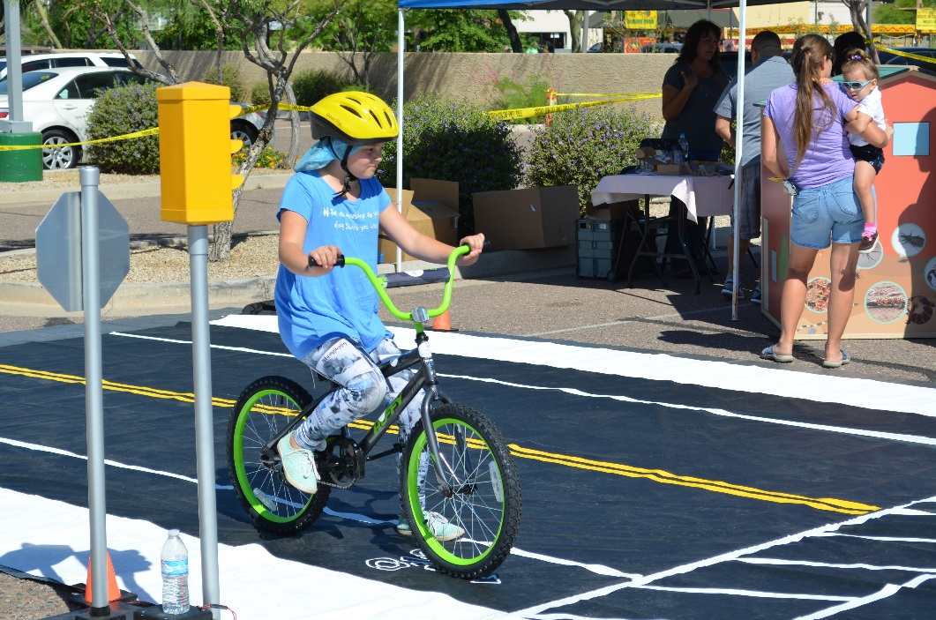
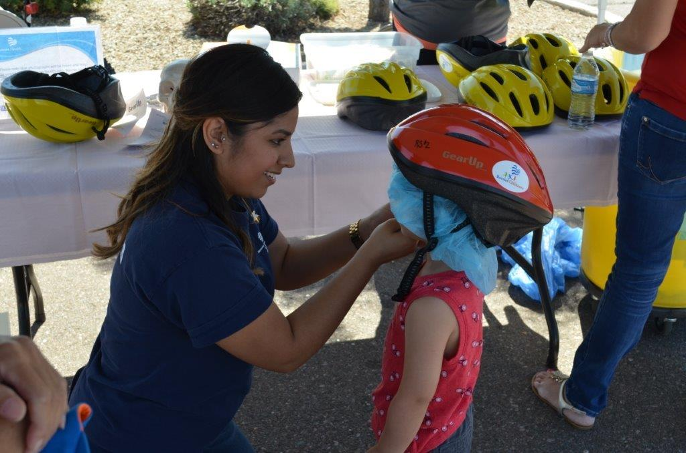
Safety Town/Bike Rodeo
Safety Town features 9 bicycles and 12 scooters in various sizes, allowing for enhanced learning among the entire family.
Children and Adults are educated on the importance of helmet use and shown how to properly fit a helmet.

Slide 17
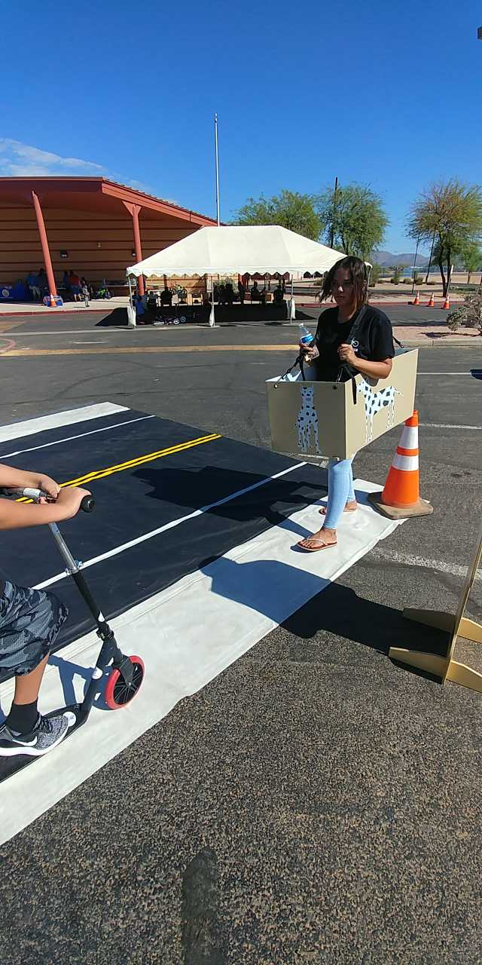
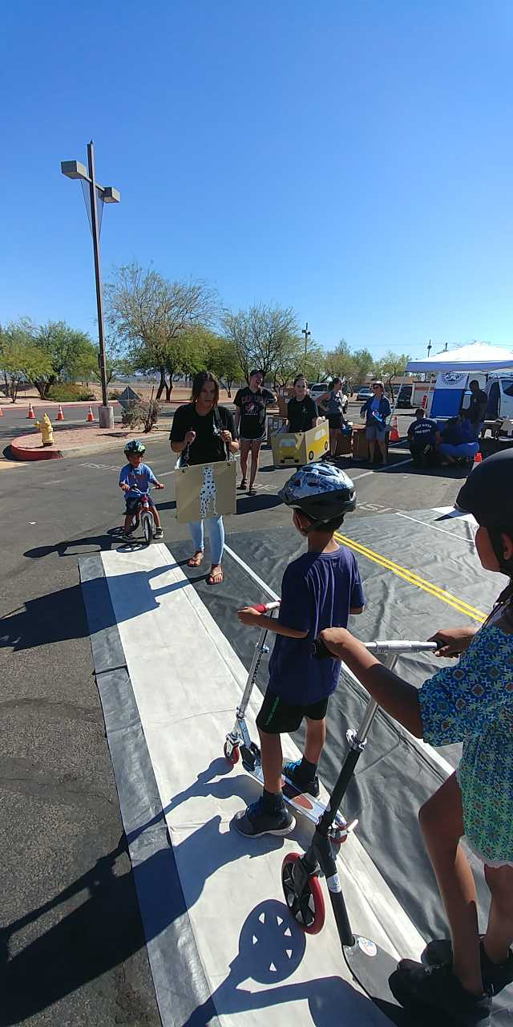
Dog Bites
Dog bites can cause pain and injury and infection. Nearly 1 in 5 people bitten by a dog requires medical attention. Any dog can bite.
Children are more likely than adults to be bitten by a dog, and when they are, the injuries can be more severe.
Safety town features a dog to teach the following
Stop! Stay still and be calm.
Say “No” or “Go Home” in a firm, deep voice.
Slowly back away

Slide 18
Deaths Due To Child Vehicle Heat Stroke And Off-Highway Vehicle Deaths
Statistics the average number of US child vehicular heat stroke per year, one every 9 days
Heat Stroke Deaths by Year since 2014
2014- 32
2015- 25
2016- 39
2017- 43
2018- 52
7 deaths by the end of May 2019
Off-Highway Vehicles Deaths
2014- 649
2015- 612
2016- 679
2017- 507
2018- 462
2019 (as of May 1st)- 96

Slide 19
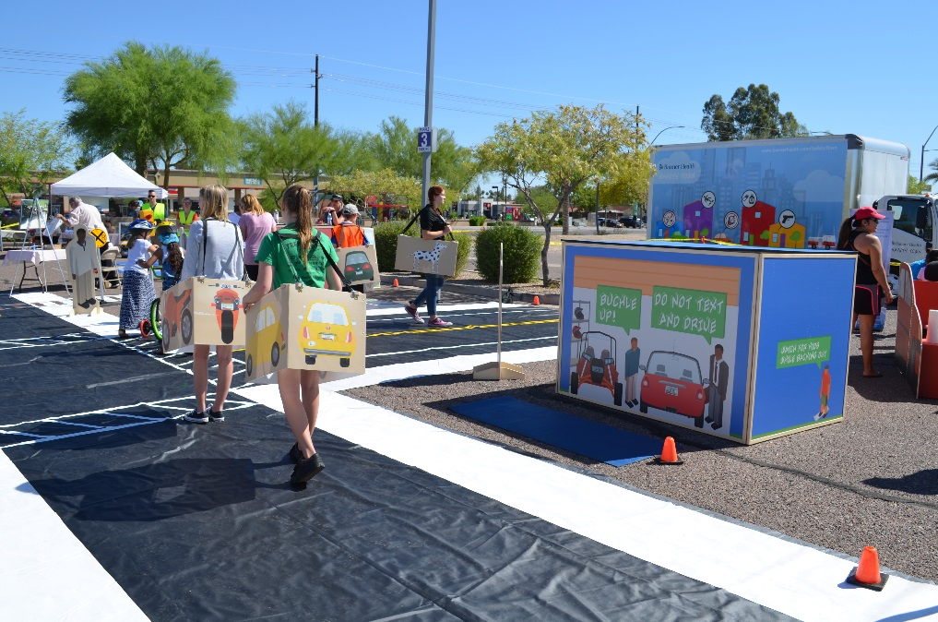
Back-Overs, Hot Cars, and OHV
The garage area discusses the dangers of back-overs and hot cars and proper use of helmets for Off Highway Vehicles and other safety tips

Slide 20
Car Crashes
According to the Arizona Department of Transportation there were 919 deaths resulting from car crashes in the state of Arizona in 2017.
On average, one person was killed in a car crash every 9.53 hours in 2017, according to ADOT data.
ADOT said 312 of those killed in 2017 weren't using seat belts including child restraints.
Speeding, impairment and lack of seat-belt usage are the leading fatality factors.
(ADOT, 2018)

Slide 21
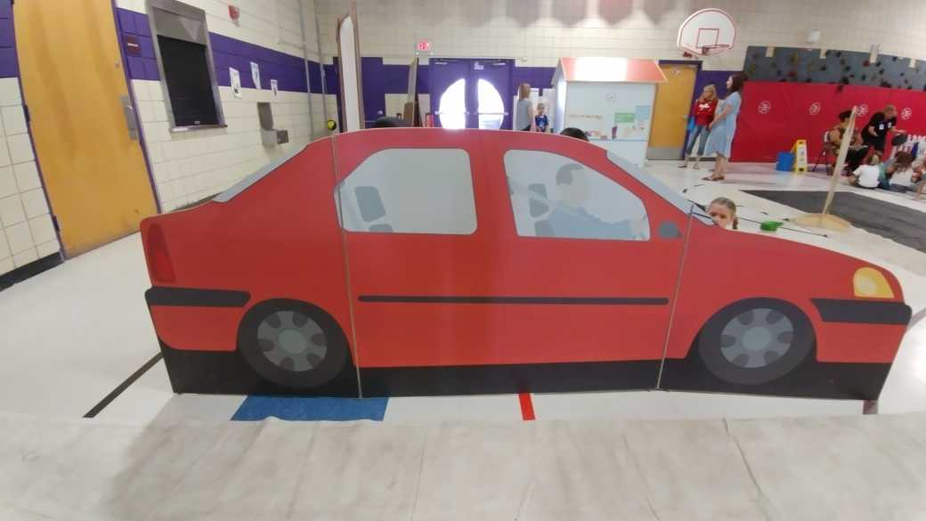
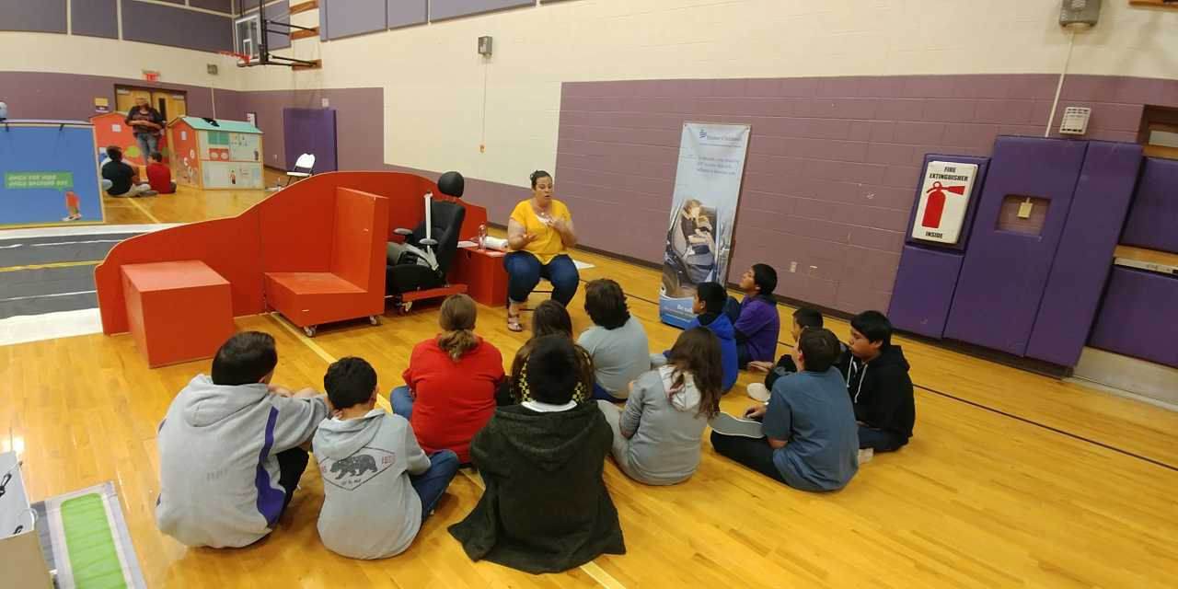
Motor Vehicle Safety: Car Seats, Booster Seats, Seatbelts, and Airbags

Slide 22
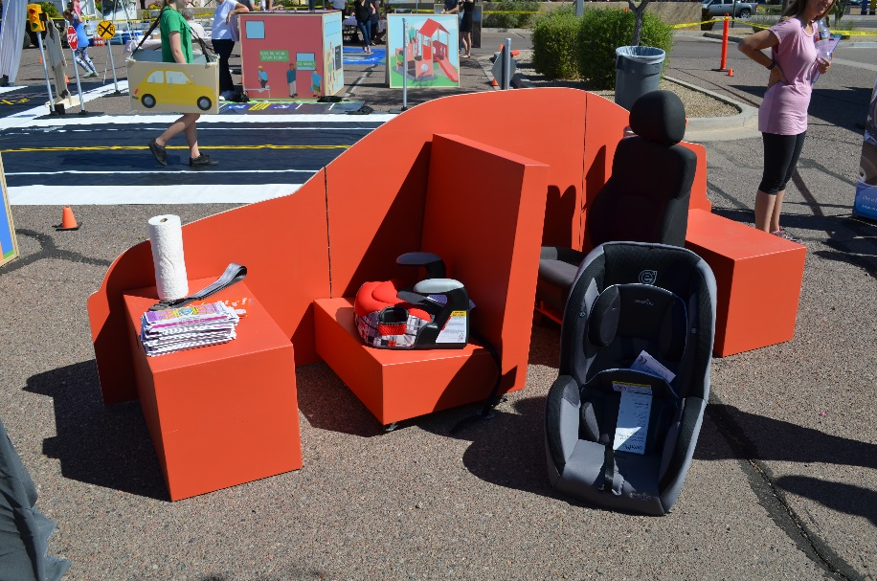
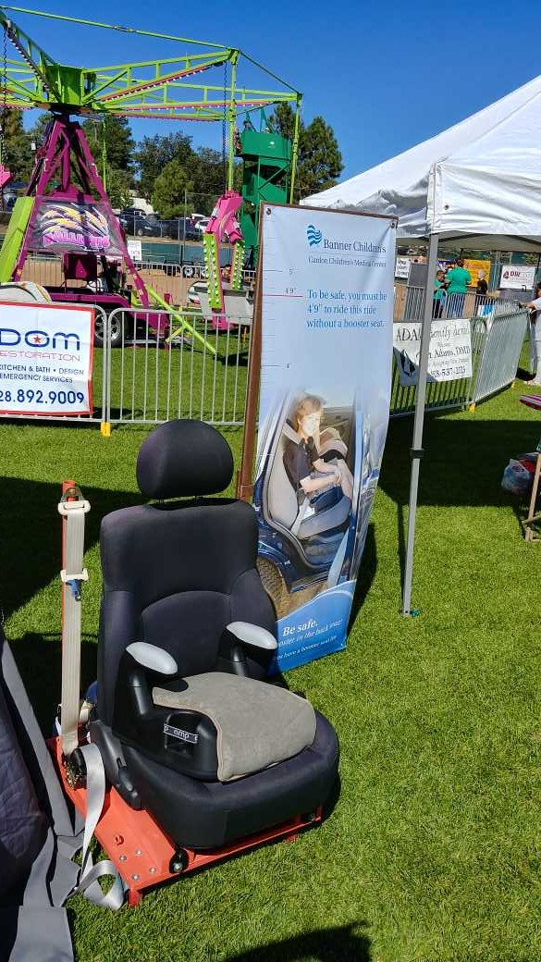
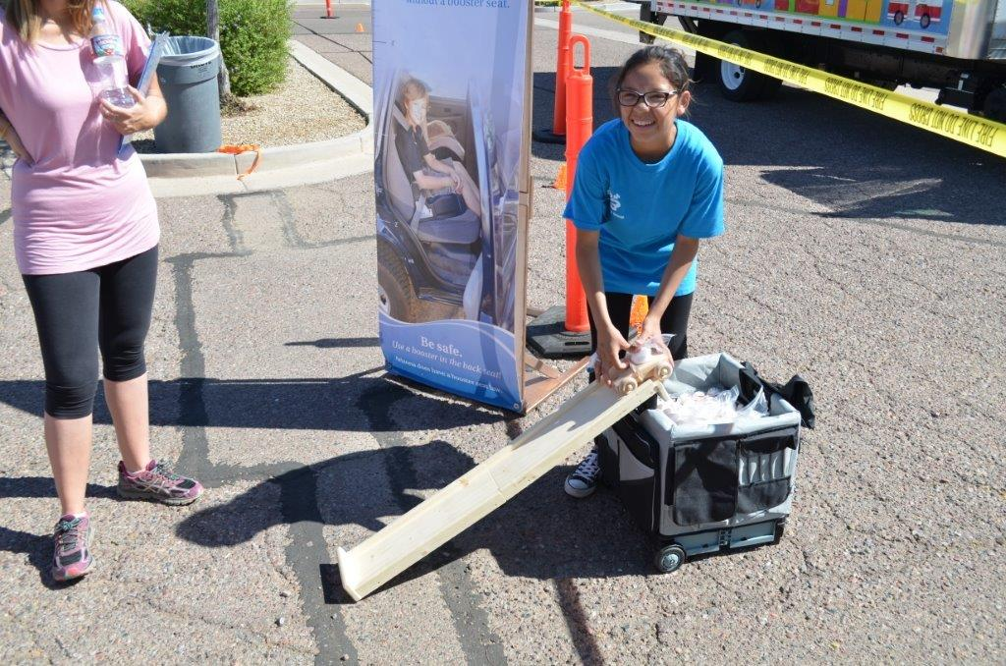
Features an interactive car with an actual seat from a car that allows real-time car and booster seat installation education
The Buckle Up for Life egg car ramp shows the importance of seatbelt

Slide 23
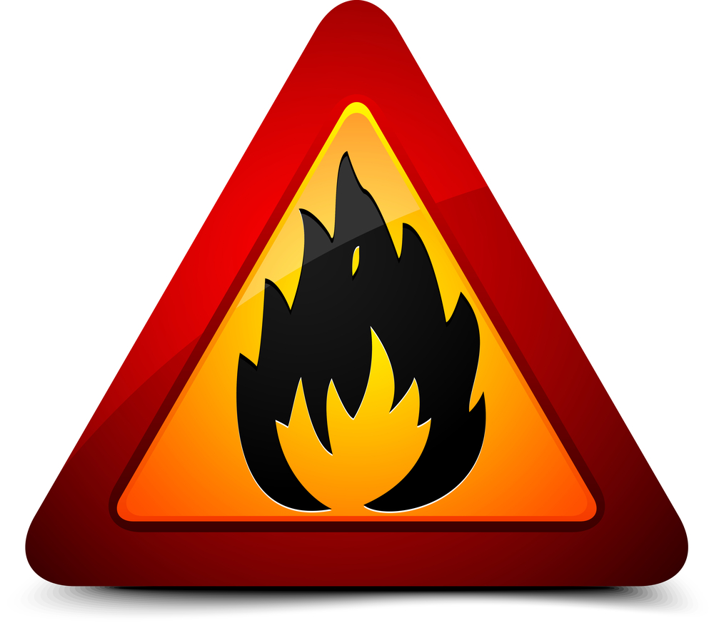
Fire Safety
In 2016, “Residential” was the leading property type for fire deaths (73.2%), fire injuries (76.5%) and fire dollar loss (54.7%)
In 2016
  1,800 fatal fires in the U.S.
  7000 fires resulting in injuries
(U.S. Fire Administration, 2019)

Slide 24
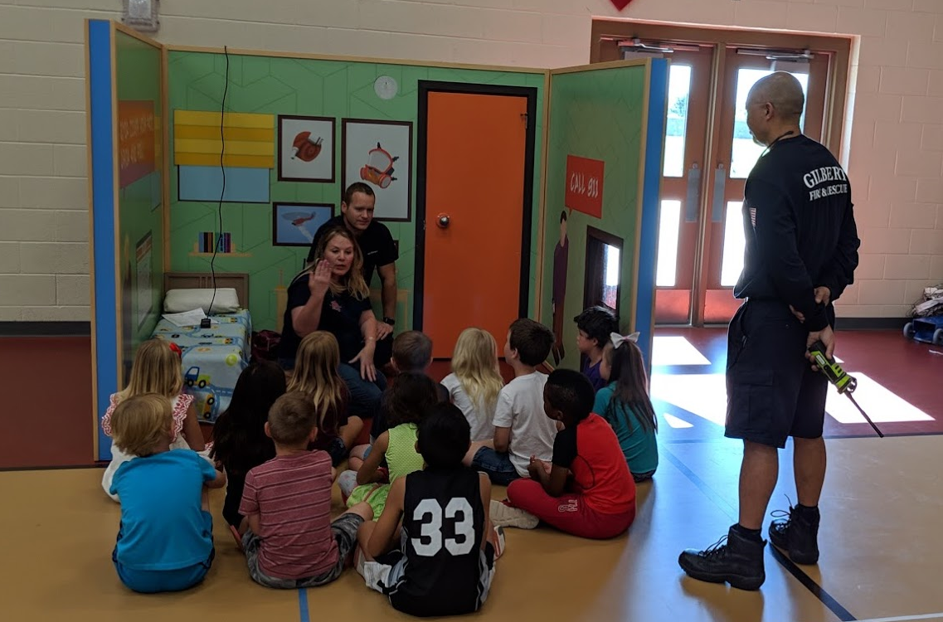
Fire Safety House

Slide 25
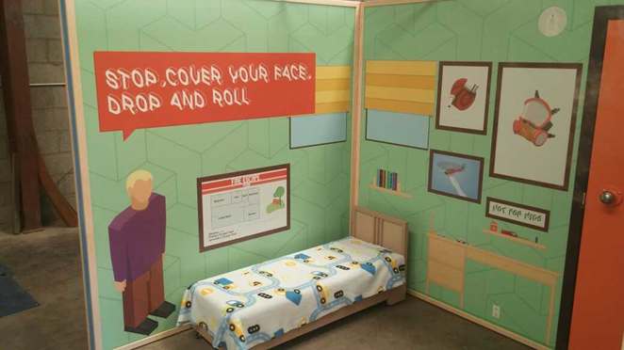
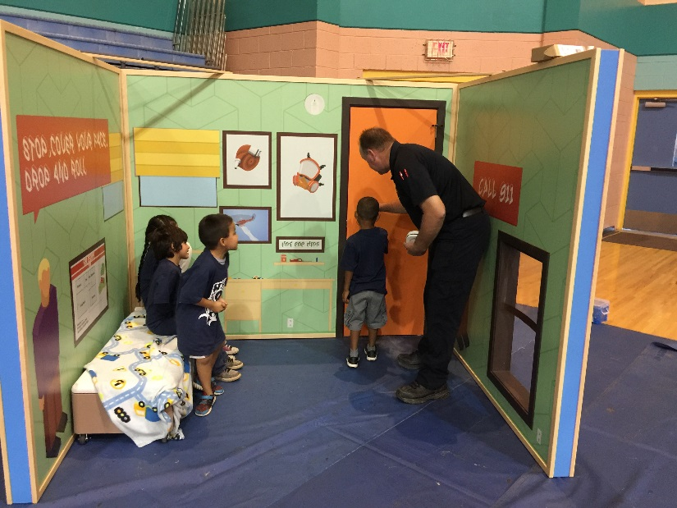
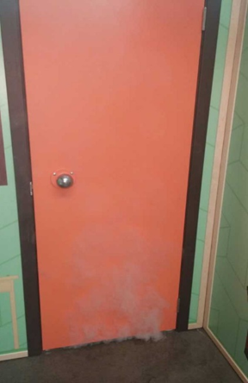

The fire house features a door knob that heats up, smoke that comes from under the door, and a window to climb out of to demonstrate an escape route.
Family education includes calling 911, importance of smoke detectors, a fire plan, and to stop, cover your face, drop, and roll.

Slide 26
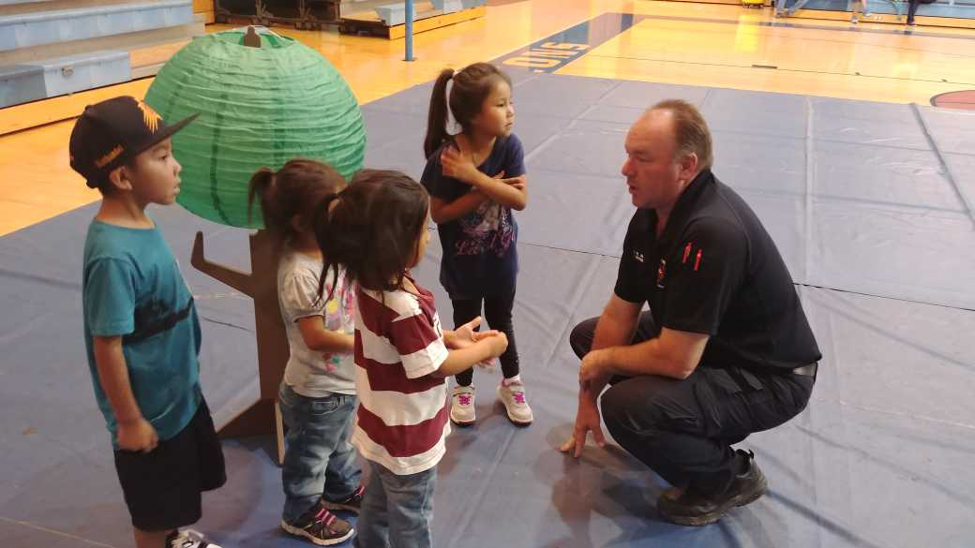
Once kids crawl through the window they meet at a safe meeting place. The importance of an fire/evacuation plan and meeting place is taught in the lesson.

Slide 27
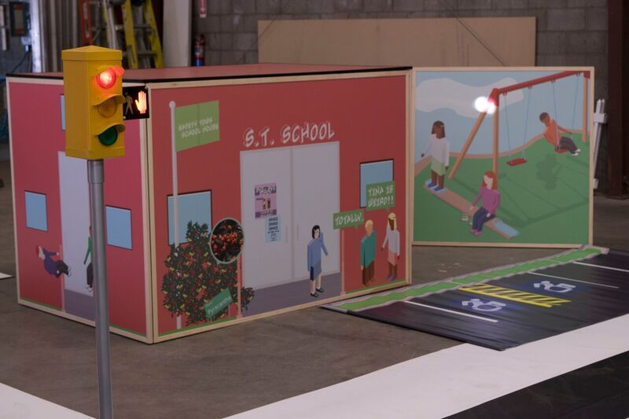
School, Anti-Bullying, and Playground Safety

Slide 28
The CDC Reports Falls Are The Leading Cause Of Non-fatal Injuries For All Children Ages 0-19
Every day, approximately 8,000 children are treated in U.S. emergency rooms for fall-related injuries
This adds up to almost 2.8 million children each year
(CDC, 2016)

Slide 29
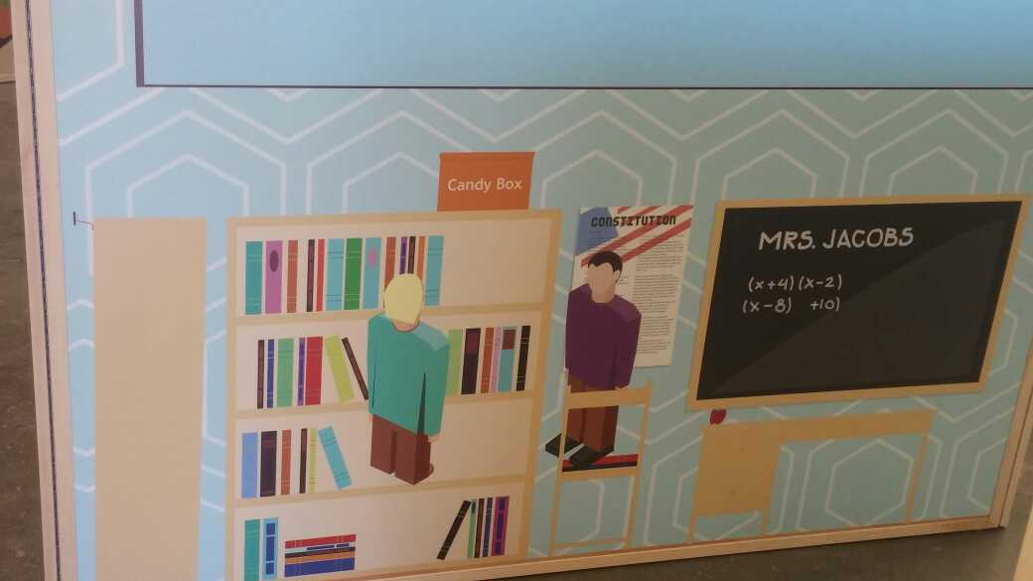
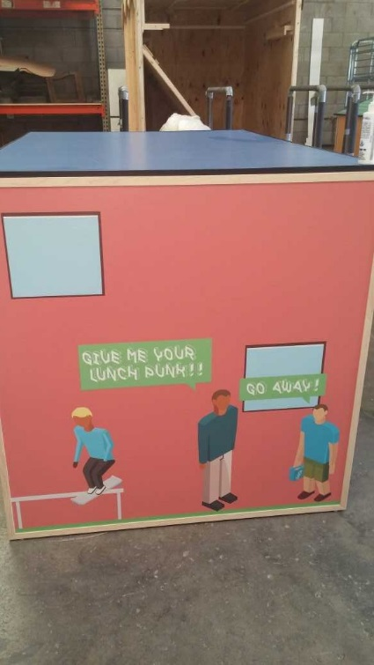
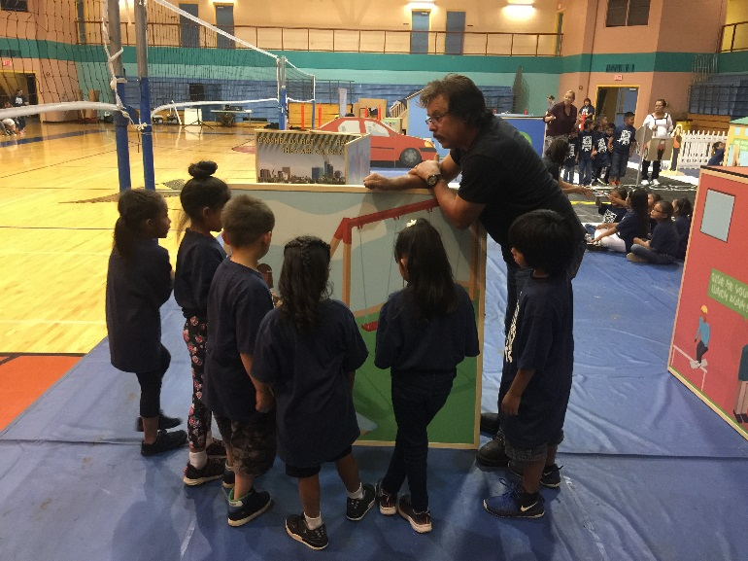
The school house teaches lessons in playground and building safety to prevent injuries, from falls, which have an increased risk to result in traumatic injury.
School & Playground Safety

Slide 30
Effects of Bullying
Bullying can affect everyone—those who are bullied, those who bully, and those who witness bullying. Bullying is linked to many negative outcomes including impacts on mental health, substance use, and suicide
Kids who are bullied can experience negative physical, school, and mental health issues. Kids who are bullied are more likely to experience: Depression and anxiety, increased feelings of sadness and loneliness, changes in sleep and eating patterns, and loss of interest in activities they used to enjoy. These issues may persist into adulthood. They are more likely to miss, skip, or drop out of school
A very small number of bullied children might retaliate through extremely violent measures. In 12 of 15 school shooting cases in the 1990s, the shooters had a history of being bullied

Slide 31
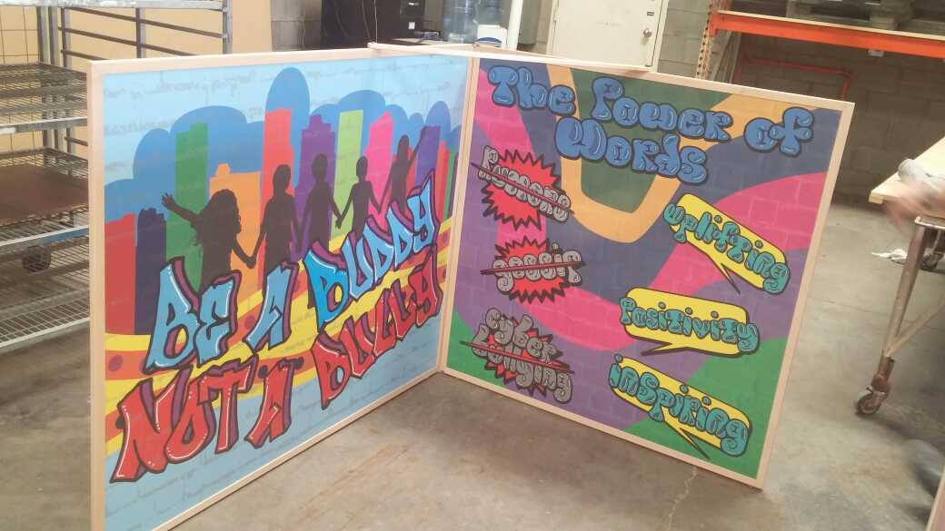

The school house and bully wall teaches children about the dangers of bullying and identifies types of bullying behavior. In this lesson children are taught the negative consequences of bullying behavior and how bullying can lead to an increased risk for injury.
School & Playground Safety

