Slide 1
Disease Management Basics for Health Office Staff
Marilyn Wyant, BSN, RN CSN

Slide 2
Severe Allergic Reaction Anaphylaxis
Anaphylaxis is a life-threatening allergic reaction. Most common forms are in response to food, insect sting, medication, or latex.
The allergy reaction is triggered by the body’s immune system. The body overreacts to the allergen and causes an allergic response.
People with allergies or asthma or a history of anaphylaxis are more at risk for having a life-threatening anaphylaxis response then the general population.

Slide 3
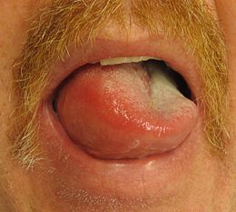
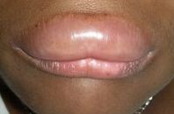
A variety of responses may occur ranging from hives in one area of the body to a full-blown response that can be life threatening. Symptoms include:
Mouth: Itching, tingling, swelling of lips, tongue, mouth

Slide 4
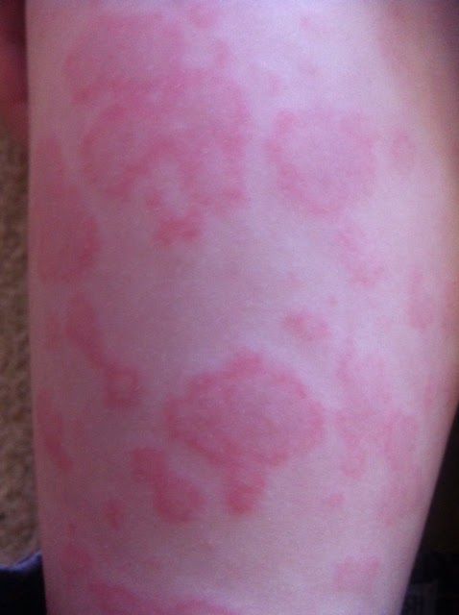
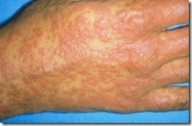
Skin: Hives Rash, Swelling

Slide 5
Anaphylaxis requires immediate medical treatment, including injection of epinephrine and treatment in an emergency room. If it is not treated properly, anaphylaxis can be fatal.
Gut: Nausea, abdominal cramps, vomiting, diarrhea
Throat: Tightening, hoarseness, hacking cough
Lung: Shortness of breath, repetitive coughing, wheezing
Heart: Thready pulse, low blood pressure, fainting, pale, blueness

Slide 6
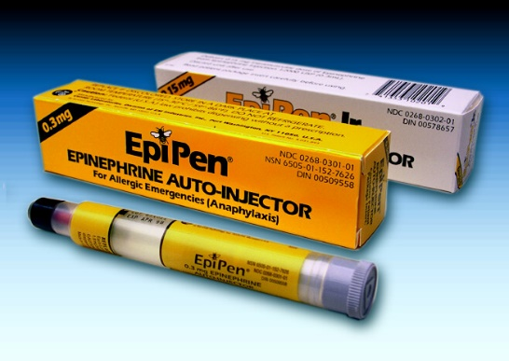
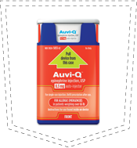
Arizona
What should you do if you suspect a severe allergic reaction ?
Administer Epinephrine Injection Immediately (Arizona Revised Statutes 15-157 allow self carry) Call 911

Slide 7
Practice Time

Slide 8
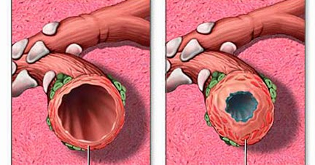
asthma is a chronic reactive airway disorder involving episodic, reversible airway obstruction. An asthma attack effects breathing in 3 ways. 1. Tracheal and bronchial linings overreact to a variety of stimuli that causes increased edema in the mucosa of the lining of the bronchial tubes Narrowing the airway
Asthma Care in the School

Slide 9
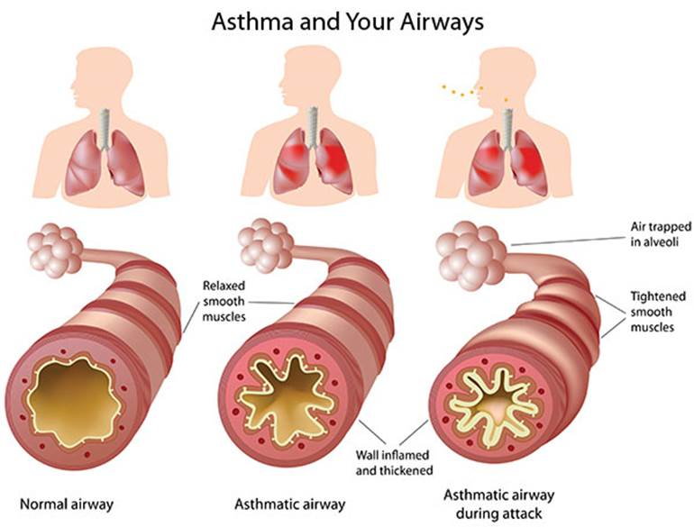
2. Bronchodilation occurs in the smooth muscles that surround the airways. This constricts the airways more.
3. Increase mucus production occurs that further blocks the airway causing an increase in work of breathing.

Slide 10
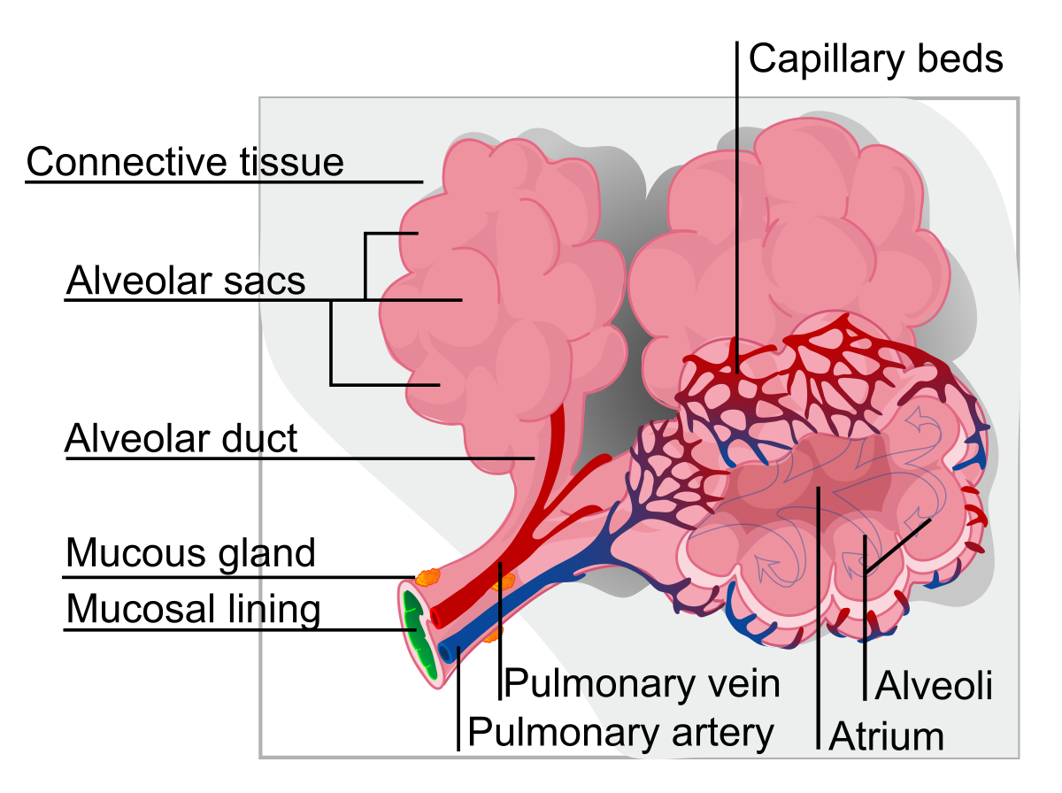
Asthma can develop at any age. 1/3 of all newly diagnosed patients are 10-30 years of age.
During an asthma attack expiratory air ( what you breathe out) decreases. This traps gas inside the bronchial tubes causing the alveolar to become hyper-inflated.
Atelectasis may develop in some lung regions. (collapse lung tissue with loss of volume.)
Atelectasis can cause hypoxemia ( lack of oxygen) and chest pain
Increase airway resistance causes labored breathing.

Slide 11
Rescue Mediation Relax tight muscles in airways helps to reduce symptoms such as coughing, wheezing, and Shortness of Breath. pROaIR hfa pROVENTil HFA Ventolin HFA Xopenex HFA Arizona Revised Statutes 15-158 allow self carry
Medication
Daily Anti-inflammatory Medication
Reduces and Prevents swelling of the airway mucosa. DOES NOT relieve sudden symptoms.
Aerospan Asmanex Flovent Diskus Flovent MDI Alvesco Pulmicort Qvar

Slide 12
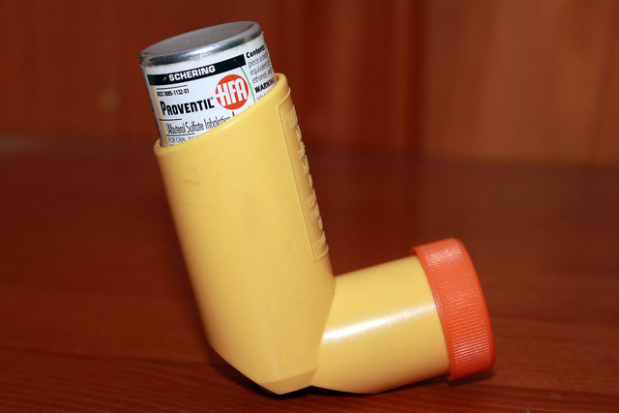
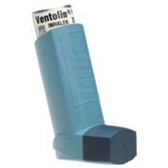
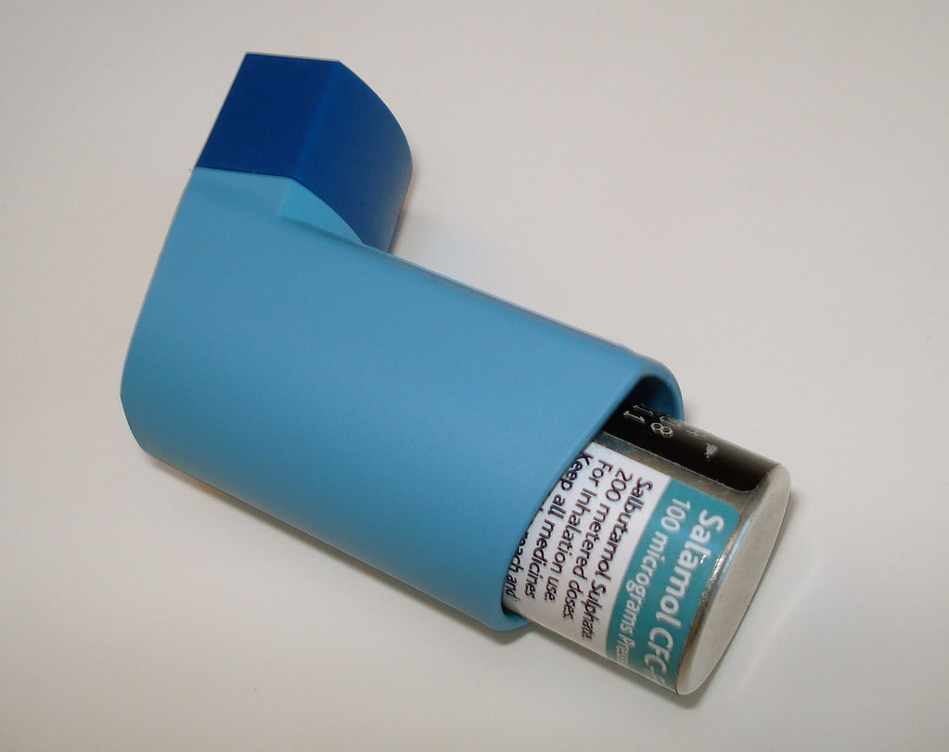
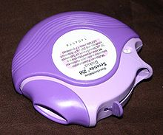
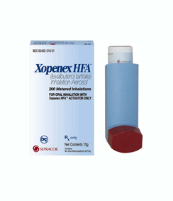
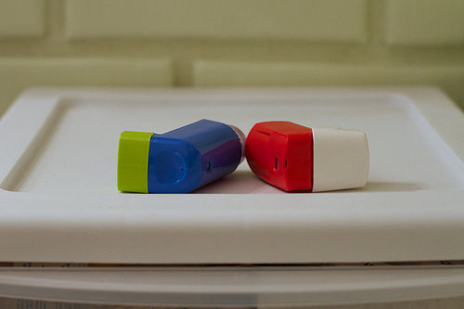
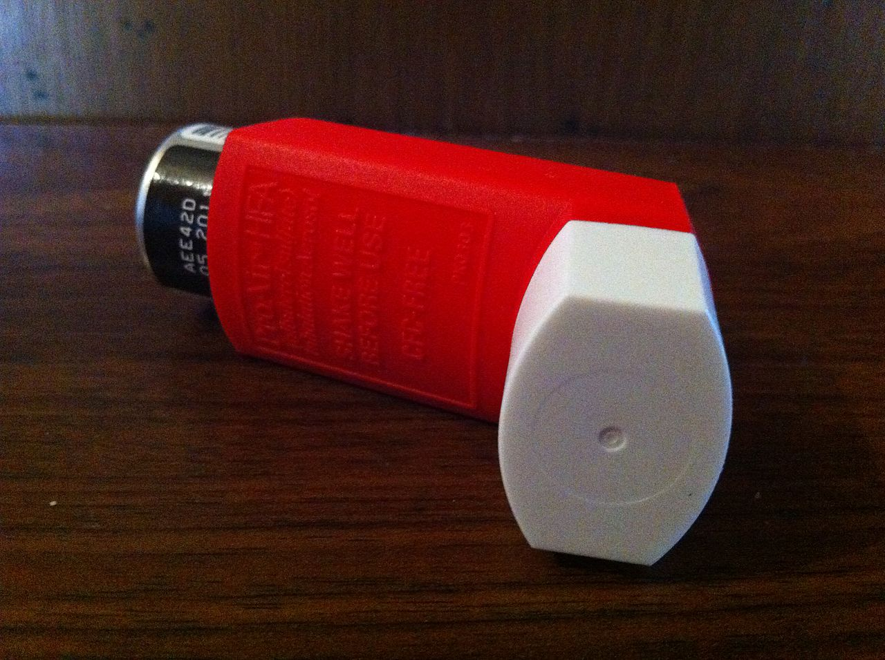
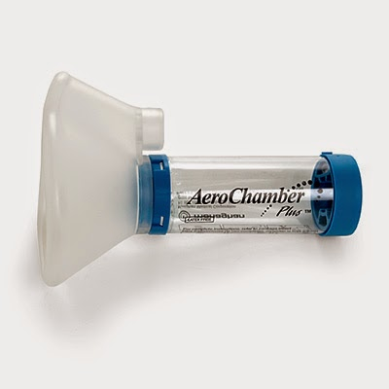
Medication Continued
Long Acting Combination Medications
Contain both long-acting bronchodilator with inhaled corticosteroid
Advair Diskus Advair HRA Dulera Symbicort

Slide 13
Known Complications of Asthma Respiratory Failure Death
Triggers
Animal Dander Emotional Stress
Food additives Genetic Factors
Cold Air Anti-inflammatory Drugs
House dust or mold Cigarette Smoke
Feathered Pillows Exercise
Change in Weather Viral Infections
Pollen Pollution

Slide 14
Laws that Support Students with Asthma ARS 15-158 Emergency administration of inhalers House Bill 2208 : Stock Albuterol Law allowing public and charter schools to stock and administer Albuterol MDI Must have Governing Board Policy that Supports Staff administering Stock Medication Must have a health care provider who will write standing orders for the Medication Established Policies and Procedures related to the administration of a stock medication Money to purchase the Albuterol MDI and Spacers for Multiple Students to support multi-student administration of the Albuterol MDI. Must complete the on-line Training program for every staff person who would use the stock Albuterol
What You Need in the Health Office for a Student With Asthma
Asthma Plan from the Doctor Self-Carry Form
Medication Order from the Doctor MDI with a Spacer
Signed parent Consent Albuterol Aerosol/ Tubing/ Air Compressor
MAR ( Medication Administration Record)

Slide 15
Common Mistakes when administering medication Not shaking the canister Not breathing out before inhaling Inhaling too early before medication administered Inhaling too late after medication administered Inhaling too fast Not holding your breath long enough after inhalation
Common Side Effects of Rescue ( Albuterol) Medication
Shaky nervous Headache muscle aches
Throat and Nasal irritation
More Serious Side Effects
Rapid Heart Rate
Pounding feeling of the heart fluttering

Slide 16
Practice Time

Slide 17
https://wrphtc.arizona.edu/training/stock-albuterol-inhaler-training-school-personnel
ARS 15-158 Emergency Administration of inhalers by trained personnel
https://www.lung.org/lung-health-and-diseases/lung-disease-lookup/asthma/asthma-education-advocacy/asthma-basics.html
https://lung.training/training/course/index.php?categoryid=1

Slide 18
Diabetes Care in the School Health Office
Vickie McWatters JDRF ( Juvenile Diabetes Research Foundation)

