Slide 2
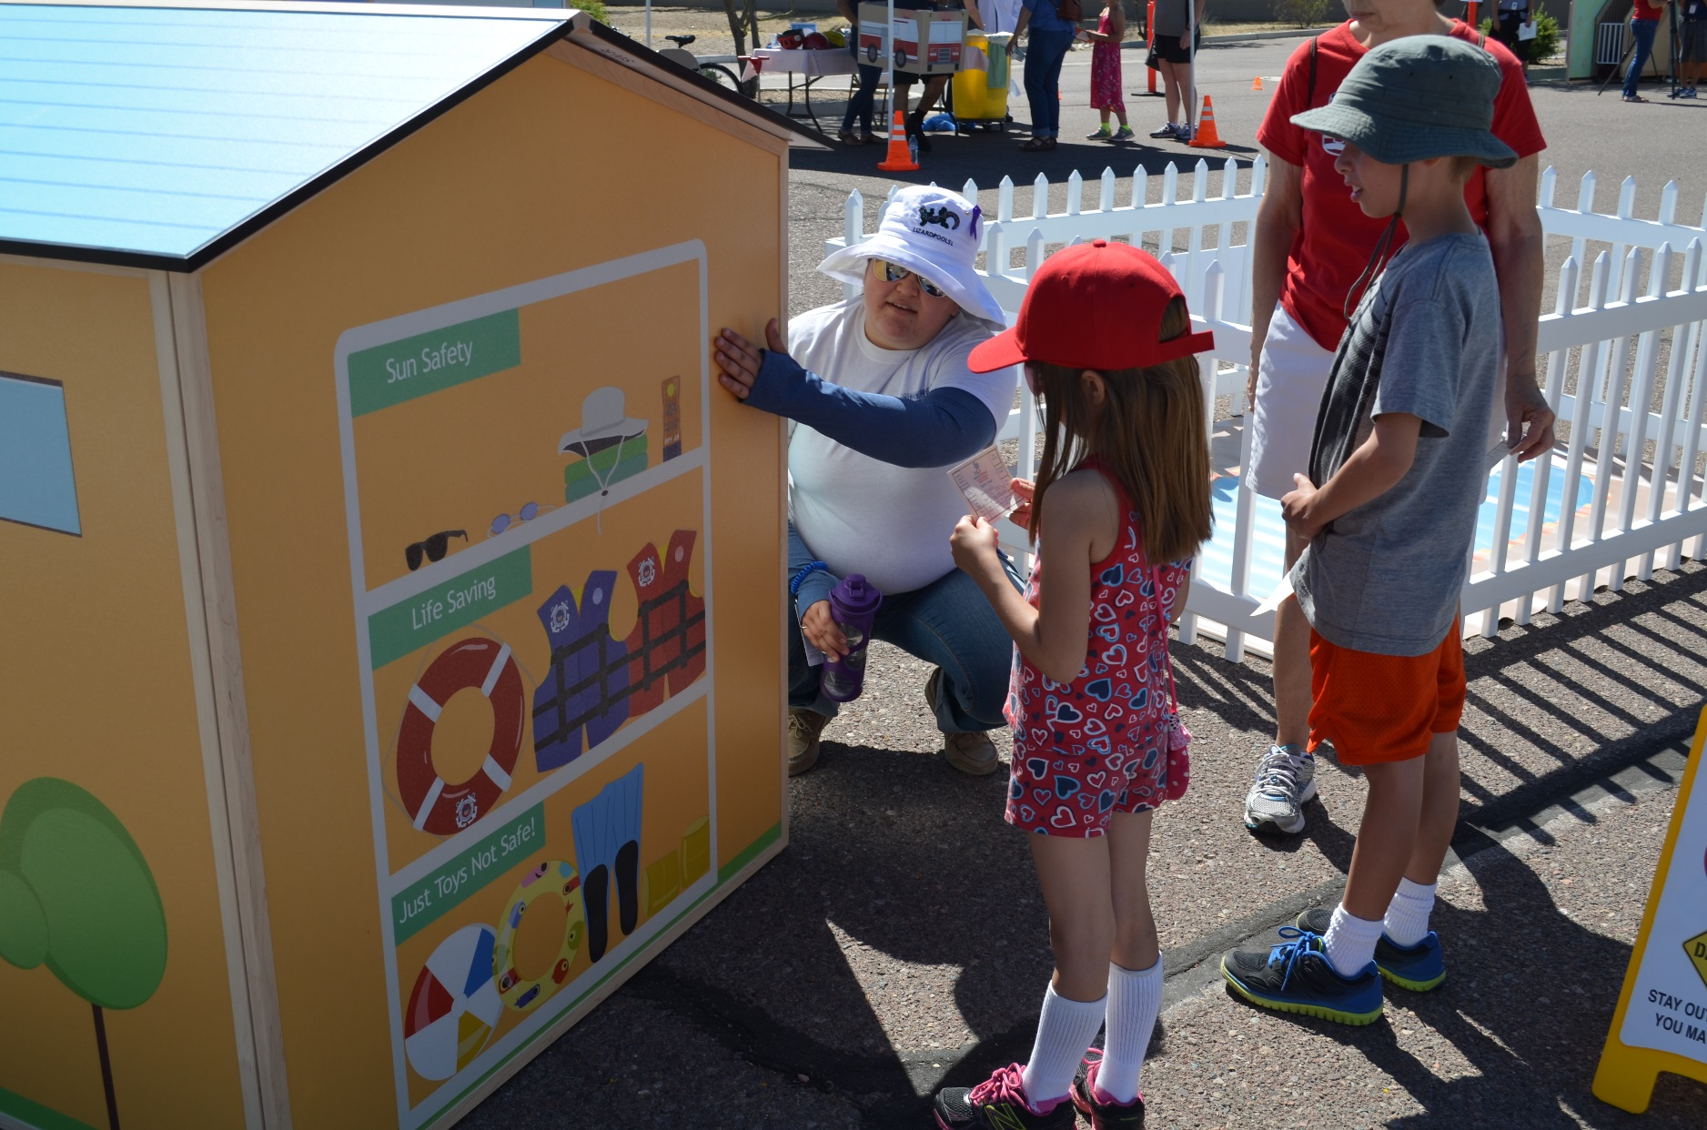
Water Safety/ Sun Safety House

Slide 3
Drowning's and Skin Cancer in Arizona
Every year there are on the average 16 children that die from drowning in Maricopa County (DPCA)
2-3 times as many adults die from drowning between 30-40 yearly (DPCA)
According to the CDC about 171 people die in AZ of melanoma every year.
(Drowning Prevention Coalition of AZ/Center for Disease Control)

Slide 4
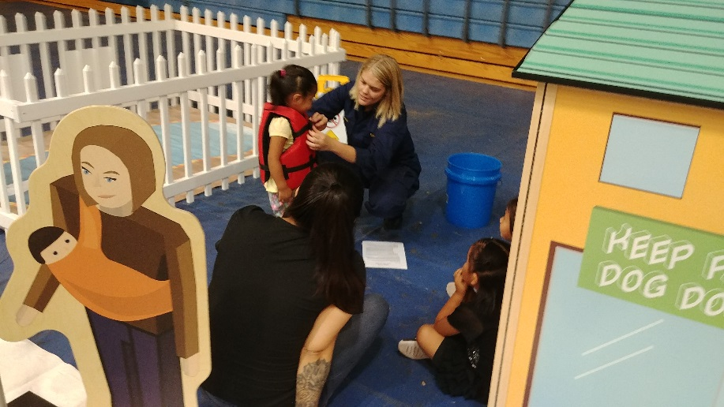
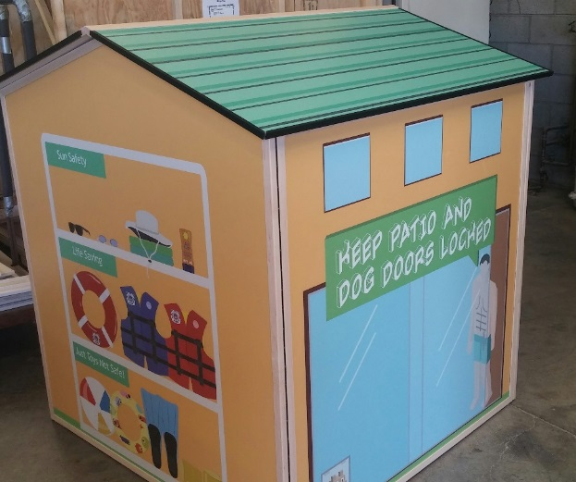
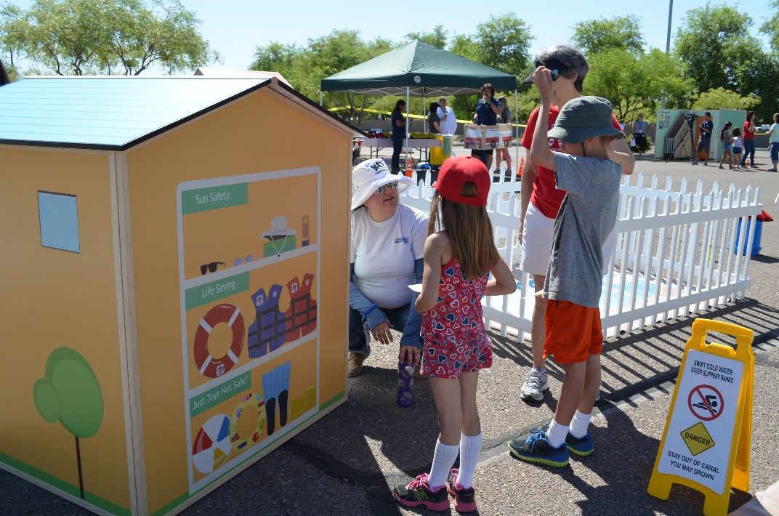
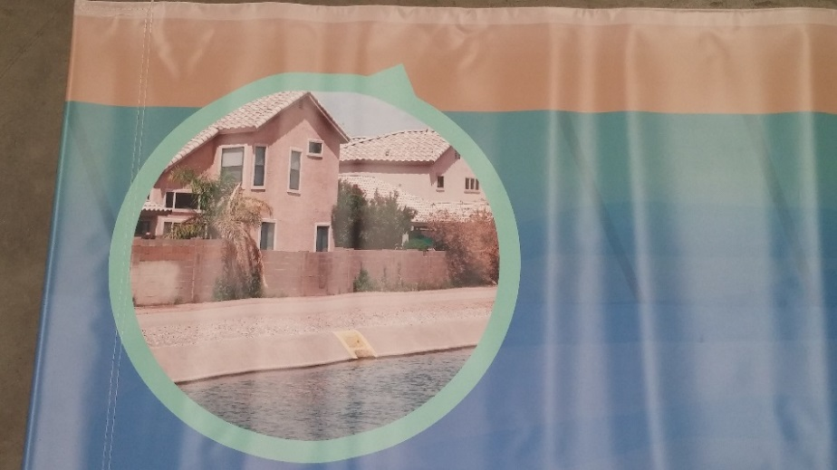
Water Safety/ Sun Safety House
Pool / Sun Safety
The water safety house features a pool, bucket and canal. Education includes the importance of locking sliding glass doors, doggy doors, pool gates, diving safety, lifesaving devices, life jackets(PDF) vs. toys, sun care, and more.
Canal Safety

Slide 5
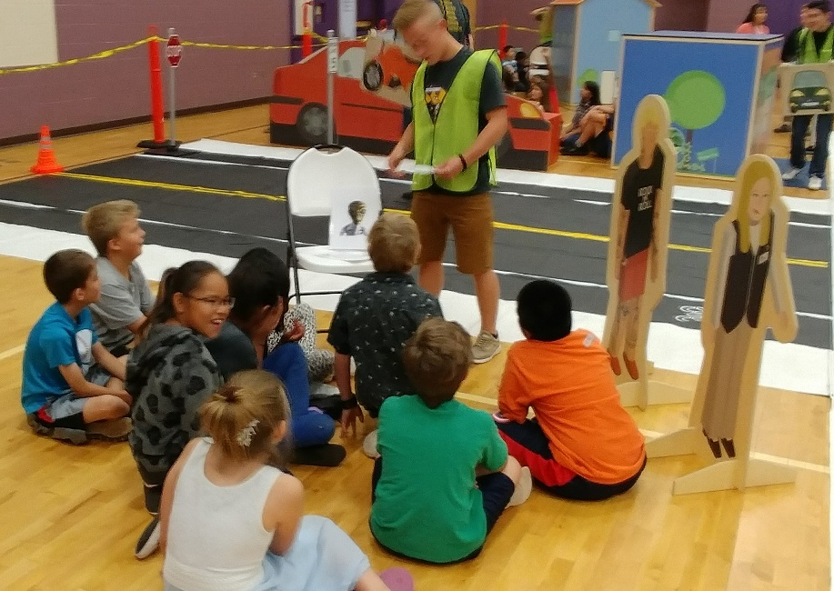
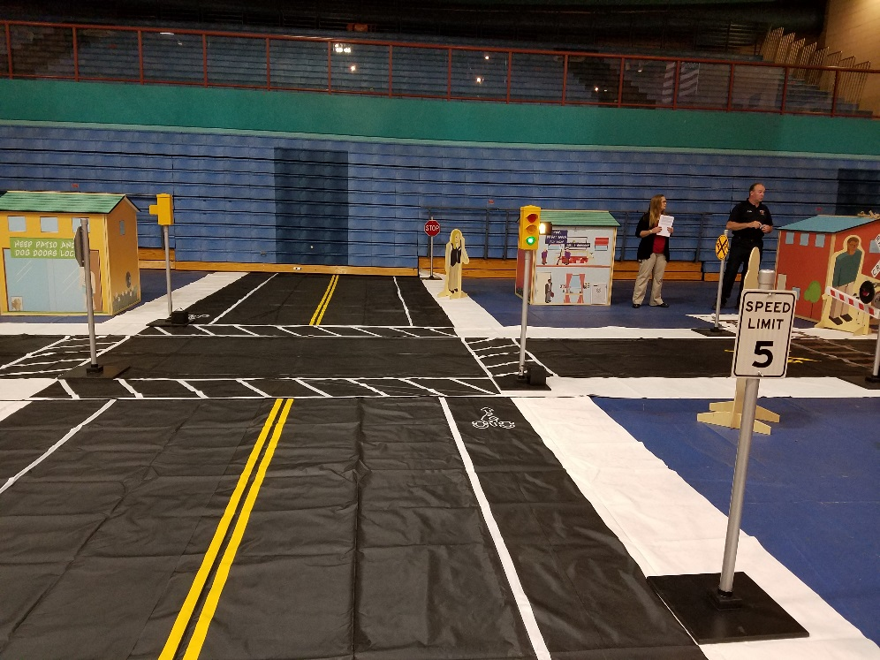
Stranger Danger

Slide 6
Railroad Safety
About every 3 hours, a person or vehicle is hit by a train
Trains today are often bigger, faster and quieter then ever
Anytime is train time – they run 24 hours a day
STAY OFF STAY AWAY STAY ALIVE
(Operation Lifesaver, 2017)

Slide 7
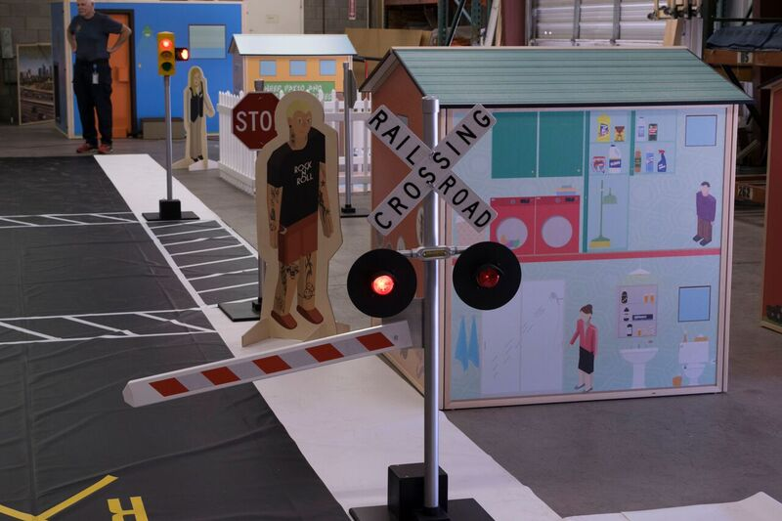
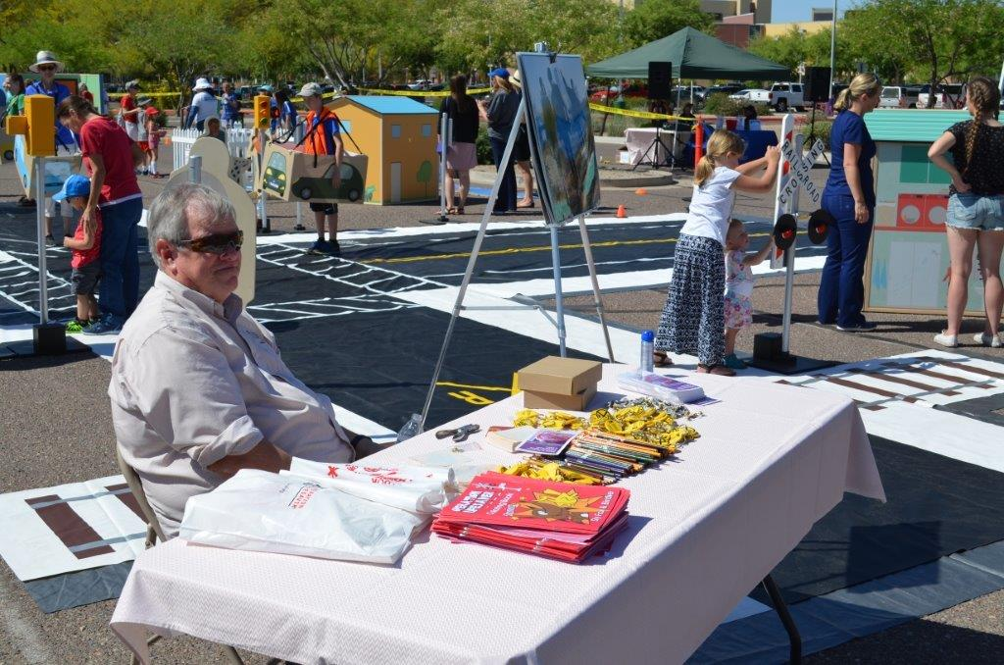


Railroad Safety and Light Rail
Operation Lifesavers Curriculum

Slide 8
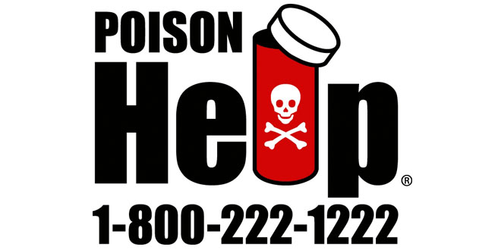
Poison Statistics- National Data 2015
In 2017, the 55 U.S. poison control centers provided telephone guidance for nearly 2.12 million human poison exposures
That’s about:
  6.4 poison exposures/1000 population
  1 poison exposure reported to U.S. poison control centers every 14.9 seconds
(National Poison Data System, 2017)

Slide 9
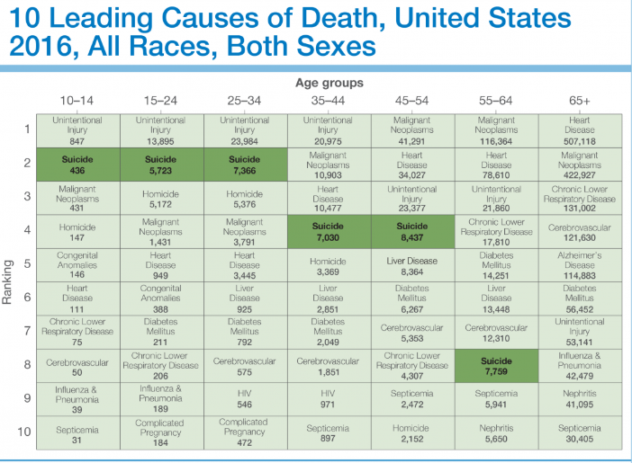

Slide 10
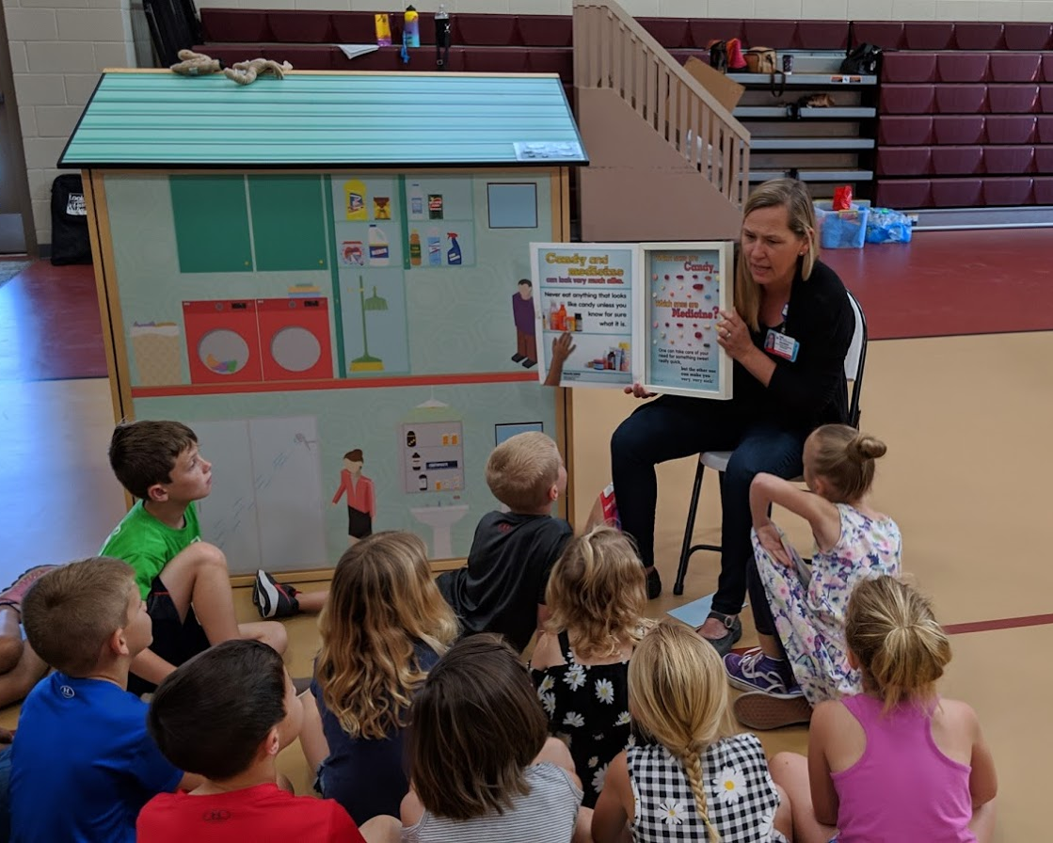
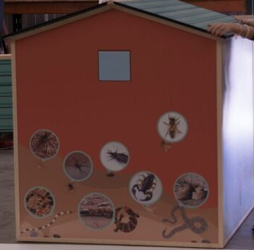
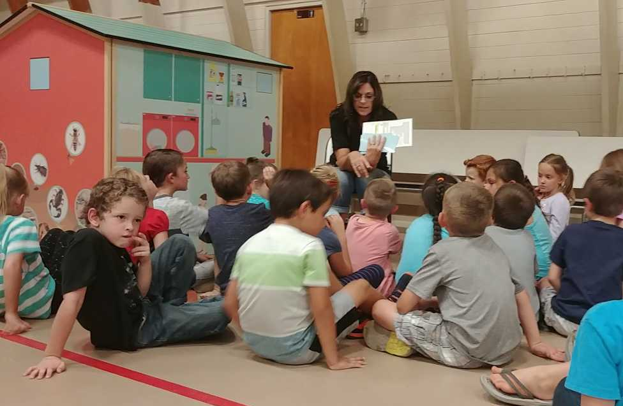
Poison House 1-800-222-1222
Plants, animals, medications, and chemicals
With 5th and 6th graders we discuss depression, overdoses, and suicides

Slide 11
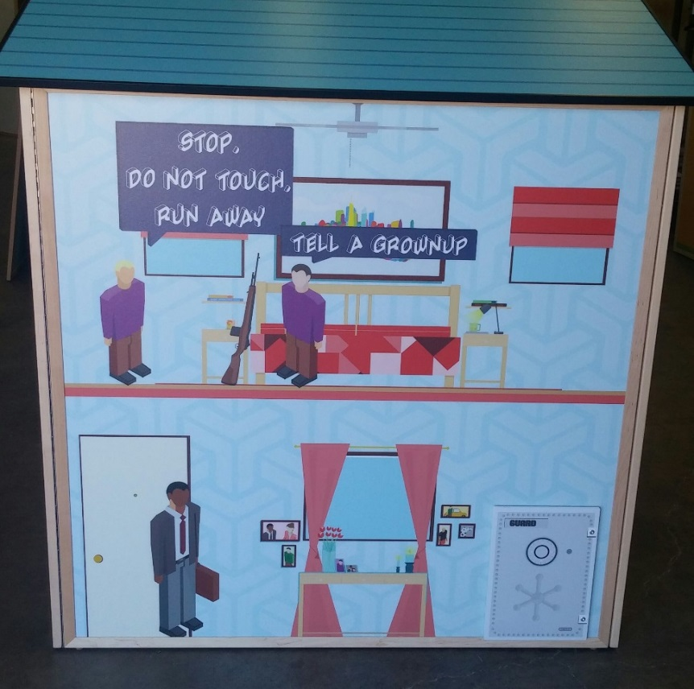
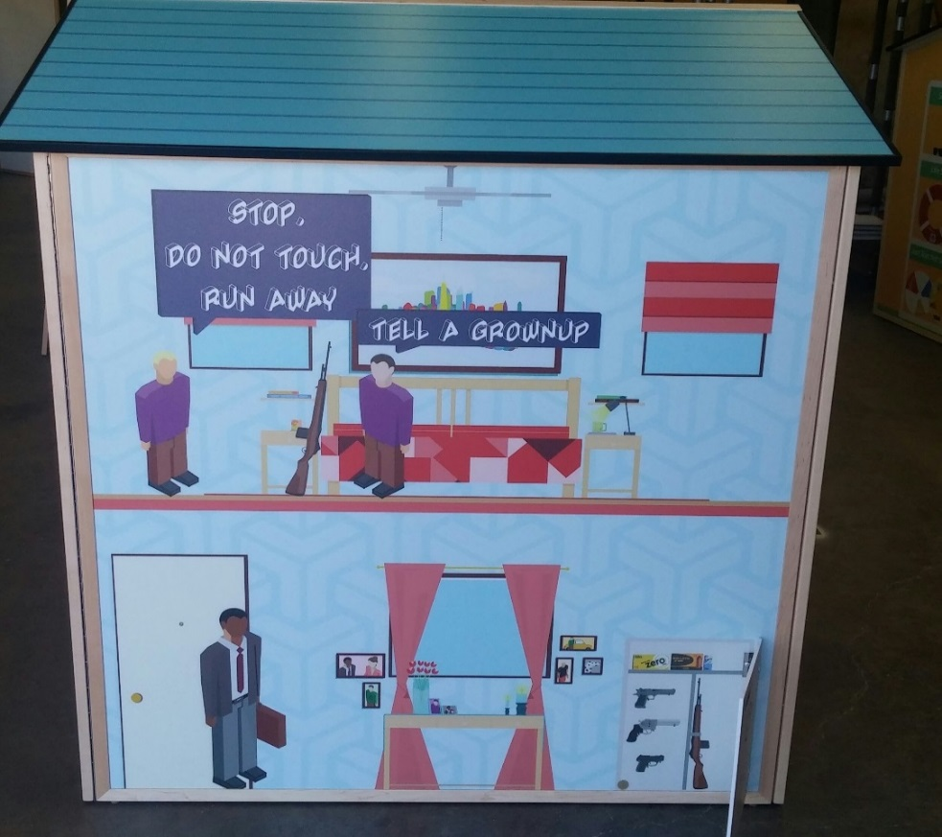
Gun Safety House
According to the Arizona Child Fatality Report, there were 43 firearm-related child fatalities in 2017
(a 19% increase from 2016, n=36)
Education focuses on both what a child does to be safe and what an adult needs to do. This house features a gun safe with a door that opens and closes. Education addresses suicide in upper grades.

Slide 12
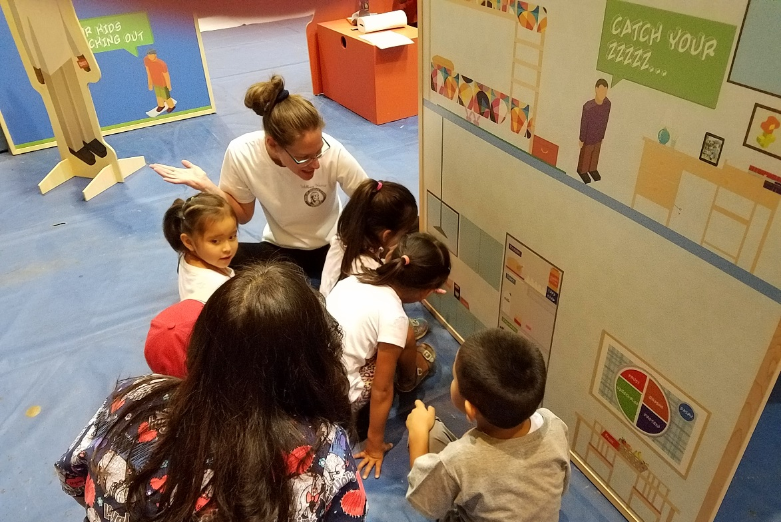
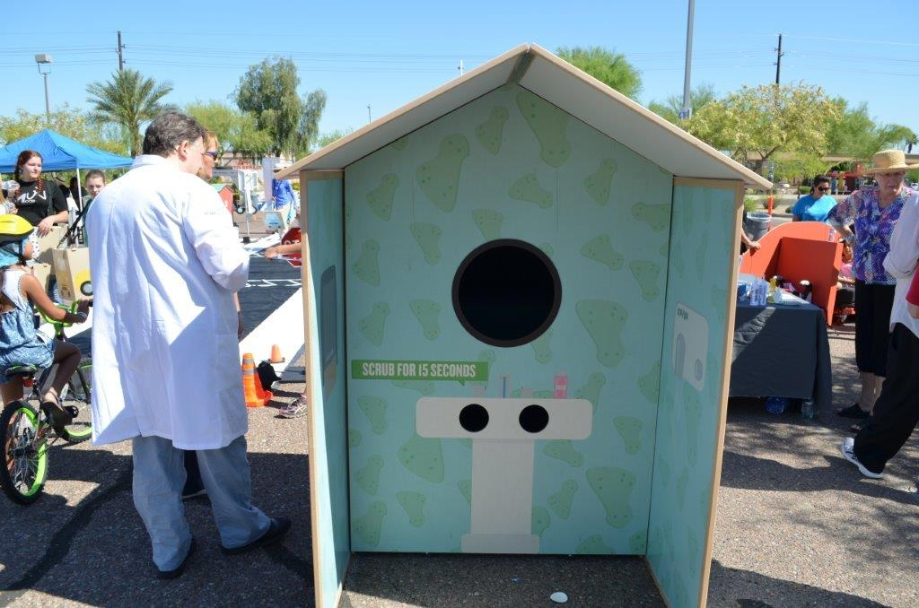
Healthy Living and Germ House
This house covers topics such as; healthy food, sleep, oral health and exercise

Slide 13
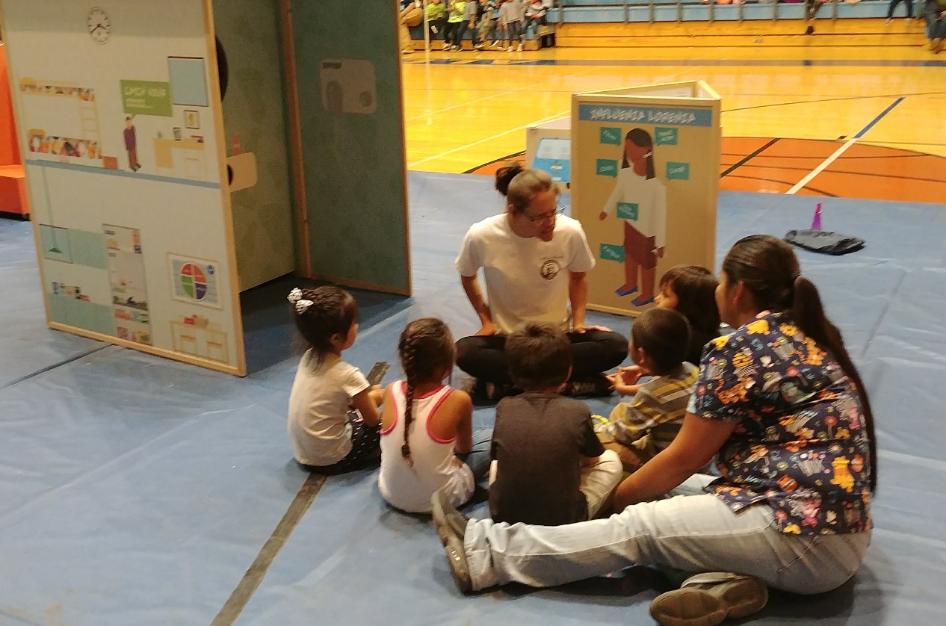
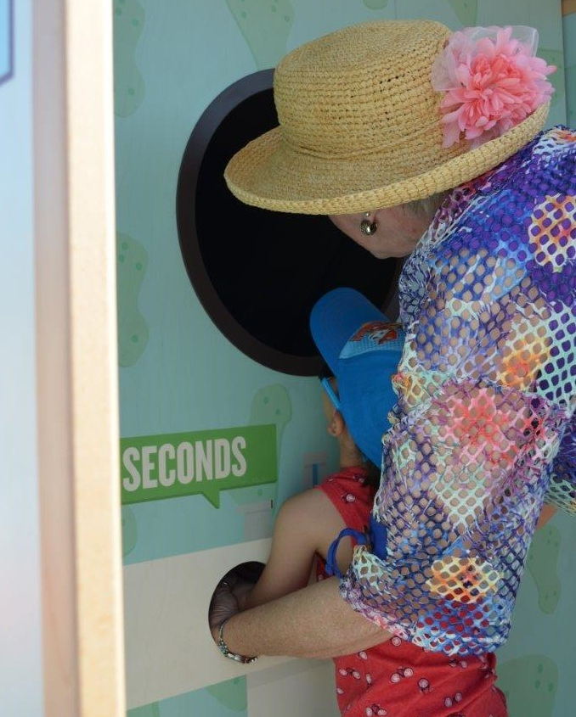
This house features a sink where children are taught the importance of washing their hands. The sink station uses glo-germ lotion and black lighting, allowing them to see what germs would be on their hands if they hadn’t washed them.
Healthy Living and Germ House

Slide 14
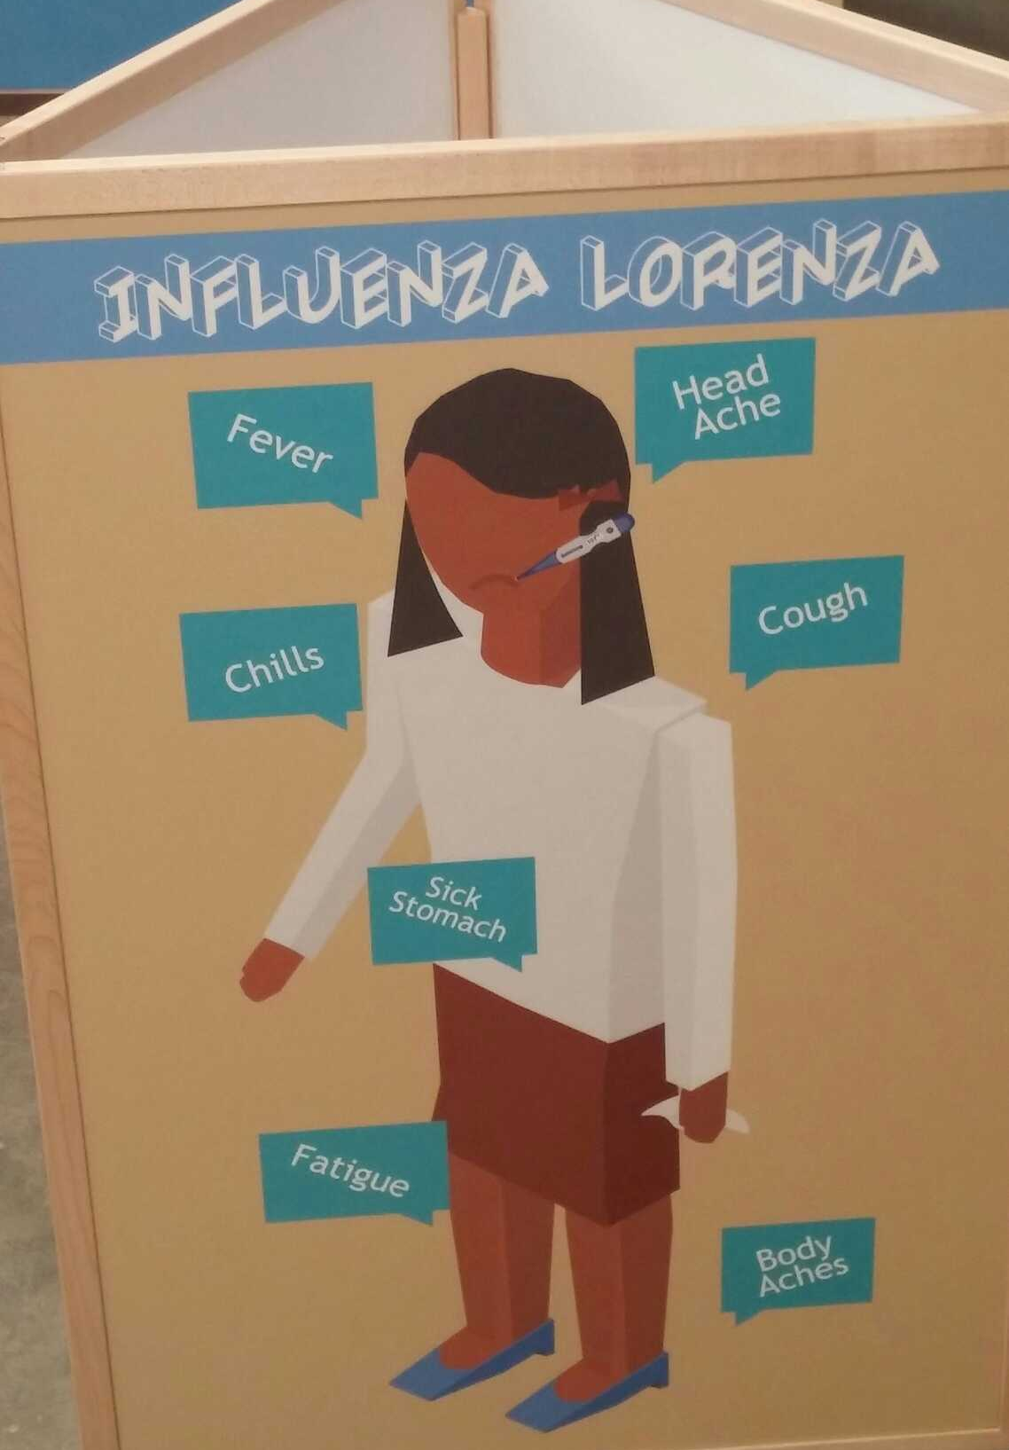
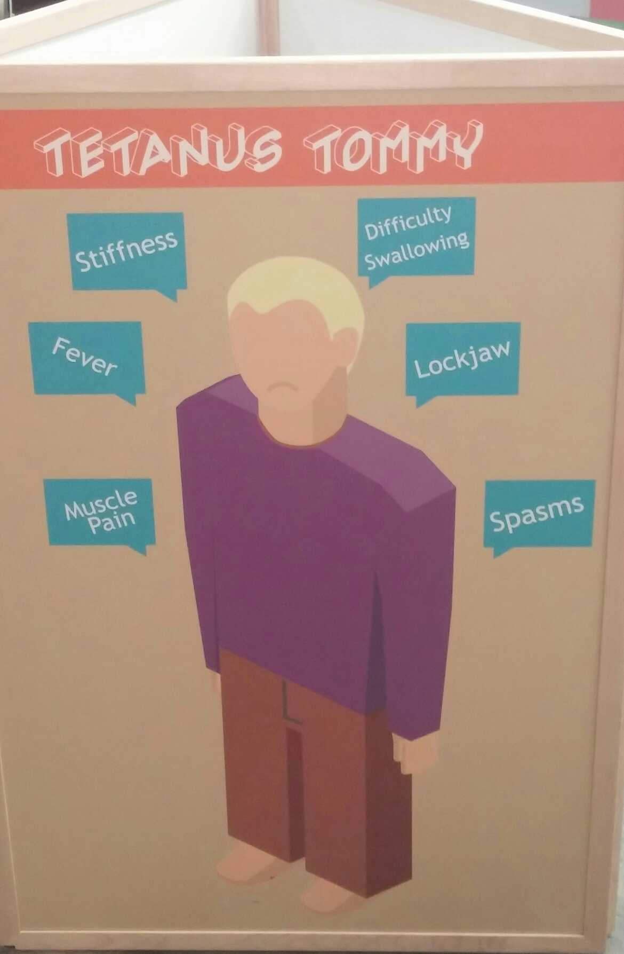
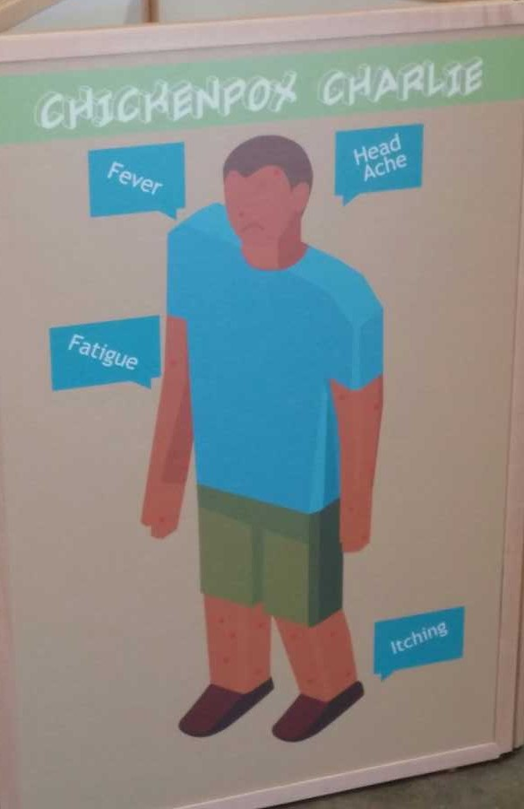
Vaccinations

Slide 15
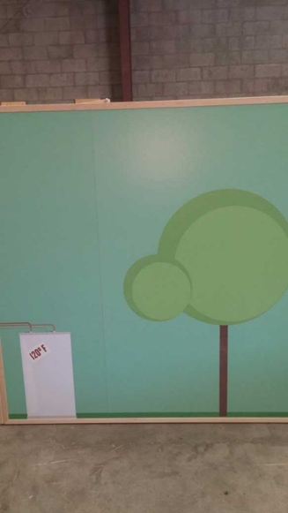
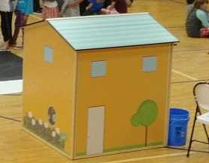
Outside Walls
The outside of all of the houses will have learning experiences. This house demonstrates that hot water temps set at 120 degrees or below prevents burns. Other houses have poisonous plants found in Arizona some poisonous to touch others to eat.

Slide 16

Distracted/Impaired Driving

Slide 17

According To The National Highway Traffic Safety Administration (2017), Distracted Driving Is Dangerous
Distracted Driving
In 2015 there were 3,477 deaths and 391,000 injuries as a result of distracted driving
Distracted driving is any activity that diverts attention from driving, including talking or texting on your phone, eating and drinking, talking to people in your vehicle, fiddling with the stereo, entertainment or navigation system—anything that takes your attention away from the task of safe driving.
You cannot drive safely unless the task of driving has your full attention. Any non-driving activity you engage in is a potential distraction and increases your risk of crashing.
(CDC, 2017)

Slide 18

The National Highway Traffic Safety Administration (2017) reports….
Impaired Driving
Every Day, 29 People In The United States Die In Alcohol-related Vehicle Crashes—that's One Person Every 50 Minutes
In 2016, 10,497 people died in alcohol-impaired driving crashes, accounting for 28% of all traffic-related deaths in the United States
The annual cost of alcohol-related crashes totals more than $44 billion
(CDC, 2017)

Slide 19

Don’t Let This Be Your Last Words
Distracted/Impaired Driving

Slide 20
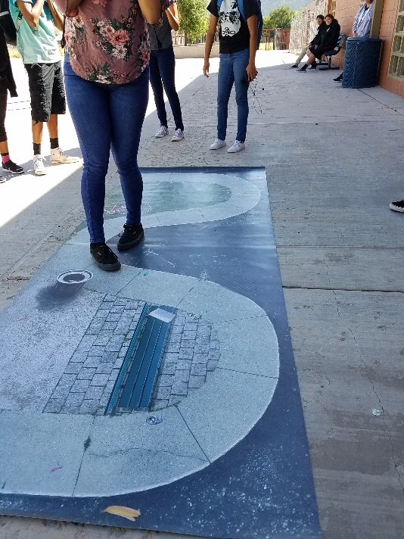
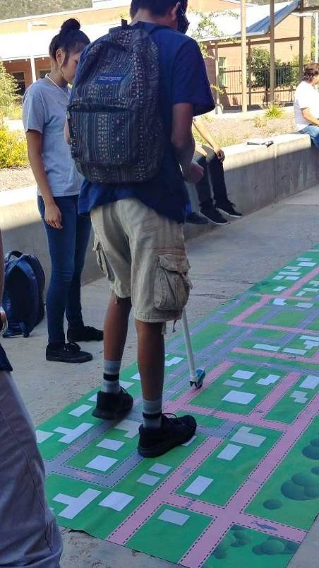
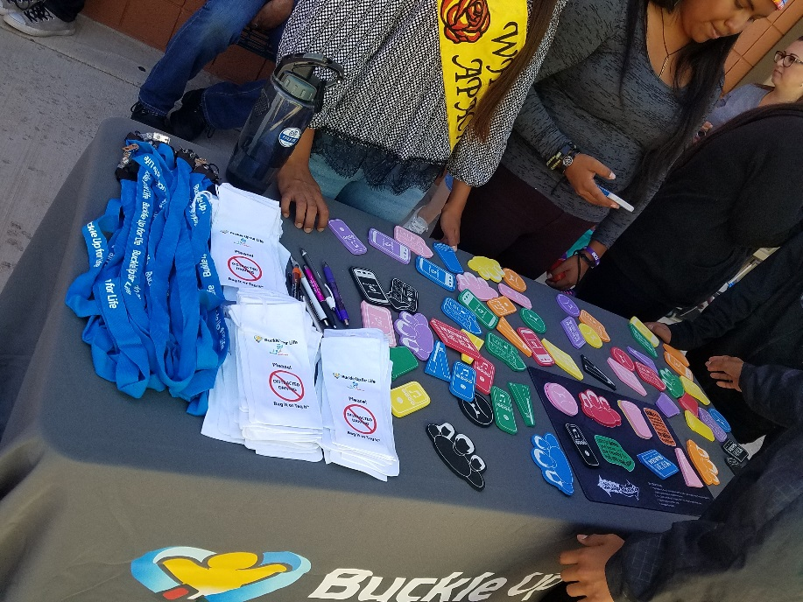
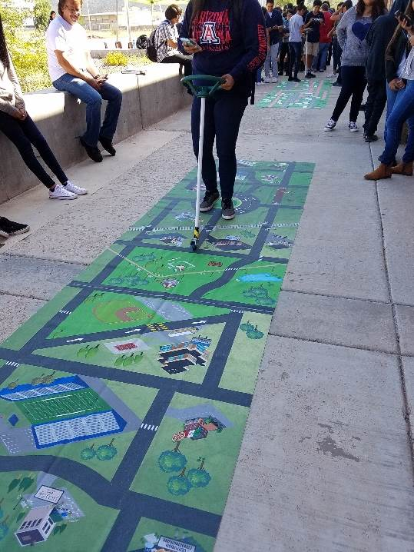
Activities which are geared towards adults and teens, include; Alcohol/Marijuana Vision Googles/ Texting Mats, Impaired Walking Mat And Impaired/Distracted Games.
Distracted/Impaired Driving

Slide 21

Adult Safety House

Slide 22
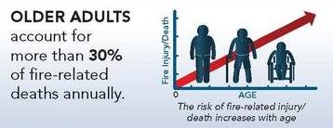
Older Adult Burn Prevention
Adult Safety House
According to the American College of Surgeons Subcommittee on Trauma Subcommittee on Injury Prevention and Control
Prevention programs to reduce burns in the elderly should include the following:
  Physicians educating elderly patients using material that highlights the increased risk for burns and how minor burns can lead to death
  Education about appropriate water heater temperature of 120-degrees Fahrenheit
  Caution when handling hot liquids
  Use of alternate forms of accelerant other than gasoline
  Recommendation to use electric rather than flame candles
  Promotion of safe cooking practices without the use of flame (gas)
  Public education about the risk of burn and death when smoking while on oxygen
  Education on safe cooking and bathing practices for people with seizures, syncope, and history of falls
  Reminders for people with diabetes mellitus or any cause of decreased sensation to keep in mind the following:
    Never walk barefoot on hot days
    Never warm their feet in hot water or with heaters
    Report even minor burns or injuries to their physician

Slide 23
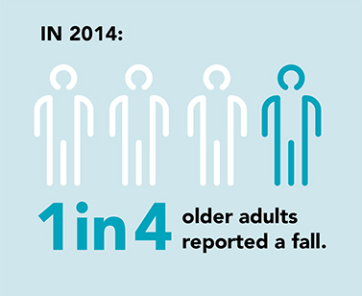
Senior Falls
Adult Safety House
2.8 million adults over the age of 65 are treated in the emergency department for injuries as a result of a fall (that’s more than 1 out of 4 older adults)
More than 800,000 older adults are hospitalized for their injuries
Approx. 300,000 of these visits are d/t hip fracture
Falls are the most common cause for a traumatic brain injury
(CDC, 2017)

Slide 24
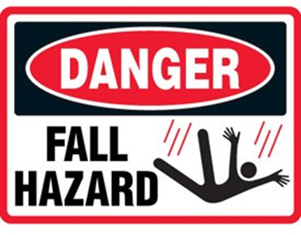
Conditions Contributing to Falls
Adult Safety House
Lower body weakness
Vitamin D deficiency (that is, not enough vitamin D in your system)
Difficulties with walking and balance
Use of medicines, such as tranquilizers, sedatives, or antidepressants. Even some over-the-counter medicines can affect balance and how steady you are on your feet.
Vision problems
Foot pain or poor footwear
Home hazards or dangers
  broken or uneven steps
  throw rugs or clutter that can be tripped over
  no handrails along stairs or in the bathroom
(CDC, 2017)

Slide 25
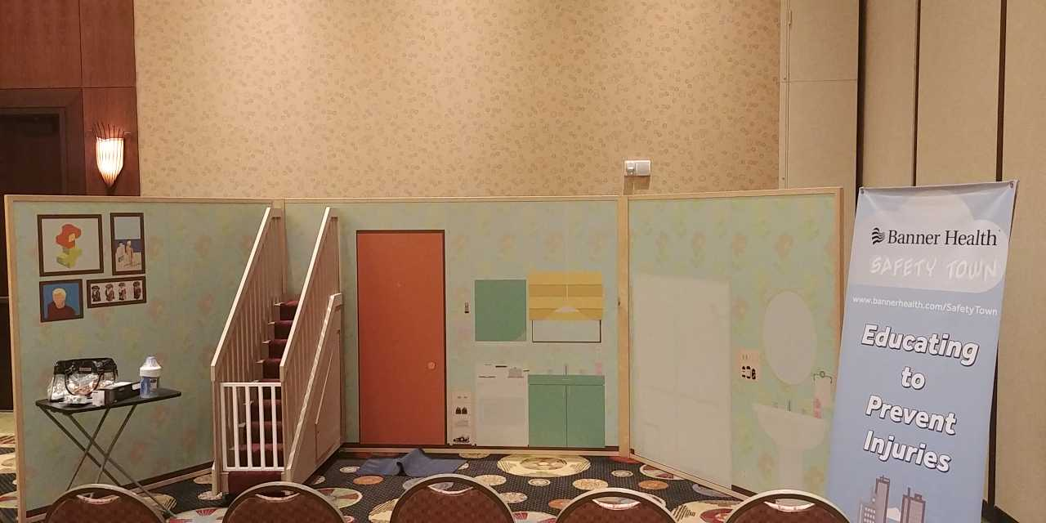
Banner Health Senior Safety House.

Slide 26
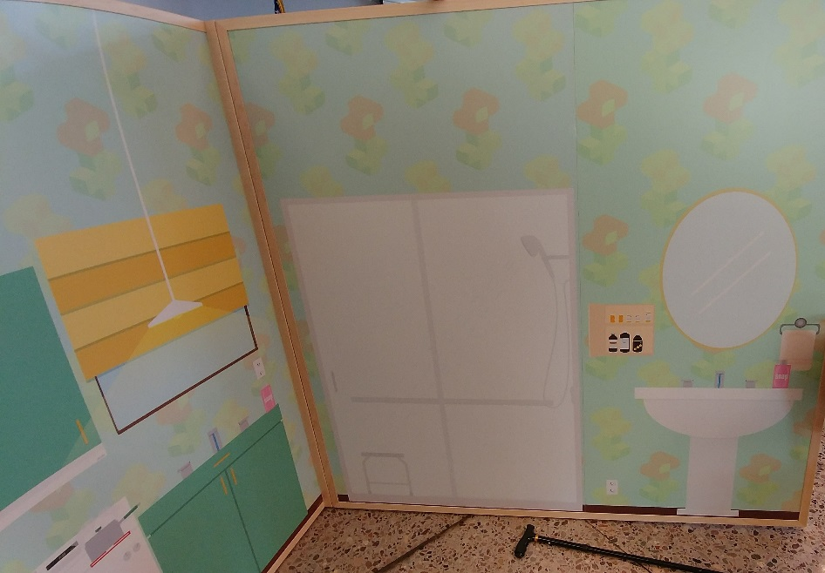
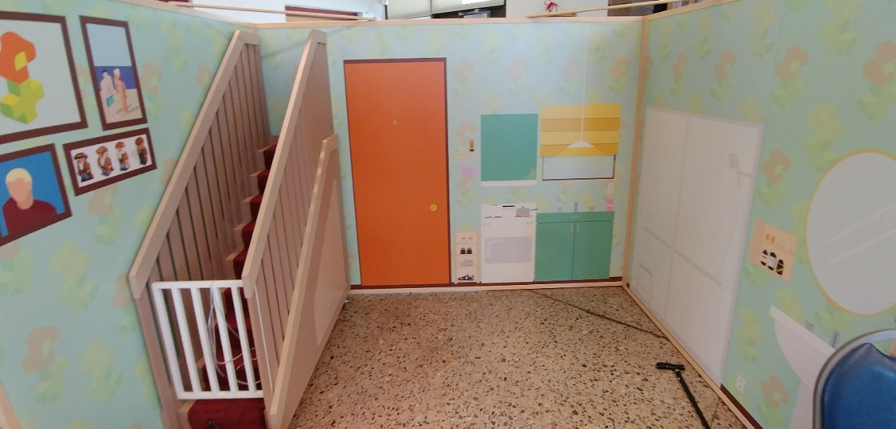
Adult Safety House
Demonstrates the importance of handrails on stairs, child gates, and removing throw rugs, rails in showers fire prevention from kitchen fires, smoke detector, proper medication usage, storage and disposal.
The house can also be turned
into a new parent/child
proofing house.

Slide 27
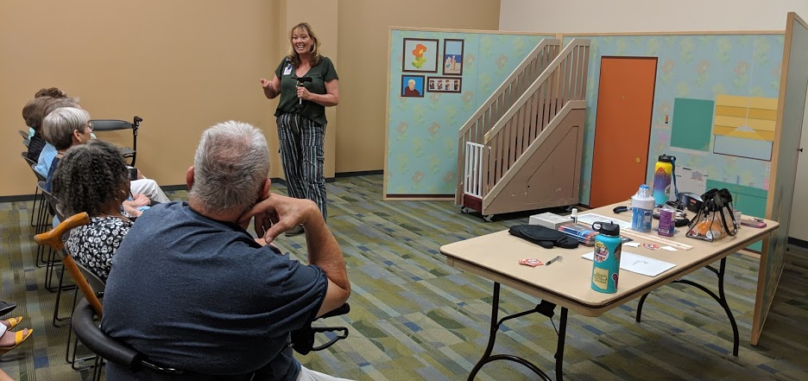
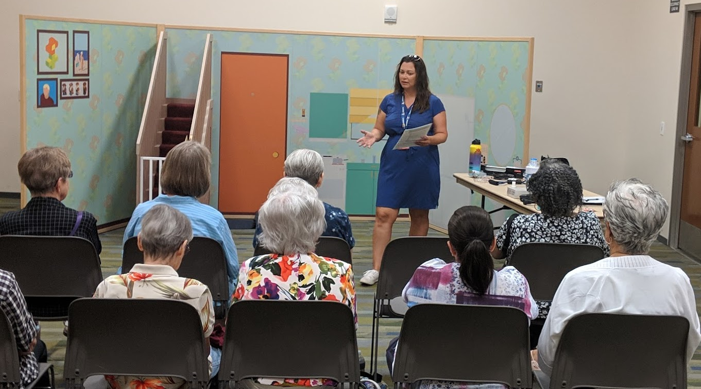
Adult Safety House

Slide 28
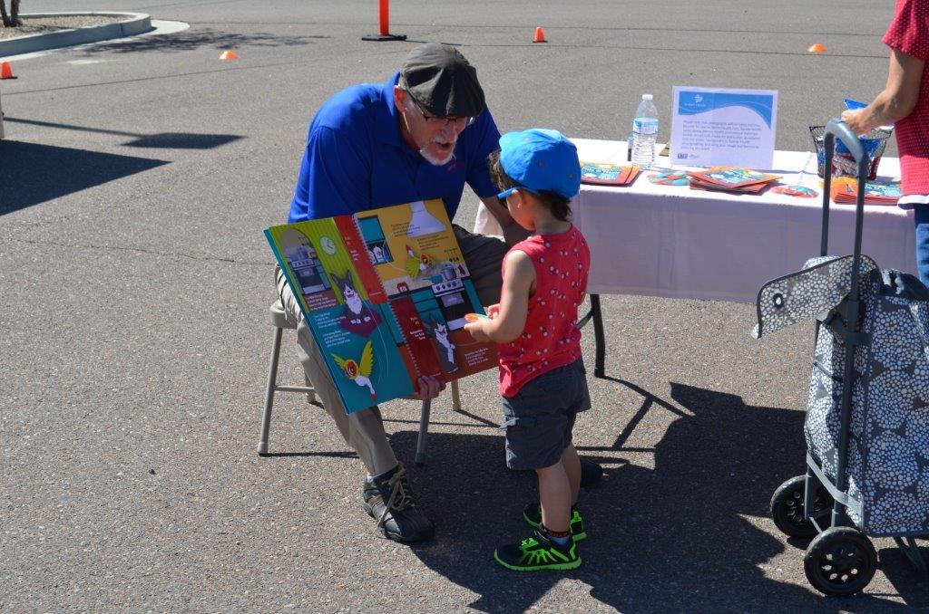
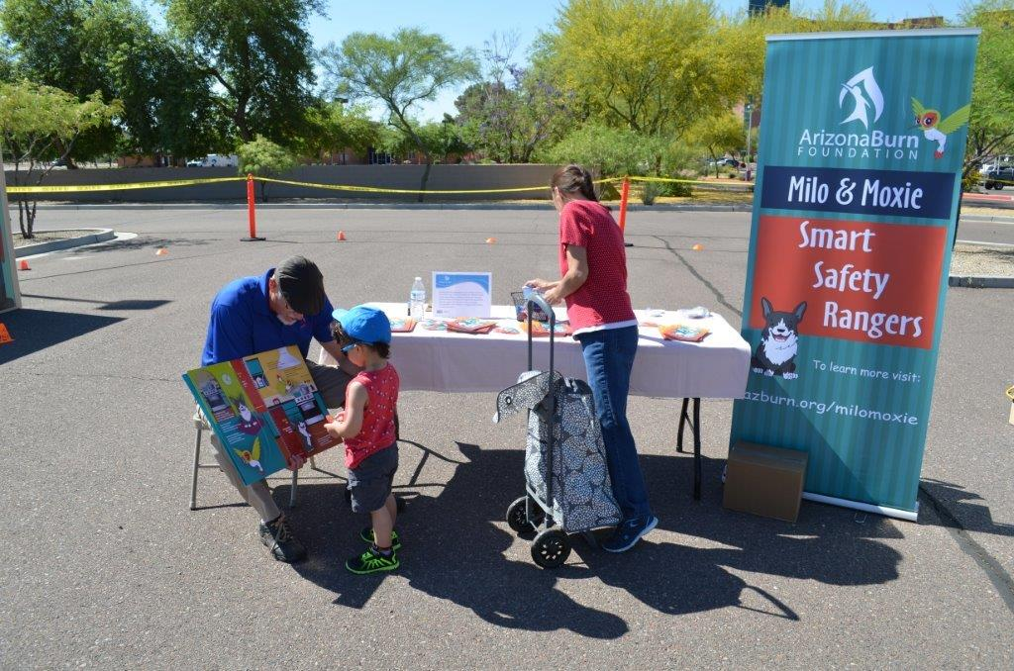
Adding Partners And Other Education To Safety Town Is Easy

Slide 29
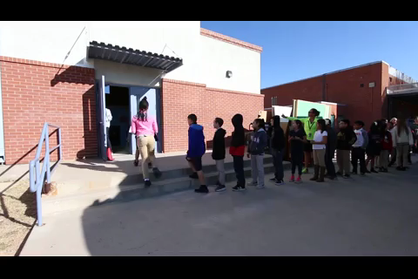

Slide 30

Banner Safety Town
To schedule contact:
Tracey Fejt RN
Tracey.Fejt@bannerhealth.com
480-412-3306
Melissa Luxton MSN, RN
Melissa.Luxton@bannerhealth.com

Slide 31


Slide 32
Resources
Suicide Prevention Resource Centerhttps://www.sprc.org/populations/children
Centers for Disease Control and Prevention https://www.cdc.gov/
Operation Lifesaver https://oli.org/
Poison Control https://www.bannerhealth.com/services/poison-drug-information
Drowning Prevention Coalition of AZ http://www.preventdrownings.org/
National Highway Traffic Safety Administration https://www.nhtsa.gov/
Arizona Department of Health Services https://www.azdhs.gov/
American College of Surgeons https://www.facs.org/
AZ Department of Transportation https://www.azdot.gov/
U.S. Fire Administration https://www.usfa.fema.gov/data/statistics/
Stopbullying.gov

