Slide 1

Documentation Guidelines

Slide 2
THE GOLDEN RULE
IF IT
WASN’T
DOCUMENTED IT
WASN’T
DONE!

Slide 3
In God We Trust… everyone else has to chart
Documentation should be done as soon as possible
Avoid late entries - If you have to make a late entry make sure you date and initial it
We are not Doctors, do not diagnose
Do not put personal opinions or labeling terms
Your documentation can be used as a legal document
Abbreviation should not be use, wright it out
Confidentially is a necessity - Need to know
Ask questions ! Avoid suggestive thoughts
Exact times
If written do not erase or use white out – draw a line through it then write the correct entry

Slide 4
SOAP
S.O.A.P is a documentation format to help identify and treat the student. Utilize the Emergency Guidelines to support your documentation. (see SNOA.org)
S: Subjective
O: Objective
A: Assessment
P: Plan

Slide 6
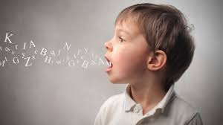
Subjective Information
Why did the student come to the Health Office?
  In their own words, not the teachers
  Use quotes when possible “ ”
  Try not to put words in their mouth

Slide 7
Pain Interview “OLD CHART”
Onset – when did this start?
Location – where is the pain located?
Duration – how long has the pain lasted?
CHaracter – sharp? dull?
Alleviating / Aggravating factors
Radiation? does the pain travel?
Time pattern (every day at 10am)

Slide 8
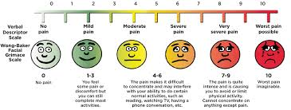
Pain Scale
1 – 10 (no pain - excruciating)
Does the number match the affect?

Slide 9
Objective & Assessment Information:
Info you see, feel or smell
Temperature
Skin (color, bruise, swelling, lacerations)
Pulse (rate, quality)
B/P, if needed
Data (blood sugar, ketones)
What were your findings
How did the patient appear

Slide 10


Plan
(outcome/evaluation)
What did you do for the student?
How did the treatment work?
What is going to happen to the student?

Slide 11
Asthma
S: “I can’t breath”, started during PE
O: Color = pink, Resp.=24, P=80
A: Known history of asthma
P: SVN albuterol given, rest, fluids. Better
after 10 min. RTC. Message left for
parent on home phone

Slide 12
Asthma - 911
S: “I can’t breath”, started during PE
O: Color = blue around lips, resp.=40,
B/P 90/60, P=140,can’t talk, sweating,
A: Known history of asthma
P: Called 911 and parent, SVN albuterol
given, EMS arrived and took over care.
Transported to hospital at 10am with
Carolen(mother).

Slide 13
Sprain
S: “I twisted my Right ankle playing
basketball” at recess
O: Ambulated into health office, no
swelling, no discoloration, no deformity
A: Injury to Right ankle
P: Rest, Elevation, Ice to ankle. Better
after 10 min. RTC. Note home with
student.

Slide 14
Fracture
S: Called to playground for possible fracture to
arm. Student fell from slide to soft surface (3
feet). Arrived to find the student holding R
arm.
O: Crying, holding arm, denies other injuries,
AAOX3, denies neck or back pain, R arm
with swelling and deformity. Taken to Health
Office in wheel chair. OR Supported until
arrival of EMS.
A: Right arm injury
P: Call 911 to splint, OR splint, ice, called Tina,
mother, who transported to ER at 10 am

Slide 15
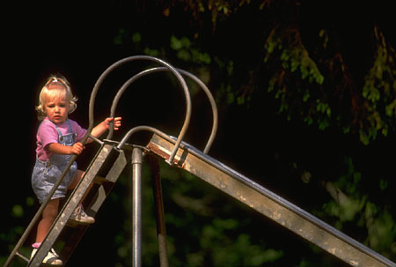
Mechanisms of Injury
Distance of fall
Surface
Did anything break the fall?
Amount of force
Twisting of body during fall or impact

Slide 16
Stomachache
S: “My stomach hurts”, it started during
the spelling test. Ate breakfast. No
vomiting.
O: Color good, Temp:98
A: Stomach pain
P: Rest, use bathroom, better after rest
and cracker, RTC, note home.

Slide 17
Headache
S: Sent by teacher who reported student
was complaining of a headache and
needs a Tylenol. Upon arrival of
student, no complaint was verbalized.
A: Color normal, denies injury, ate lunch
O: Temp- 98, throat clear, denies C/O HA.
P: Fluids, RTC

Slide 19
Things to Remember About Medication!
No meds for the first 2 hours or the last 2 hours of school. Unless prescribed or verification of no meds were already given. If medication is needed the last 2 hours parent/guardian permission needs to be obtained.
No Tylenol/Acetaminophen or Ibuprofen is to be given on the 1st health office visit.
You need to show and document that other measure were taken before giving medication.
There needs to be a reasonable time in between visits before giving.
Document the name of the med given the time given the amount given
Acetaminophen 250 mg @ 1:00pm – If documenting on a Medication Record the name of the med the time and days it is to be given the dosage amount, name and initials of the person giving the med the amount of medication received

Slide 20
Describe, DO NOT diagnose!
Do not state subjective feelings
  Teacher feels he is “faking”
Do not use judgmental terminology
  Student never comes to school in appropriate clothes
Do not overstep your authority
  May not return to school until seen by a doctor

Slide 21
Parent Contact
When contacting a parent/guardian make sure!
Is it the right parent!
    Wrong screen
    Similar name
  Custody
Make sure that anyone you are contacting is on the Emergency Contact list!!!
Do not text or call from your personal cell phone!!!
If leaving a message on voicemail
  Identify who you are
  What school you are at and phone number
  Brief sentence about why need to call back

Slide 22
Any Questions?
Data is only good if it is entered correctly
Who is the one giving you the info Dr. or Mom?
Was it charted properly?
Who is getting the data? Principal, District, SNOA, NASN, the state?

Slide 23
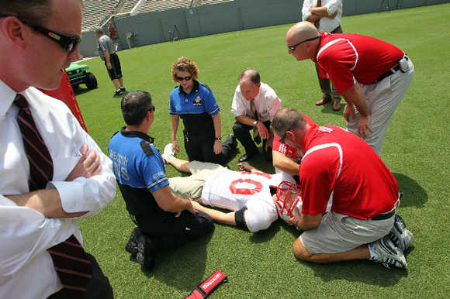
Group Practice
You are called to the field for a 15 year old student who was running at full speed during football and ran into a pole. The student is complaining of abdominal pain and throwing up.

Slide 24
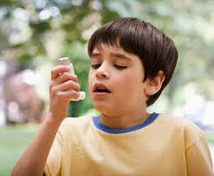
Group Practice
You are called to a classroom to see an asthmatic student who is so short of breath he can’t walk down to the office.

Slide 25
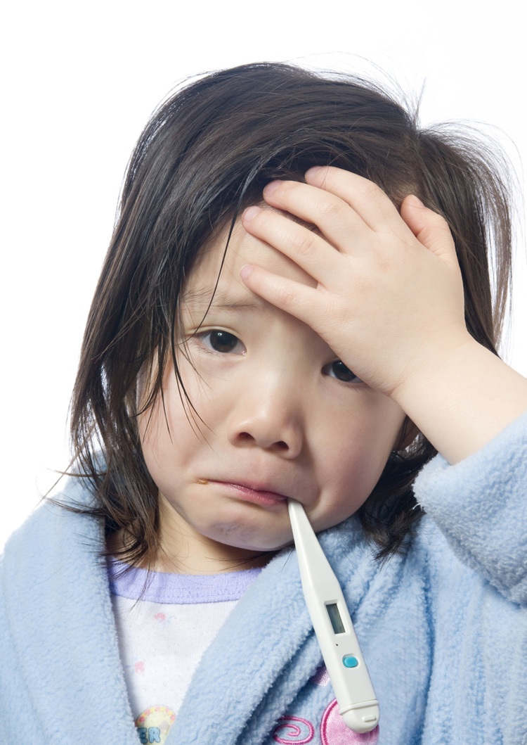
Group Practice
A 5 year old student comes into the health office C/O a stomachache. She has a high fever.

Slide 26
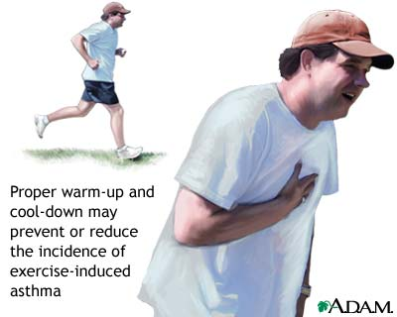
Group Practice
A 50 year old male teacher come into the office C/O chest pain. The principal asks you to look at him.

Slide 27
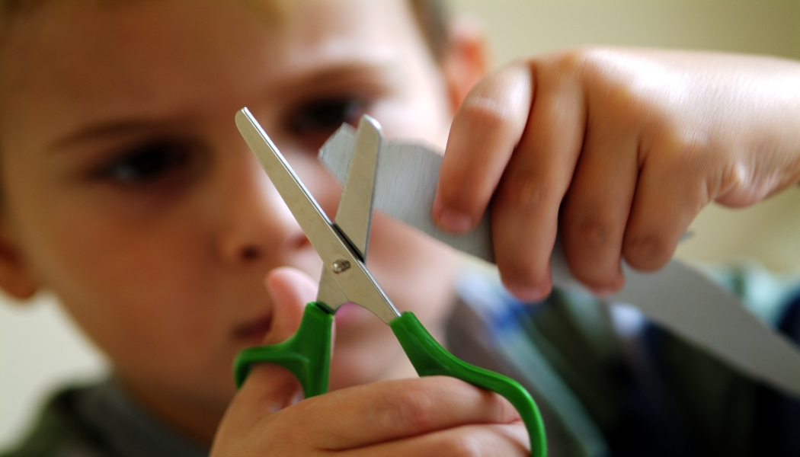
Group Practice
A 10 year old boy has just run into your office with a teacher holding a bloody hand yelling that he cut himself with a pair of scissors.

Slide 28

Group Practice
A six year old girl ran into the Health Office crying. She says she has sand in her eye and can’t see.

Slide 29

Group Practice
A 16 year old girl was sent to the Health Office for sleeping in class. She has nausea and vomiting “on and off” in the mornings.

Slide 30
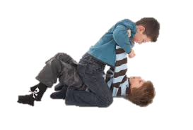
Group Practice
A 12 year old boy was involved in a fight on the playground a few min. ago. He reports that his right hand is broken.
Would this be a police report?

Slide 31
Documentation Quiz

Slide 32

Questions??

