Slide 1
T1D in the Schools
VICKIE MCWATTERS
June 2019

Slide 2
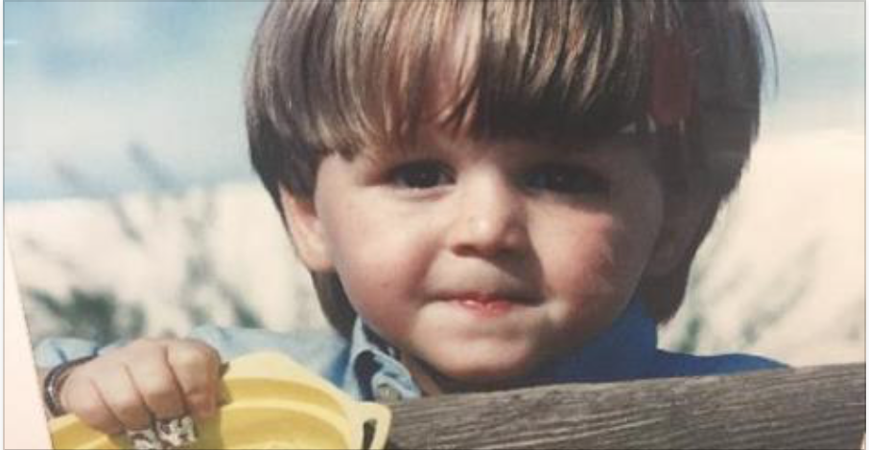
MEET ALEX

Slide 3
DIABETES
Notes:
What Is T1D? T1D often develops in children, adolescents, and young adults, so it used to be called “juvenile diabetes.” Now we know that T1D can be diagnosed at almost any age. T1D is not contagious. You cannot catch T1D from someone who has it. Researchers continue to study how and why T1D occurs in certain children and families. Although T1D cannot be cured, it can be controlled.

Slide 4
Type 1 Diabetes
||
AUTOIMMUNE DISEASE
VS
Type 2 Diabetes
||
METABOLIC DISORDER
Notes:
What is Type 1 Diabetes? A healthy pancreas produces insulin, a hormone that the body uses to change glucose in the blood into energy. Glucose in the blood comes from the food and drink a person consumes. A person with T1D doesn’t produce any insulin. Without insulin, the glucose builds up in the blood, causing high blood glucose, or hyperglycemia. Since people with T1D can’t produce their own insulin, they must put insulin into the bloodstream through injections or an insulin pump.
What Is Type 2 Diabetes? People with type 2 diabetes (T2D) produce some of their own insulin, but the insulin is either insufficient in quantity or ineffective in its ability to stabilize blood-glucose levels. Ineffective action of insulin is called insulin “resistance.” Many factors can cause insulin resistance; a major cause is known to be obesity. People with T2D can sometimes manage their disease with diet and exercise. Some individuals with T2D can take an oral medication that improves the effectiveness of the insulin, while others need to inject additional insulin. Most school-age children with diabetes have T1D. Unfortunately, however, as more and more of our nation’s children become overweight and sedentary, T2D is occurring more frequently in school-age children.

Slide 5
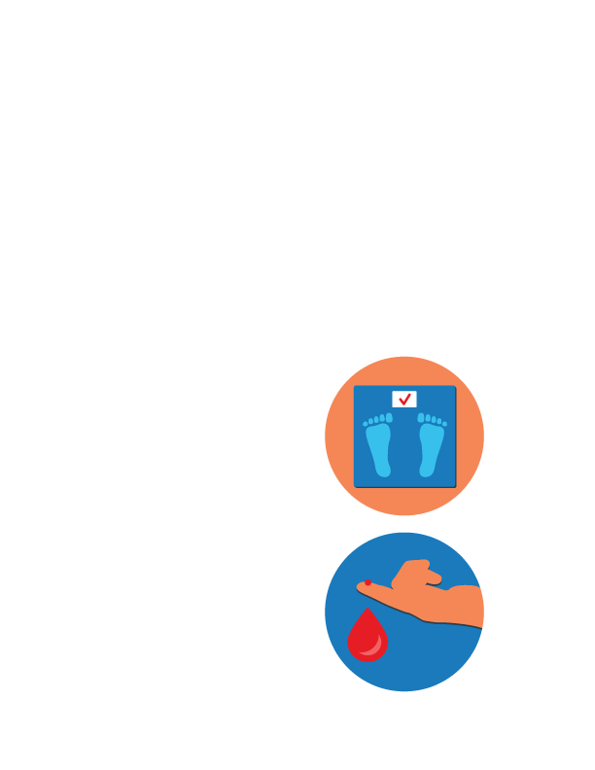
CAN WE PREVENT DIABETES?
TYPE 2 – YES
Exercise
Eat Healthy
TYPE 1 – NO
Injections of Insulin Required to Live
Constant Monitoring of Blood Glucose Levels

Slide 6
T1D MANAGEMENT

Slide 7
DIABETES MANAGEMENT – TAKES A TEAM
PARENT
HEALTHCARE PROVIDER
EDUCATORS
T1D
TEACHERS
SCHOOL NURSE
SUPPORT STAFF
Notes:
Essential to establish a partnership with school in order to create a supportive environment for your child and school staff to be able to comfortably communicate with you

Slide 8
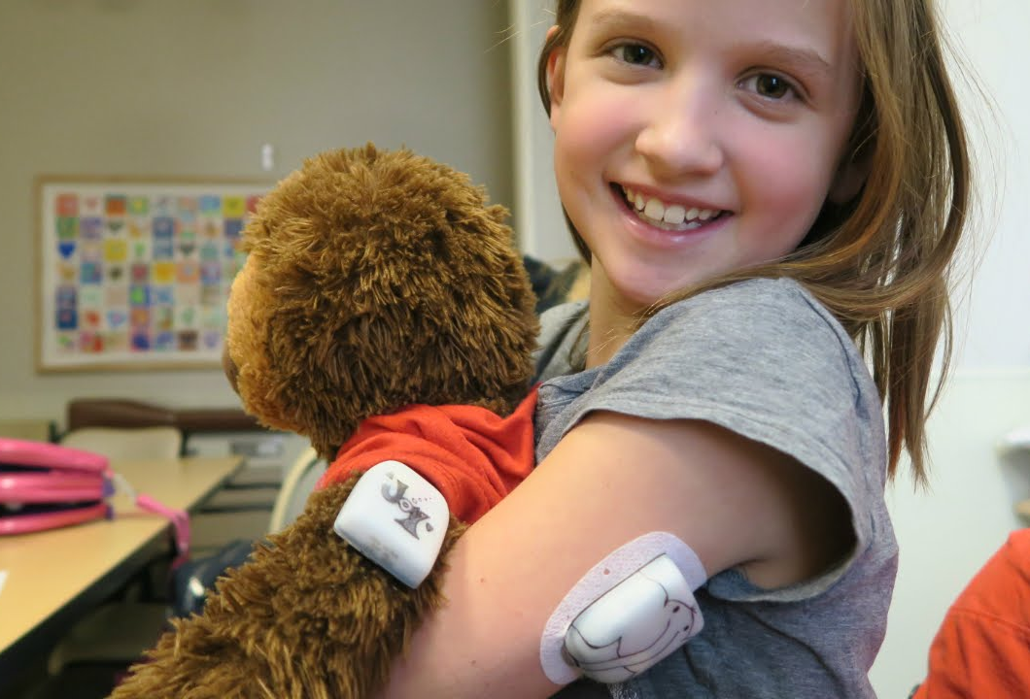
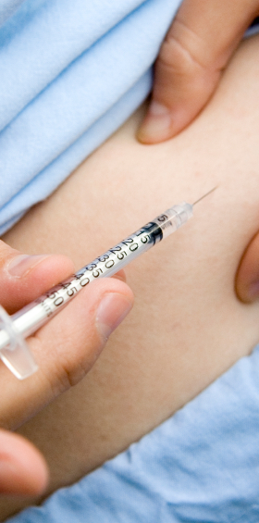
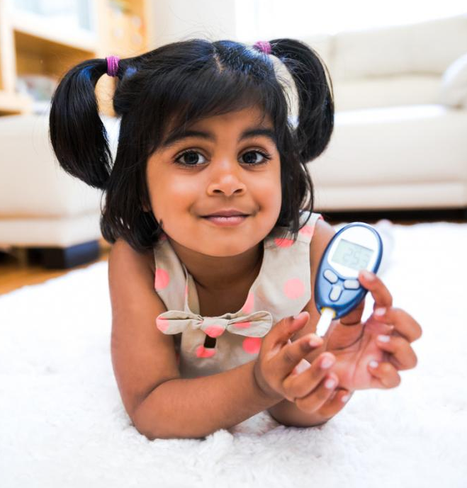
T1D TOOLS

Slide 9

T1D EQUIPMENT
Glucose Meter
Lancets and Lancing Device
Test Strips
Syringe
Insulin Pump
Low BG Kit
CGM (continuous glucose monitor)
Cell Phone (Apps for monitoring CGM)
Glucagon Kit

Slide 10
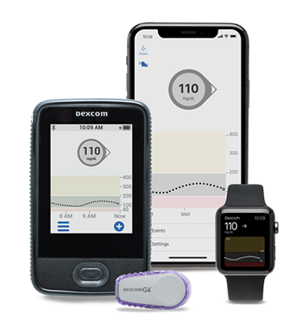
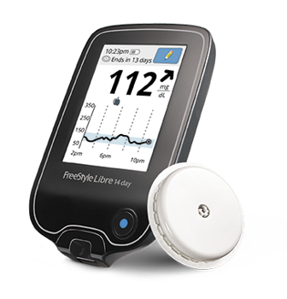
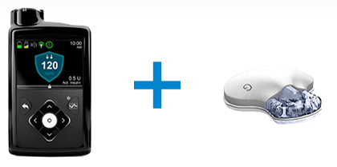
CONTINUOUS GLUCOSE MONITOR (CGM)

Slide 11
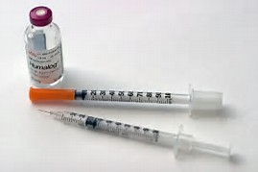
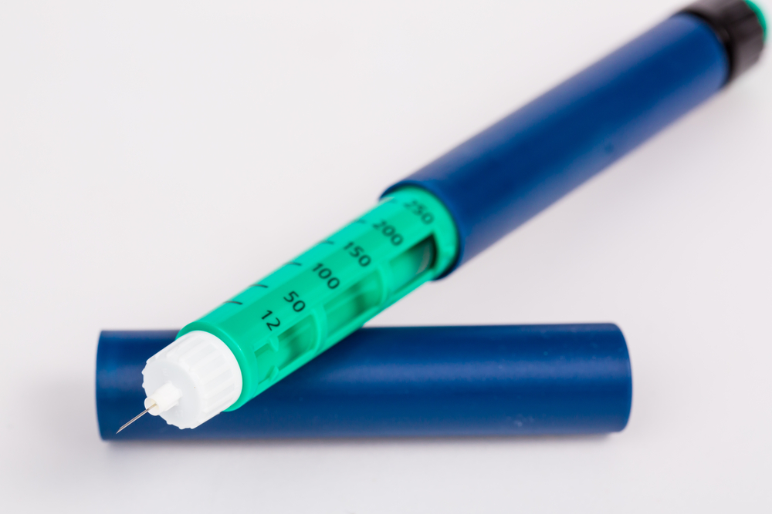
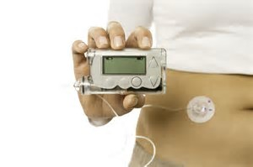
INSULIN DELIVERY

Slide 12
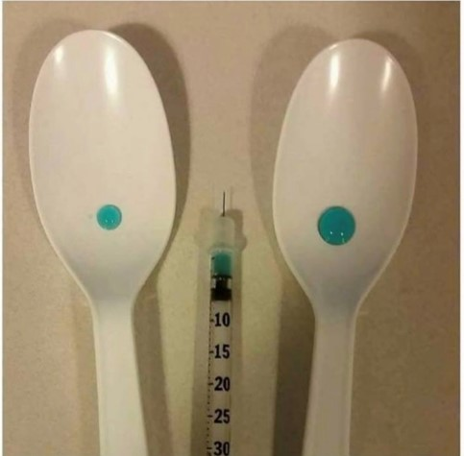
INSULIN
The left spoon has 2 units of insulin. The right spoon has 10 units of insulin.
If you needed to take 2 units, but accidentally took 10 units instead, it could be deadly in a matter of hours.

Slide 13
BLOOD GLUCOSE LEVELS
Notes:
What are “normal” glucose levels? Non-Diabetic is about 70 – 120. Your T1D student will have a range of where their HCP will want to try to keep their glucose.

Slide 14
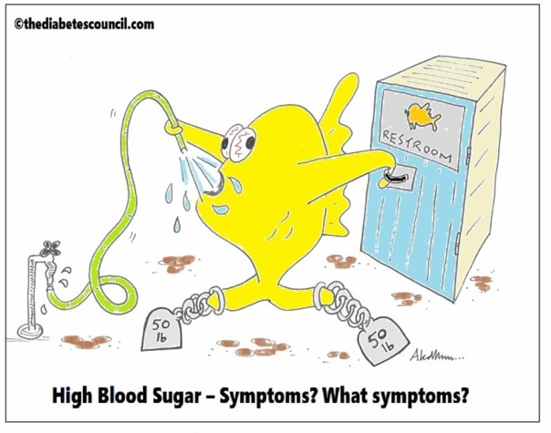
HIGH GLUCOSE SYMPTOMS
(HYPERGLYCEMIA)
Tired
Thirsty
Frequent Urination
Weak
Headaches
Dizzy
Nausea
Blurred Vision/Eyesight

Slide 15
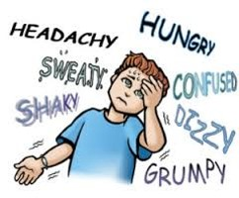
LOW GLUCOSE SYMPTOMS
(HYPOGLYCIMIA)
Hungry
Shaky
Sweaty
Headache
Confusion
Dizzy
Irritable
Angry

Slide 16
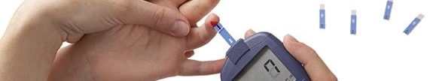
WHEN TO CHECK BLOOD GLUCOSE LEVELS
Before Meals and 2 Hours After Meals
Before Exercise and After Exercise
Before a Stressful Situation and After a Stressful Situation
ANY TIME THE T1D FEELS OR ACTS LIKE THEY HAVE A LOW BLOOD GLUCOSE
The key to good T1D control is a careful balance between food, exercise, and insulin.

Slide 17



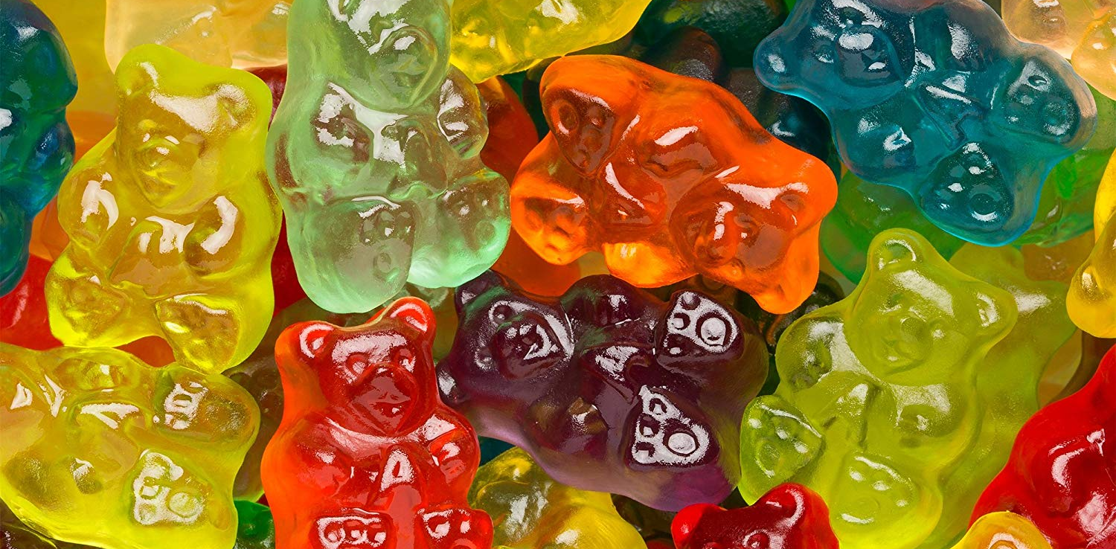

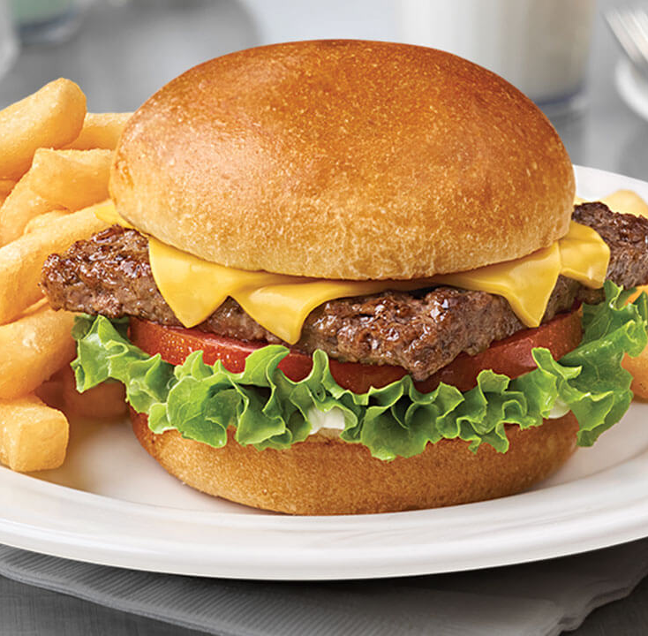









FOOD – FRIEND OR FOE?

Slide 18
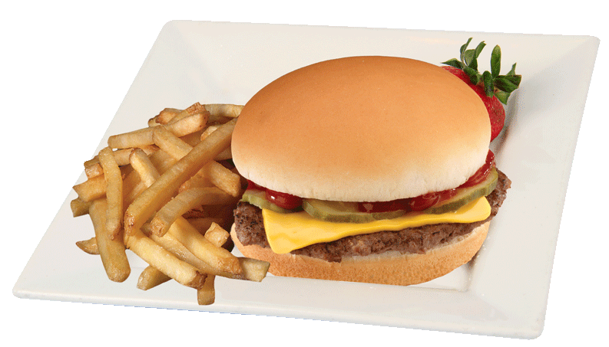
HOW MUCH INSULIN?

Slide 19
FAST ACTING CARBOHYDRATES
Cup of Juice or Regular Soda
Glucose Tablets
Skittles/Jellybeans (each about 1 gram of carbs)
Table Sugar
Honey
Raisins
Foods that raise your blood glucose quickly are carbohydrates that are lacking of protein and fat.

Slide 20
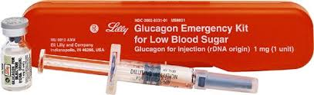
SEVERE HYPOGLYCEMIA
Use Glucagon if:
Unconscious and/or can’t swallow
Notes:
If the child has passed out or can’t swallow, a glucagon shot is needed
Get the glucagon kit, have someone call 911
Kit contains glucagon tablet, and separate diluent
Inject and mix the diluent into the glucagon bottle, draw dose and give IM

Slide 21
TREATMENT REMINDERS
Ensure T1D students are escorted to the nurses office
Food/drink may need to be consumed in the classroom
A cell phone may be used as a piece of equipment to check glucose levels
Routine testing and injections of insulin are a critical part of T1D management
Episodes of hypoglycemia and hyperglycemia can change the personality of the T1D
Every T1D is different and may present symptoms differently than others
Notes:
If the child has passed out or can’t swallow, a glucagon shot is needed
Get the glucagon kit, have someone call 911
Kit contains glucagon tablet, and separate diluent
Inject and mix the diluent into the glucagon bottle, draw dose and give IM

Slide 22
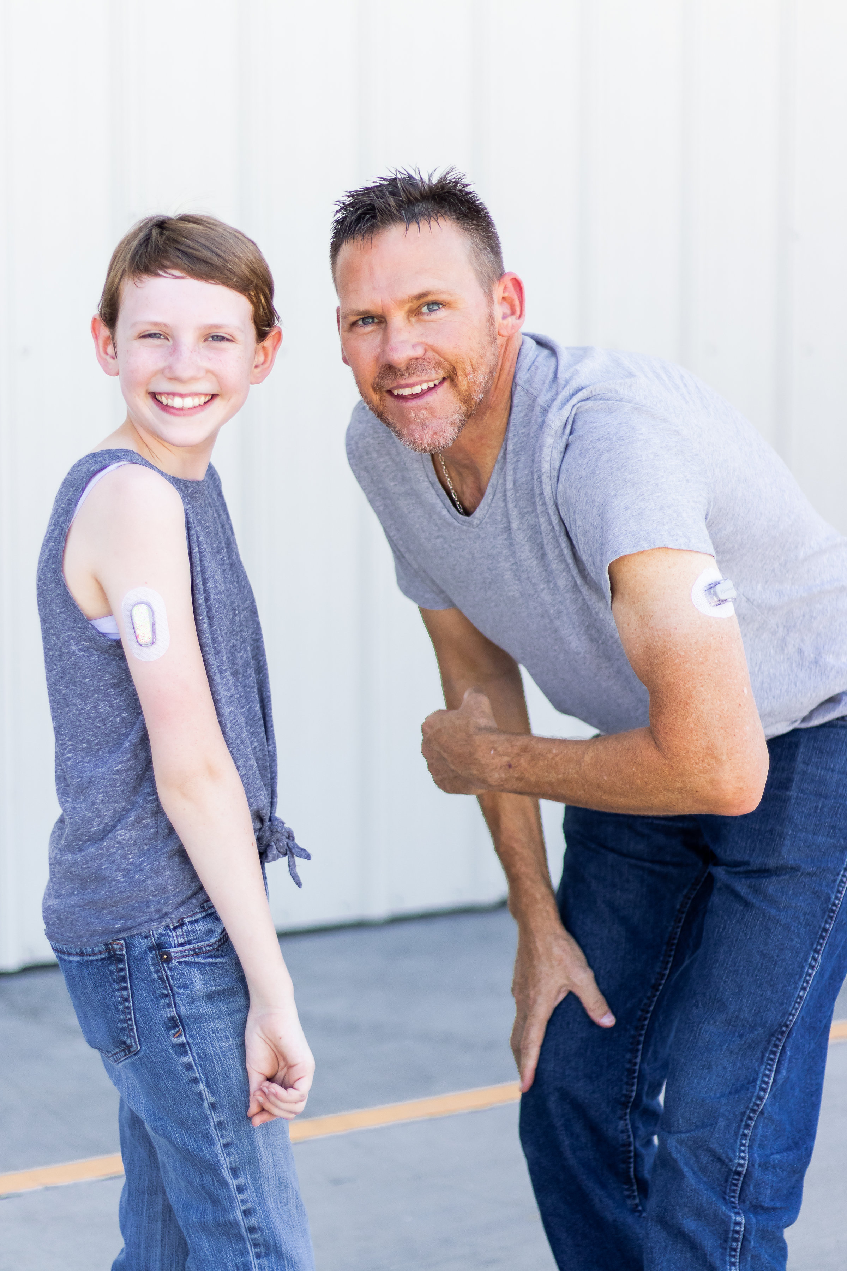
YOU DON’T KNOW HOW STRONG YOU ARE, UNTIL BEING STRONG IS THE ONLY OPTION YOU HAVE
TYPE ONE

Slide 23
VICKIE MCWATTERS
Development Manager
vmcwatters@jdrf.org | 602-224-1822

