Slide 1
Trauma Awareness
in Education: Understanding
the Impact of Adversity in Childhood
Lori Robinson, MSW
City of Tempe Human Services Department
CARE 7

Slide 2
CARE 7
Crisis Response Team
Victim Advocacy
Veteran Services
Counseling
High School Youth Specialists
Trauma-Informed Care

Slide 3
“In the beginner's mind there are many possibilities, but in the expert's mind there are few. ”
-Shunryu Suzuki

Slide 4
Overview:
Adverse Childhood Experiences (ACE) Study
Stress response system
Signs and symptoms of trauma
Resilience and protective factors
Self-care

Slide 5
Experiences Shape Perspective (Identity, Values, Ideas, Beliefs, Safety, Trust)

Slide 6
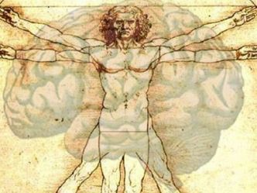
Scientific Advances
are shifting the way that we understand human health and behavior

Slide 7
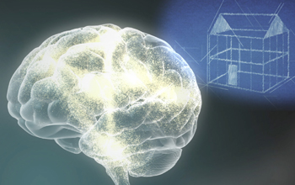
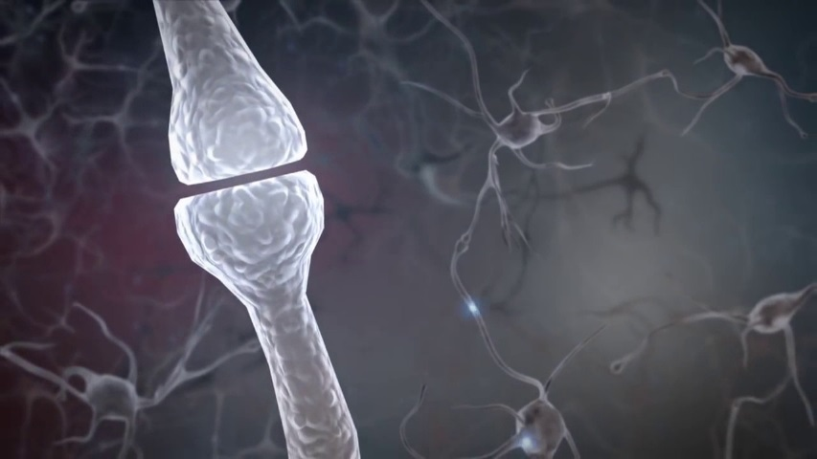
For Better or Worse
Early experiences build brain architecture
Serve and return interactions shape brain circuitry

Slide 8
Still Face Experiment
https://www.youtube.com/watch?v=apzXGEbZht0

Slide 9
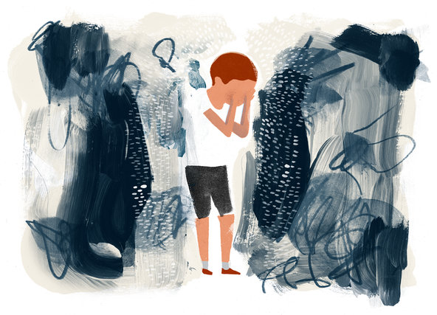
Toxic Stress Derails Healthy Development
Prolonged activation of the stress response system in the absence of protective relationships.
Art: Keith Negley
Center on the Developing Child, Harvard University

Slide 10
HOPE = Relationships Heal

Slide 11
The Adverse Childhood Experiences (ACE) Study
How many of you are familiar with the ACE Study and the research findings?
Notes:
Slide 3- What are ACES?
11

Slide 12
Adverse Childhood Experiences (ACE)
Research Study
1995-1997, published in 1998
CDC/Kaiser Permanente (Dr. Felitti and Dr. Anda)
17,421 participants
Middle Class, predominately white, college educated

Slide 13
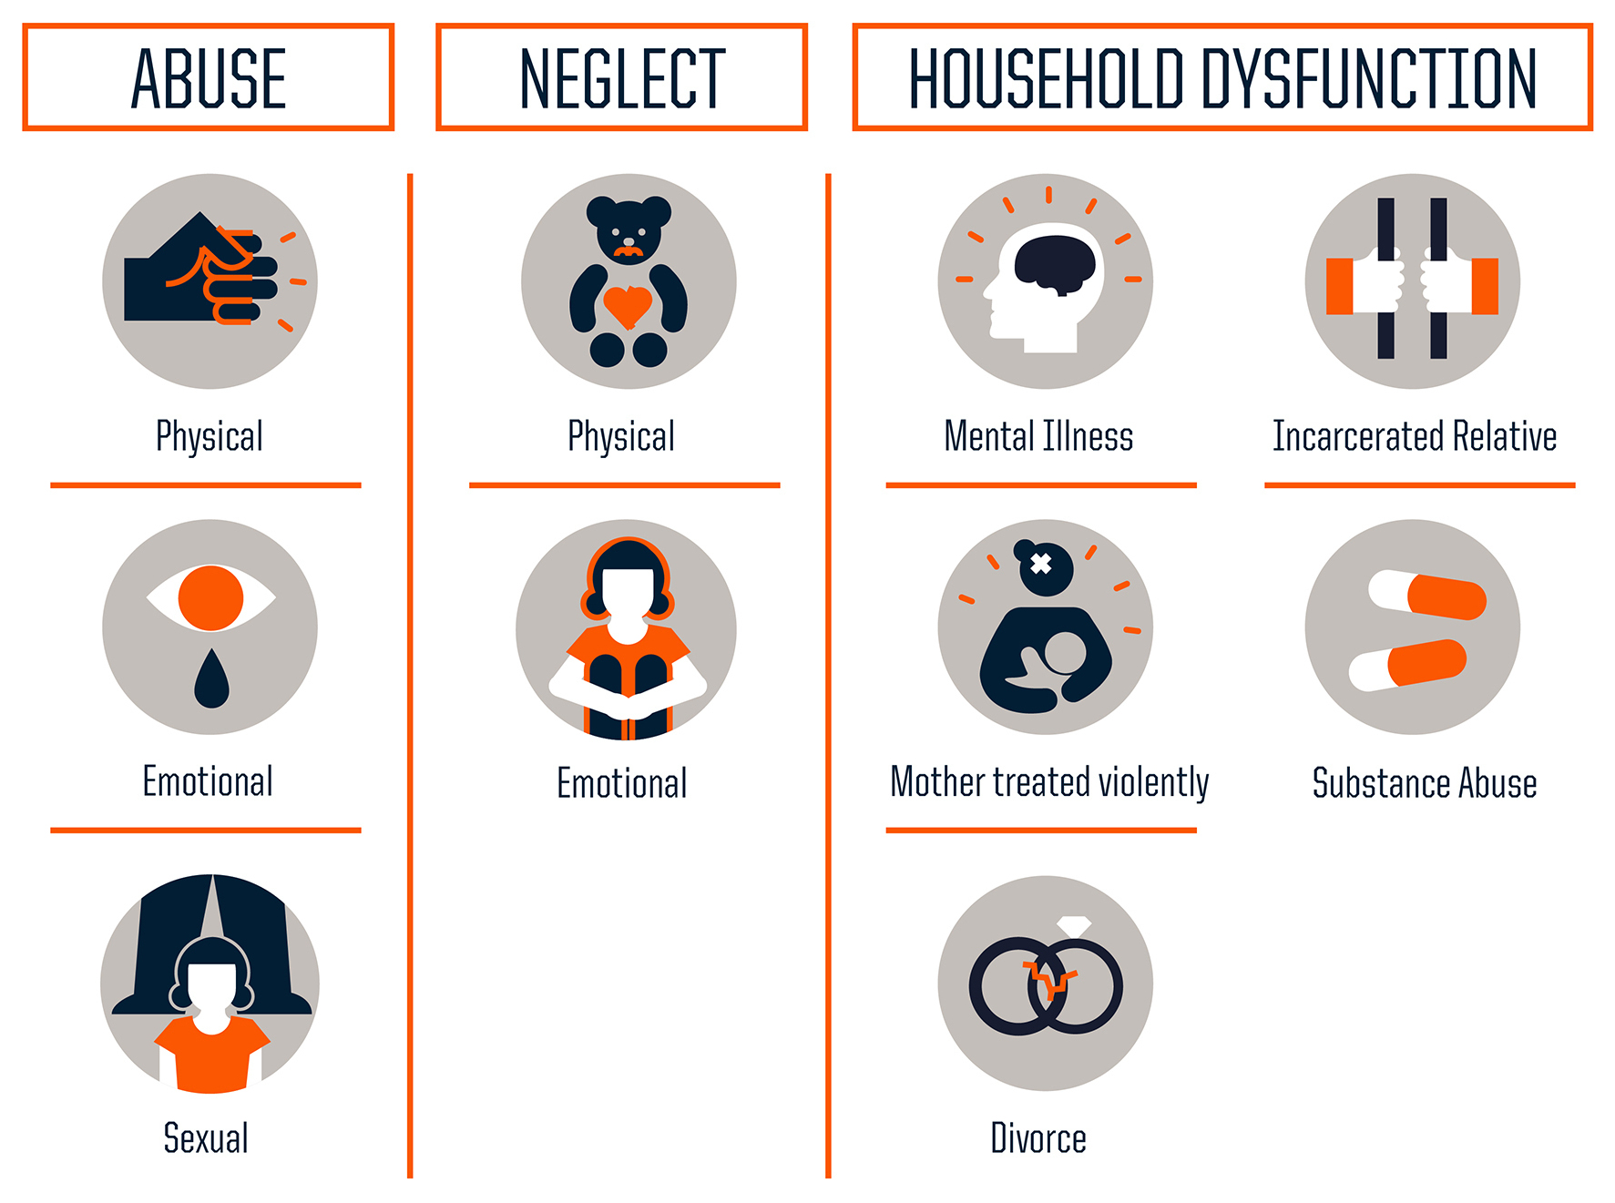
Adverse Childhood Experiences

Slide 14
ACEs are Common
0

Slide 15
Adversity Impacts Health and Behavior

Slide 16
33% report no ACEs | 51% report 1-3 ACEs | 16% report 4-10 ACEs
With 0 ACEs | With 3 ACEs | With 7+ ACEs
1 in 16 smokes | 1 in 9 smokes | 1 in 6 smokes
1 in 69 is alcoholic | 1 in 9 is alcoholic | 1 in 6 is alcoholic
1 in 480 uses IV drugs | 1 in 43 uses IV drugs | 1 in 30 uses IV drugs
1 in 14 has heart disease | 1 in 7 has heart disease | 1 in 6 has heart disease
1 in 96 attempts suicide | 1 in 10 attempts suicide | 1 in 5 attempts suicide

Slide 17
ACEs are Interrelated and have a Cumulative Stressor Effect
It is the # of different categories or the DOSE of stress, not the intensity of the ACE that impacts health outcomes.
Notes:
Slide 24- ACE’s are highly interrelated and commonly occur in clusters. If any ACE is present, there is an 87% chance at least one other category of ACE is present. ACE’s are so interrelated that trying to determine the impact of one ACE does not make sense.

Slide 18
ACE’s are Highly Interrelated
Alcohol Abuse in the Home and the Risk of Other Household Exposures During Childhood
Notes:
Slide 26- This chart shows the interrelationship if a parent was an alcoholic and is then more likely to have experienced other categories of ACE’s.

Slide 19
Why is the ACE Study Important?
ACEs are very common
Strong predictors of future health
Research gives us context – a framework for understanding behavior and health
Reduces stigma, shame and social taboo

Slide 20
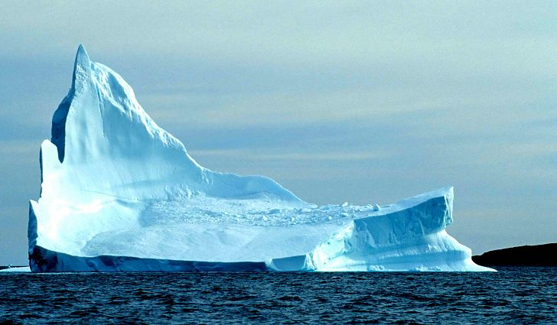
What We See…
Difficulty Learning
Behavior Problems
Physical Illness

Slide 21
What Happened First?
ACEs
Trauma
Chronic Hyperarousal

Slide 22
Not an excuse, rather an explanation…
Dr. Vincent Felitti

Slide 23
Why? What is going on here?
Impact of unhealthy coping mechanisms played out over time
Impact of chronic, unrelieved stress on the brain and the central nervous system
*Even if you don’t engage in unhealthy behaviors, your health risk is still elevated with a high ACE score
Dr. Vincent Felitti

Slide 24
Trauma
is the result of
DAMAGING
stress
Dr. Sandra Bloom, Sanctuary Model

Slide 25
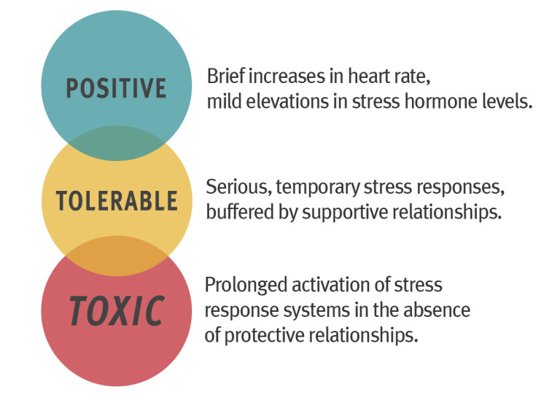
Center on the Developing Child, Harvard University

Slide 26
Trauma is not an event or experience but how an event or experience remains in our body

Slide 27
Fight, Flight, Freeze

Slide 28
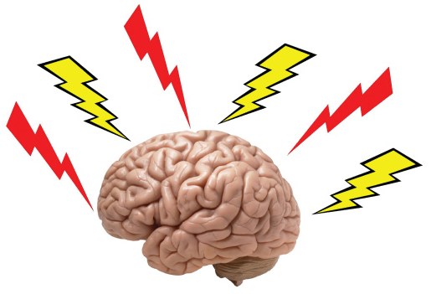
Our Brilliant Brains
Behavior is an ADAPTATION for survival
Toxic stress results in the stress response system set on high alert

Slide 29
Toxic Stress Puts Our Survival Brain In Charge

Slide 30
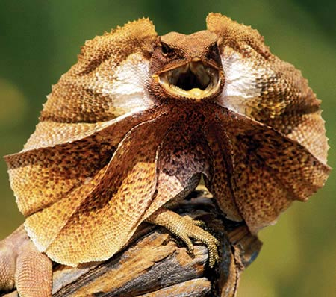
Toxic Stress Puts the Lizard in Charge

Slide 32
your ego is not your amigo

Slide 33
Prefrontal Cortex – Executive Functioning
Logic
Reasoning
Perspective
Future thinking
Planning
Organizing
Impulse control
Arizona Trauma Institute

Slide 34
Executive Function and Self Regulation
https://developingchild.harvard.edu/science/key-concepts/executive-function/

