Slide 1
Vaping, E-Cigarettes, and Lung Injury
Cori Daines, MD
Pediatric Pulmonary and Sleep Medicine
University of Arizona
SNOA Conference June 12, 2023

Slide 2
Disclosures
I have no relevant financial relationships with the manufacture(s) of any commercial product(s) and/or providers(s) of commercial services discussed in this CME activity.
I do not intend to discuss an unapproved/investigative use of a commercial product/device in my presentation.

Slide 3
Outline
Definition
Etiologies
Mechanism
Symptoms
Treatment
Outcomes
Prevention
Other inhalants
Pathology
EVALI or COVID-19

Slide 4
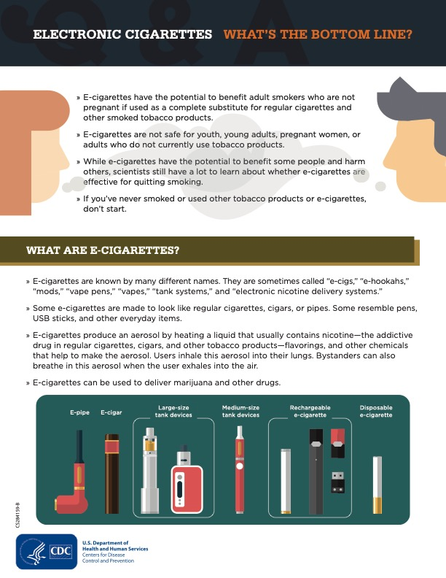

Slide 5
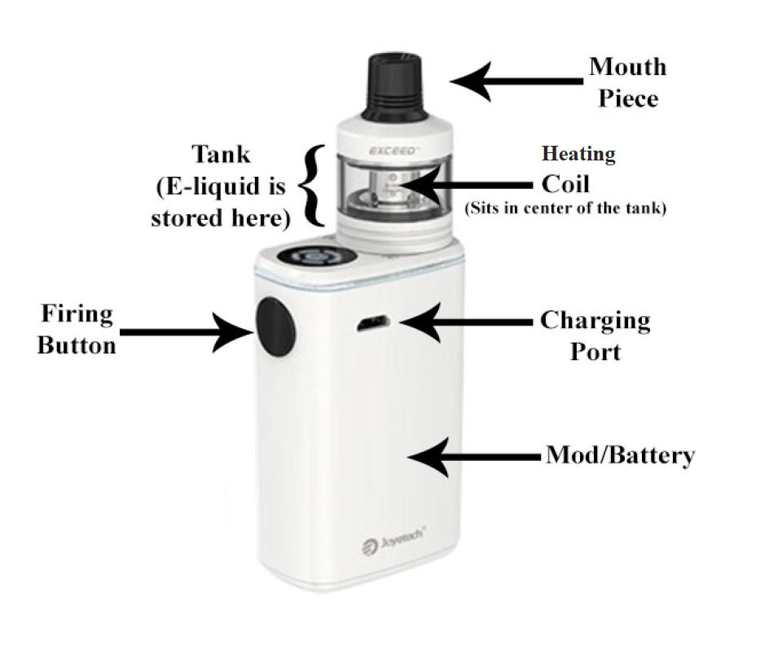
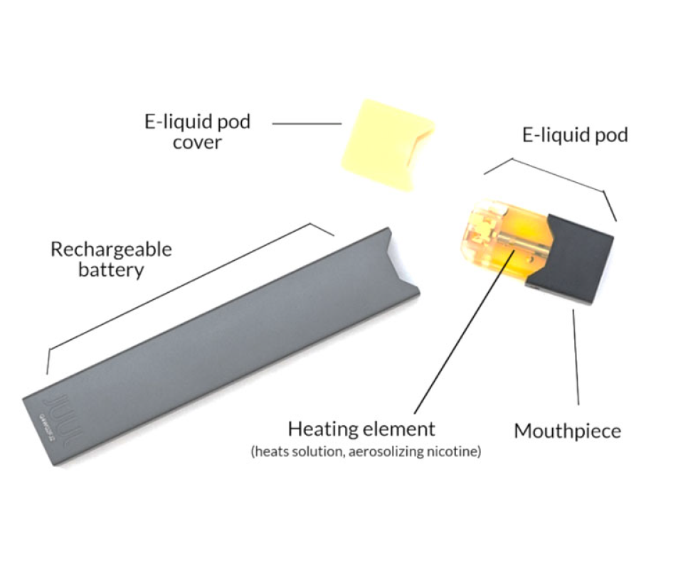
cdc.gov

Slide 6
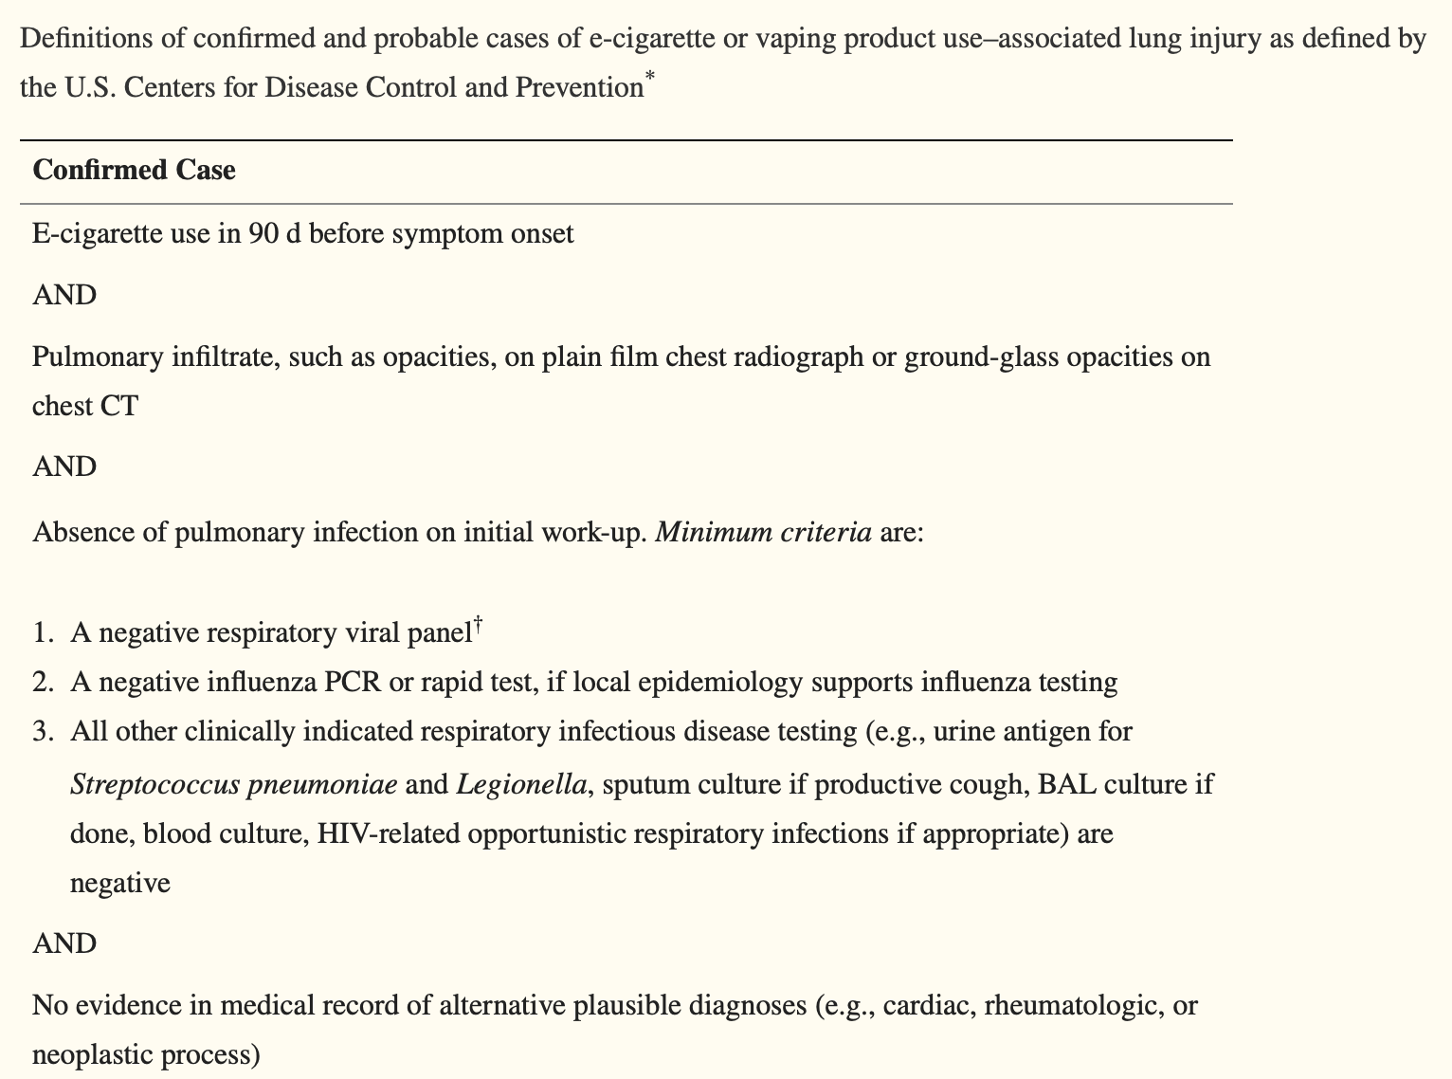
Definition of EVALI--Acute Lung Injury
EVALI—E-cigarette
or vaping product
related acute lung
injury
Definition:
Rebuli ME, Rose JJ, Noël A, Croft DP, Benowitz NL, Cohen AH, Goniewicz ML, Larsen BT, Leigh N, McGraw MD, Melzer AC, Penn AL, Rahman I, Upson D, Crotty Alexander LE, Ewart G, Jaspers I, Jordt SE, Kligerman S, Loughlin CE, McConnell R, Neptune ER, Nguyen TB, Pinkerton KE, Witek TJ Jr. The E-cigarette or Vaping Product Use-Associated Lung Injury Epidemic: Pathogenesis, Management, and Future Directions: An Official American Thoracic Society Workshop Report. Ann Am Thorac Soc. 2023 Jan;20(1):1-17. doi: 10.1513/AnnalsATS.202209-796ST. PMID: 36584985; PMCID: PMC9819258.

Slide 7
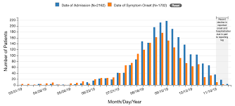
EVALI
Officially recognized by the CDC in the summer of 2019
Peaks in incidence June through September 2019 with a decrease since, likely due to information/surveillance

Slide 8
EVALI—National Statistics
As of February 18, 2020
2807 hospitalizations—all states
68 deaths—29 states, age range 15-75
Hospitalizations: 66% male, median age 24, range 13-85 years, 15% under 18 y.o., 37% 18-24 y.o., 24% 25-34 y.o., 24% over 35 years
As of January 14, 2020
82% using THC products, 33% exclusively—78% getting “informally”
57% using nicotine products, 14% exclusively—69% getting commercially
Numbers are declining during COVID
CDC stopped collection data after this

Slide 10
Public Health Needs
Rebuli ME, Rose JJ, Noël A, Croft DP, Benowitz NL, Cohen AH, Goniewicz ML, Larsen BT, Leigh N, McGraw MD, Melzer AC, Penn AL, Rahman I, Upson D, Crotty Alexander LE, Ewart G, Jaspers I, Jordt SE, Kligerman S, Loughlin CE, McConnell R, Neptune ER, Nguyen TB, Pinkerton KE, Witek TJ Jr. The E-cigarette or Vaping Product Use-Associated Lung Injury Epidemic: Pathogenesis, Management, and Future Directions: An Official American Thoracic Society Workshop Report. Ann Am Thorac Soc. 2023 Jan;20(1):1-17. doi: 10.1513/AnnalsATS.202209-796ST. PMID: 36584985; PMCID: PMC9819258.

Slide 11
Pathology
Acute fibrinous pneumonitis, diffuse alveolar damage, organizing pneumonia
Acute eosinophilic pneumonia
Diffuse alveolar hemorrhage
Lipoid pneumonia
Bronchiolar interstitial lung disease
All suggest more than one mechanism and a continuum of disease

Slide 12
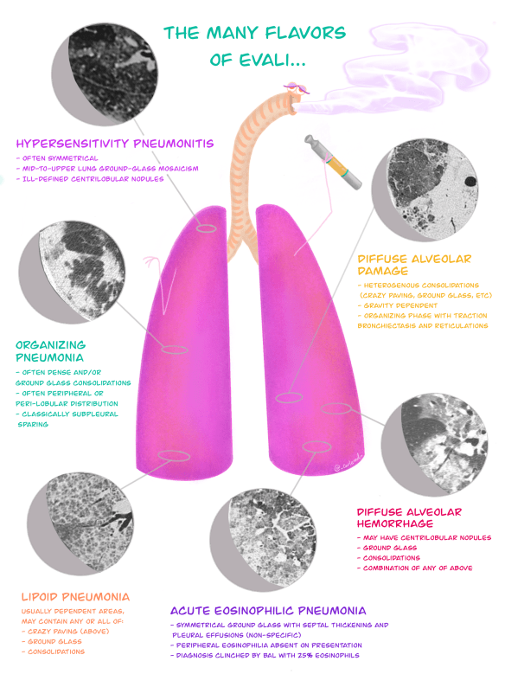

Slide 13
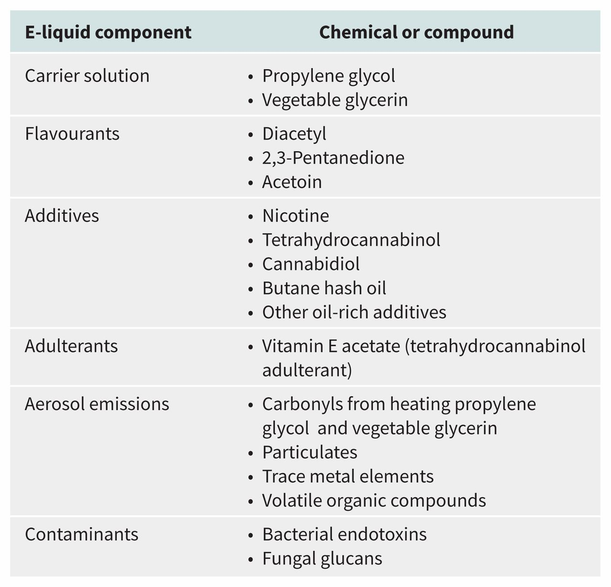
Simon T. Landman et al. CMAJ 2019;191:E1321-E1331
©2019 by Canadian Medical Association

Slide 14
Risks
THC—present in lung lavage samples from 75-80% of acute injury victims
Vitamin E acetate—used as a thickener, usually with THC—present in lung lavage of over 90% of acute injury victims
Nicotine—present in lung lavage of over 60% of acute injury victims. Also present in lavage of smokers without symptoms
Other elements—CBD, plant oils, medium chain triglycerides, petroleum products, byproducts

Slide 15
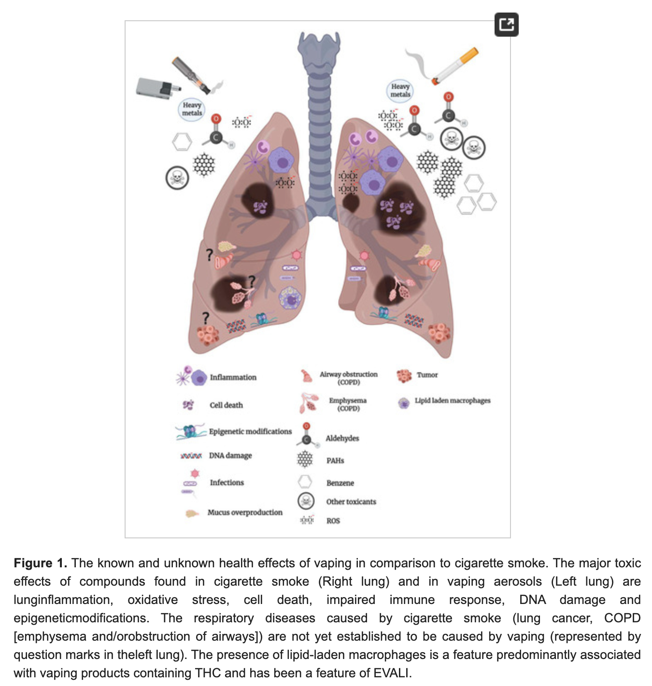
Traboulsi H J Int
Mol Sci 2020

Slide 16
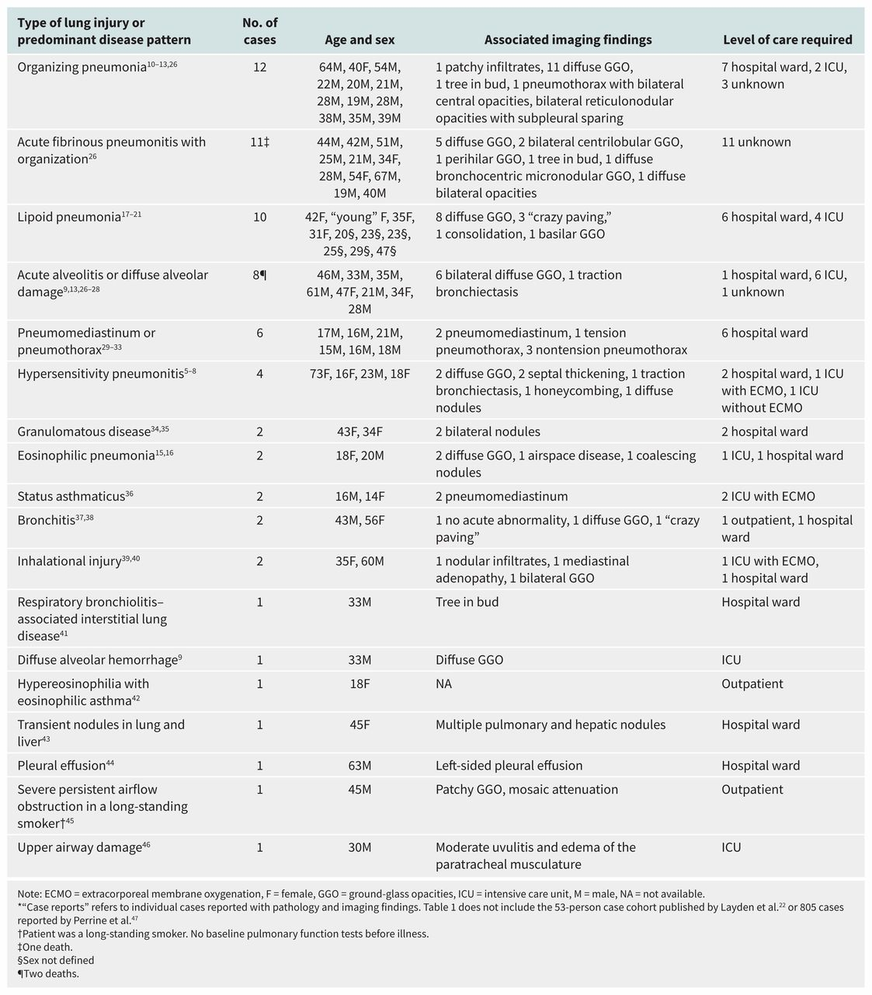
Patterns of disease shown in case reports of vaping-associated pulmonary illnesses: an overview of the medical literature up to Oct. 30, 2019*.
Simon T. Landman et al. CMAJ 2019;191:E1321-E1331
©2019 by Canadian Medical Association
Notes:
Patterns of disease shown in case reports of vaping-associated pulmonary illnesses: an overview of the medical literature up to Oct. 30, 2019*

Slide 17
Patterns of disease shown in case reports of vaping-associated pulmonary illnesses: an overview of the medical literature up to Oct. 30, 2019*.
Simon T. Landman et al. CMAJ 2019;191:E1321-E1331
©2019 by Canadian Medical Association
Notes:
Patterns of disease shown in case reports of vaping-associated pulmonary illnesses: an overview of the medical literature up to Oct. 30, 2019*

Slide 18
Patterns of disease shown in case reports of vaping-associated pulmonary illnesses: an overview of the medical literature up to Oct. 30, 2019*.
Simon T. Landman et al. CMAJ 2019;191:E1321-E1331
©2019 by Canadian Medical Association
Notes:
Patterns of disease shown in case reports of vaping-associated pulmonary illnesses: an overview of the medical literature up to Oct. 30, 2019*

Slide 19
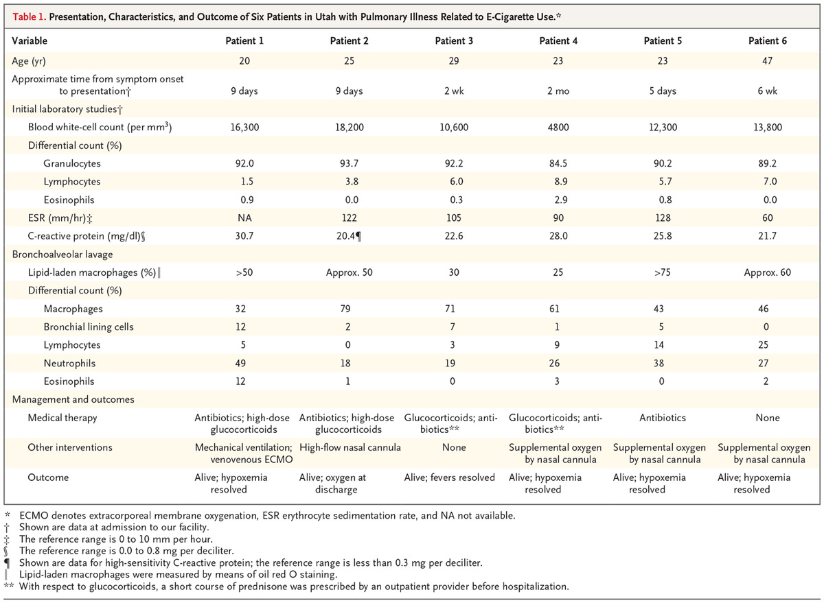
SD Maddock et al. N Engl J Med 2019;381:1488-1489.
Presentation, Characteristics, and Outcome of Six Patients in Utah with Pulmonary Illness Related to E-Cigarette Use.*

Slide 20
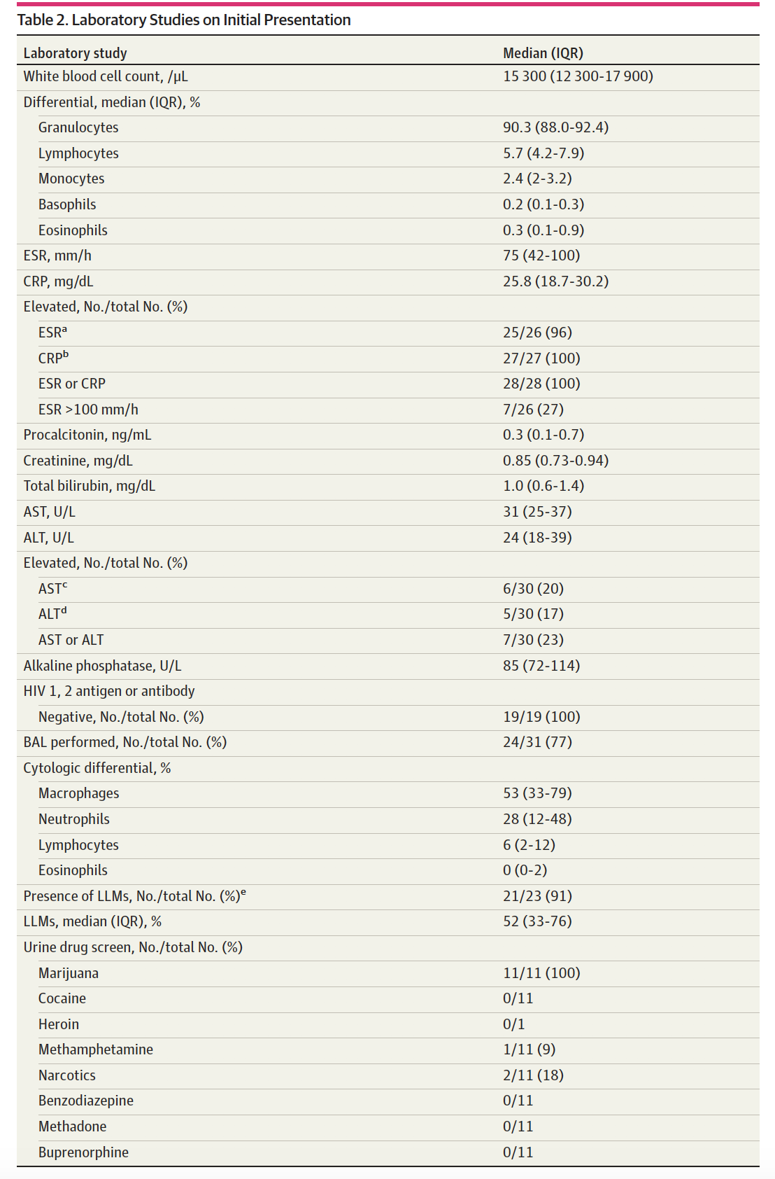
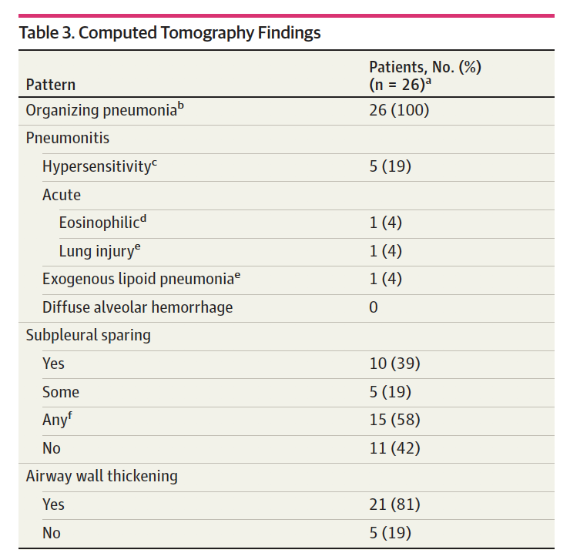
Newest Case Series
Aberegg SK et al, JAMA Network Open 2020

Slide 21
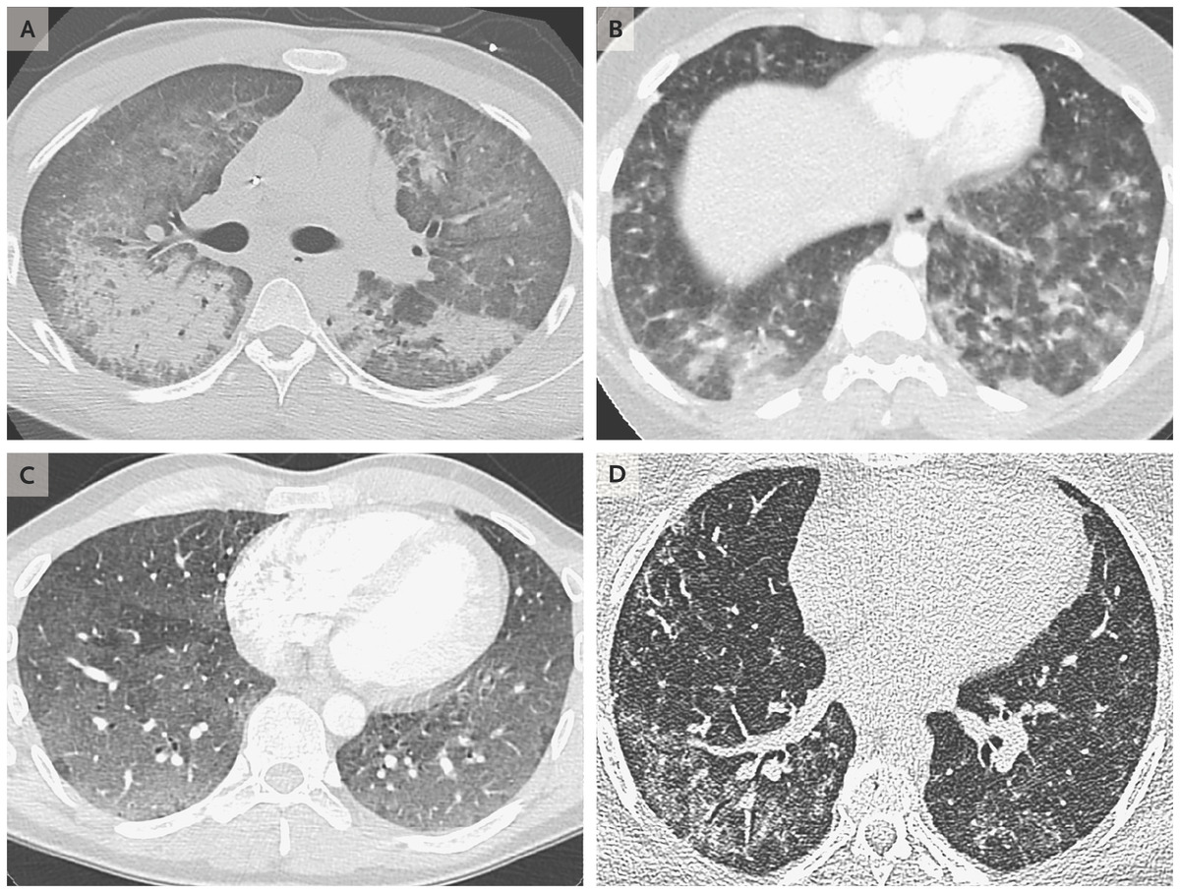
TS Henry et al. N Engl J Med 2019;381:1486-1487.
Computed Tomographic Scans of the Chest Obtained from Patients with Vaping-Associated Lung Injury.
Notes:
Figure 1. Computed Tomographic Scans of the Chest Obtained from Patients with Vaping-Associated Lung Injury. An image obtained from a 20-year-old man with diffuse alveolar damage (Panel A) shows dependent consolidation and diffuse ground-glass opacity, with some areas of bronchial dilatation typical of diffuse alveolar damage. The patient underwent intubation on hospital day 2 but eventually recovered after receiving glucocorticoid therapy. An image obtained from a 19-year-old woman with acute eosinophilic pneumonia (Panel B) shows diffuse nodular areas of consolidation and ground-glass opacity, with mild septal thickening and a small right pleural effusion. The findings cleared within days after the administration of glucocorticoids. An image obtained from a 35-year-old man with a pattern of hypersensitivity pneumonitis (Panel C) shows extensive centrilobular ground-glass attenuation nodules, especially in the anterior region, and more confluent ground-glass opacity in the dependent lungs, with lobules of mosaic attenuation. The patient’s symptoms improved after cessation of vaping. An image obtained from a 49-year-old woman with giant-cell interstitial pneumonia (Panel D), which was diagnosed on the basis of findings on surgical biopsy of the lung and was attributed to cobalt in her vape pen, shows fibrosis characterized by peripheral reticulation, ground-glass opacity, and mild traction bronchiectasis. The patient’s symptoms improved after cessation of vaping.

Slide 22
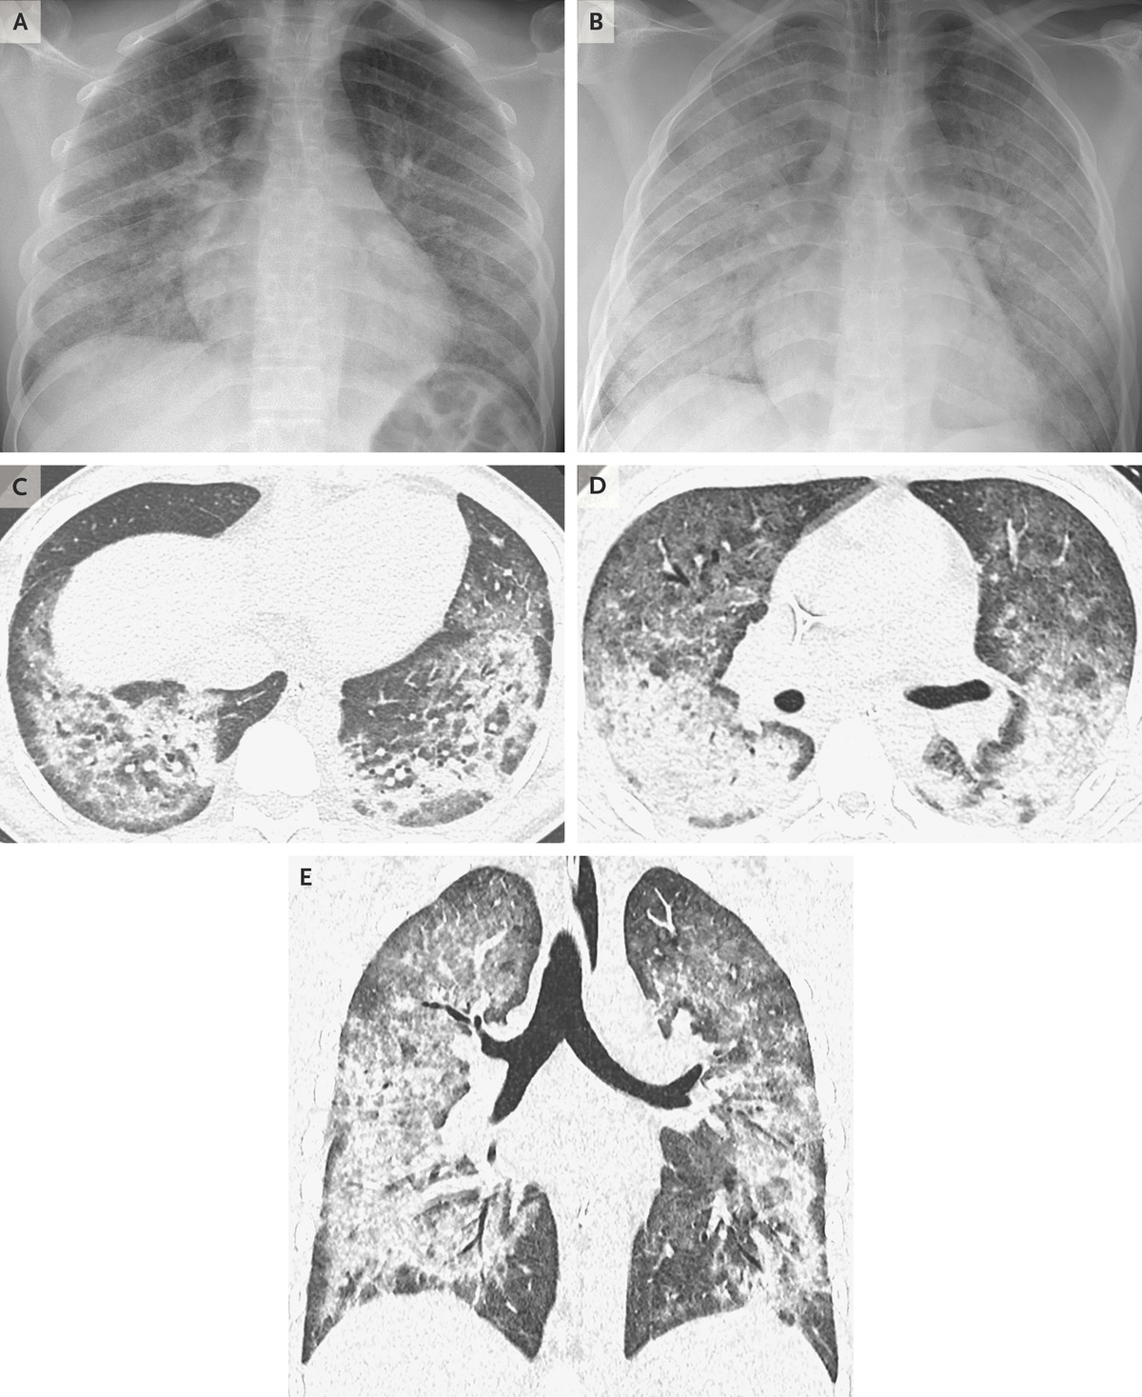
JE Layden et al. N Engl J Med 2019. DOI: 10.1056/NEJMoa1911614
Chest Radiographs and High-Resolution Computed Tomographic Imaging in a 17-Year-Old Male Patient with Diffuse Lung Disease.
Notes:
Figure 2. Chest Radiographs and High-Resolution Computed Tomographic Imaging in a 17-Year-Old Male Patient with Diffuse Lung Disease. In the initial radiograph of the chest at admission (Panel A), the anterior–posterior image shows hazy opacities that are predominant in the mid and lower lungs. An anterior–posterior radiograph of the chest that was obtained approximately 12 hours after presentation (Panel B) shows rapid worsening of diffuse lung opacities with developing consolidation and air bronchograms. Axial (Panels C and D, showing different segments of the lung in order to visualize the extent of the opacities) and coronal reformatted (Panel E) high-resolution CT images of the chest show ground-glass opacities in both lungs and dense consolidation in a peribronchial and perilobular distribution, with relative subpleural sparing — findings consistent with an organizing pneumonia pattern of lung injury.

Slide 23
EVALI—Clinical Features
Shortness of breath
Cough
Chest pain
Pleuritic chest pain
Hemoptysis
Fever and chills
Nausea, vomiting, diarrhea
Abdominal pain
Present days to months ahead of acute process

Slide 24
https://emergency.cdc.gov/coca/calls/2019/callinfo_112119.asp

Slide 25
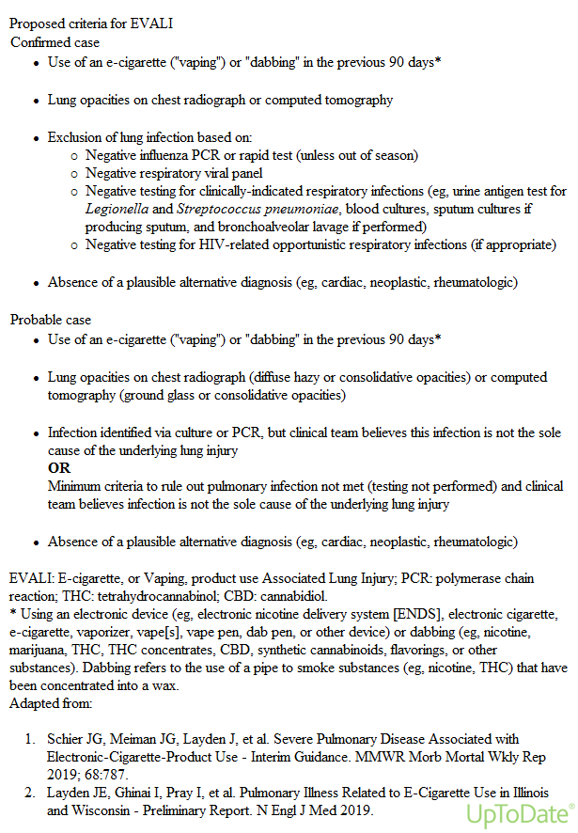
cdc.gov

Slide 26
EVALI or COVID-19
Symptoms similar: cough, chest pain, shortness of breath, hypoxia
Even fever, nausea, vomiting, diarrhea, fatigue
Maybe different: nasal congestion, loss of taste/smell
Lab findings of inflammation in both
Imaging may be similar

Slide 27
Confounders—the ACE2 Receptor
ACE2 is a receptor protein on epithelial cells
Breaks down large protein angiotensin II which causes inflammation and bronchoconstriction
In smokers and likely vapers, ACE2 is upregulated—more receptors
ACE2 is also the target of the SARS-CoV-2 virus, so more ACE2 means more sites for virus to bind
Rates of ICU hospitalization and ventilator need in COVID-19 are 2 times higher in smokers

Slide 28
Children and youth 13-24 yrs
More common symptoms if smoked and vaped – cough, fever, fatigue, difficulty breathing
And more likely to get a COVID-19 test
But even more likely to have a POSITIVE COVID-19 test
Giaha SM, et al J Adol Health 2020

Slide 29
And What About MIS-C?
Multisystem inflammatory syndrome in children
Usually post-COVID but symptoms are similar
Fever
Abdominal pain, vomiting, diarrhea
Rash
Bloodshot eyes
Difficulty breathing

Slide 30
Treatment
Hospitalization
Include or exclude viral illnesses—Influenza, SARS-CoV-2
Respiratory support—oxygen, ventilation, ECMO
Antibiotics to cover community acquire pneumonia
Consider steroids
Prognosis – complete resolution to death—no clear associations

Slide 31
COVID-19 Testing--https://emergency.cdc.gov/coca/calls/2019/callinfo_112119.asp
Notes:
CDC

Slide 32
https://emergency.cdc.gov/coca/calls/2019/callinfo_112119.asp

Slide 33
https://emergency.cdc.gov/coca/calls/2019/callinfo_112119.asp

Slide 34
https://emergency.cdc.gov/coca/calls/2019/callinfo_112119.asp

Slide 35
https://emergency.cdc.gov/coca/calls/2019/callinfo_112119.asp

Slide 36
Consider COVID-19 Testing--https://emergency.cdc.gov/coca/calls/2019/callinfo_112119.asp

