Slide 1
The Role of the School Nurse Health Assistant in Emergency Preparedness-- School Nurses Organization of Arizona Annual Conference June 21, 2019

Slide 2
Presented by…
Kaylee Sorensen Emergency Management Consultant The Trust ksorensen@the-trust.org

Slide 3
Background and experience…
Kaylee Sorensen has worked for the Arizona School Risk Retention Trust (Trust) for seven years. She earned her master of arts in emergency management and homeland security from Arizona State University and oversees the Trust Emergency Management Program.
Kaylee conducts trainings, assists districts with planning, and facilitates regional school safety consortiums around the state. She also serves on the Arizona Department of Education’s Emergency Preparedness Advisory Council, and as secretary of the International Association of Emergency Manager’s Children in Disaster Caucus.

Slide 4
Workshop Goal
The goal of this workshop is to assist school nurse health assistants in identifying actions and resources necessary so that they may respond to the best of their capabilities to school emergency events that may occur.

Slide 5
Small Group Activity
Divide into small groups of 4-6 people. Share an incident with your group in which your school or a school in your district needed to use emergency response procedures.
Select one of the incidences shared to report out to the entire group.

Slide 6
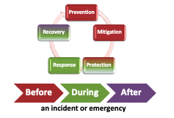
Five Preparedness Missions
Source: Developing High-Quality School Emergency Operations Plans – REMS TA Center
Notes:
PPD-8 (a Presidential Directive) describes the nation’s approach to preparedness and defines preparedness around five mission areas:
Prevention, Mitigation, Protection, Response, and Recovery.
It represents an evolution in our collective understanding of national preparedness and is based on the lessons learned from terrorist attacks, hurricanes, school incidents, and other experiences.
Prevention means the capabilities necessary to avoid, deter, or stop an imminent crime or threatened or actual mass casualty incident.
Mitigation means the capabilities necessary to eliminate or reduce the loss of life and property damage by lessening the impact of an event or emergency.
Protection means the capabilities to secure schools against acts of violence and manmade or natural disasters.
Response means the capabilities necessary to stabilize an emergency once it has already happened or is certain to happen in an unpreventable way.
Recovery means the capabilities necessary to assist schools affected by an event or emergency in restoring the learning environment.
These mission areas generally align with the three timeframes associated with an incident: before, during, and after.
Before: The majority of Prevention, Mitigation, and Protection activities generally occur before an incident, although these three mission areas do have ongoing activities that can occur throughout an incident.
During: Response activities occur during an incident.
After: Recovery activities can begin during an incident and occur after an incident.
To help avoid confusion over terms and allow for ease of reference, we will generally use the terms: “before,” “during,” and “after.”

Slide 7
Prevention
Prevention means the capabilities necessary to avoid, deter, or stop an imminent crime or threat or actual mass casualty incident.
Discuss in small group how and what role(s) the health assistant can play in Prevention as defined above.

Slide 8
Prevention--School Health Assistant can…
Contribute to building a positive school culture.
Develop positive and professional relationships with students.
Know who to report threats of violence to whether they be spoken, written or reported by a student or parent.
Subject matter experts report that positive school culture and meaningful professional relationships between staff and students significantly reduces the potential for targeted violence.
Schools need to be like Cheers, a place where everyone knows your name.

Slide 9
Protection
Protection means the capabilities to secure schools against acts of violence and manmade or natural disasters.
Discuss in small group how and what role(s) the health assistant can play in Protection as defined above.

Slide 10
Protection--School Health Assistant can…
Follow school procedures to ensure a single point of entry.
Know how to identify which adults may have access to, and sign out a student.
If comfortable to do so, confront persons on campus who are not wearing a visitor badge and take or direct them to the office.
Help to monitor that all entrances to the school (other than main entrance to office) are locked once the school day begins.

Slide 11
Mitigation
Mitigation means the capabilities necessary to eliminate or reduce the loss of life and property damage by lessening the impact of an event or emergency.
Discuss in small group how and what role(s) the health assistant can play in Mitigation as defined above.

Slide 12
Mitigation--School Health Assistant can…
Know their required courses of action for lockdown, evacuation, reverse evacuation, shelter-in-place and off-site relocation/reunification.
Participate fully in exercises and drills. Provide appropriate feedback as necessary.
Ensure that students in their charge during drills and exercises follow required courses of action.
Know the procedure for reporting missing or injured students during a real world event.

Slide 13
Response
Response means the capabilities necessary to stabilize an emergency once it has already happened or is certain to happen in an unpreventable way.
Discuss in small group how and what role(s) the health assistant can play in Response as defined above.

Slide 14
Response--School Health Assistant can…
Lead by example. Students should follow your lead.
Know your role, be calm and confidant.
Recognize that your school’s emergency guidelines for staff cannot be written to cover exactly how an incident may unfold.
In short, you must have situational awareness. Know your environment to include locations that you can safely escape.

Slide 15
Recovery
Recovery means the capabilities necessary to assist schools affected by an event or emergency in restoring the learning environment.
Discuss in small group how and what role(s) the health assistant can play in Recovery as defined above.

Slide 16
Recovery--School Health Assistant can…
Volunteer to be trained in Psychological First Aid for Schools (PFA-S) if such training is offered to all staff members.
Report students and staff members who may be having emotional difficulties processing a traumatic event to the identified behavioral/emotional recovery team leader.
Ensure that the school health office has an up-to-date inventory on hand of all supplies and equipment.
Volunteer to serve as a liaison team member for donations made to the school.

Slide 17
Prevention, Protection, Response, Mitigation and Recovery Actions Often Overlap Like A Venn Diagram
Prevention
Protection
Recovery
Response
Mitigation

Slide 18
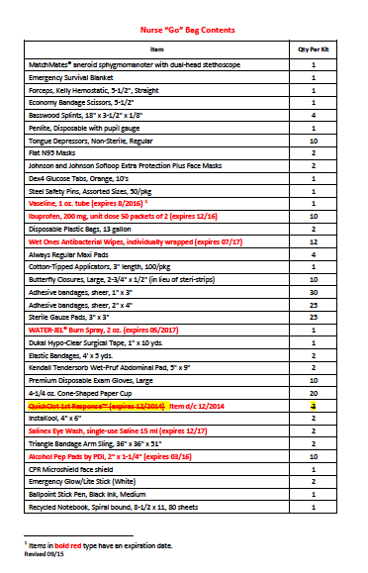
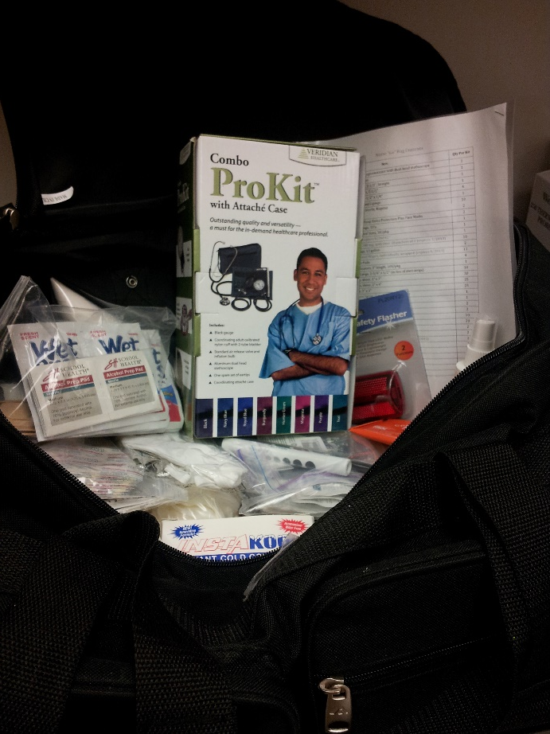
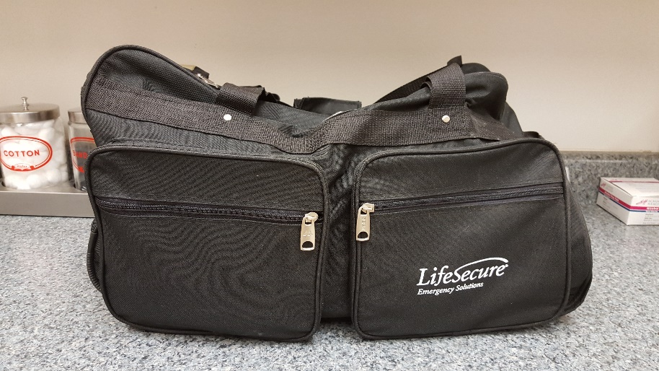
Change Topics— Nurse’s Go Kit

Slide 19
Activity--
Work in small groups for five-minutes. Identify 15 items that you must include in a nurse’s Go Kit. Record your items on chart paper and be ready to report out.

Slide 20
One district’s list…
Lets start with…
Student emergency cards
Student medications
District issued staff ID
Personal and school keys
Thoughts?

Slide 21
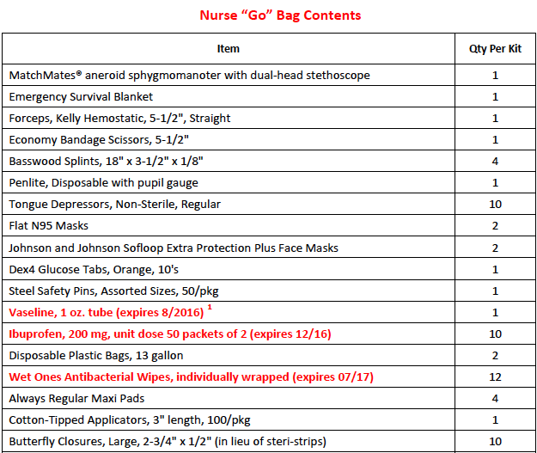
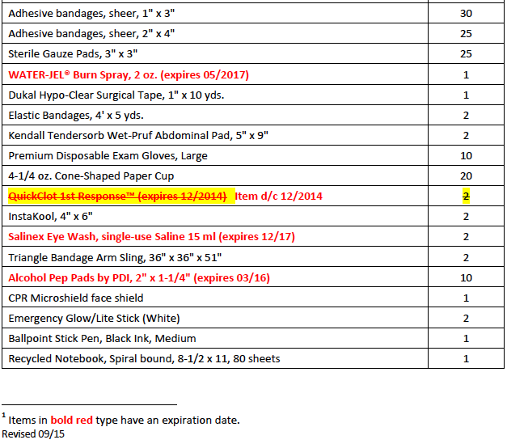
And add…

Slide 22
Essential questions about Nurse’s Go Kit…
Is there a required list of items for the kit?
NO
Who decides what to include in the kit?
District team is best!
Where can the district team go for direction?
American Red Cross website
Google school nurse go kit
Neighboring school districts
Bottom line?
Use the expertise within your district to identify what items to include in the nurse’s ”Go Kit”

Slide 23
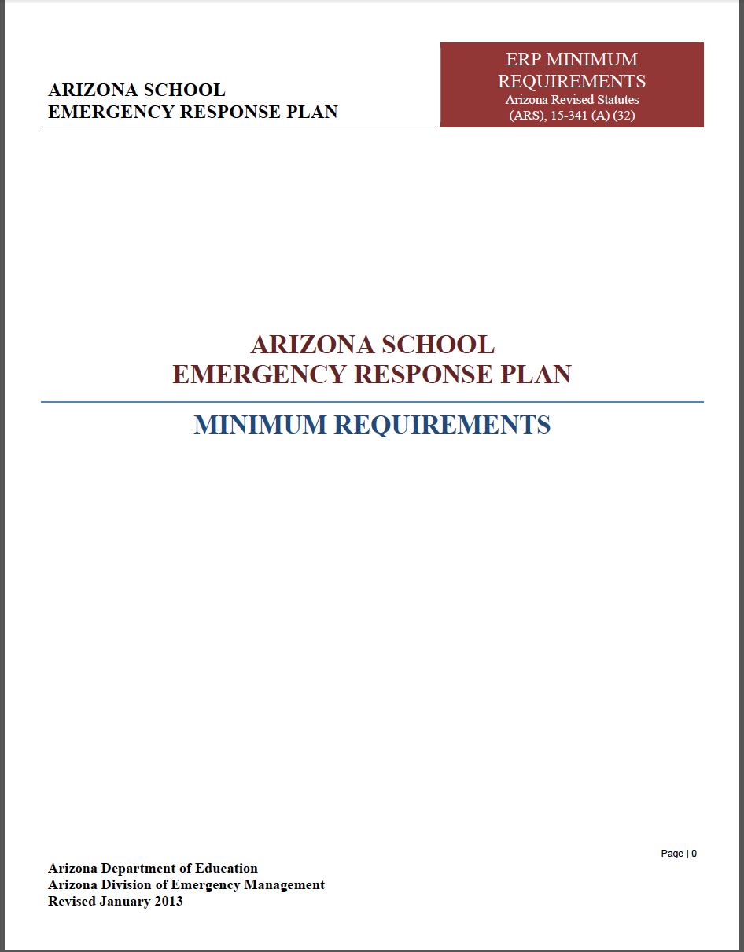
Change Topics Again— ADE Minimum Requirements for School Emergency Preparedness
ARS 15-341 (A) (32) requires each school site to have an emergency response plan that meets minimum requirements.
The Arizona Department of Education (ADE) and the Arizona Department of Emergency & Military Affairs (DEMA) are responsible for developing the minimum standards for school emergency response plans in Arizona.

Slide 24
What’s Included in Minimum Requirements?
Multi-hazard plan.
Incorporation of the Incident Command System (ICS) to manage school incidents and emergencies.
Utilize plain language for commands to alert students and staff to emergency response.
Describe how access and functional needs, and/or non-English students will be provided for.
To assist students and staff, develop a quick response guide. Post guides in classrooms.
Develop procedures for off-campus emergencies.
Conduct annual training of all staff on warning/response signals, evacuation routes, assembly areas, emergency procedures…

Slide 25
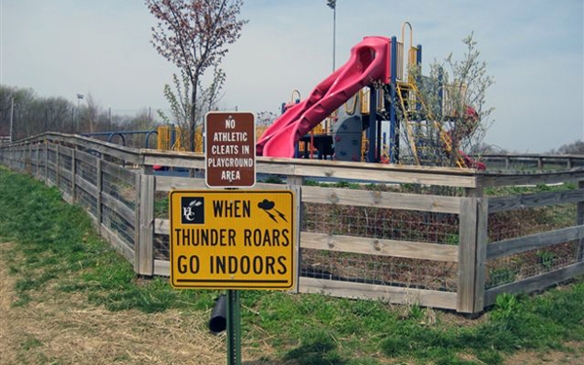
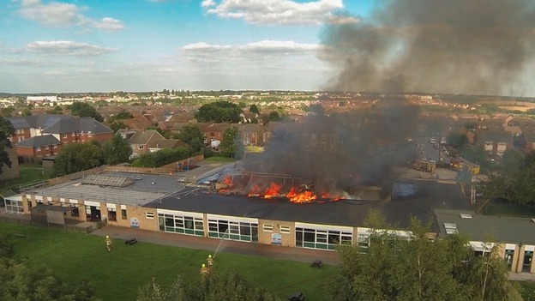
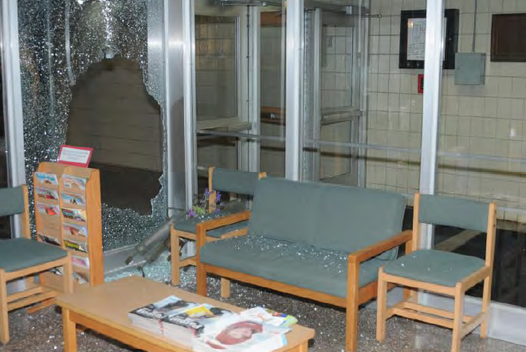
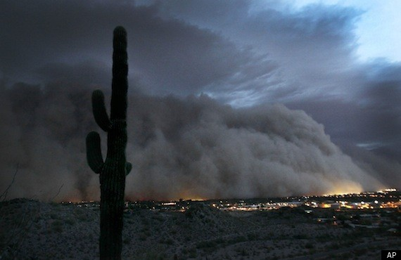
A Multi-Hazard Plan Addresses Threats/Hazards for Your School and Community
Notes:
Human caused such as fights, missing student, civic unrest, intruders, bomb threats, as well as cyber threats.
Environmental hazard such as floods, microburst, severe weather, dust storms, and range fires.
Technological hazard to include power outage, loss of water, accidental release of hazardous materials within the school, such as gas leaks or laboratory spills, and, radiological releases from nuclear power plan stations or interstate/rail hazardous material spills.
Biological hazard to include infectious diseases (pandemic influenza) contaminated food outbreaks, and rodent borne such as hanta virus, etc.

Slide 26
What threats & hazards are unique to your school?
Power outage
Monsoons
Haboobs
Bee swarms
Wild animals (coyotes, javelinas, bobcats)
Wildland fires
Rattlesnakes
Palo Verde Nuclear Generating Station (PVNGS)
Floods
Extreme heat
Others

Slide 27
Hot topic—active shooter!
Schools continue to be one of the safest places for students be during the day.
The Education Department reports that roughly 50 million children attend public schools for roughly 180 days per year.
Source: Washington Post, David Ropelik, Harvard University, March 8, 2018

Slide 28
Probability of being shot and killed at school…
Since Columbine, approximately 200 public school students have been shot to death while school was in session, including the recent slaughter at Marjory Stoneman Douglas High School in Parkland, FL.
That means the statistical likelihood of any given public school student being killed by a gun, in school, on any given day since 1999 was roughly 1 in 614,000,000 (50 million children attend public schools/180 days per year/200 student deaths).
The chance of a child being shot and killed in a public school is extraordinarily low. Not zero — no risk is.
Source: Washington Post, David Ropelik, Harvard University, March 8, 2018

Slide 29
More statistics….
What Can Be Done About School Shootings? A Review of the Evidence (Randy Borum, Dewey G. Cornell, William Modzelinski, and Shane R. Jameson
Any given school can expect to expect a student homicide about one in every 6,000 years.
125,000 K-12 schools $÷$ 21 deaths/year
Note: In the 10-year period from 1996-1997 to 2005-2006, 207 student homicides occurred in U.S. schools which equates to 21 deaths per year.
Source: 2010 Educational Researcher, Vol. 39, pp. 27-37

Slide 30
Schools Focus on Active Shooter Because……

Slide 31
Have you thought about what to do in your office in the event of an active shooter?
Situational Awareness:
Know your environment (nurse’s office).
Know your escape routes.
How long does it take you to lock your office and cover your windows (if that is your protocol).
Some approaches teach the quick
ability to barricade the door (follow
your plan/district policy on this action).
If you opt to fight back--how would you
accomplish this action? (Note: Most
district policies do not require staff to take
actions that would put themselves in danger).
Picture Source: Forty-Seven Seconds, Mark Williams, retired
Special Agent, Arizona Attorney General’s Office, high school English teacher.

Slide 32
Questions? Thank you!
Kaylee Sorensen Emergency Management Consultant The Trust ksorensen@the-trust.org

