Slide 2
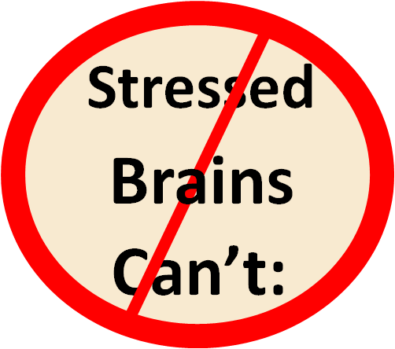
Learn
Process information
Regulate behavior

Slide 3
Impact of Stress on Children
Overwhelm and despair
See world as dangerous
Distrustful of adults
Poor relationships with peers
Short attention span
Struggle learning

Slide 4
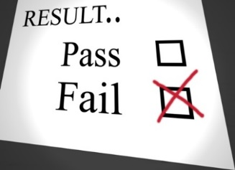
Repeated 1 or More Grades
-National Survey of Children’s Health, 2012

Slide 5
Chronic Absenteeism
ACEs are associated with chronic absenteeism in children and poor workplace attendance in adults.
-Academic Pediatric Association, 2017;
Oregon Pediatric Improvement Partnership, 2017

Slide 6
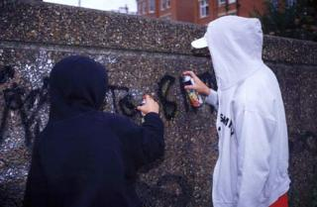
By Adolescence Children Seek Relief
Cutting
Drinking alcohol
Smoking tobacco*
Sexual promiscuity
Using drugs*
Overeating/eating disorders
Delinquent behavior, violence
*Note: nicotine and methamphetamines
are anti-depressants
Notes:
6
Slide 51- As children become teenagers they are much more independent and are searching for a way to cope. This is when many turn to some of these almost successful ways. The likelihood a teen will begin drinking alcohol at age14 dramatically increases with each ACE.

Slide 7
High Risk Teen Behaviors
May not be the core problem
They may be the solution
A way to feel in control, safe or just better
Dismissing them as “bad habits” or “self destructive behaviors misses their functionality.
Notes:
7

Slide 10
Arizona ranks last as the state with the highest proportion of children 0-17 years of age that experienced 2 or more ACEs

Slide 11
18% of Arizona’s children have experienced 3 or more ACEs (1 out of 5) National Survey of Children’s Health, 2016

Slide 12
AZ Kids with 5+ ACES Would Fill State Farm Stadium

Slide 13
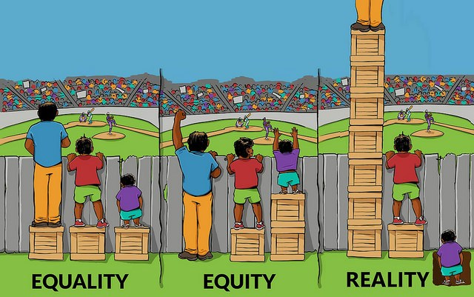
Equity vs. Equality

Slide 14
Resilience = Biology + Environment

Slide 15
Protective Factor = CONNECTION
Relationships + Skills = Resilience

Slide 16
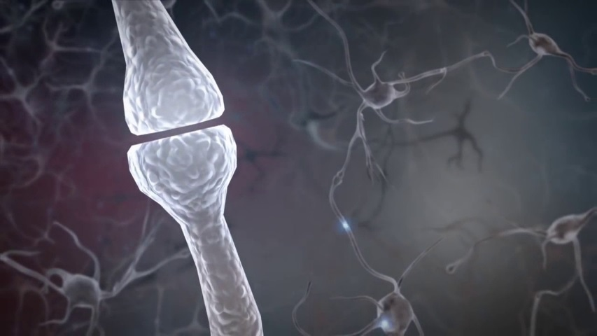
What Can I do?
Safety
Connection
Think first, what happened to you?
Not,
what is wrong with you?

Slide 18
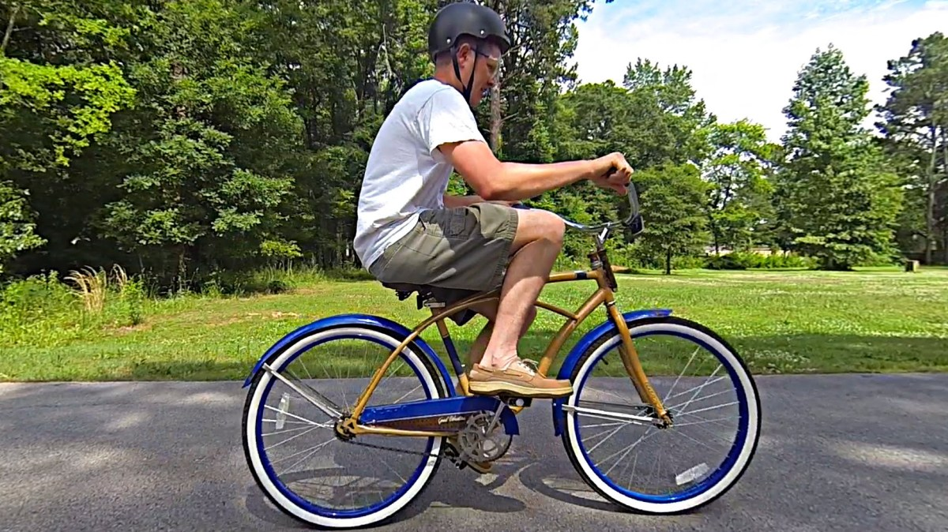
Procedural Memory
The Backwards Brain Bicycle: Smarter Every Day https://video.search.yahoo.com/yhs/search?fr=yhs-itm-001&hsimp=yhs-001&hspart=itm&p=backwards+bicycle#id=1&vid=edef346451c97b78f6083b138866718b&action=click

Slide 19
Connection = Safety = Healing

Slide 20
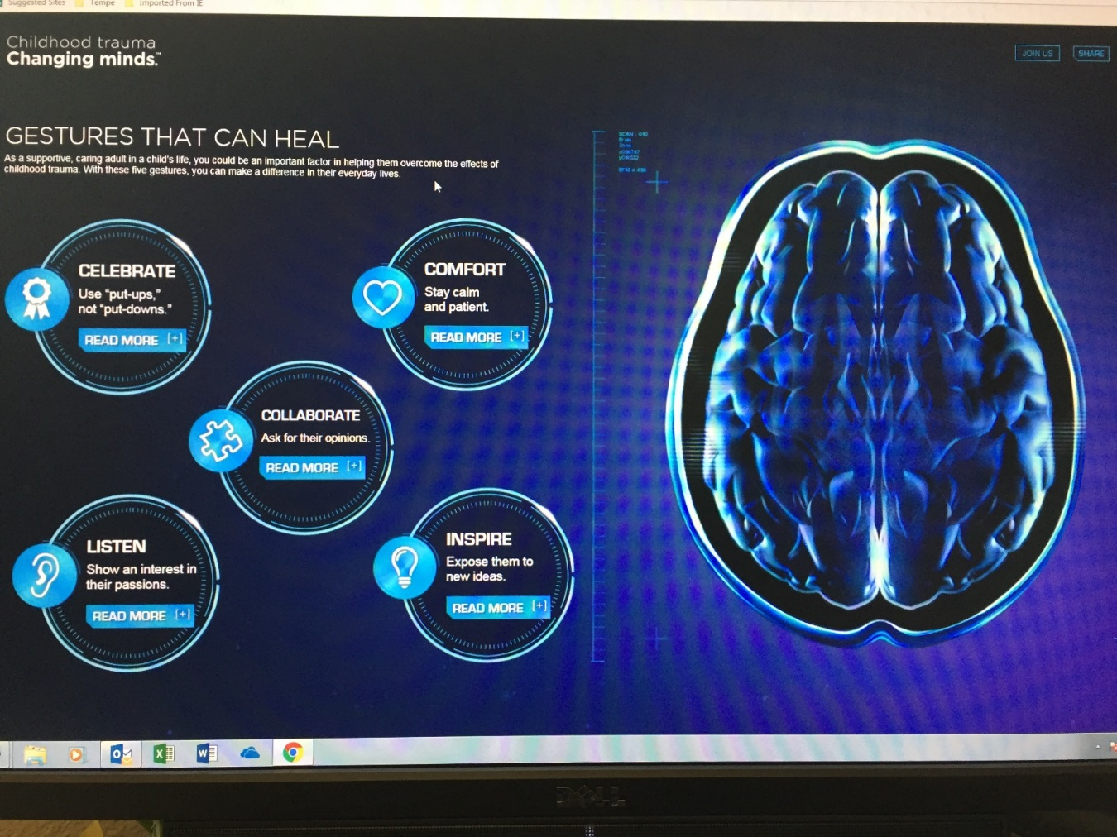
Changing Minds: Gestures That Can Heal
Celebrate
Comfort
Collaborate
Listen
Inspire

Slide 21
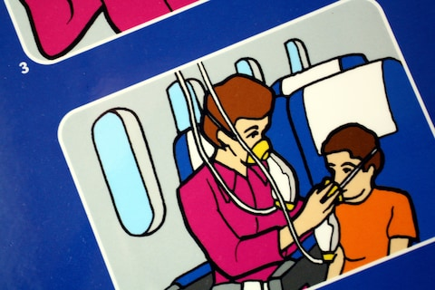
Take Care of Yourself
Emotional Health
Physical Health
Workplace Health
Physical Environment
Personal Outlook

Slide 22
Strengths-Based

Slide 23
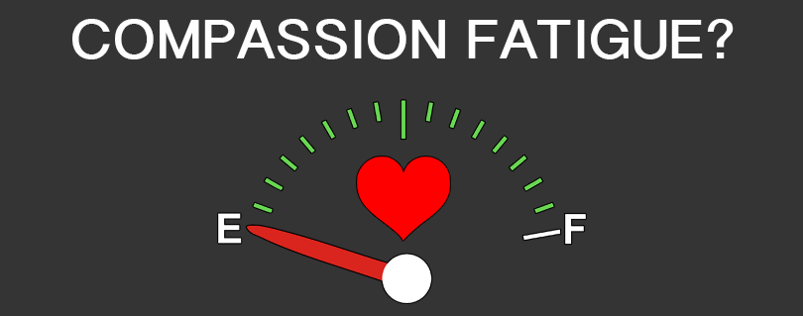

Slide 24
Emotional strain/cost for the helper of working with those in crisis, suffering and with trauma histories.

Slide 25
Burnout (Not Trauma Related)
Emotional exhaustion
Detachment
Reduced sense of accomplishment
Often rooted in organizational factors:
Work load, low wages, confusing policies, lack of support

Slide 26
Secondary/Vicarious Trauma
Trauma the helper is exposed to
Secondary Traumatic Stress (STS):
Signs and symptoms of this exposure
Inevitable in helping professions

Slide 27
Signs and Symptoms of STS
Fatigue
Sleep disturbances
Inability to concentrate
Anxiety
Pessimism
Black/white thinking
Absenteeism
Figley, 1995

Slide 28
Moral Stress
Repeatedly finding yourself in circumstances where you can’t do what you think/know/feel is the right thing to do.
John Maher, MA, MD, FRCPC

Slide 29
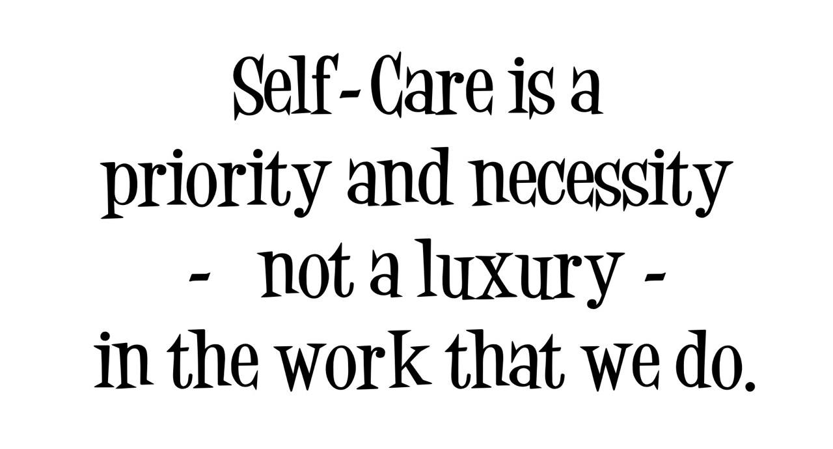

Slide 30
Self-Care
Self-reflection (self-regulation)
Sleep
Diet
Exercise
Remember your why
Be curious/learn new things
Have mentors

Slide 31
Promoting Resilience
Emotional Intelligence
Help-seeking behaviors
Optimism
Humor
Gratitude
Relational wealth

Slide 32
“Nurturing relationships with caring adults can prevent or reverse the damaging effects of toxic stress.” Dr. Nadine Burke Harris

Slide 34
Brain Power: From Neurons to Networks
https://video.search.yahoo.com/yhs/search?fr=yhs-itm-001&hsimp=yhs-001&hspart=itm&p=brain+power%3A+from+neurons+to+networks#id=1&vid=1af7757fb01aac4c6ee6920b9300c30b&action=click

Slide 35
Thank You!
Lori Robinson, MSW
Lori_Robinson@tempe.gov

Slide 36
Online Resources

Slide 37
Resources
Academic Pediatric Association
Arizona Trauma Institute
Arizona Youth Survey
Dr. Robert Anda
Bronfenbrenner Ecological Systems Theory
Center on the Developing Child, Harvard University
Changing Minds.org
Dr. Sandra Bloom. The Sanctuary Model http://www.sanctuaryweb.com/
Felitti, Vincent et al. ACE Study. Journal of American Medicine. 1998
International Association of Trauma Professionals
National Child Traumatic Stress Network – www.nctsnet.org
National Survey of Children’s Health, 2012, 2016
SAMSHA- Trauma Informed Approach and Systems https://www.samhsa.gov/nctic/trauma-interventions

