Slide 1
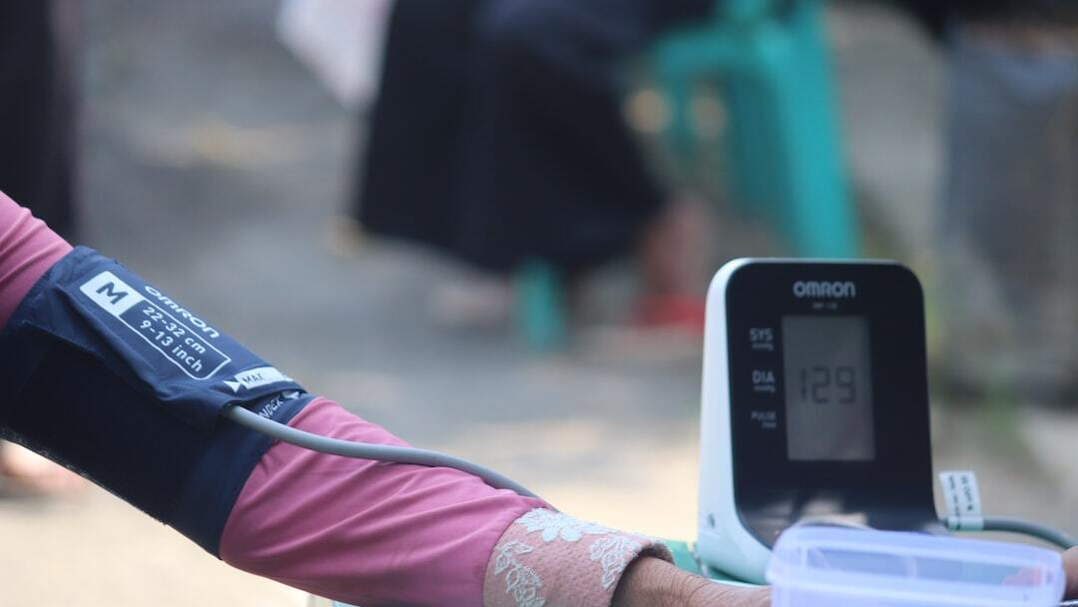
Introduction to Hypertension
Definition: Hypertension, or high blood pressure, is a condition where the force of the blood against the artery walls is consistently too high.
Causes: Genetics, poor diet, lack of physical activity, obesity, excessive alcohol consumption, stress, and chronic conditions such as kidney disease.
Photo by Mufid Majnun on Unsplash

Slide 2
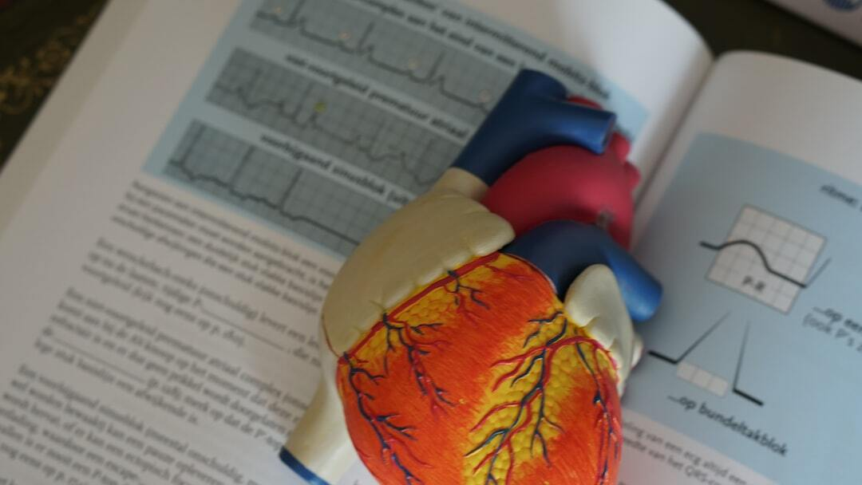
Pathophysiology
Mechanisms: Increased cardiac output, increased peripheral resistance, or both. Chronic hypertension can lead to damage of the heart, blood vessels, kidneys, and other organs.
Photo by Robina Weermeijer on Unsplash

Slide 3
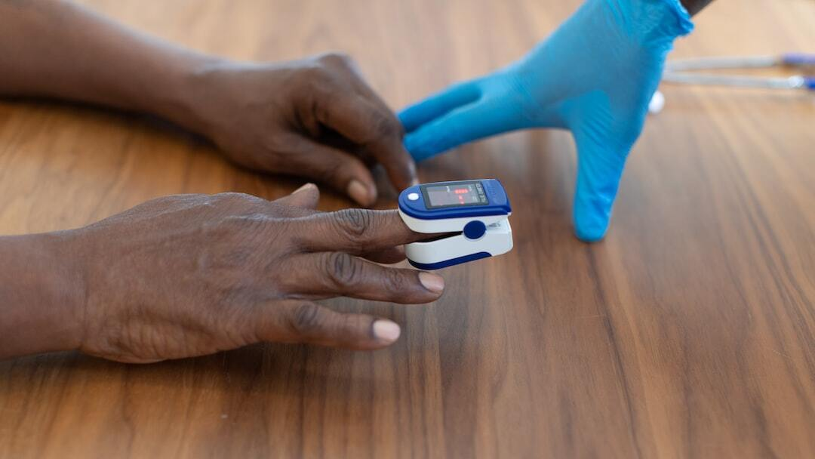
Symptoms
Asymptomatic Nature: Often called the 'silent killer' because it usually has no symptoms.
Possible Symptoms: Headaches, shortness of breath, nosebleeds, chest pain, dizziness, and visual changes.
Photo by Nappy on Unsplash

Slide 4
Diagnostic Tests
Blood Pressure Measurement: Using a sphygmomanometer. Normal: <120/80 mmHg, Elevated: 120-129/<80 mmHg, Hypertension Stage 1: 130-139/80-89 mmHg, Hypertension Stage 2: ≥140/90 mmHg.
Additional Tests: Electrocardiogram (ECG), echocardiogram, blood tests (kidney function, cholesterol), and urinalysis.
Photo by Mufid Majnun on Unsplash

Slide 5
Treatment Based on Staging
Lifestyle Modifications: Dietary changes (DASH diet), salt reduction, regular physical activity, weight management, alcohol limitation, smoking cessation.
Stage 1 Hypertension: First-line medications: Thiazide diuretics (e.g., hydrochlorothiazide), ACE inhibitors (e.g., lisinopril), ARBs (e.g., losartan), calcium channel blockers (e.g., amlodipine).
Stage 2 Hypertension: Combination therapy often required: ACE inhibitor or ARB + thiazide diuretic or calcium channel blocker.
Photo by Laurynas Mereckas on Unsplash

Slide 6
Managing Hypertensive Crisis
Hypertensive Urgency: BP ≥180/≥120 mmHg without organ damage. Treatment: Oral antihypertensive medications and close follow-up.
Hypertensive Emergency: BP ≥180/≥120 mmHg with evidence of organ damage. Treatment: Immediate hospitalization and intravenous antihypertensive medications.
Photo by Nappy on Unsplash

Slide 7
Monitoring and Follow-Up
Regular Monitoring: Home blood pressure monitoring and regular check-ups with a healthcare provider.
Adherence to Treatment: Importance of taking medications as prescribed and making lifestyle changes.
Photo by Mufid Majnun on Unsplash

Slide 8
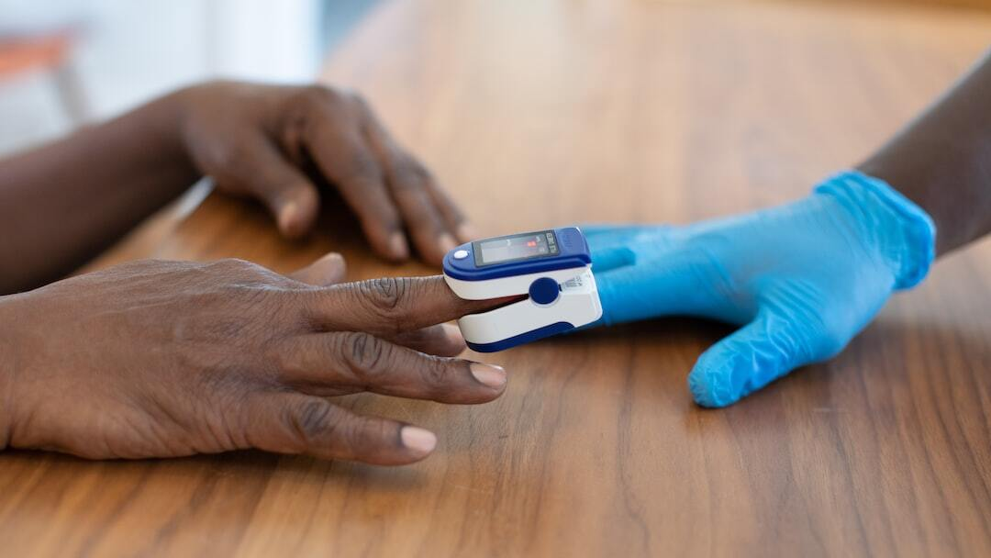
Future Directions in Hypertension Management
Personalized Medicine: Tailoring treatment based on genetic and phenotypic characteristics.
Telehealth: Remote monitoring and virtual consultations to enhance patient management.
Innovative Therapies: Development of new drugs and interventions.
Photo by Nappy on Unsplash

Slide 9
References
American Heart Association (AHA): [Hypertension](https://www.heart.org/en/health-topics/high-blood-pressure)
National Heart, Lung, and Blood Institute (NHLBI): [High Blood Pressure](https://www.nhlbi.nih.gov/health-topics/high-blood-pressure)
Centers for Disease Control and Prevention (CDC): [High Blood Pressure](https://www.cdc.gov/bloodpressure/index.htm)

Slide 10
Diet Management
Type 1 and Type 2: Balancing insulin doses with carbohydrate intake.
Healthy Eating: Emphasizing whole grains, vegetables, lean proteins, healthy fats.
Glycemic Index: Choosing foods with a lower glycemic index.
Photo by Magalie De Preux on Unsplash

Slide 11
Insulin Use and Dosing
Types of Insulin: Rapid-acting, short-acting, intermediate-acting, long-acting.
Dosing: Based on carbohydrate intake, blood glucose levels, physical activity, and other factors.
Administration: Injection techniques, use of insulin pens and pumps.
Photo by Matt C on Unsplash

Slide 12
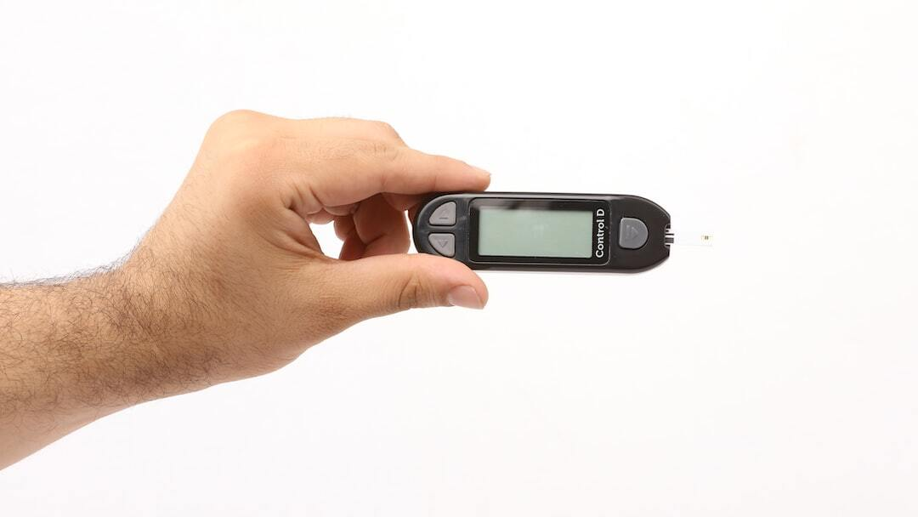
Future of Diabetes Management
Technological Advances: Insulin pumps, artificial pancreas, non-invasive glucose monitoring.
Pancreas Transplant: Indications, procedure, and outcomes.
Photo by Akash Deep on Unsplash

Slide 13
References
National Institutes of Health (NIH): [Diabetes](https://www.nih.gov/)
Centers for Disease Control and Prevention (CDC): [Diabetes](https://www.cdc.gov/diabetes/home/index.html)
American Diabetes Association (ADA): [Diabetes](https://www.diabetes.org/)

