Slide 1
Managing Asthma
Introduction: Asthma is a chronic inflammatory disease of the airways characterized by episodes of wheezing, breathlessness, chest tightness, and coughing.
Types Based on Symptoms: Includes intermittent, mild persistent, moderate persistent, and severe persistent asthma.
Photo by Online Marketing on Unsplash

Slide 2
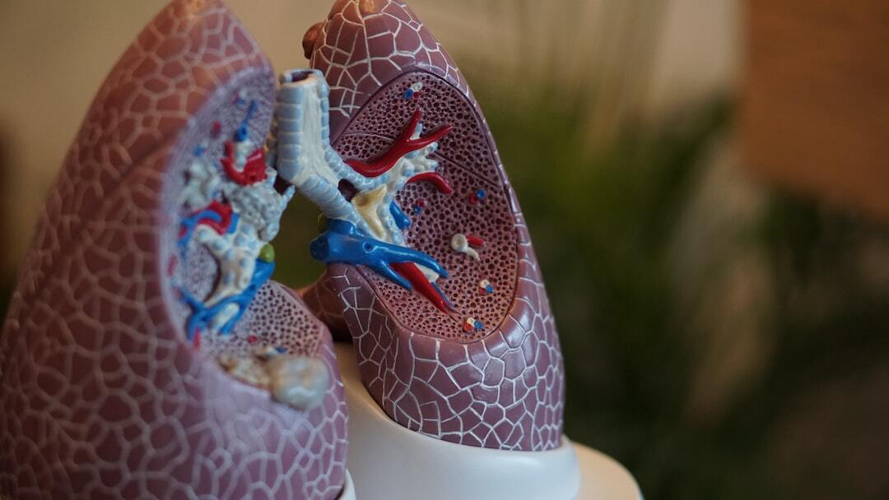
Diagnosing Asthma
Pulmonary Function Tests (PFTs): Measure lung function, including spirometry which assesses the amount and speed of air a person can inhale and exhale.
Bronchoprovocation Test: Assesses airway hyperresponsiveness by measuring lung function after exposure to asthma triggers.
Peak Expiratory Flow (PEF): Measures how fast a person can exhale, helping to monitor asthma control.
Photo by Robina Weermeijer on Unsplash

Slide 3
Asthma Symptoms
Daytime Symptoms: Wheezing, shortness of breath, chest tightness, and coughing, especially during physical activity or exposure to triggers.
Nighttime Symptoms: Worsening of symptoms at night, leading to disturbed sleep and nighttime awakenings.
Photo by Tonik on Unsplash

Slide 4
Treating Asthma: Inhalers
Quick-Relief Inhalers: Short-acting beta-agonists (e.g., albuterol) used for rapid relief of asthma symptoms during an attack.
Long-Term Control Inhalers: Inhaled corticosteroids (e.g., fluticasone), long-acting beta-agonists (e.g., salmeterol), and combination inhalers (e.g., fluticasone/salmeterol) for daily management to prevent symptoms.
Photo by JESHOOTS.COM on Unsplash

Slide 5
Asthma Prevention
Avoiding Triggers: Identify and avoid common asthma triggers such as allergens, smoke, pollution, and respiratory infections.
Allergy Management: Using allergy medications or immunotherapy to reduce sensitivity to allergens.
Regular Check-Ups: Routine visits to a healthcare provider to monitor asthma control and adjust treatment as needed.
Photo by JESHOOTS.COM on Unsplash

Slide 6
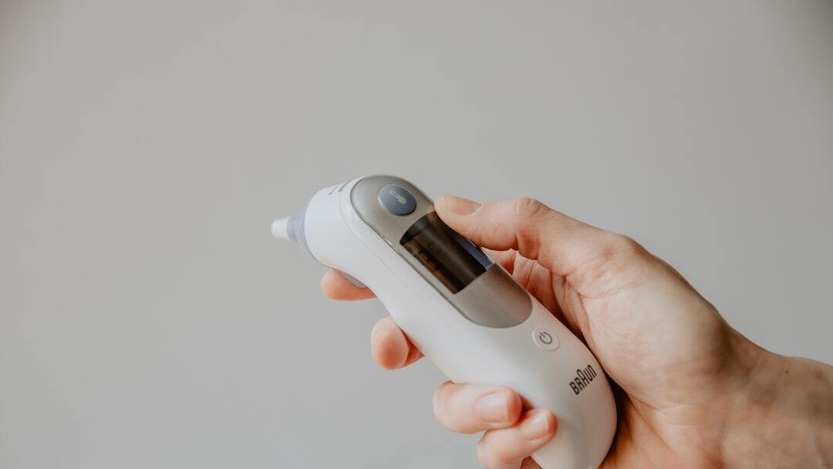
Predicting an Attack: Peak Flow Meter
Objective Measurement: Peak flow meters measure the highest speed at which air can be blown out of the lungs after a deep breath. This helps in monitoring asthma control and predicting attacks.
Usage: Patients use peak flow meters regularly to monitor their lung function and recognize early signs of worsening asthma.
Photo by Kelly Sikkema on Unsplash

Slide 7
Summary of Asthma Types, Symptoms, PFT Values, and Treatments
Intermittent Asthma:-Symptoms: Occasional symptoms, less than twice a week.
PFT Values: Normal FEV1 between exacerbations, FEV1 > 80% predicted. Best Treatment: Short-acting beta-agonists (SABAs) as needed (e.g., albuterol).
Mild Persistent Asthma: -Symptoms: Symptoms more than twice a week, but not daily. PFT Values: FEV1 > 80% predicted. Best Treatment: Low-dose inhaled corticosteroids (ICS) (e.g., fluticasone).
Moderate Persistent Asthma: - Symptoms: Daily symptoms, nighttime symptoms more than once a week.PFT Values: FEV1 60-80% predicted. Best Treatment: Low to medium-dose ICS + Long-acting beta-agonists (LABAs) (e.g., fluticasone/salmeterol).
Severe Persistent Asthma: - Symptoms: Symptoms throughout the day, frequent nighttime symptoms. PFT Values: FEV1 < 60% predicted. Best Treatment: High-dose ICS + LABAs + oral corticosteroids if needed (e.g., fluticasone/salmeterol + prednisone).
Photo by Robina Weermeijer on Unsplash

Slide 8
References
Asthma Management Article: Visit our website for a detailed guide on managing asthma: [Asthma Management Guide](https://theunitedmedicalgroup.com/how-to-guide)
Hashmi MF, Cataletto ME. Asthma. [Updated 2024 May 3]. In: StatPearls [Internet]. Treasure Island (FL): StatPearls Publishing; 2024 Jan-. Available from: https://www.ncbi.nlm.nih.gov/books/NBK430901/
Asthma. (2023, October 26). Asthma. https://www.cdc.gov/asthma/index.html

