Slide 1
Managing Crohn's Disease and Ulcerative Colitis
Introduction: Crohn's disease and ulcerative colitis are chronic inflammatory bowel diseases (IBD) that cause inflammation of the gastrointestinal tract.
Types: Crohn's Disease can affect any part of the GI tract, while Ulcerative Colitis is limited to the colon and rectum.
Photo by Volodymyr Hryshchenko on Unsplash

Slide 2
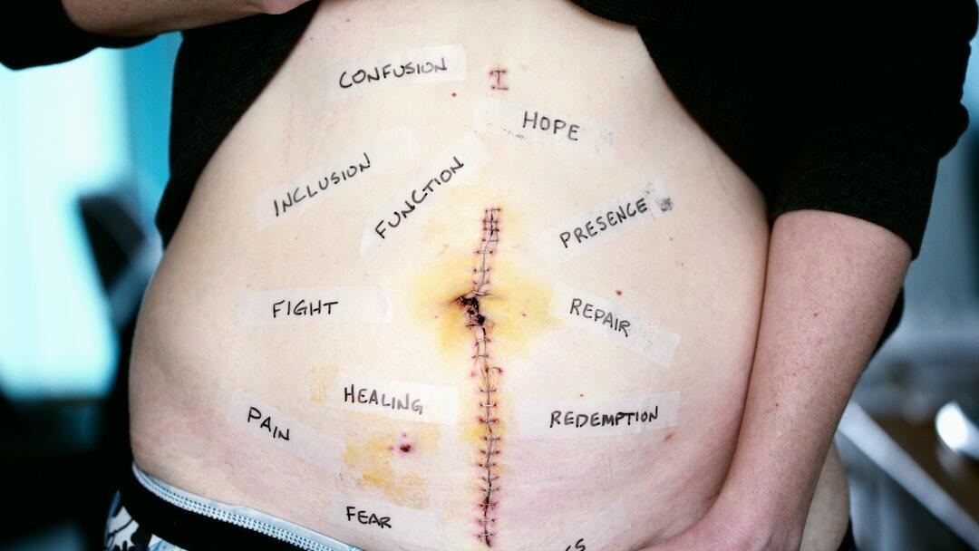
Symptoms of Crohn's Disease and Ulcerative Colitis
Crohn's Disease Symptoms: Abdominal pain, diarrhea (often bloody), weight loss, fatigue, and mouth sores. May cause inflammation in other parts of the body such as the eyes, skin, and joints.
Ulcerative Colitis Symptoms: Frequent, urgent bowel movements, abdominal pain, blood and mucus in stool, weight loss, fatigue, and fever.
Photo by Alexander Grey on Unsplash

Slide 3
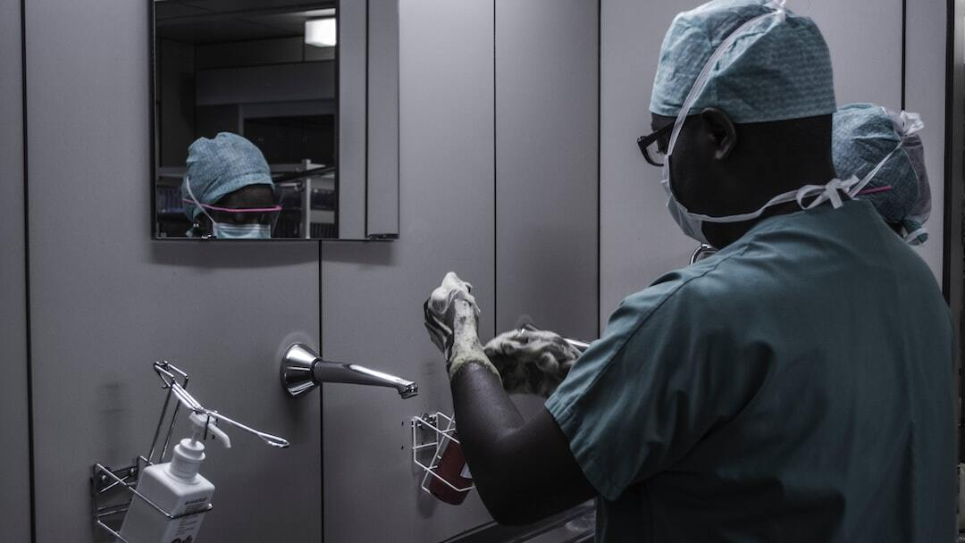
Screening and Diagnosis
Screening Criteria: Family history of IBD, persistent gastrointestinal symptoms, and unexplained weight loss.
Diagnosis: -
Endoscopy: Colonoscopy or upper endoscopy to visualize the GI tract and obtain biopsies.
Imaging: CT or MRI enterography to assess the extent of inflammation.
Lab Tests: Blood tests for anemia and inflammation markers (CRP, ESR); stool tests for fecal calprotectin.
Photo by Piron Guillaume on Unsplash

Slide 4
Etiology and Risk Factors
Genetic Factors: Family history of IBD increases the risk. Certain genetic mutations (e.g., NOD2/CARD15) are associated with Crohn's disease.
Environmental Factors: Diet, smoking, and use of nonsteroidal anti-inflammatory drugs (NSAIDs) can trigger or exacerbate symptoms.
Immune System Dysfunction: Abnormal immune response causing inflammation in the GI tract.
Photo by Alexander Grey on Unsplash

Slide 5
Diet and Lifestyle
Diet: -
Crohn's Disease: Low-residue diet to reduce bowel frequency, avoid trigger foods (e.g., dairy, high-fiber foods).
Ulcerative Colitis: Well-balanced diet, avoid foods that worsen symptoms (e.g., spicy foods, alcohol).
Lifestyle Modifications: Regular exercise, stress management techniques, smoking cessation.
Photo by David B Townsend on Unsplash

Slide 6
Treatments for Crohn's Disease and Ulcerative Colitis
Medications: -
Aminosalicylates: Anti-inflammatory drugs (e.g., mesalamine).
Corticosteroids: For acute flares (e.g., prednisone). -
Immunomodulators: Suppress the immune system (e.g., azathioprine).
Biologics: Target specific proteins involved in inflammation (e.g., infliximab, adalimumab).
Surgical Treatments: -
Crohn's Disease: Resection of diseased bowel segments, strictureplasty.
Ulcerative Colitis: Colectomy with ileostomy or ileoanal anastomosis.

Slide 7
Complications
Crohn's Disease: Fistulas, strictures, abscesses, malnutrition, and increased risk of colorectal cancer.
Ulcerative Colitis: Severe bleeding, toxic megacolon, perforated colon, and increased risk of colorectal cancer.
Photo by Alexander Grey on Unsplash

Slide 8
Referrals and Monitoring
Referrals: Referral to a gastroenterologist for specialized care. Surgical consultation for complicated cases.
Monitoring and Surveillance: Regular follow-ups with a healthcare provider, colonoscopies for cancer surveillance, monitoring disease activity with lab tests and imaging.
Special Diets: Individualized dietary plans to manage symptoms and maintain nutritional status.
Photo by JESHOOTS.COM on Unsplash

Slide 9
References
American Gastroenterological Association: [IBD Resources](https://www.gastro.org/practice-guidance/gi-patient-center/topic/inflammatory-bowel-disease-ibd)
Centers for Disease Control and Prevention (CDC): [IBD Information](https://www.cdc.gov/ibd/)
National Institutes of Health (NIH): [Crohn's Disease and Ulcerative Colitis](https://www.nih.gov/)

Slide 10
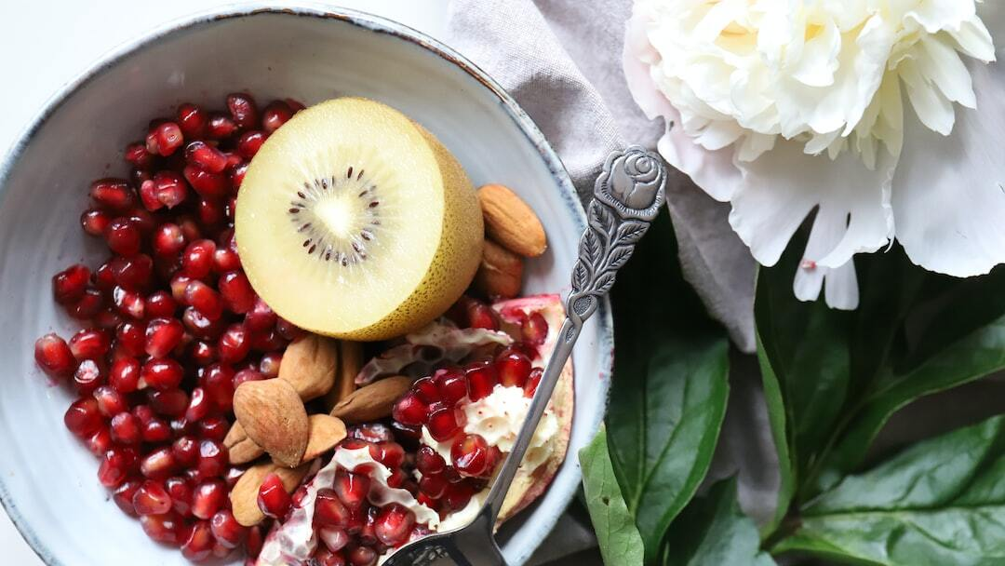
Diet Management
Type 1 and Type 2: Balancing insulin doses with carbohydrate intake.
Healthy Eating: Emphasizing whole grains, vegetables, lean proteins, healthy fats.
Glycemic Index: Choosing foods with a lower glycemic index.
Photo by Magalie De Preux on Unsplash

Slide 11
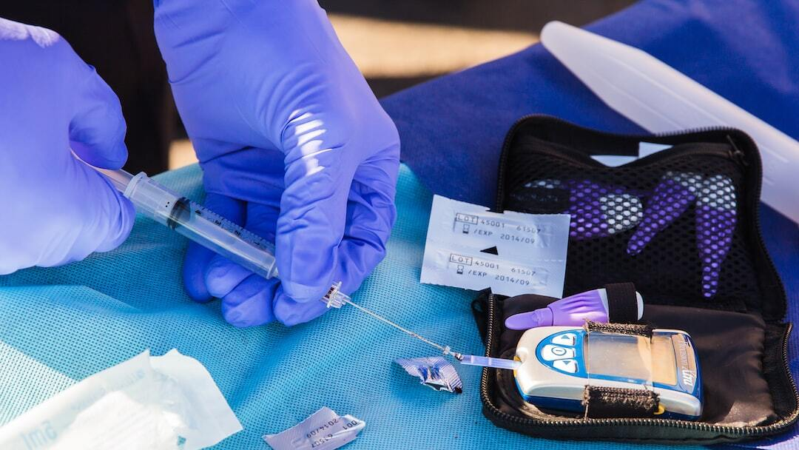
Insulin Use and Dosing
Types of Insulin: Rapid-acting, short-acting, intermediate-acting, long-acting.
Dosing: Based on carbohydrate intake, blood glucose levels, physical activity, and other factors.
Administration: Injection techniques, use of insulin pens and pumps.
Photo by Matt C on Unsplash

Slide 12
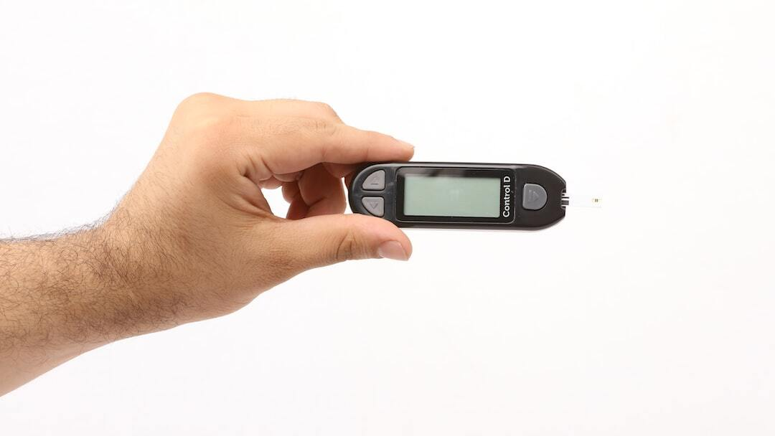
Future of Diabetes Management
Technological Advances: Insulin pumps, artificial pancreas, non-invasive glucose monitoring.
Pancreas Transplant: Indications, procedure, and outcomes.
Photo by Akash Deep on Unsplash

Slide 13
References
National Institutes of Health (NIH): [Diabetes](https://www.nih.gov/)
Centers for Disease Control and Prevention (CDC): [Diabetes](https://www.cdc.gov/diabetes/home/index.html)
American Diabetes Association (ADA): [Diabetes](https://www.diabetes.org/)

