Slide 1
Managing Sinusitis
Introduction: Sinusitis, also known as rhinosinusitis, is an inflammation of the sinuses that can be caused by viral, bacterial, or allergic reactions.
Types: Viral, Allergic, Bacterial
Photo by Ani Kolleshi on Unsplash

Slide 2
Causes of Sinusitis
Viral Sinusitis: Commonly caused by upper respiratory infections, such as the common cold.
Allergic Sinusitis: Triggered by allergens like pollen, dust mites, and pet dander.
Bacterial Sinusitis: Occurs when bacteria infect the sinuses, often following a viral infection.
Photo by Kelly Sikkema on Unsplash

Slide 3
Symptoms of Sinusitis
Common Symptoms: Facial pain or pressure, nasal congestion, nasal discharge (yellow or green), loss of smell, and cough or congestion.
Other Symptoms: Fever, bad breath, fatigue, and dental pain.
Photo by Kyle Glenn on Unsplash

Slide 4
Treatments for Sinusitis
Viral Sinusitis: Rest, hydration, nasal decongestants, saline nasal sprays, and over-the-counter pain relievers (e.g., ibuprofen).
Allergic Sinusitis: Antihistamines (e.g., loratadine), nasal corticosteroids (e.g., fluticasone), and avoidance of allergens.
Bacterial Sinusitis: Antibiotics (e.g., amoxicillin) if symptoms persist for more than 10 days or worsen after initial improvement.
Photo by Kelly Sikkema on Unsplash

Slide 5
When Are Antibiotics Appropriate?
Persistent Symptoms: Symptoms lasting more than 10 days without improvement.
Severe Symptoms: High fever (102°F or higher), facial pain lasting more than three to four days, or purulent nasal discharge.
Worsening Symptoms: Symptoms that initially improve but then worsen after five to six days.
Photo by Thought Catalog on Unsplash

Slide 6
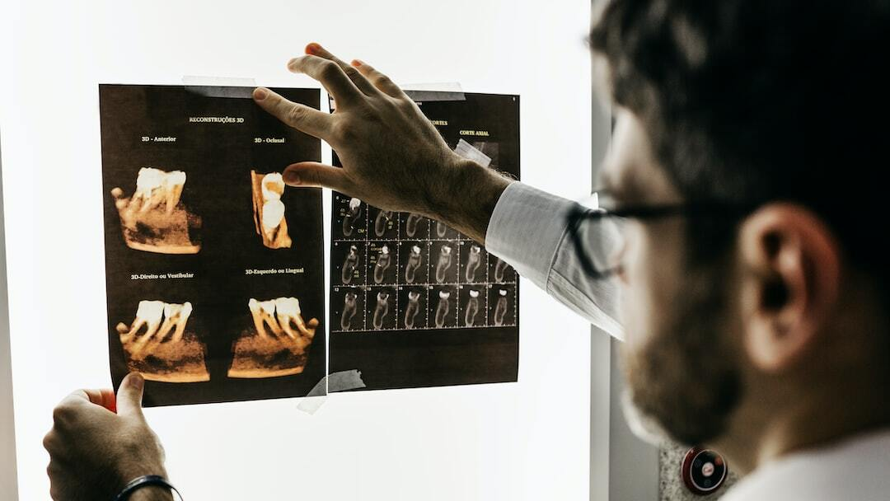
Evaluation with Imaging
When to Consider Imaging: Symptoms not improving with treatment, recurrent sinusitis, or suspicion of complications.
Types of Imaging: CT scan is the preferred method to evaluate sinus anatomy and detect blockages or other abnormalities.
Photo by Jonathan Borba on Unsplash

Slide 7
Surgery and ENT Follow-Up
When to Consider Surgery: Chronic sinusitis not responding to medical treatment, presence of nasal polyps, or structural abnormalities causing obstruction.
Types of Surgery: Functional Endoscopic Sinus Surgery (FESS) to remove blockages and improve sinus drainage.
ENT Follow-Up: Patients with recurrent or chronic sinusitis should be evaluated by an ENT specialist for ongoing management.
Photo by JAFAR AHMED on Unsplash

Slide 8
References
Centers for Disease Control and Prevention (CDC): [Sinusitis](https://www.cdc.gov/sinusitis/index.html)
National Institutes of Health (NIH): [Sinusitis](https://www.nih.gov/)
United Medical Group: [How to Manage Sinusitis](https://theunitedmedicalgroup.com/how-to-guide)

