Slide 1
Colleague Satisfaction Survey
October 2025

Slide 2
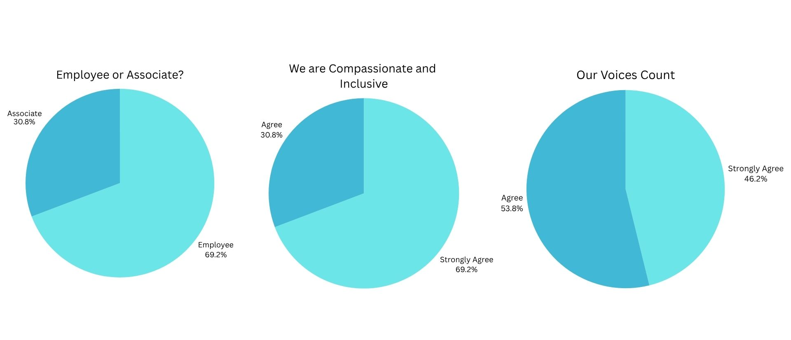

Results

Slide 3
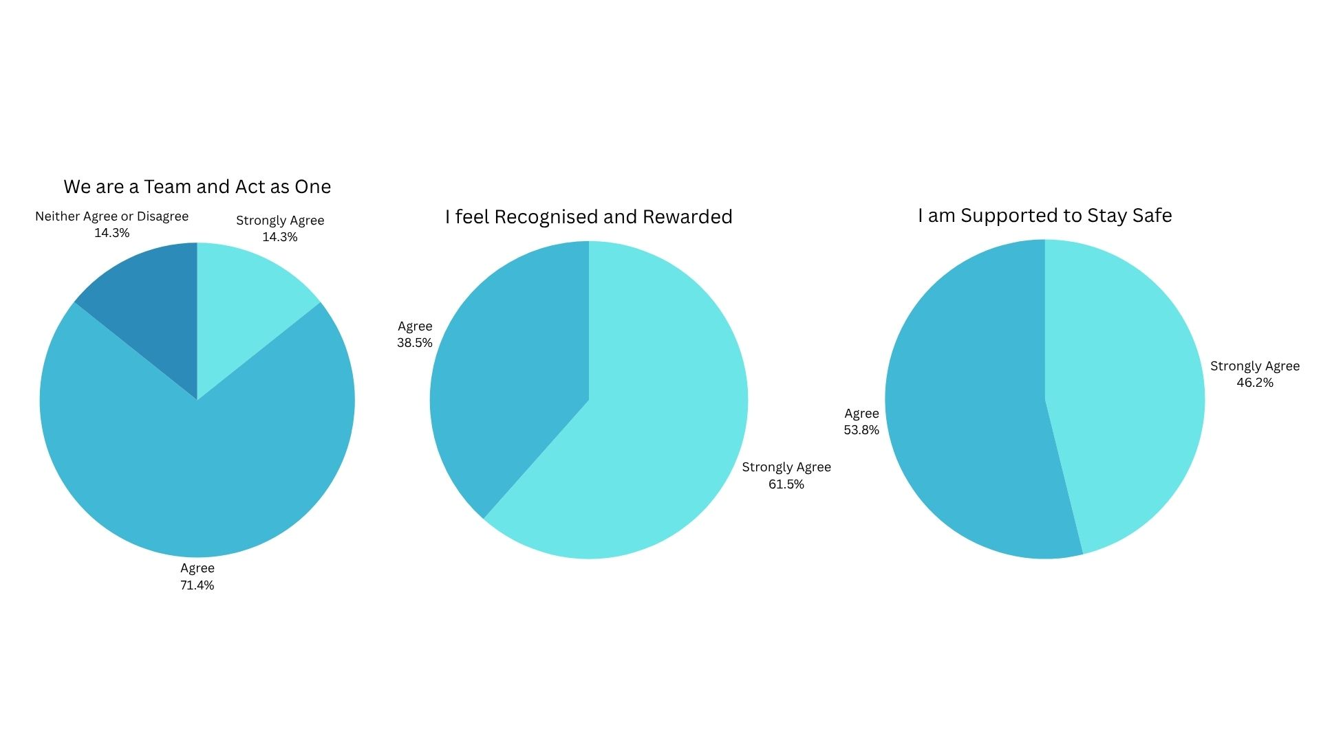
Results

Slide 4
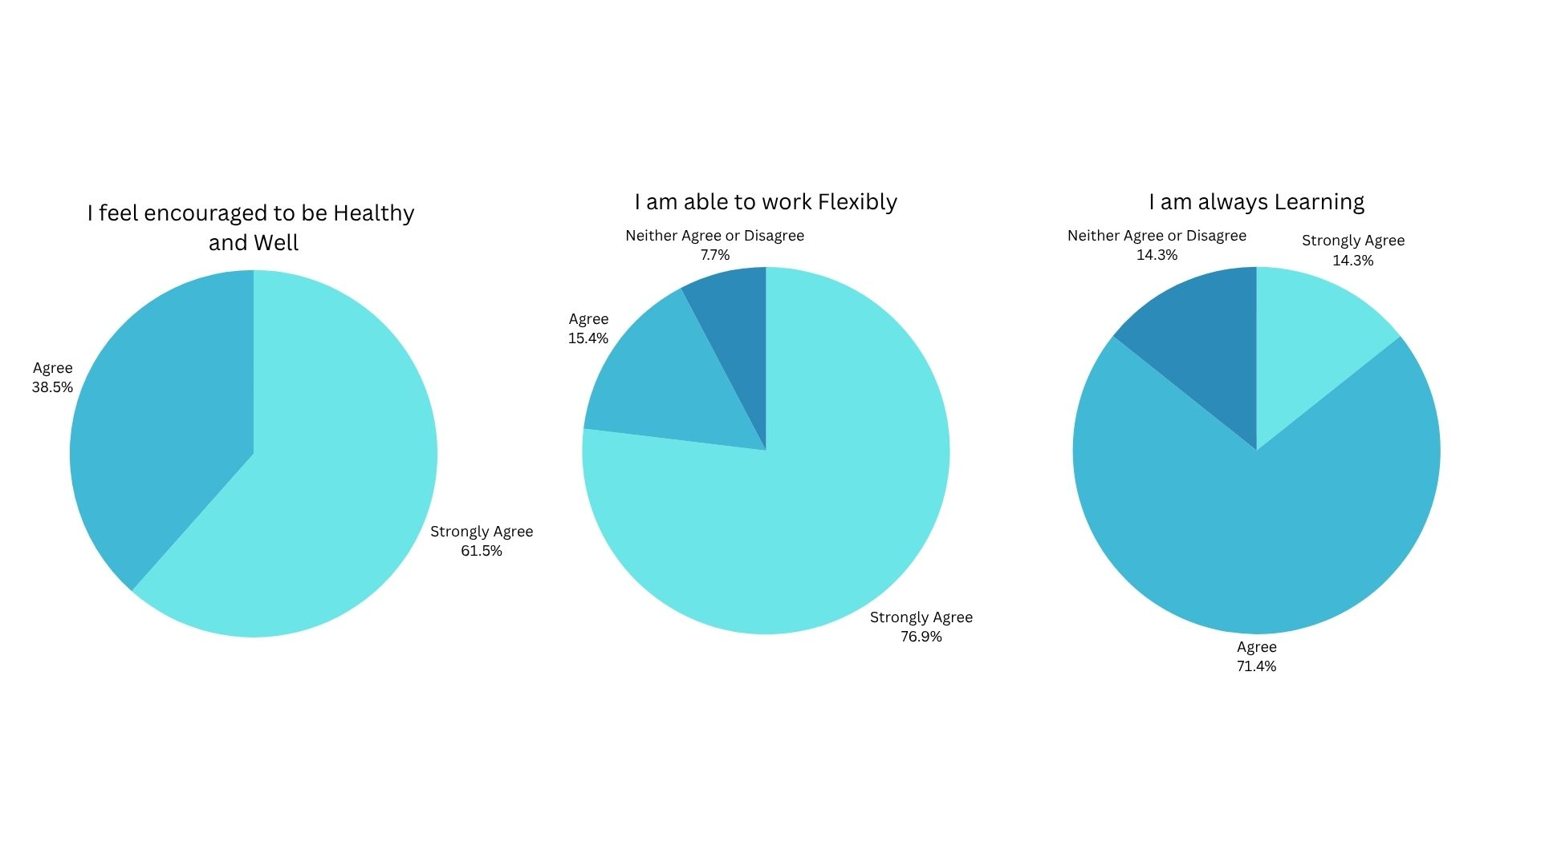
Results

Slide 5
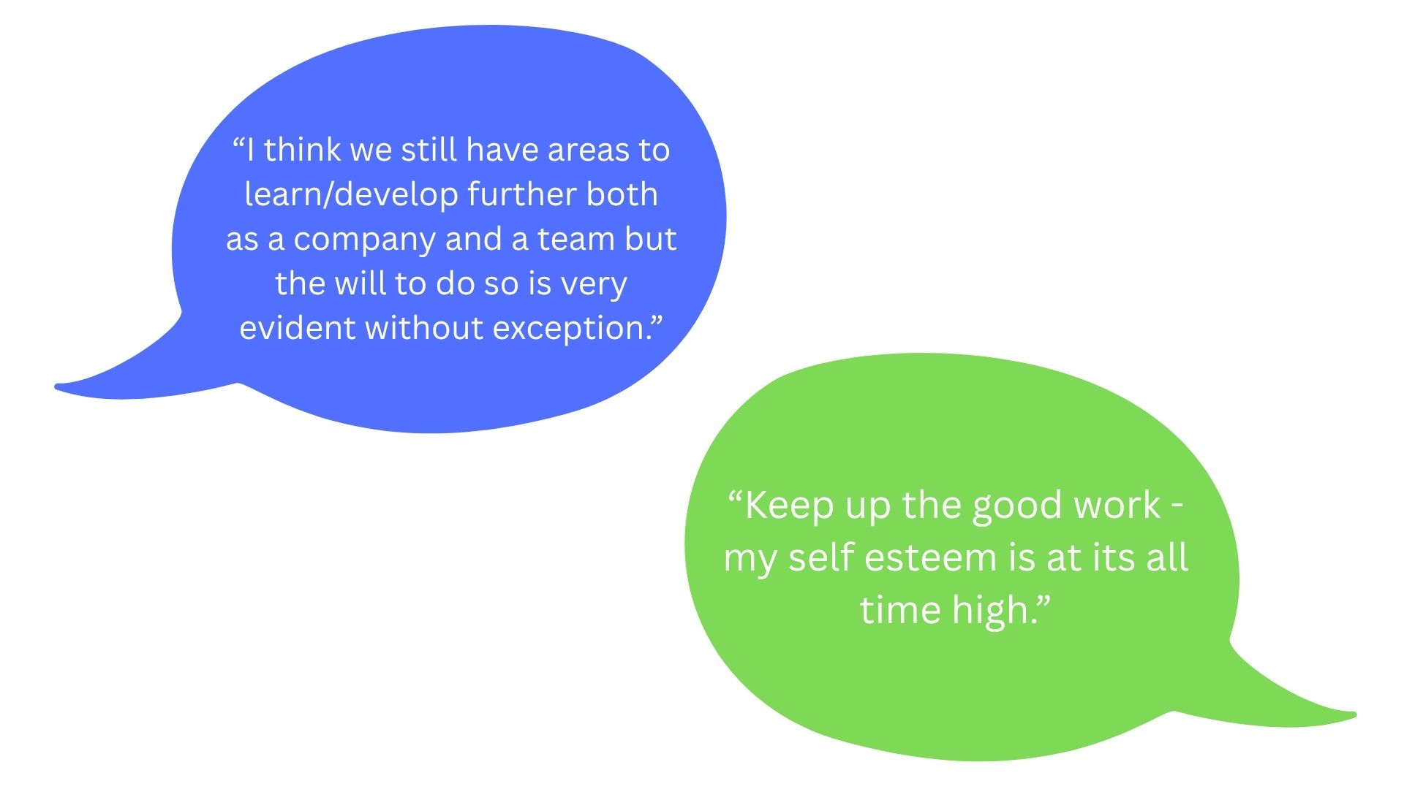
Other Comments

