Slide 1
Values-Based Leadership
March 7, 2019
Kris Mailepors, MBA CODP
kris@bushidoleadership.com

Slide 2
Today’s Takeaways
Learn how our values are our habits
Our habits leverage which priorities rise to the top
Learn how values drive motivation, behavior, engagement, and culture more than anything
Kris@bushidoleadership.com

Slide 3
To get today’s slides
Go to www.bushidoleadership.com/resources
Slides are pinned to the top of the page for 1 week
Join our mailing list for white papers and case studies
Kris@bushidoleadership.com

Slide 4
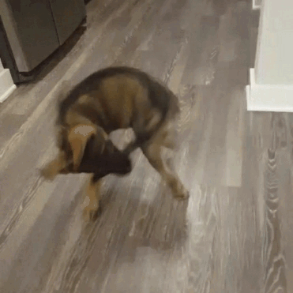
Have you been here before?
Scenario 1: A group of leaders got a half-day Change Management Training 10 months ago. A new change has hit the organization and no one is applying what they learned.
Scenario 2: An employee took “Conflict Resolution” for support in overcoming some difficult relationships on the team. 6 months later, there is still conflict on the team with this individual.
Why is training failing in a 21st century workplace
But it’s better than nothing?

Slide 5
What if…
What if you could throw away competencies, training, attendance, butts in seats, etc… and still be able to measure A+ leadership year over year, retain your leaders, and have all the benefits of an engaged, motivated team?
Best Practices that are really hard to implement
No Competencies
No Performance Ratings
No soft-skill “training”

Slide 6
Bruce Lee the Scholar
3 Stages of Cultivation
Primitive stage
Leadership happens naturally. Survival of the fittest. Others “can’t cut it”
Stage of Art
Training (block kick strike). Scientific knowledge. Crucial Conversation, EI, Critical thinking. (separate from primitive state/’self’ ….mind stops to calculate)
All that you “know” only serves to separate you from your people.
Stage of Artlessness
Techniques are unconscious. Understand the “end game” and how you get there can be achieved many ways.

Slide 7
Level 1 “Training & Development”
Common measures of success?
What can go wrong?
Training Event

Slide 8
Level 2 “Development”
Books
Community/ Network
Putting the PERSON at the center; University Model
What works?
What’s difficult?
Job Rotations
Mentor/ Mentee
Training Events
mLearning
Conference
Classes
WBT

Slide 9
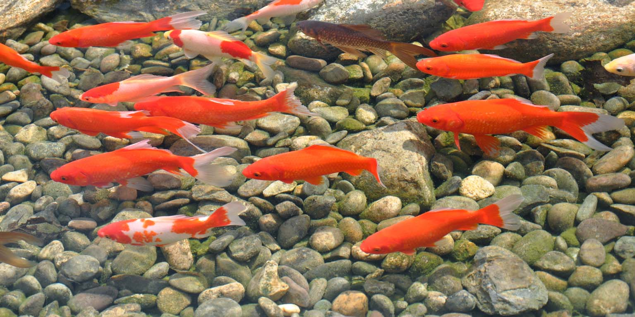
As OD Practitioners, we use words like sophisticated and robust

Slide 10
Priorities – Habits – Systems
Have you ever seen a “flavor of the month?”
Why do they lose steam?
Do a FORENSIC SYSTEMS ANALYSIS for any gaps. (don’t train to fix)
BSN – with tuition limits?
Survey Answer: “I’m not included in decisions”
Tell managers to “do better” or take another look at how approvals work?
Source: www.Neuroleadership.com

Slide 11
Bruce Lee the Scholar
3 Stages of Cultivation
Primitive stage
Leadership happens naturally. Survival of the fittest. Others “can’t cut it”
Stage of Art
Training (block kick strike). Scientific knowledge. Crucial Conversation, EI, Critical thinking. (separate from primitive state/’self’ ….mind stops to calculate)
All that you “know” only serves to separate you from your people.
Stage of Artlessness
Techniques are unconscious. Understand the “end game” and how you get there can be achieved many ways.

Slide 12
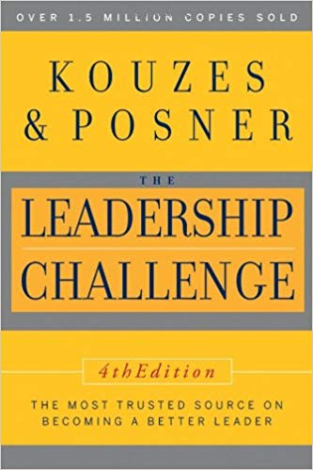

Slide 13
Values… Where do your Values Live?
Buried deep in the website?
On a bulletin board behind the copier?
Do your leaders “quiz” people on them?
NASA, AMAZON, APPLE?
Make great products that will change the world
Customer Obsession
Safety
Steve Jobs: ”It’s a complicated and noisy world, and we’re not going to get a chance to get people to remember much about us. No company is. So we have to be really clear about what we want them to know about us.”

Slide 14
Values… Why do people follow Values > Skills?
People may respect and admire your skills and knowledge, but to be truly motivated and engaged, they have to trust you & relate to you.
Have you ever seen a leader who was “too qualified” and wasn’t a fit?
Your values are what people see; the first thing they sniff out.
Your relationships are your best asset as a leader.

Slide 15
Corporate or Personal Values?
It really doesn’t matter.
If the corporate values are well thought out, live them.
If they’re arbitrary (synergy, innovation, ethical, etc.)
Values-Based Leadership is simply Culture Change

Slide 16
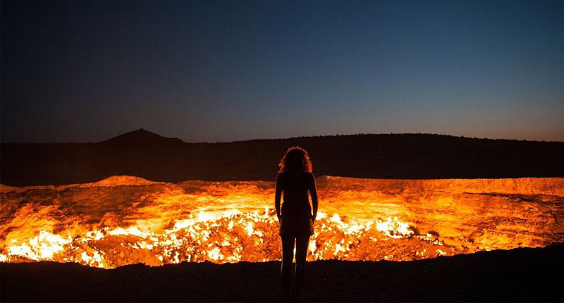
What’s your landscape?

Slide 17
What’s your landscape?

Slide 18
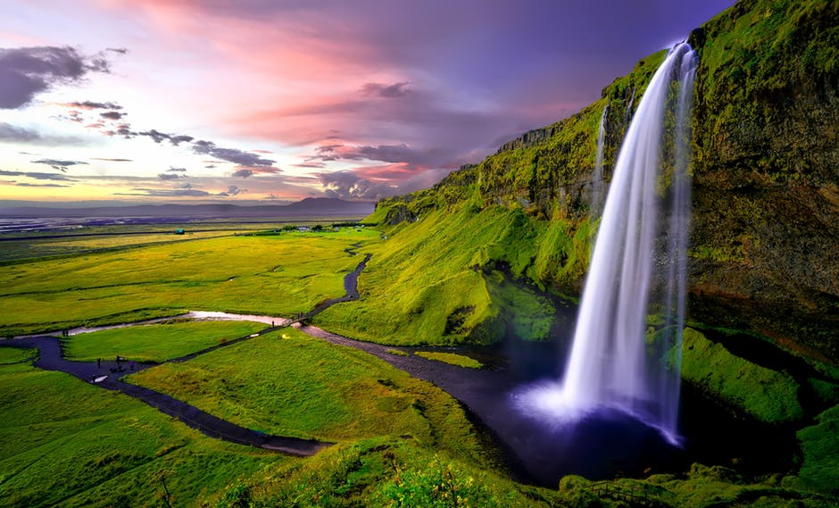
What’s your landscape?

Slide 19
The landscape: It’s all about your culture
How do you “create” culture

Slide 20
Culture
How long does it take to change your culture?

Slide 21
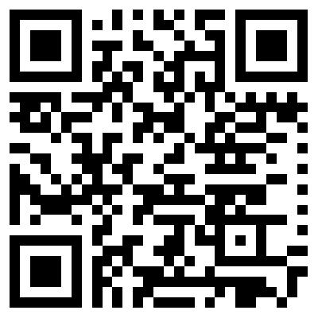
Creating a Culture: What are the rules
What are your values? Those are the rules
www.1000minds.com/go/valuesassessment1

Slide 22
Creating a Culture: What are the rules?
Know your values
To demonstrate this value, I will:
If I breach this value in any way, I will:
When I see someone demonstrating this value, I will:
If someone behaves in conflict with this value, I will:

Slide 23
Today’s Takeaways
Learn how our values are our habits
Our habits leverage which priorities rise to the top
Learn how values drive motivation, behavior, engagement, and culture more than anything
Kris@bushidoleadership.com

Slide 24
Culture Fundamental: shared everyday habits/behaviors carried out across a group regularly; consciously or not.
Leadership can be rooted in BRAIN FUNCTION, not a list of competencies people are trying to keep track of. When people chase competencies, it becomes a “thing” they have to do, or put on their plate.

