Slide 1
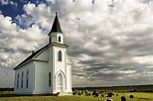
Safety in the Faith Community

Slide 2
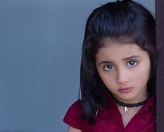
How did we get to this place?
Girl with a Question
Notes:
“Am I still a virgin in God’s eyes?”

Slide 3
About Offenders
90% of abuse occurs with someone a child knows/trusts
Offenders seek kids who are emotionally needy, “traumatized, confused and frightened.”
In other words, kids who have a “hole in their heart.”

Slide 4
About Offenders
54.9 % of child molesters offended when another child was present (The Tricky Part, by Martin Moran)
23.9% offended when another adult was present (Underwood, Journal of Research and Treatment)
It may be subtle
Notes:
“You can commit murder if you do it in plain sight.”

Slide 5
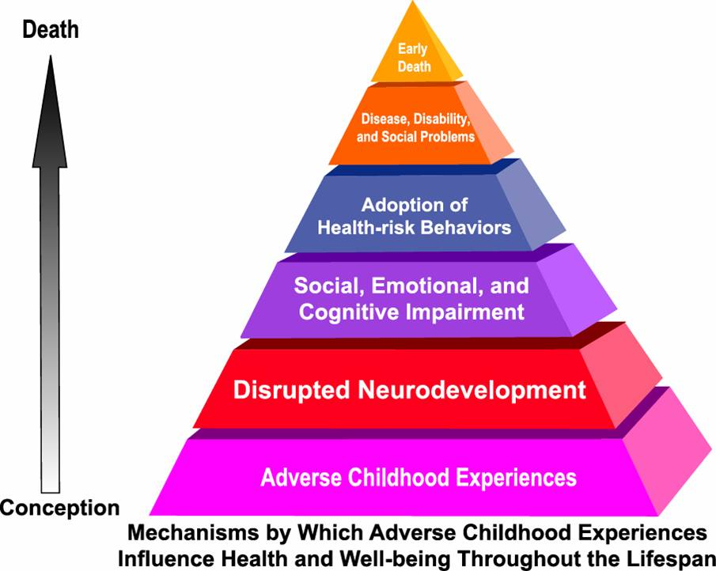
Physical and Emotional Impacts of Abuse
Now over 25 ACE studies (from 1998 to present)
Notes:
Adverse childhood experiences
Over 17,000 men and women surveyed on 10 types of Adverse Childhood Experiences (ACE’s) (sexual, physical, emotional, neglect, witness of domestic violence, etc.)

Slide 6
1 or More ACE Increases Risk of
Cancer
Heart disease
STD’s
Liver disease
Smoking
Alcohol abuse
Obesity
Drug dependence
IV drug use
Notes:
Physical signs

Slide 7
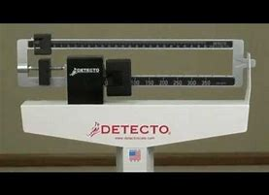
More Adverse Childhood Experience Studies
Correlation between obesity and childhood abuse
“You’ve taken away my best coping mechanism.”
Notes:
“If I’m obese, I’m not sexually attractive”

Slide 8
Emotional Impacts of ACE’s
Depression
Anxiety Disorders
Hallucinations
Sleep disturbances
Memory disturbances
Anger problems
Domestic violence risk
Job problems
Relational problems
Notes:
Emotional signs

Slide 9
Polyvictimization Research
Nearly 66% of victims exposed to more than one type of victimization, 30% 5 or more types, 10% 11 or more types
Polyvictimization more highly related to trauma symptoms than experiencing repeated victimization of a single type
Notes:
John Doe better off if beaten several times a week and no other ACE’s, than if he is beaten sometimes, also neglected, sexually abused and has his parents screaming at him systematically

Slide 10
Behaviors Indicating Abuse
Unexplained Injuries
Changes in behavior or regressive behaviors
Changes in eating or sleeping patterns Lack of personal care or hygiene
Risk-taking behaviors
Inappropriate Sexual behaviors (Safe Horizon, 2014)
Showing intensity or frequency of any of these signs
Extreme changes in school performance (either negative or positive)
Notes:
Note healthy sexual behaviors book, note the word “changes”

Slide 11
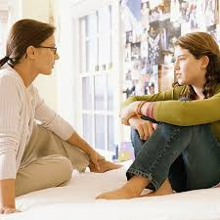
Types of Disclosure
Denial of Abuse
Tentative Disclosure (“I forgot”, “I have a friend who”, “what if…”)
Active Disclosure (details of abuse)
Subtle clues and looking for response/ trust
After disclosure, many recant
Why??? Often people will rally around offender, blame victim, accuse of lying, etc.

Slide 12
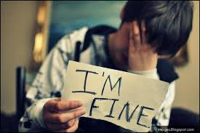
Boys and Disclosure
Fewer Boys Disclose Abuse
Cultural norms not allowing for boys to be “victims”
Boys “should be” tough, problem solvers, protectors, etc.
Afraid of being labeled (“gay,” “weak”)
Assumptions/jokes “Where was I when there were teachers like this?” Jay Leno
Mickey Mantle, The Last Boy
Notes:
20 years, average time of disclosure, AK boys especially-there is a premium on “tough”

Slide 13
When a Child Discloses
Tell the child you believe her
Always attempt to remain calm
Listen more than talk
Let the child end the conversation if he wants to
“Tell me about that…”

Slide 14
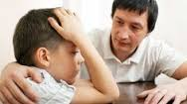
Remember
Investigating abuse and neglect is not your job
Your role is to support the child in whatever way he/she needs
Don’t underestimate your ability to make a difference!
Notes:
Olga, Sex-trafficked victim at CMC

Slide 15
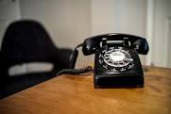
After Disclosure
Tell them they did the right thing
Tell the child that you have to tell someone who can help
Don’t make promises you can’t keep!
OCS screening line: 1 (800) 478-4444
Valdez Police Department 835-4560

Slide 16
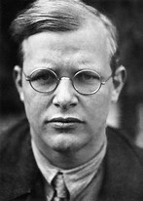
Moral Obligation to Act
“Silence in the face of evil is itself evil. Not to act is to act.” Dietrich Bonhoeffer
Why are we silent?
Ambiguity
Group cohesion
Dispersion of responsibility
Notes:
While volunteers are not Mandatory Reporters by law, we are all morally responsible for the safety of children

Slide 17
Returning to our Roots
“The church was the first institution to provide refuge for abandoned children and the church put pressure on the state to legislate against practices that endangered children, ending in an historic edict by Constantine…”
Dr. Paul Offit (2015)

Slide 18
The Impact of Sexual Abuse on Spirituality
One study of 527 CA victims found that these victims had “significant spiritual injury”
These injuries included feelings of guilt, anger, grief, despair, doubt, fear of death and belief that God is unfair
However, many victims reported praying more frequently and having a “spiritual experience.”
(Lawson, Child Abuse and Neglect)

Slide 19
Affecting Children and Beyond…
Even without a perpetrator manipulating a child’s faith, The victim’s analysis of religious doctrine may cause a block
Girl with a question (Age 7)
13 YO girl—”Why did you wait so long?” (1:45-1:47)
Police Officer in the Back of the room
Notes:
Mental health important! Not sure if we have time for police officer story….stay in your area of expertise. “This isn’t my area but I can find out from someone who knows. I will walk through this fire with you.”

Slide 20
How Often do Offenders Use “Religious Cover?”
93% of offenders describe themselves as “religious.” (Abel, study of 3,952 male offenders)
Survey of 2,864 church leaders, 20% knew of a sex offender in their church (Christianity Today, 2010)
Hard core offenders maintain significant religious involvement, had more convictions, younger victims (Eshuys and Smallbone, 2006)

Slide 21
WHY???
Faith communities provide “cheap grace,” “gullible” religious people and easy access to children

Slide 22
How Sex Offenders View Churches
“I consider church people easy to fool…they have a trust that comes from being Christians…They tend to be better folks all around. And they seem to want to believe in the good that exists in all people…I think they want to believe in people. And because of that, you can easily convince, with our without convincing words.”

Slide 23
Church Policies
Jacob Wetterling Resource Center
Keep Kids Safe tab
Personal Safety
Online Safety
Communities of Faith
Trainings?
Education for children on abuse prevention? (Safe Children’s Act now law)
Time length in faith community before volunteering?
Designated person to handle reports?
Understood that we always report to outside agency (OCS, law enforcement) in addition to reports within church about CA
Notes:
Gunderson Safe Children’s Act—Bree’s and Erin’s Law

Slide 24
Screening and Selection
Five recommended pre-employment screenings
Informing applicant of policies, requiring written acknowledgement and asking questions
Written application with questions pertinent to abuse (how they would respond, etc.)
Personal interview with additional questions about reporting, etc.
Verbal, not just written, references!!!
Notes:
Alexander Appel

Slide 25
Background Checks
Criminal background checks. But note that most offenders have never been caught (Abel study)
Google search where future employees may have worked, search Social media sites, etc.

Slide 26
Monitoring Behavior
Two deep leadership
No one-on-one contact (keep “private discussions” in view of others)
Respect for privacy and expectation of modesty
“Should we fire him/her? It wasn’t really criminal behavior. They had a good reason.”
What is best practice?
Reporting policy for all church workers (paid and volunteer)
Notes:
Porn in coach’s house. “But they came early. I was doing a research project for my Master’s,” etc.

Slide 27
More Policies and Guidelines
Separate sleeping accommodations for children and adults?
Limit events at workers homes???
Appropriate attire and actions
Windows and open doors
Sexual jokes, references prohibited
Prohibit corporal punishment
Watch use of cameras and digital devices
Notes:
Some can add issues—such as kids sleeping unsupervised. Overall safety? Workers’ homes—in a small place like AK, limited in places to have events, maybe close off areas

Slide 28
Watching out at Camp or Overnight Activities
Does a counselor single out a child for gifts or favors?
Do adult leaders find ways to “accidentally” be where children are dressing
Is the child from a divorced, overly chaotic, or uninvolved family?
Trust your gut, not excuses….
Notes:
Bakken

Slide 29
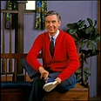
“Look for the Helpers”
When Mr. Rogers would see something scary on the news as a young boy, he remembers him mom saying, “Yes, a lot of bad things happen in the world, but there are always people you can find who are helping. Look for the helpers in this story.”
Notes:
Be one who makes things better! CMC story if time?

Slide 30
Thank You!
Please feel free to contact us with questions, suggestions, etc. (907) 822-3733
director@crbcac.org
familyadvocate@crbcac.org
preventioncoordinator@crbcac.org

