Slide 1
Copper River Basin Child Advocacy Center
Mandatory Reporting and Signs of Child Abuse

Slide 2
Presented By:
*Gina Hoke
Copper River Basin Child Advocacy Center—Director
*Laura Scott
Copper River Basin Child Advocacy Center—Family Advocate
Notes:
Put in tab to play

Slide 3
CRBCAC Board and Staff
Lori Jangala President
Pam Verfaillie
Vice President
Jason Williams
Secretary
Victoria Rego
Director
Starr Knighten
Treasurer
Deborah Plant
Director
Gina Hoke Executive Director
Laura Scott
Family Advocate
Kelly Gerlach
Prevention Coordinator
Notes:
Always seeking board diversity

Slide 4
Copper River Basin Child Advocacy Center Status
Not-For-Profit 501(c)(3) Status
Serving families in the CRB, Valdez and surrounding areas since January, 2009
Co-located with OCS at the former Gakona School
Notes:
While we are not affiliated with OCS and our purposes are different, we work together on cases and being in the same building is helpful for streamlining communication

Slide 5
What are Child Advocacy Centers (CAC’s)?
Child-focused, child friendly, neutral, and culturally sensitive
Community based
Multidisciplinary Team (MDT): Medical, Child Protection, Law Enforcement, Mental Health, Tribal Liaison, Forensic Medical examiner, District Attorney,etc…
Notes:
Community based/ what the specific needs of the community are.
Would love more board diversity (i.e. various cultures, men, people of diverse backgrounds, etc., please let us know if you have ideas, nominations, etc.)

Slide 6
Our Goals
To reduce trauma by fewer interviews and a non-invasive exam
To provide support for children and families who have been affected by abuse
To improve prosecution rates

Slide 7
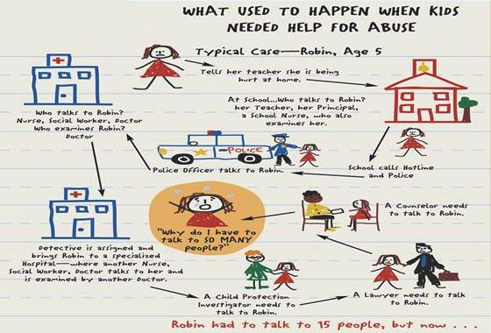
What Used to Happen
Notes:
Before the CRBCAC…
Sexual abuse interviews had to be conducted in the CRSD schools, the child’s home, or at the CAC in the Mat-Su Valley (The Children’s Place).
These situations are rarely conducive to disclosure or providing justice to the allegedly victimized child.
https://www.nationalchildrensalliance.org/cac-model/

Slide 8
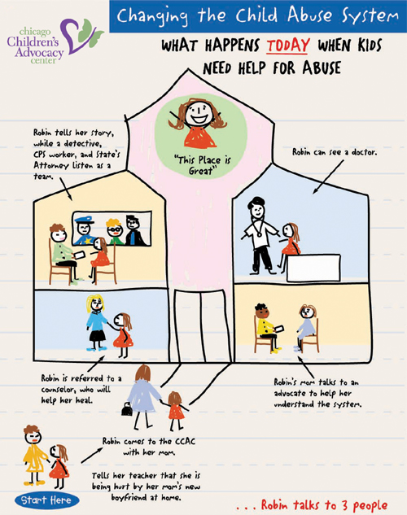
What Happens Now
Notes:
Go to vimeo on Desktop!

Slide 9
NCA CAC Video

Slide 10
Collaboration is the key:
Collaboration among agencies is what makes the CAC model a success
Sharing with local boards, agencies, and professionals
Community acknowledgement of need and community support
Notes:
Child Maltreatment Conference—a lot of what prevents prosecution and perpetuates people finally being sent to trial after their third or fourth offense for the same crime is a lack of communication between agencies (law enforcement, child protective services, medical files, etc.)

Slide 11
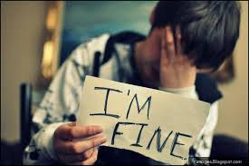
Alaska CAC’s in 2018
Total number of children served in Alaskan CAC’s: 2,208
Gender of children
Male 700
Female 1,504
Undisclosed 4
Age of children at first contact with center:
0-6 714
7-12 812
13-18 682
Undisclosed 0
(National Children’s Alliance, 2019)
Notes:
From january to june, 2017, CAC’s saw 760 children. Male 253, female 506

Slide 12
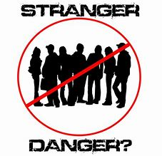
Alleged Offender Demographics in Alaska
Total Number of Alleged Offenders: 1,565
Parent 596
Stepparent 25
Other Relative 337
Parent’s boyfriend/girlfriend 96
Other known person 349
Unknown 255
(NCA, 2018)
Notes:
16%--unknown person, 38% parent

Slide 13
Stranger in the Woods?
In 90% of reported sexual abuse cases, the alleged perpetrator is someone the child knows.
In 39% of reported sexual abuse cases, the alleged perpetrator is a parent or caregiver.
(National Children’s Alliance.org, 2015)
Notes:
A lot of grooming goes on with the people children and their families feel safe with

Slide 14
Ages of Alleged Offenders in Alaska
Under 13 112
Age 13-17 155
Age 18 + 925
Age undisclosed 431
(NCA, 2017)
Notes:
Note: another word for very young “offenders” necessary to bring up
1st Bullet removed---Between 2003 and 2012, AST responded to 5,119 SAM offenses (DPS)
* In FY 2013, 42%of the cases seen at CAC’s were ages 0-6 years, 33% were ages 7-12, and 24.5% were ages 13-18 (ACA)

Slide 15
Types of Reported Abuse
Sexual Abuse 1,699
Physical Abuse 504
Neglect 240
Witness to Violence 169
Drug Endangerment 57
Other 58
(NCA, 2019)

Slide 16
Race of Total children seen at Alaska CAC’s
White 727
Black/African American 119
Hispanic/Latino 79
American Indian/Alaska Native 1009
Asian/Pacific Islander 152
Other 78
Undisclosed 44
(NCA, 2019)
Notes:
Consider total percentages of each race for a sense of accuracy
2015– white—64%
2017 American Indian—18.2%
2017 Black—3%

Slide 17
Services Received by Children
Medical Exam/Treatment 930
Counseling Therapy 131
Referral to Counseling Therapy 261
Onsite Forensic Interviewing 1687
Offsite Forensic Interviewing 11
(NCA, 2019)

Slide 18
Long Road

Slide 19
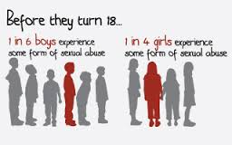
What is the prevalence of child sexual abuse?
5-15% of men report they were abused as a child. (50-150 per 1,000 men)
20-25% of women report they were abused as a child. (160-250 per 1,000 women)
Notes:
Nationally, girls are abused 3-4 times more often than boys. Often, people don’t disclose until adulthood. Boys disclosure av—20 yrs?

Slide 20
Definition of Child Abuse and Neglect
“Any recent act or failure to act on the part of a parent or caretaker which results in death, serious physical or emotional harm, sexual abuse or exploitation; or an act or failure to act which presents an imminent risk of serious harm.” (dhss.alaska.gov/ocs)
Notes:
I start here Definition of CA and neglect aligned with federal legislation with lays groundwork for state laws
4 major types of neglect: physical abuse, neglect, sexual abuse, mental injury
Many forms of sexual abuse, not just rape—watching someone undress, asking them to watch something inappropriate, touching over clothing, etc.

Slide 21
Child Abuse and neglect strongly linked to:
Juvenile and adult crime
Teen pregnancy
Alcohol and drug abuse
Suicide
Future family violence
Poor Adult Health and serious long-term health problems (ACE study)
Notes:
ACES study, obesity (31%)
Risk of developing adult health issues higher in proportion to the extent and/or amount of your trauma
Resilience/ neuroplasticity gives us hope
Instead of what’s wrong with you—what happened to you

Slide 22
Signs of Child Abuse
Unexplained Injuries
Changes in behavior or regressive behaviors
Changes in eating or sleeping patterns
Extreme changes in school performance (either negative or positive)
“What’s wrong with you vs. what happened to you?”
Notes:
Hand out booklet
Thumb sucking in elementary school, bed wetting, etc.
Whats wrong vs. what happened to you?– and do they have positive factors in their life to counteract the negative (later—Olga, sex slave story)

Slide 23
More Signs of Child Abuse
Lack of personal care or hygiene
Risk-taking behaviors
Inappropriate Sexual behaviors
Fear of certain individuals or of going home (Safe Horizon, 2019)
Showing intensity or frequency of any of these signs
Notes:
Give booklet on Understanding Children’s Sexual Behaviors

Slide 24
When a Child Discloses
Tell the child you believe her
Always attempt to remain calm
Listen more than talk
Let the child end the conversation if he wants to
Notes:
Adolescent may respond best to recreational setting—shooting hoops, playing catch, etc.

Slide 25
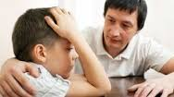
After They Tell You
Tell them they did the right thing
Tell the child that you have to tell someone who can help
Don’t make promises you can’t keep
Notes:
(i.e. “You won’t have to leave your home.” “I’ll make sure you won’t get hurt again. This person is going to jail for a long time!”
There are a lot of systematic hoops to jump through. Often what we want to happen and even what should happen contrasts with reality.

Slide 26
OCS Reporting Video
Notes:
Megans story (on desktop)

Slide 27
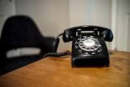
The Process
All reports go through Central Intake Office in Anchorage
If your call is screened in, they will send a computerized report to our Region’s OCS worker (Crystal Logsdon)
The intake supervisors make the final decision on whether a call gets screened in
Notes:
Screen in rate about 50%. OCS website very informative
all reports go to ORCA, even if not substantiated. Sometimes the number of screened out reports increases the chance of it being screened in the next time. I have been told on the phone (mostly because of speculation and because it was 3rd hand info.), that the call would definitely NOT be screened in.
You can call/email back to find out if screened in/out, or receive the info. Via mail

Slide 28
State of Alaska Reporting
To make a report:
Call the Central Intake Office
1 (800) 478-4444
Email Reportchildabuse@alaska.gov
Notes:
Disks available. OCS website—go to useful links, report child abuse. There are also sections on mandatory reporting and indicators of child abuse. All reports must go through the screening line. Once we know there is a suspicion of child maltreatment, we are obligated as mandatory reporters to report to OCS screening line. If you call troopers, they will call OCS

Slide 29
Obstacles to Reporting
“I don’t have much information and I’m not sure what I have is accurate.”
“I think the child is just trying to get attention.”
“If I tell, the child will be taken out of the home and I don’t want to see them in foster care.”
“This is a respected community member! He would never….”
“This person is unsafe. She will retaliate.”
Notes:
How much proof do you have to have? None, just share what you know.
Children don’t usually lie about SA—it’s not your job to investigate
OCS first priority is to keep kids with their family, not to remove unless absolutely necessary for child’s safety. Things have changed in that regard. The news focuses on the outliers—the terrible stories that are newsworthy, not the good ones.
Abuse is not a respecter of demograhpic or racial boundaries…part of grooming process is gaining trust
Statistically, abusers don’t just stop but escalate. Law enforcement is involved once a case is screened in. Help is available for safety plans. (Machievelli quote?)
Groups—each take a scenario, come back to talk about it

Slide 30
Cases and Insight
Groups
What are your thoughts based on what you have seen in the field?
What obstacles to reporting have you seen and/or experienced?

Slide 31
“Look for the Helpers”
“With all of the horrible things going on today, remember to look for the helpers in the story.” Mama Rogers
Notes:
Kids are resilient. Change can happen. Be encouraged. We are the helpers! Olga story☺
Story of gal who was sex-trafficked—2 people who made a difference—a teacher who told her to keep studying, that no matter what people did to her body, they couldn’t take away the information she worked to build in her mind. And a foster parent she stayed with twice when pregnant. Mothered her, made her feel safe, like a person worthy of care. Passed GED after studying for a week. “Don’t tell me what I can or can’t do.” “I will always be grateful to them but will always be sad about this.” “These people changed my life but have passed on and were not able to see the fruit of what they did.”

Slide 32
Contact Us
Facebook
Staff email:
director@crbcac.org
familyadvocate@crbcac.org
preventioncoordinator@crbcac.org
We want to hear your feedback and ideas for activities and programs to provide effective community outreach

Slide 33
Thank you!

