Slide 1

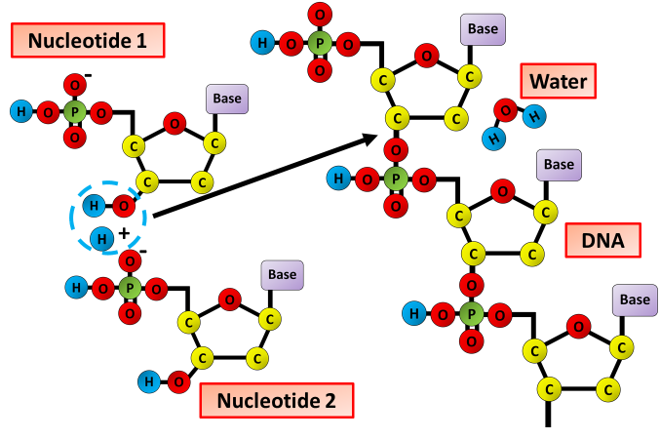

The Great Biology Pubish Quiz
DNA Synthesis

Slide 2

The Great Biology Pubish Quiz
DNA Synthesis
What is the name of the process by which DNA is copied?
A
Transcription
Translation
B
C
DNA splicing
D
DNA replication

Slide 3
The Great Biology Pubish Quiz
DNA Synthesis
Which enzyme unwinds the DNA double helix during replication?
A
Helicase
DNA ligase
B
C
DNA polymerase
D
Transporting oxygen

Slide 4
The Great Biology Pubish Quiz
DNA Synthesis
What is the role of DNA polymerase in DNA synthesis?
A
Joining Okazaki fragments
Adding nucleotides to a new DNA strand
B
C
Unzipping the DNA strands
D
Sealing gaps in the sugar-phosphate backbone

Slide 5
The Great Biology Pubish Quiz
DNA Synthesis
In which direction does DNA polymerase synthesize the new strand?
A
5' to 5'
3' to 5'
B
C
5' to 3'
D
Random direction

Slide 6
The Great Biology Pubish Quiz
DNA Synthesis
What are Okazaki fragments?
A
Small RNA primers used in replication
Short DNA fragments on the lagging strand
B
C
Enzymes that aid DNA synthesis
D
Segments of mRNA used in translation

Slide 7
The Great Biology Pubish Quiz
DNA Synthesis
Which enzyme joins the Okazaki fragments together?
A
Helicase
B
Primase
C
DNA polymerase
D
DNA ligase

Slide 8

The Great Biology Pubish Quiz
DNA Synthesis
Question 1
D
Question 2
A
Question 3
B
Question 4
C
Question 5
B
Question 6
D

