Slide 1
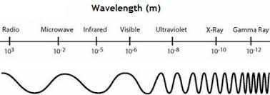

EM Spectrum Question
The diagram below shows the EM spectrum
Mark Scheme
Which type of electromagnetic wave has the longest wavelength?
Which type of electromagnetic wave is used in mobile phone communication?
Which part of the electromagnetic spectrum can be seen by the human eye?
Which electromagnetic wave has the highest frequency?

