Slide 1
Graphite Practice Question
Diamond and graphite are different forms of the element carbon. They both have giant structures of carbon atoms, joined together by covalent bonds. The diagram below shows the structure of graphite:
Describe the structure and properties of graphite
Key things to include:
How many bonds do carbon atoms form
What happens to the 4th electron
Why can the layers slide over each other
_____________________________________________________________________________________________________________________________________________________________________________________________________________________________________________________________________________________________________________________________________________________________________________________________________________________________________________________________________________________________________________________________________
Answer
Link to video

Slide 2
Graphite Practice Question

Slide 3
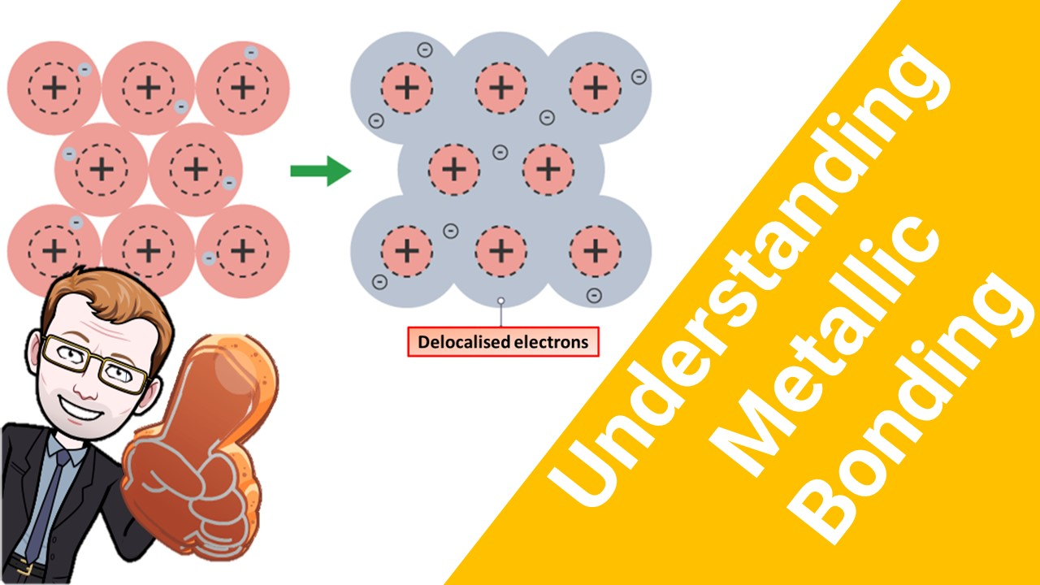
Click here to access my bonding youtube videos
Resources that this activity would work well with
Lesson on TES
Lessons on TPT
Follow me on social media to stay in touch
Keep up to date with my new content:

