Slide 1
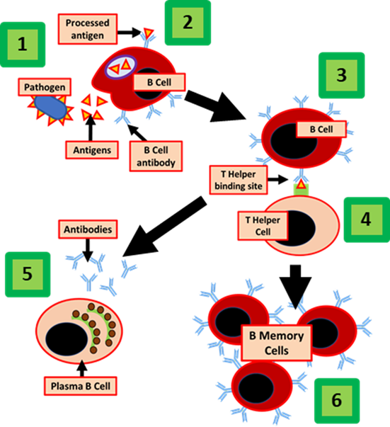

Immune System Question
The diagram shows some of parts of the immune system
Video Link
What is the main function of the immune system?
What type of cells are essential in the immune response?
What are antibodies?
Which organ produces many of the immune system's white blood cells?

