Slide 1
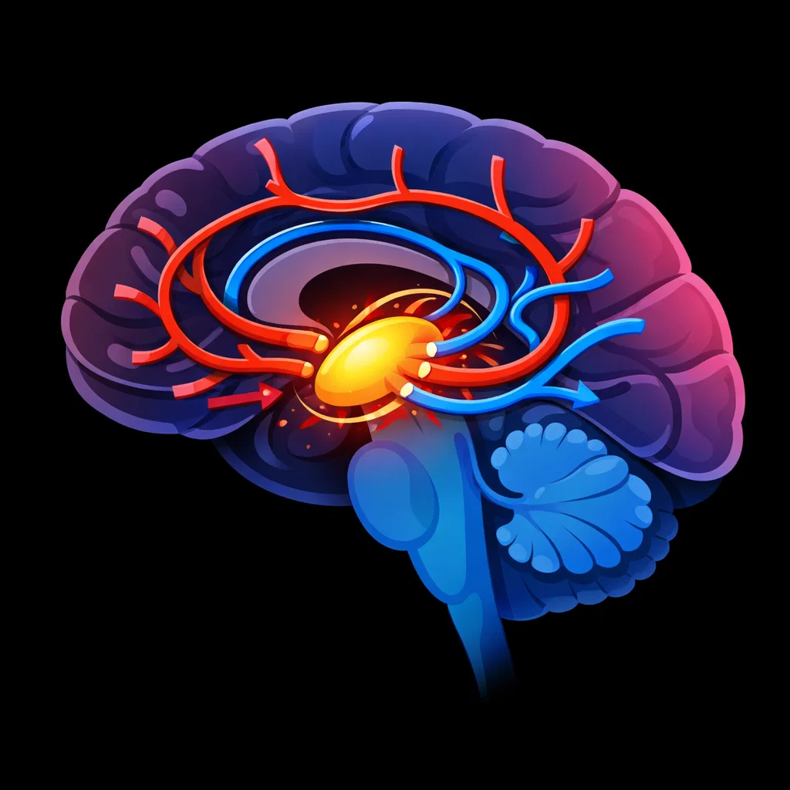
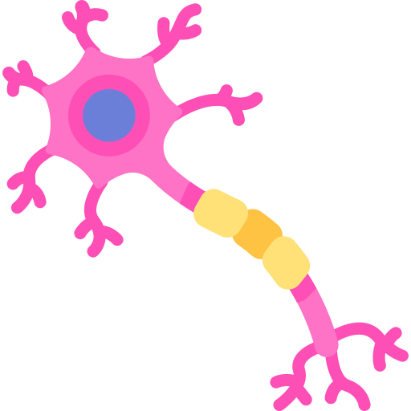


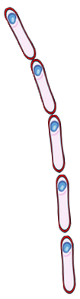

The Role of the Hypothalamus
1: The Hypothalamus acts as the body’s thermostat.
Key questions
What part of the brain acts as the body’s thermostat?
6: If the temperature is too high or too low, the hypothalamus sends signals to start responses such as sweating, shivering, or changes in blood flow.
What does the hypothalamus monitor to detect body temperature?
Brain
What structures in the skin detect temperature changes?
Hypothalamus
4: These receptors send nerve signals to the hypothalamus with information about skin temperature.
How is information about skin temperature sent to the hypothalamus?
5: The hypothalamus compares this information with the body’s normal temperature (about 37 °C).
What normal body temperature does the hypothalamus compare against?
Nerve cells
2: It constantly monitors the temperature of the blood flowing through the brain.
What does the hypothalamus do if body temperature is too high or too low?
3: Temperature receptors in the skin also detect changes in the external environment.
Blood vessel

Slide 2
Key questions
What part of the brain acts as the body’s thermostat?
1:
6:
What does the hypothalamus monitor to detect body temperature?
Brain
What structures in the skin detect temperature changes?
Hypothalamus
4:
How is information about skin temperature sent to the hypothalamus?
5:
What normal body temperature does the hypothalamus compare against?
Nerve cells
2:
What does the hypothalamus do if body temperature is too high or too low?
3:
Blood vessel

