Slide 1
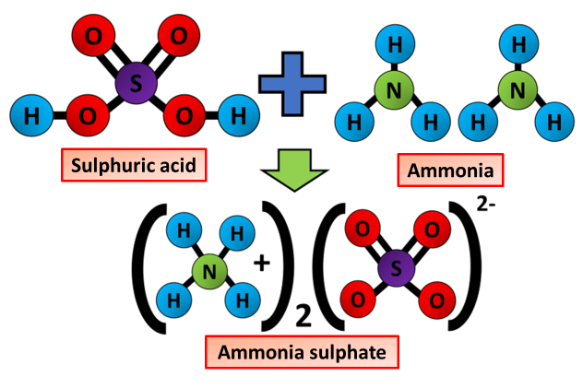

Fertilisers Question
The diagram shows how Ammonium Sulfate is produced. Describe how ammonium sulfate is produced in the lab and on an industrial scale
Key things to include:
What is reacted together
How is crystallisation carried out
_______________________________________________________________________________________________________________________________________________________________________________________________________________________________________________________________________________________________________________________________________________________________________________________________________________________________________
Answer
Link to video

