Slide 1

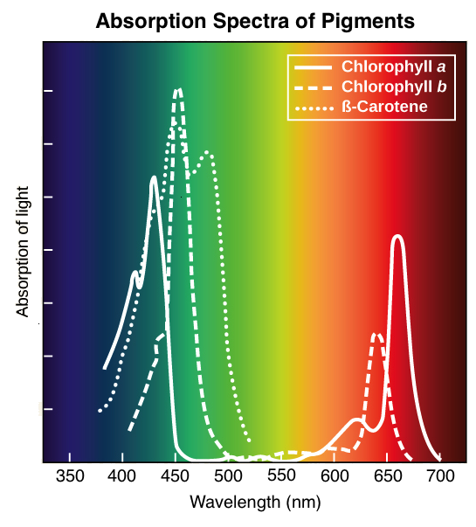

The Great Biology Pubish Quiz
Chlorophyll

Slide 2

The Great Biology Pubish Quiz
Chlorophyll
What is the primary role of chlorophyll in photosynthesis?
A
Absorbing light energy
Producing ATP directly
B
C
Transporting electrons to the mitochondria
D
Breaking down glucose

Slide 3
The Great Biology Pubish Quiz
Chlorophyll
Which type of chlorophyll is the most abundant in plants?
A
Chlorophyll a
Chlorophyll b
B
C
Chlorophyll c
D
Chlorophyll d

Slide 4
The Great Biology Pubish Quiz
Chlorophyll
In which part of the chloroplast is chlorophyll found?
A
Stroma
Thylakoid membranes
B
C
Outer membrane
D
Cristae

Slide 5
The Great Biology Pubish Quiz
Chlorophyll
Why does chlorophyll appear green?
A
It absorbs red and blue light and reflects green
It only absorbs green light
B
C
It only absorbs green light
D
It reflects all wavelengths of visible light

Slide 6
The Great Biology Pubish Quiz
Chlorophyll
What happens to chlorophyll when it absorbs light energy?
A
It releases oxygen
It donates excited electrons to the electron transport chain
B
C
It breaks down ATP
D
It forms water molecules

Slide 7
The Great Biology Pubish Quiz
Chlorophyll
Which metal ion is found in the centre of a chlorophyll molecule?
A
Iron
B
Magnesium
C
Copper
D
Zinc

Slide 8

The Great Biology Pubish Quiz
Chlorophyll
Question 1
A
Question 2
A
Question 3
B
Question 4
A
Question 5
B
Question 6
B

