Slide 1
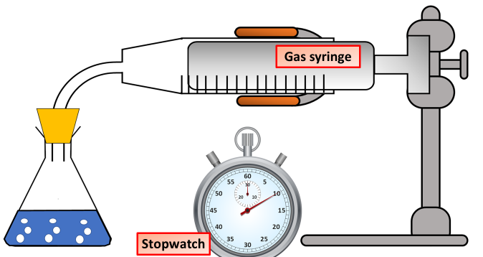

Rate of Reaction Question
Using the equipment below plan an investigation into how the concentration of acid affects the rate of reaction with limestone
Key things to include:
What are you reacting together
What are you going to measure
What are te control variables
_______________________________________________________________________________________________________________________________________________________________________________________________________________________________________________________________________________________________________________________________________________________________________________________________________________________________________
Answer
Link to video

