Slide 1
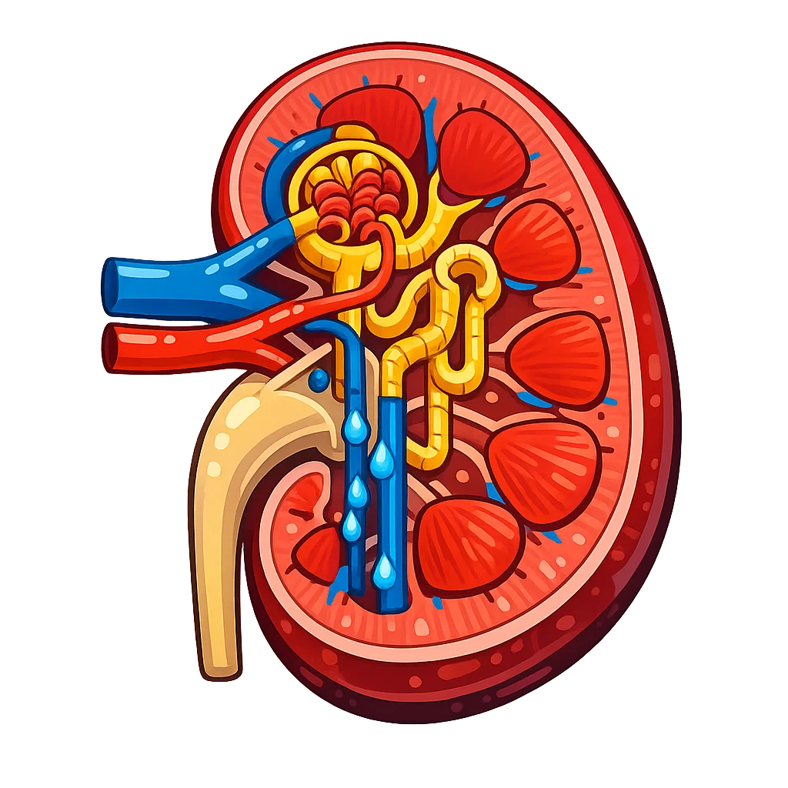
The Function of the Kidney
3: In the nephron, a process called Ultrafiltration forces small molecules like water, glucose, salts, and urea out of the blood.
Key questions
4: Useful substances such as glucose, some salts, and most of the water are taken back into the blood by Selective reabsorption.
How does blood enter the Kidney?
What are the tiny filtering units in the kidney called?
Renal vein
What process filters small molecules from the blood in the nephron?
2: The blood passes into millions of tiny filtering units called Nephron.
Renal Artery
1: Blood enters the Kidney through the renal artery carrying waste substances such as Urea, excess salts, and water
What process returns useful substances to the blood?
Nephron
What is the liquid waste produced by the kidneys called?
6: The urine then travels from the kidneys to the bladder through the Ureter, where it is stored before leaving the body.
Ureter
5: Waste substances, including urea and excess water, remain in the tubule and form Urine.
Through which tube does urine travel to the bladder?

Slide 2
3:
4:.
Renal vein
2:
Renal Artery
1:
Nephron
6:
Ureter
5:

