Slide 1
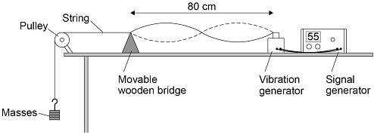
Waves Practical Practice Question
A student wants to investigate how the speed of a wave on a stretched string depends on the tension in the string.
Describe a method the student could use for this investigation.
Key things to include:
How can you change the tension of the string
How can you change the frequency
How can you measure the frequency
Answer
________________________________________________________________________________________________________________________________________________________________________________________________________________________________________________________________________________________________________________________________________________________________________________________
Link to video

Slide 2
Waves Practical Practice Question

