Slide 1
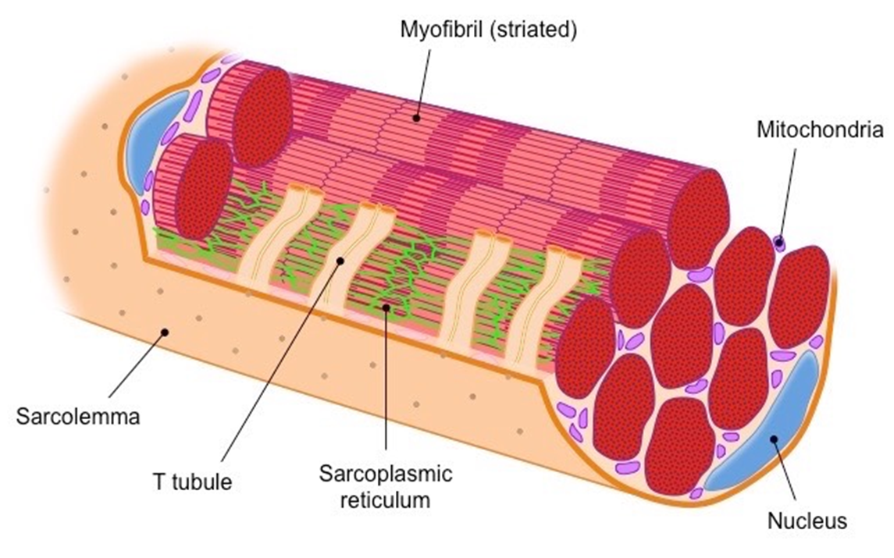
The Great Biology Pubish Quiz
Muscle Structure

Slide 2
The Great Biology Pubish Quiz
Muscle Structure
What is the basic contractile unit of a muscle?
A
Myofibril
Sarcomere
B
C
Actin
D
Myosin

Slide 3
The Great Biology Pubish Quiz
Muscle Structure
Which protein forms the thick filaments in a sarcomere?
A
Actin
Tropomyosin
B
C
Myosin
D
Troponin

Slide 4
Epimysium
The Great Biology Pubish Quiz
Muscle Structure
Endomysium
Which structure surrounds individual muscle fibres?
A
Epimysium
Perimysium
B
C
Endomysium
D
Sarcolemma

Slide 5
The Great Biology Pubish Quiz
Muscle Structure
What is the name of the cell membrane of a muscle fibre?
A
Sarcolemma
Sarcoplasm
B
C
Sarcomere
D
Sarcoplasmic

Slide 6
The Great Biology Pubish Quiz
Muscle Structure
Which protein blocks the myosin-binding sites on actin?
A
Myosin
Troponin
B
C
Creatine
D
Tropomyosin

Slide 7
The Great Biology Pubish Quiz
Muscle Structure
What organelle stores calcium ions needed for contraction?
A
Nucleus
B
Sarcolemma
C
Mitochondrion
D
Sarcoplasmic reticulum

Slide 8
The Great Biology Pubish Quiz
Muscle Structure
Question 1
B
Question 2
C
Question 3
C
Question 4
A
Question 5
D
Question 6
D

