Slide 1

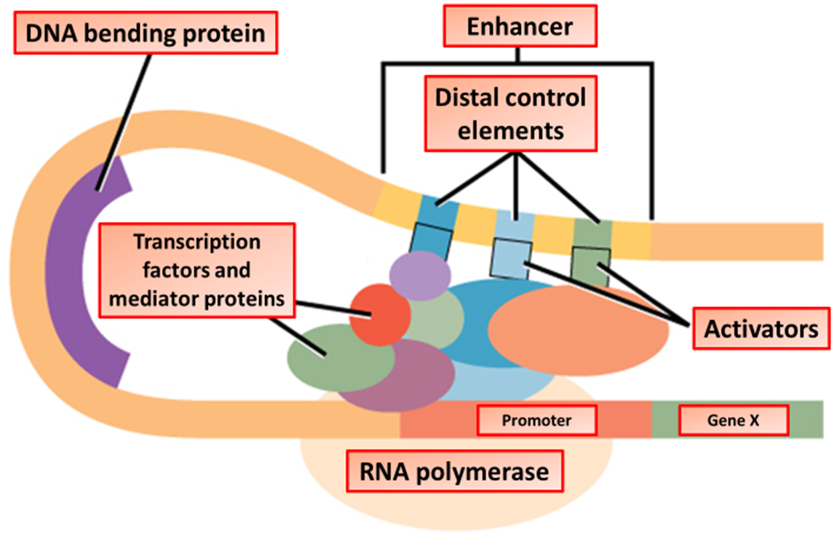

The Great Biology Pubish Quiz
Transcriptional Control

Slide 2

The Great Biology Pubish Quiz
Transcriptional Control
Which enzyme is responsible for transcribing DNA into mRNA?
A
DNA polymerase
Helicase
B
C
Ligase
D
RNA polymerase

Slide 3
The Great Biology Pubish Quiz
Transcriptional Control
What binds to the operator region in prokaryotic transcriptional control?
A
Activator
Repressor
B
C
RNA polymerase
D
Promoter

Slide 4
The Great Biology Pubish Quiz
Transcriptional Control
Which type of transcription factor increases gene expression?
A
Repressor
Enhancer
B
C
Activator
D
Operator

Slide 5
The Great Biology Pubish Quiz
Transcriptional Control
What is the function of histone acetylation in eukaryotic cells?
A
Inhibits transcription
Promotes transcription
B
C
Degrades mRNA
D
Silences genes

Slide 6
The Great Biology Pubish Quiz
Transcriptional Control
Which process leads to gene silencing by tightly packing chromatin?
A
Acetylation
Phosphorylation
B
C
Methylation
D
Ubiquitination

Slide 7
The Great Biology Pubish Quiz
Transcriptional Control
Which of the following is a structural gene in the lac operon?
A
LacZ
B
Promoter
C
Operator
D
Repressor

Slide 8

The Great Biology Pubish Quiz
Transcriptional Control
Question 1
D
Question 2
B
Question 3
C
Question 4
B
Question 5
C
A

